Slide 1


Improving Software Maintainability through Automated Refactoring
Author: Simon Baars
Company Supervisor: Xander Schrijen
Host Company: Software Improvement Group
Academic Supervisor: Ana Oprescu
Location: Amsterdam
Date: 28 August 2019

Slide 2
25%
Notes:
Up to 25% of code is cloned. This is 25% extra code that has to be maintained.

Slide 3

One “simple” change...
25%
Notes:
Up to 25% of code is cloned. This is 25% extra code that has to be maintained.

Slide 4
“If you see the same code structure in more than one place, you can be sure that your program will be better if you find a way to unify them”
~ Martin Fowler & Kent Beck in Refactoring

Slide 5

Find clones
Assess
impact
Refactor clones

Slide 6



Find clones
Assess
impact
Refactor clones

Slide 7

Find clones
Assess
impact
Refactor clones

Slide 8
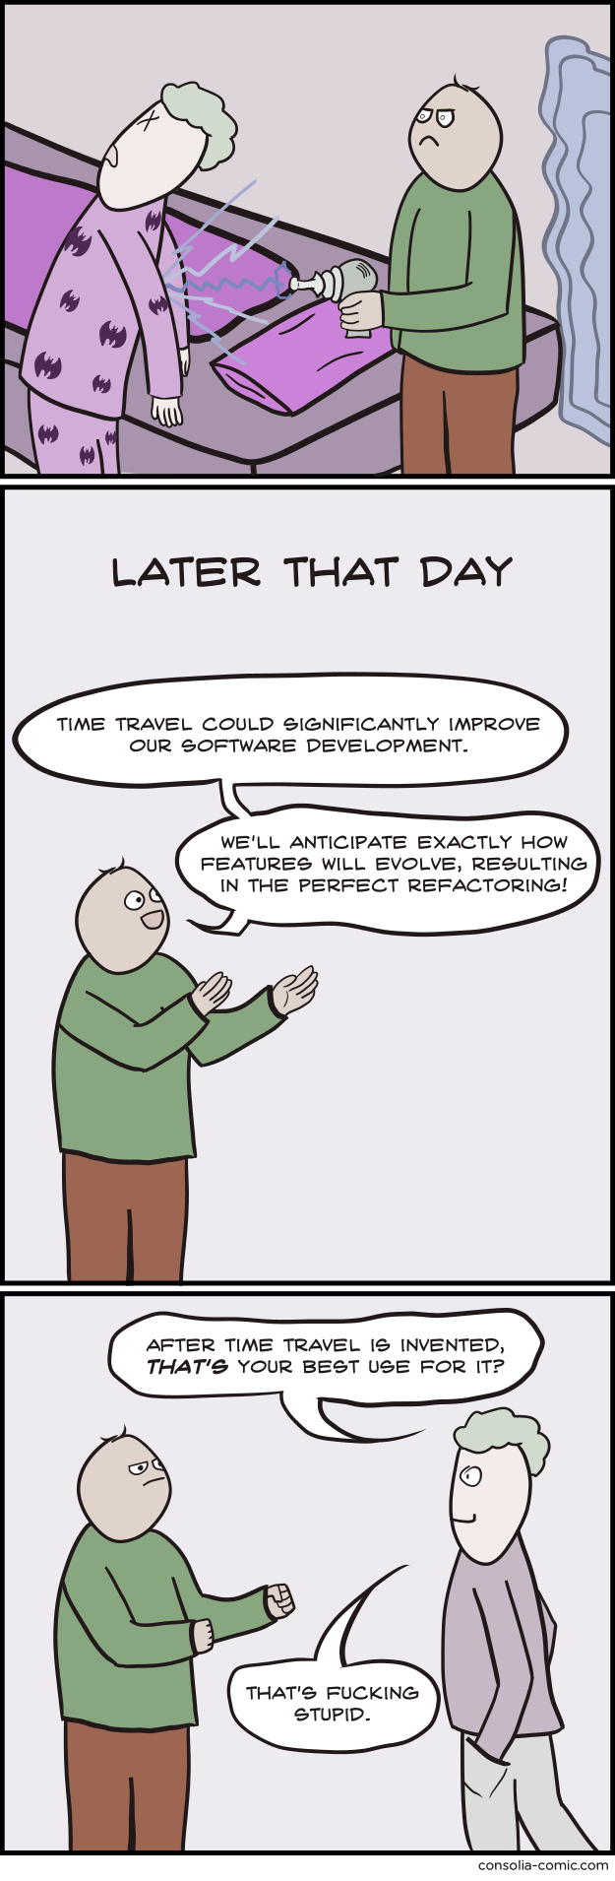

Slide 9
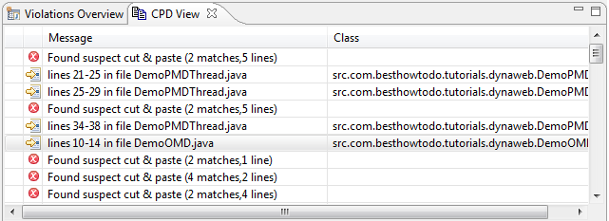

Slide 10
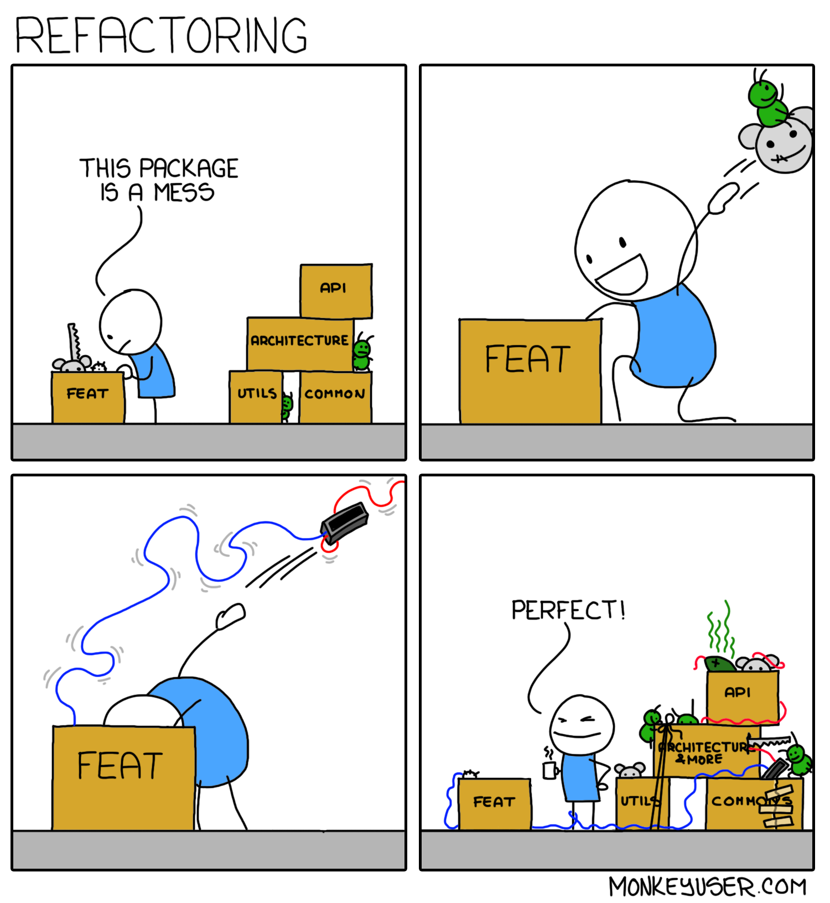
Notes:
Problems: Refactoring can reduce bugs
Refactoring does not always improve maintainability
Refactoring does not happen at all

Slide 11
RQ1.
How can we define clone types such that they can be automatically refactored?

Slide 12
RQ1.
How can we define clone types such that they can be automatically refactored?
RQ2.
How can we prioritize refactoring opportunities based on the context of clones?

Slide 13
RQ1.
How can we define clone types such that they can be automatically refactored?
RQ2.
How can we prioritize refactoring opportunities based on the context of clones?
RQ3.
What are the discriminating factors to decide when a clone should be refactored

Slide 14
Type 1.
Identical code fragments except for variations in whitespace (may be also variations in layout), and comments.

Slide 15
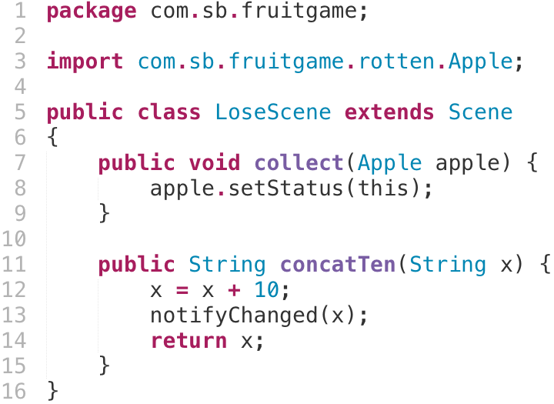
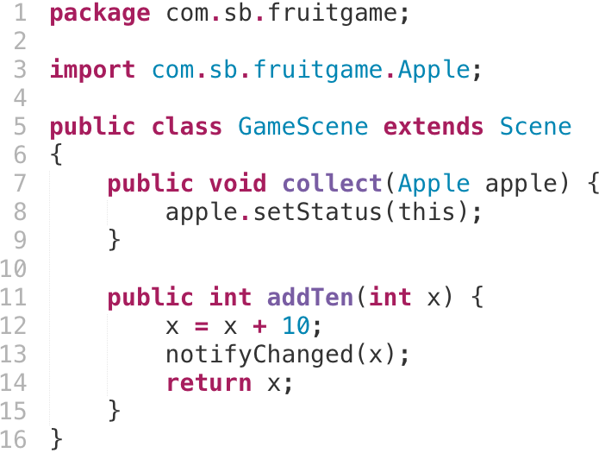
Type 1.
Identical code fragments except for variations in whitespace (may be also variations in layout), and comments.

Slide 16
Type 1.
Identical code fragments except for variations in whitespace (may be also variations in layout), and comments.

Slide 17
Type 1.
Textually identical code fragments except for variations in whitespace and comments.
package com.sb.cryo.addition;
import com.notificationlib.*;
import java.util.List;
public class AdditionUtils {
public void addToList(List l) {
l.add(getClass().getName());
}
public int addTen(int x) {
x = x + 10; // add number
Notifier.notifyChanged(x);
return x;
}
}
package com.sb.cryo.util;
import com.sb.cryo.notifier.*;
import java.awt.List;
public class StringUtils {
public void addToList(List l) {
l.add(getClass().getName());
}
public String concatTen(String x) {
x = x + 10; // concat number
Notifier.notifyChanged(x);
return x;
}
}

Slide 18
Type 1R.
Contextually & textually identical code fragments except for variations in layout and comments.
package com.sb.cryo.addition;
import com.notificationlib.*;
import java.util.List;
public class AdditionUtils {
public void addToList(List l) {
l.add(getClass().getName());
}
public int addTen(int x) {
x = x + 10; // add number
Notifier.notifyChanged(x);
return x;
}
}
package com.sb.cryo.util;
import com.sb.cryo.notifier.*;
import java.awt.List;
public class StringUtils {
public void addToList(List l) {
l.add(getClass().getName());
}
public String concatTen(String x) {
x = x + 10; // concat number
Notifier.notifyChanged(x);
return x;
}
}
Notes:
We propose type 1R. Type 1R takes into account the context of expressions to be sure we are talking about the same functional concepts. This ensures that the code can be refactored without introducing side effects.

Slide 19
Type 1R.
Contextually & textually identical code fragments except for variations in layout and comments.
package com.sb.cryo.addition;
import com.notificationlib.*;
import java.util.List;
public class AdditionUtils {
public void addToList(List l) {
l.add(getClass().getName());
}
public int addTen(int x) {
x = x + 10; // add number
Notifier.notifyChanged(x);
return x;
}
}
package com.sb.cryo.util;
import com.sb.cryo.notifier.*;
import java.awt.List;
public class StringUtils {
public void addToList(List l) {
l.add(getClass().getName());
}
public String concatTen(String x) {
x = x + 10; // concat number
Notifier.notifyChanged(x);
return x;
}
}
java.util.List
java.awt.List
Notes:
Fully Qualified Identifier
The types referenced by these type references differ, so this line isn’t seen as cloned.

Slide 20
Type 1R.
Contextually & textually identical code fragments except for variations in layout and comments.
package com.sb.cryo.addition;
import com.notificationlib.*;
import java.util.List;
public class AdditionUtils {
public void addToList(List l) {
l.add(getClass().getName());
}
public int addTen(int x) {
x = x + 10; // add number
Notifier.notifyChanged(x);
return x;
}
}
package com.sb.cryo.util;
import com.sb.cryo.notifier.*;
import java.awt.List;
public class StringUtils {
public void addToList(List l) {
l.add(getClass().getName());
}
public String concatTen(String x) {
x = x + 10; // concat number
Notifier.notifyChanged(x);
return x;
}
}
java.util.List.add(java.lang.Object)
java.awt.List.add(java.lang.String)
Notes:
Type 1R takes into account the Fully Qualified Signature of method references.

Slide 21
Type 1R.
Contextually & textually identical code fragments except for variations in layout and comments.
package com.sb.cryo.addition;
import com.notificationlib.*;
import java.util.List;
public class AdditionUtils {
public void addToList(List l) {
l.add(getClass().getName());
}
public int addTen(int x) {
x = x + 10; // add number
Notifier.notifyChanged(x);
return x;
}
}
package com.sb.cryo.util;
import com.sb.cryo.notifier.*;
import java.awt.List;
public class StringUtils {
public void addToList(List l) {
l.add(getClass().getName());
}
public String concatTen(String x) {
x = x + 10; // concat number
Notifier.notifyChanged(x);
return x;
}
}
int
java.lang.String
int
java.lang.String
int
java.lang.String
Notes:
Type 1R checks the type of variable references.

Slide 22
Type 1R.
Retrieving contextual information can be challenging!
package com.sb.cryo.addition;
import com.notificationlib.*;
import java.util.List;
public class AdditionUtils {
public void addToList(List l) {
l.add(getClass().getName());
}
public int addTen(int x) {
x = x + 10; // add number
Notifier.notifyChanged(x);
return x;
}
}
package com.sb.cryo.util;
import com.sb.cryo.notifier.*;
import java.awt.List;
public class StringUtils {
public void addToList(List l) {
l.add(getClass().getName());
}
public String concatTen(String x) {
x = x + 10; // concat number
Notifier.notifyChanged(x);
return x;
}
}
?
Notes:
Language dependent
Need everything surrounding a software system to be sure referenced symbols are equal.

Slide 23
Type 1R Summarized
In addition to type 1 rules, we compare contextual information of:
1. Type references (Fully Qualified Identifier)
2. Variable references (type)
3. Method references (Fully Qualified Signature)
Retrieving fully qualified identifiers/signatures can be challenging!
Notes:
Type 1R checks the type of variable references.

Slide 24
Shortcomings type 1
Textually equal code fragments
Notes:
Contextual information is missing

Slide 25
Shortcomings type 1
Textually equal code fragments
Notes:
Contextual information is missing

Slide 26
Shortcomings type 1
Textually equal code fragments
com.sb.fruitgame.Apple

Slide 27
Type 1R
Textually & functionally equal code fragments

Slide 28
Type 1R
Textually & functionally equal code fragments
com.sb.fruitgame.Apple

Slide 29
Shortcomings type 1
Textually equal code fragments
com.sb.fruitgame.Apple

Slide 30
Shortcomings type 1
Textually equal code fragments
com.sb.fruitgame.Apple
com.sb.fruitgame.GameScene

Slide 31
Type 1R
Textually & functionally equal code fragments
com.sb.fruitgame.Apple
com.sb.fruitgame.GameScene
int

Slide 32
Type 1R
Textually & functionally equal code fragments
com.sb.fruitgame.Apple
com.sb.fruitgame.GameScene
com.sb.fruitgame.Fruit.setStatus(com.sb.fruitgame.Scene)
int
com.sb.fruitgame.Scene.notifyChanged(int)

Slide 33
Shortcomings type 1
Textually equal code fragments
com.sb.fruitgame.Apple
com.sb.fruitgame.Apple

Slide 34
Type 1.
Identical code fragments except for variations in whitespace (may be also variations in layout), and comments.
Type 2.
Structurally/syntactically identical fragments except for variations in identifiers, literals, types, layout, and comments.

Slide 35
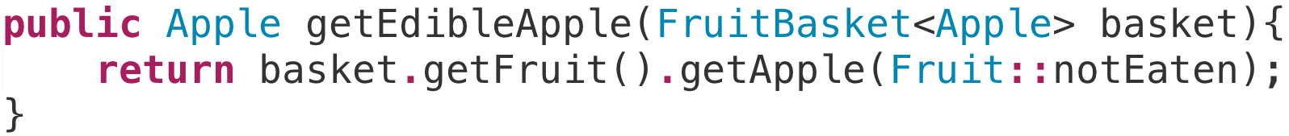
Shortcomings type 2
Type 2 clones allow any(!) variation in identifiers, literals and types(!)
Notes:
TRADEOFFS!!!

Slide 36
Type 2R clones
No design tradeoff
  Class/enum/interface names
  Method names
  Variable names (sometimes)
Design tradeoff
  Literals
  Variable references
  Called methods
Code Example

Slide 37
Code Example

Slide 38
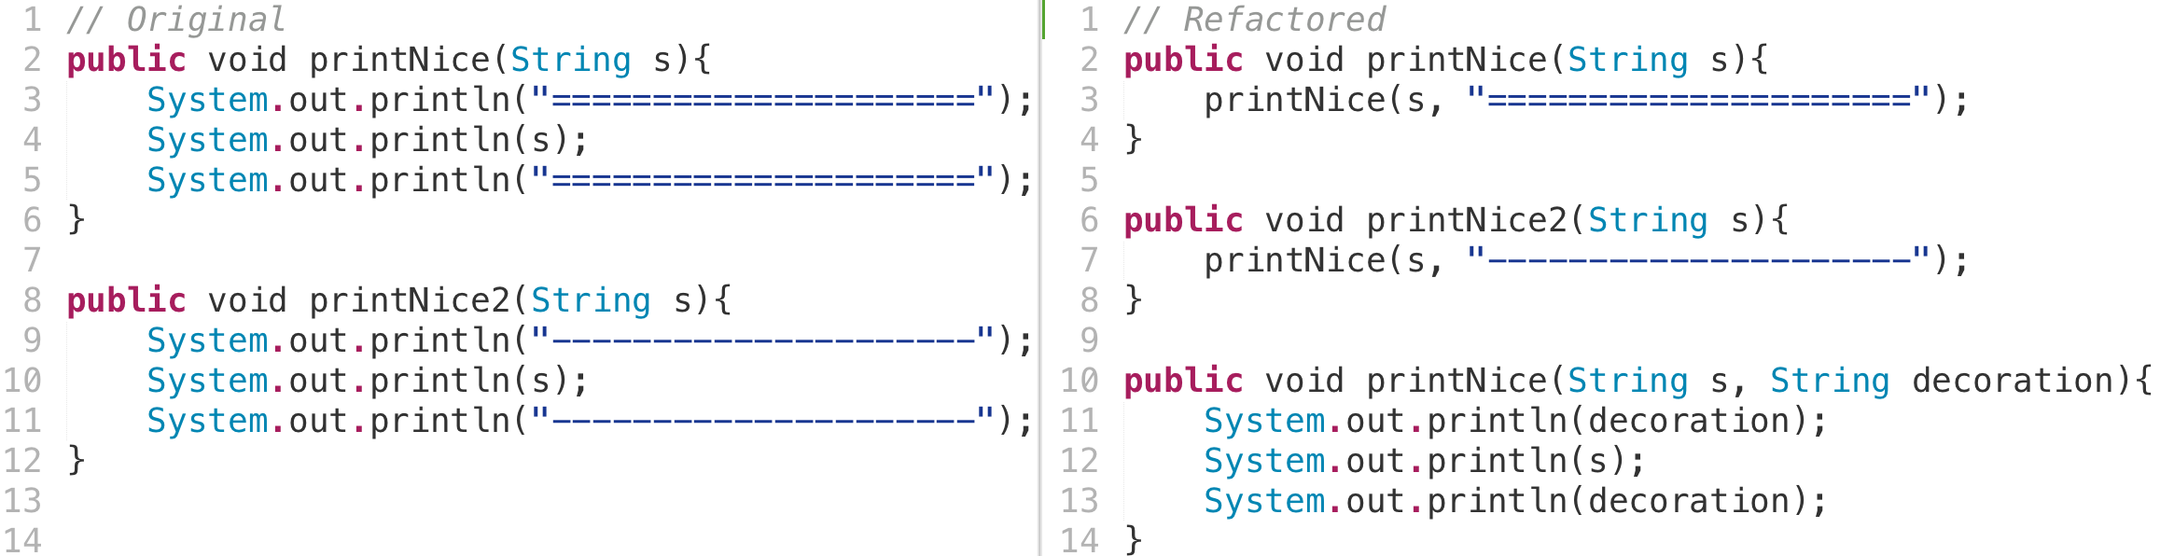
Type 2R clones
Tradeoff: different literal creates extra parameter

Slide 39
Type 1.
Identical code fragments except for variations in whitespace (may be also variations in layout), and comments.
Type 2.
Structurally/syntactically identical fragments except for variations in identifiers, literals, types, layout, and comments.
Type 3.
Copied fragments with further modifications. Statements can be changed, added or removed in addition to variations in identifiers, literals, types, layout, and comments.

Slide 40
Code Example

Slide 41
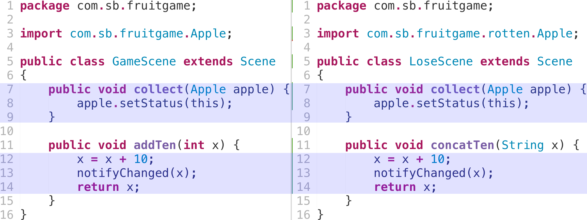
Shortcomings type 1
Textually equal code fragments

Slide 42
Type 1R clones
Functionally + textually equal code fragments
Compare fully qualified identifier (FQI) of:
  Type references
          Apple → com.sb.Apple
  Method signatures
          eat(apple) → com.sb.Waste com.sb.EatController.eat(com.sb.Apple)
Compare FQI of the types of variables
          myApple → (com.sb.Apple)myApple

Slide 43
Shortcomings type 1
Textually equal code fragments

Slide 44
Clone types
How can we automatically refactor different types of clones?
Type 1. Identical code fragments except for variations in whitespace (may be also variations in layout) and comments.
Type 2. Structurally/syntactically identical fragments except for variations in identifiers, literals, types, layout and comments.
Notes:
These types have shortcomings when looking at what we can and should refactor.
Type 1 is textual equality except for whitespace and comments.
Type 2 is structurally equal code.
Type 3 allows any variability. Most tools implement this with some notion of similarity.
Type 4 is out of scope.
There are a lot of studies that implement clone detection tools to detect these types of clones. For most tools, the main point of focus is effe
A higher type of clone means that it's harder to detect. It also makes the clone harder to refactor, as more transformations would be required. Higher clone types also become more disputable whether they actually indicate a harmful antipattern (not every clone is harmful). Type 1 clones are most often, if not always with the right thresholds, harmful. Type 2 and type 3 clones are more disputable whether they are harmful and whether they can be merged in a way that improves the design of the code.

Slide 45
Clone types
How can we automatically refactor different types of clones?
Type 1. Identical code fragments except for variations in whitespace (may be also variations in layout) and comments.
Type 2. Structurally/syntactically identical fragments except for variations in identifiers, literals, types, layout and comments.
Type 3. Copied fragments with further modifications. Statements can be changed, added or removed in addition to variations in identifiers, literals, types, layout and comments.
Notes:
These types have shortcomings when looking at what we can and should refactor.
Type 1 is textual equality except for whitespace and comments.
Type 2 is structurally equal code.
Type 3 allows any variability. Most tools implement this with some notion of similarity.
Type 4 is out of scope.
There are a lot of studies that implement clone detection tools to detect these types of clones. For most tools, the main point of focus is effe
A higher type of clone means that it's harder to detect. It also makes the clone harder to refactor, as more transformations would be required. Higher clone types also become more disputable whether they actually indicate a harmful antipattern (not every clone is harmful). Type 1 clones are most often, if not always with the right thresholds, harmful. Type 2 and type 3 clones are more disputable whether they are harmful and whether they can be merged in a way that improves the design of the code.

Slide 46
Shortcomings type 3
How to refactor if anything can change
Copied fragments: how to determine statically.
Ambiguous definition
Most tools use similarity score
Notes:
Definition is not so “static code analysis” friendly.
Type 3 clones allow added, removed and changed statements. This means basically anything can change. Most tools use a similarity threshold to see which type 3 clones should be considered.

Slide 47
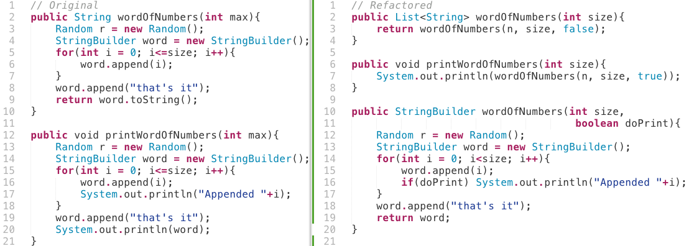
Type 3R clones
Gapped Statements

Slide 48
Type 3R clones
Added/removed/changed statement → solve with conditional

Slide 49
CloneRefactor
Relation, Location, Contents, Refactorability
T1, T2, T3, T1R, T2R, T3R
WIP
Detect Clones
Map Context
Refactor

Slide 50
CloneRefactor
Relation, Location, Contents, Refactorability
T1, T2, T3, T1R, T2R, T3R
WIP
Detect Clones
Map Context
Refactor

Slide 51
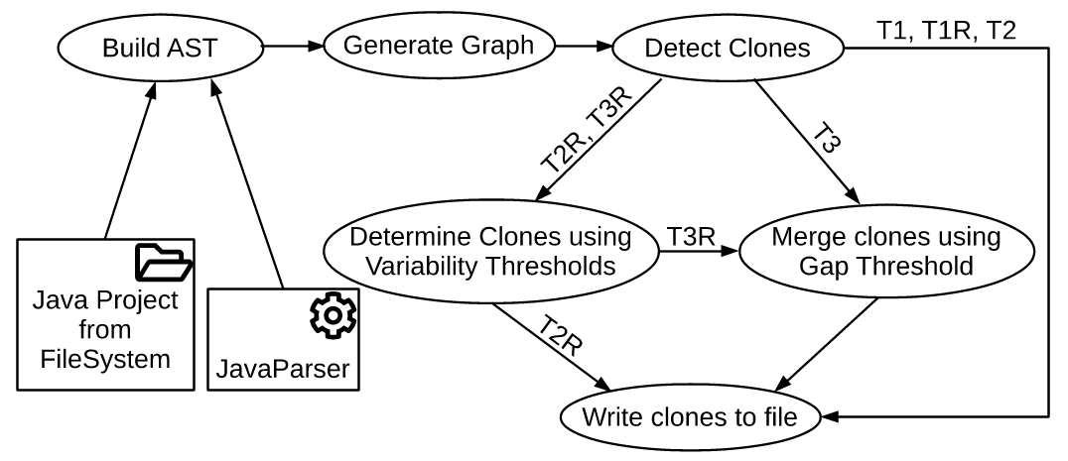
CloneRefactor

Slide 52
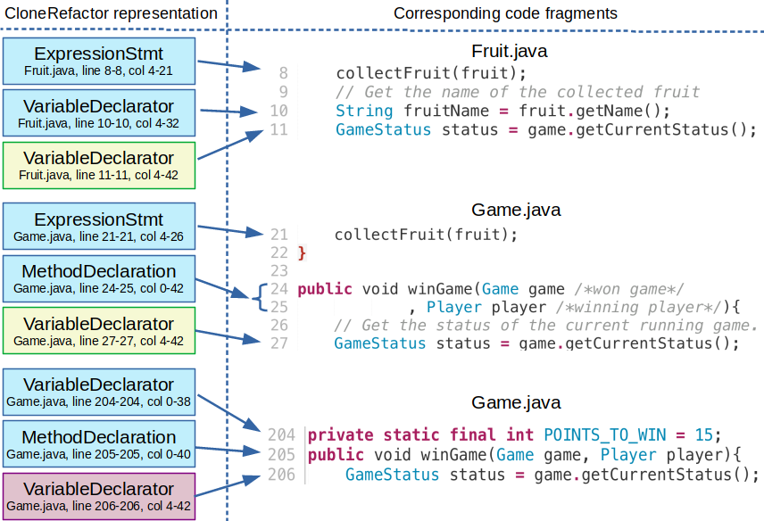

Slide 53
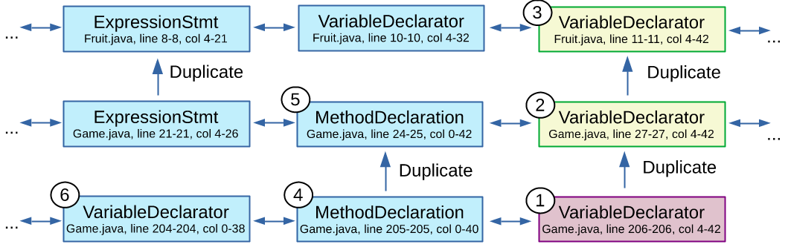

Slide 54
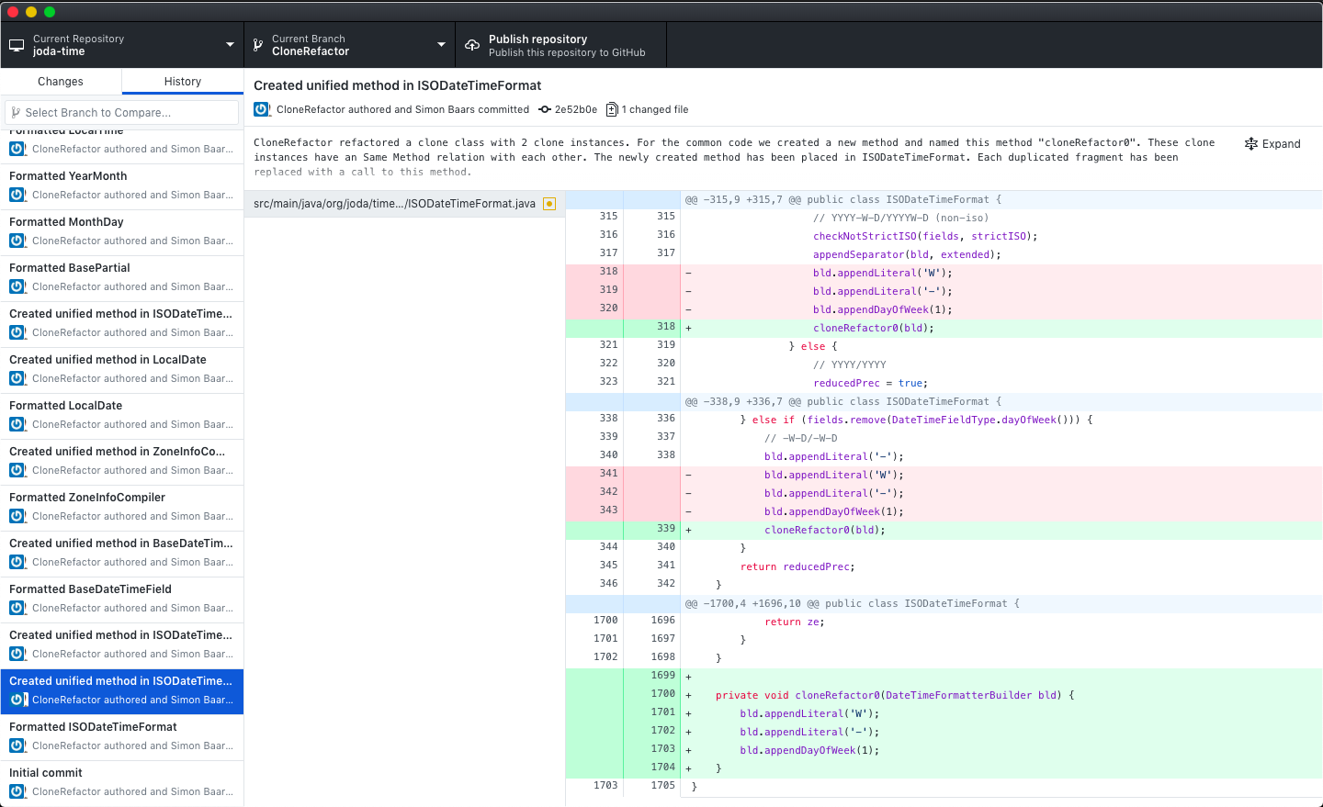

Slide 55
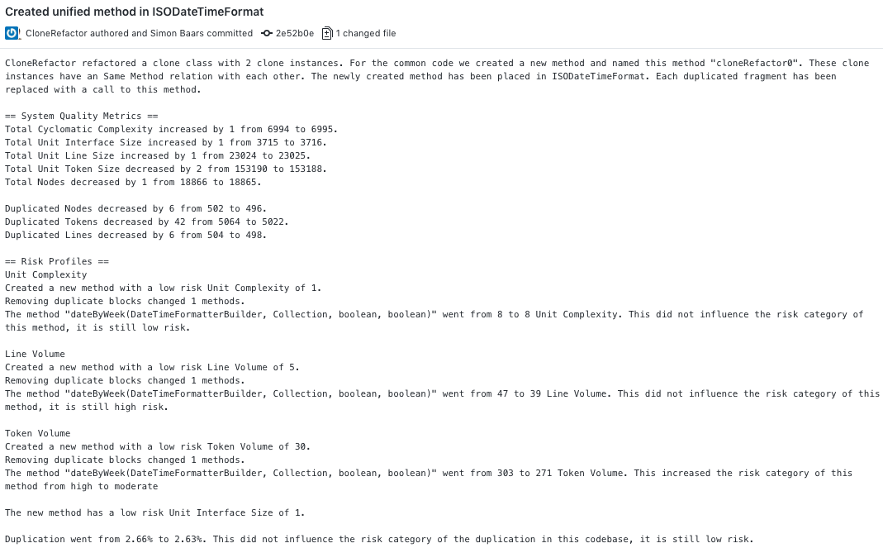

Slide 56

Experiments
Corpus with 2.267 Java projects
  GitHub projects with relatively high number of forks
Clone Types
Context
Refactorability
Thresholds

Slide 57
Token threshold
node = Statement/Declaration

Slide 58
Token threshold
node = Statement/Declaration

Slide 59
Token threshold

Slide 60
Token threshold

Slide 61
Token threshold

Slide 62
Clone Types
Amount of clones found
Performance

Slide 63
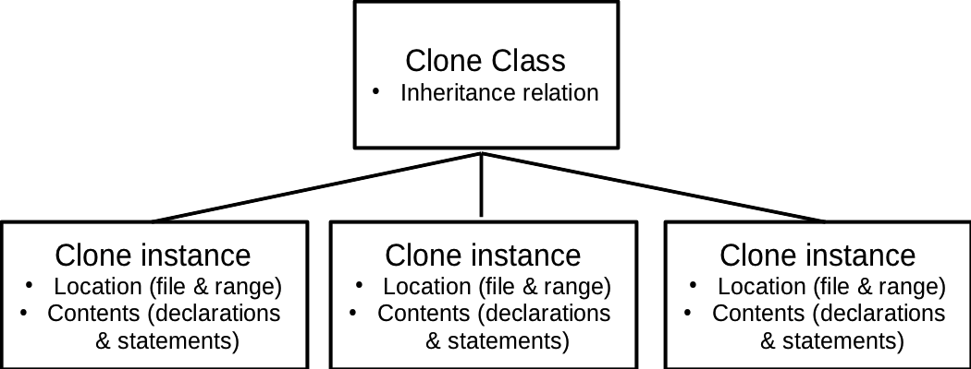
Code Clone Context
How are cloned instances related, where is my clone located and what does my clone contain?
Page <number> of 13
Notes:
To be able to refactor code clones, it is very important to consider the context of the clone. We define the following aspects of the clone as its context:
\item The relation of clone instances among each other (for example: two clone instances in a clone class are part of the same object).
\item Where a clone instance occurs in the code (for instance: a method-level clone is a clone instance that is (a part of) a single method).
\item The contents of a clone instance (for instance: the clone instance consists of a one method declaration, a foreach statement and two variable declarations).
Everything in the context of a clone has a big impact on how it has to be refactored. For this study we performed measurements on the context of clones in a large corpus of open source projects.

Slide 64
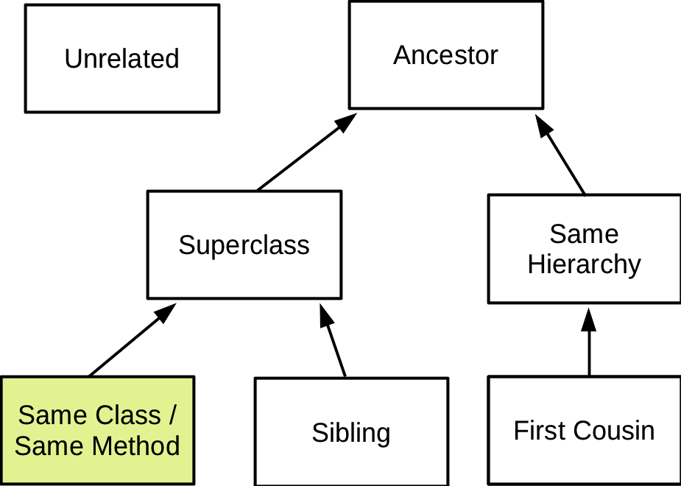
Clone Relations
Relation through inheritance between clone instances
Notes:
We took the categories from an existing study.
We don’t take into account external classes, as they aren’t interesting for refactoring.
We have an extra category that is not modelled here: same external superclass.

Slide 65
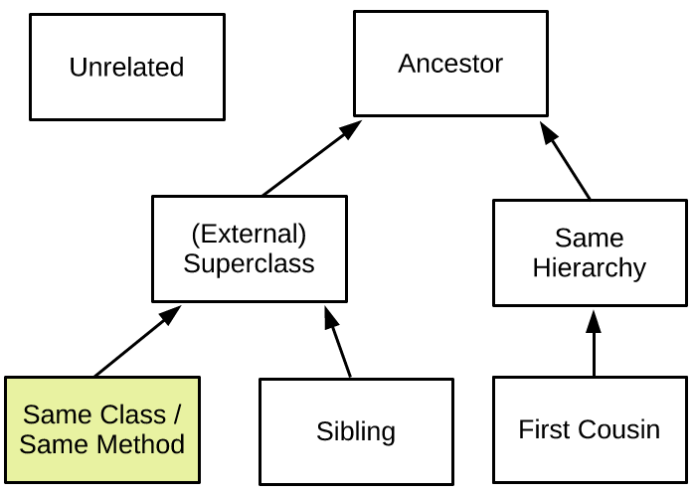
Relation between clone instances

Slide 66
Location of clones

Slide 67
Contents of clones

Slide 68
Refactorability
To what extend can we extract methods?

Slide 69
Next steps
Analyze impact of “Extract Method” refactorings
RQ3.
To what extent can we automate the process of refactoring clones?
Analyze Refactored Source Code
  Maintainability index
    Volume
    Duplication
    Complexity
  Survey
Dynamic Thresholds based on tradeoff
  Relation
  Number of parameters

Slide 70
RQ1.
How can we define clone types such that they can be automatically refactored?
RQ2.
How can we prioritize refactoring opportunities based on the context of clones?
RQ3.
What are the discriminating factors to decide when a clone should be refactored

Slide 71
Summary
Refactoring-Oriented clone types
T1R. Textually and functionally identical code fragments.
T2R. Allow change in controlled features of a codebase. Refactoring opportunities for these controlled features are known.
T3R. Allows a gap of different statements between clones, constrained by a threshold.
Refactoring oriented clone types take about 5 times as long to detect and yield fewer clones.
Almost half of all clones are in the same class/method, about 35% is unrelated.
About 80% of clones is found in methods.
Applying refactorings will be a goldmine for threshold related information.

Slide 72
Type 2R clones
No design tradeoff
  Class/enum/interface names
  Method names
  Variable names (sometimes)
Design tradeoff
  Literals (of the same type)
  Variable references (sometimes)
  Called methods
public class A {
public void doA() {
print("hello");
}
}
public class B {
public void doB() {
print("hello");
}
}

Slide 73
Type 2R clones
No design tradeoff
  Class/enum/interface names
  Method names
  Variable names (sometimes)
Design tradeoff
  Literals (of the same type)
  Variable references (sometimes)
  Called methods
public void doA() {
String message = "hello";
print(message);
}
public void doB() {
String hello = "hello";
print(hello);
}

Slide 74
Type 2R clones
No design tradeoff
  Class/enum/interface names
  Method names
  Variable names (sometimes)
Design tradeoff
  Literals (of the same type)
  Variable references (sometimes)
  Called methods
// Original
void doABC(){
doA();
doB("abc");
doC();
}
void doDEF(){
doA();
doB("def");
doC();
}
// Refactored
void doABC(){
doThis("abc");
}
void doDEF(){
doThis("def");
}
void doThis(String letters){
doA();
doB(letters);
doC();
}

