Slide 1
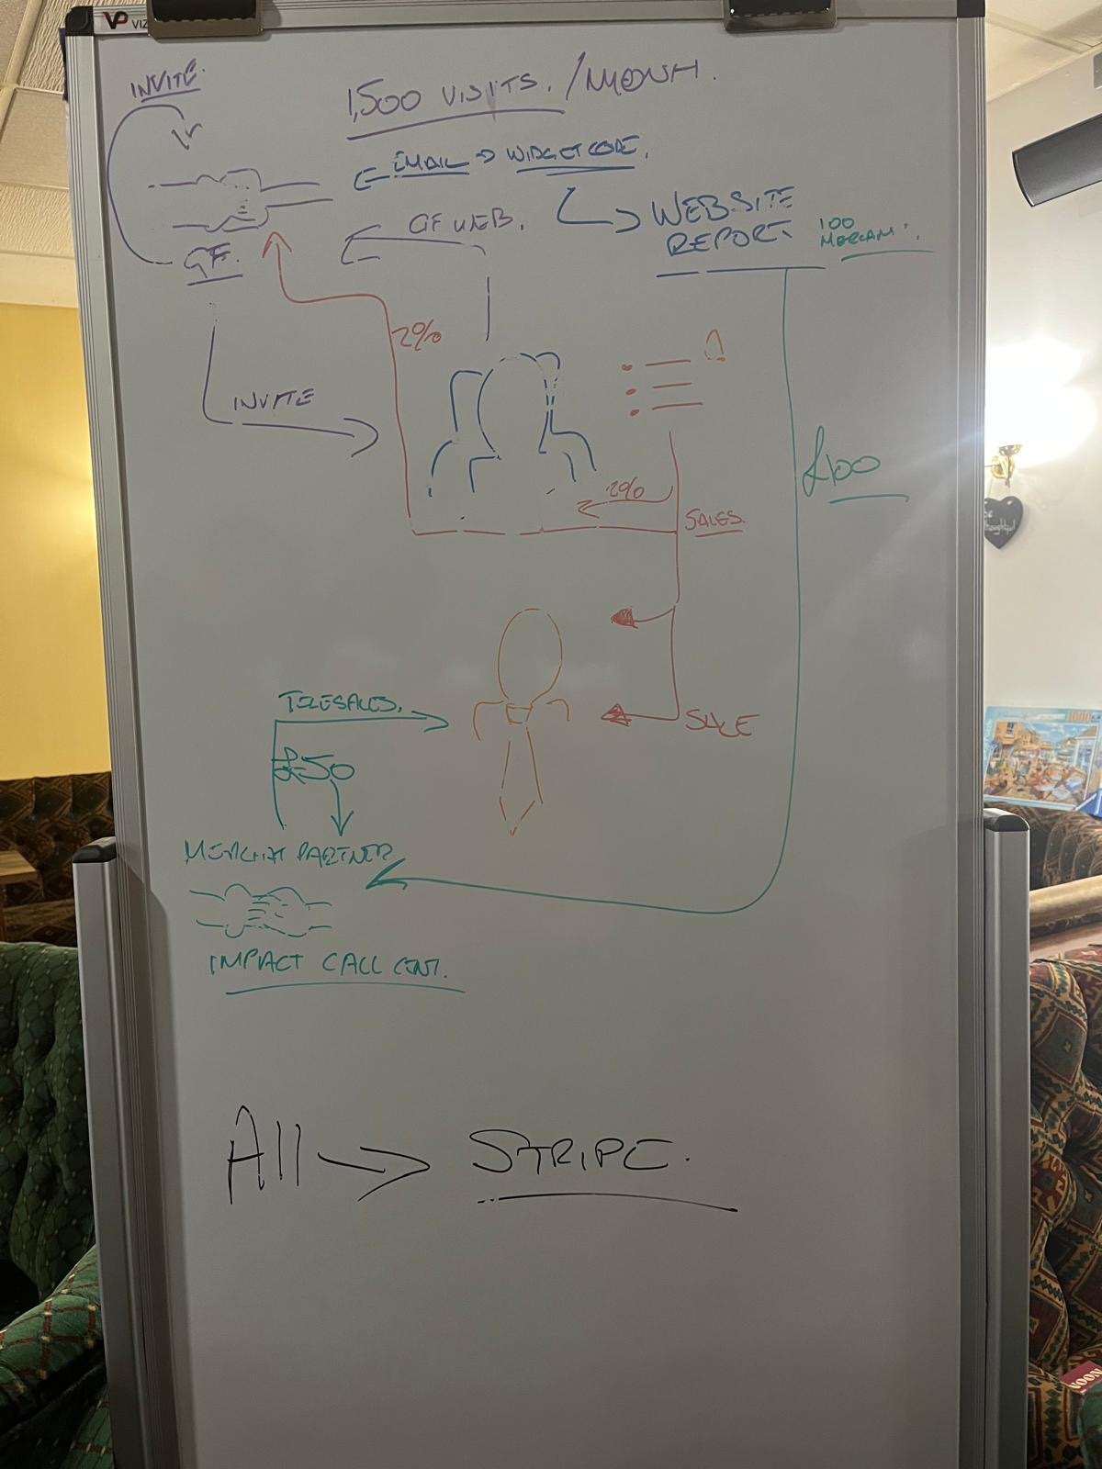

Club Madeira
On-boarding Process

Slide 2
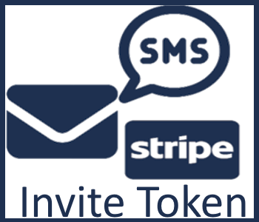


Community Partners are digital agencies like you!
We send an invite token to the community partner.
The community partner connects via stripe.
The partner hosts their own partner site.
The partner website is branded up as the partner.
https://github.com/SimonBarnett/Madeira-Partners/

Slide 3

The community partner uses their partner site
to send invite tokens
to their communities*
*Must be engaged communities with a current membership and minimum 1500 visitors a month.

Slide 4
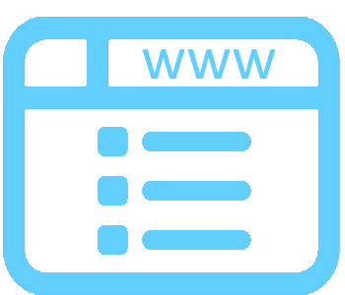
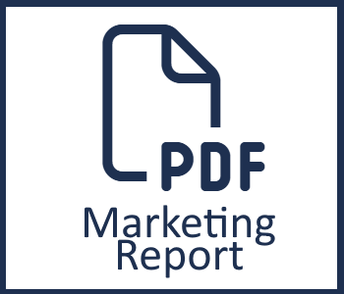

{
When a community connects via stripe:
Their catalogue widget is sent to the community partner to publish on the community website.
The marketing report, identifying potential merchants for the community, is sent to the merchant partner.

Slide 5
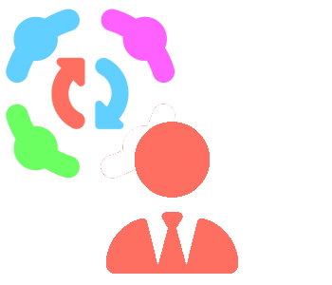
Merchant partners:
use the marketing report for telesales.
send invite tokens to merchants who agree to list products on a community.
Receive the £50 sign-up fee in commission when merchant completes onboarding.

Slide 6
Onboarding Merchants list their products by:
providing the read-only parts token from their catalogue (WIX, Woo, Shopifiy, Magento etc).
Adding the tracking widget to the <HEAD> of their site (parts without widget are ignored).
Implementing a web-hook in their back end to report sales.
Merchant parts are listed where relevant, on ALL community catalogues.

Slide 7
{
2%
Sale
2%
When a community catalogue refers a sale to a merchant
both the community
and the referring partner
receive 2% commission, automatically, via stripe.

Slide 8
When a community partner has onboarded 20 qualifying communities
they receive 2 free partner invites.
Community partners get one additional partner invite for every 10 additional onboarded communities.
Inviting new partners allows you to increase the number of communities buying from your merchants, and the number of merchants selling to your communities.

Slide 9
{
2%
Sale
{
1%
Owns Merchant
1%
Owns Community
When the merchant and community of a referred sale belong to different community partners
the commission is split between them.

Slide 10

We use affiliates to populate the categories of the community catalogue.
Commission on these sales, and sales made through our members-only Chrome extension do not have an identifiable source.
In order to offer communities a profit share on these sales, rebates are paid to the community pro-rata, based on their relative traffic.
E.g. If your community was responsible for 10% of the years network traffic, your community gets 10% of the annual profit share.

