Slide 1
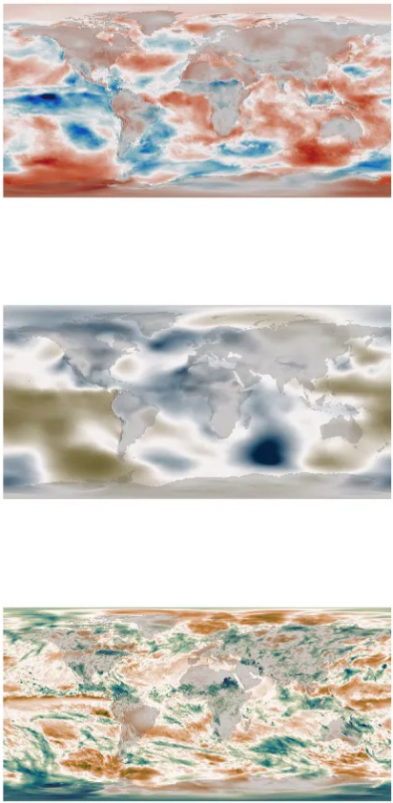
Temperature
Pressure
Deep Learning
Generative
Model
State Vector
(Embedding)
Precipitation

Slide 2
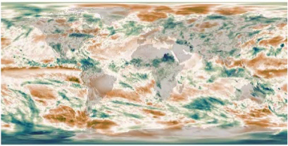
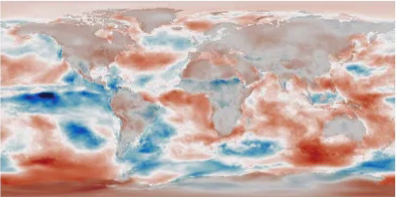
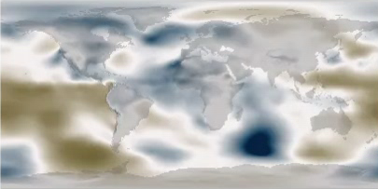
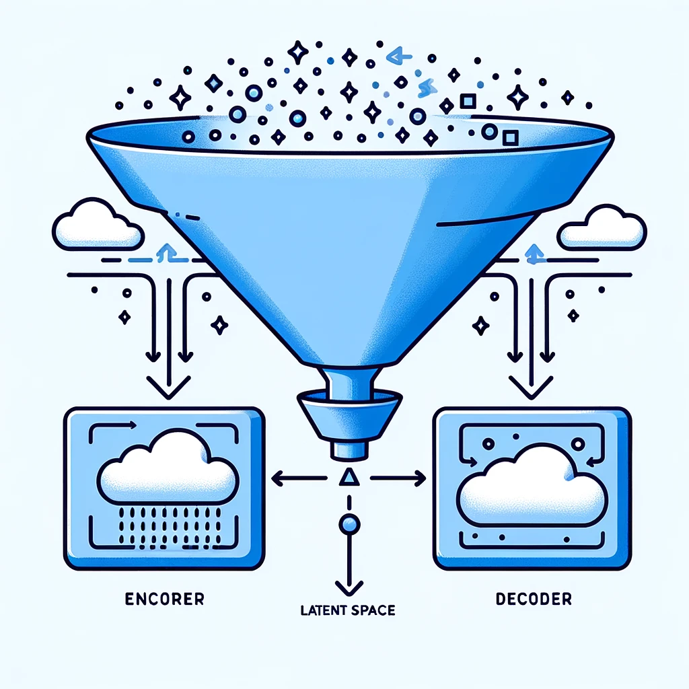
Temperature
Pressure
Deep Learning
Generative
Model
State Vector
(Embedding)
Precipitation
Deep Convolutional Variational Autoencoder

Slide 3


Train the VAE on 80 years of monthly averages from ERA5
Temperature
Train the two models together to
Make the outputs match the input
Pressure
Deep Learning
Encoding
Model
Deep Learning
Generative
Model
State Vector
(Embedding)
Precipitation
Precipitation
Train the embedding space to be a unit normal distribution.
Don’t show input precipitation to the encoder
(forces the model to learn the T,MSLP -> Precipitation relationship).

