Slide 1
Assignment 5 Neural Style Transfer
Simon Han YANG 1930026144
Put in Your partner’s name and ID

Slide 2
Please put your images in the slides for each of the cases.

Slide 3
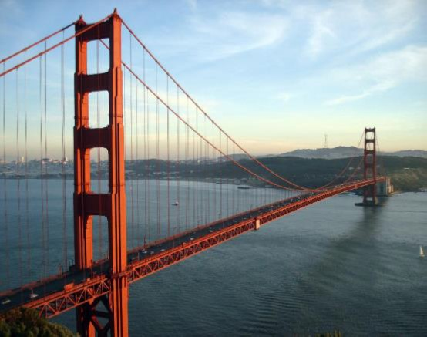
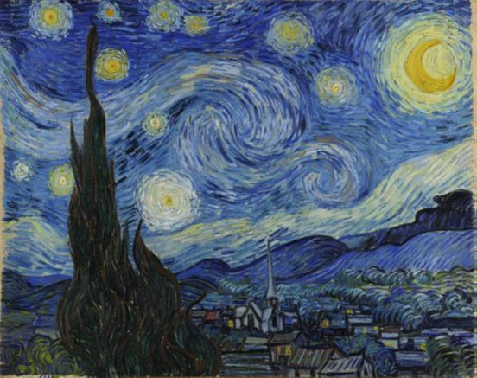
Case 1
Content image
Style image (change if needed)

Slide 4
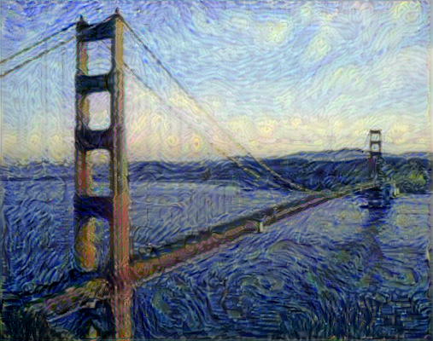
Case 1 – Generated Image

Slide 5
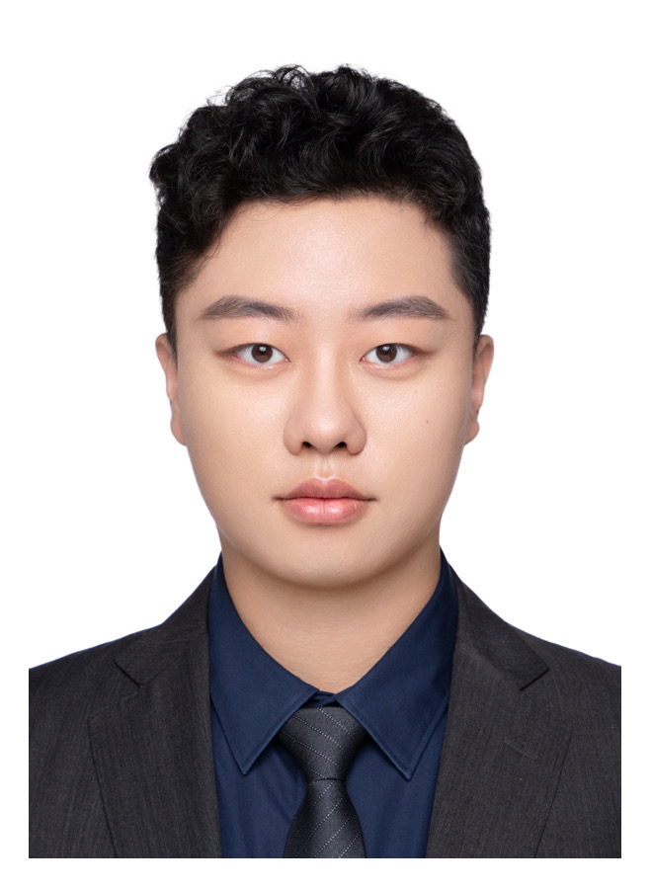
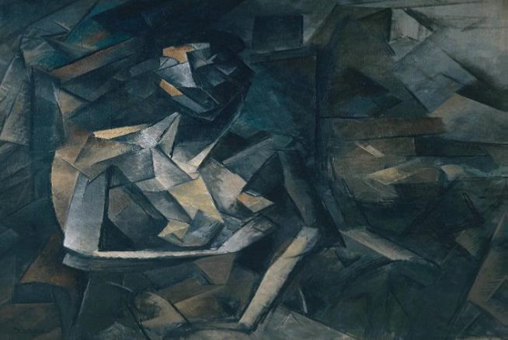
Case 2
Content image
Style image

Slide 6
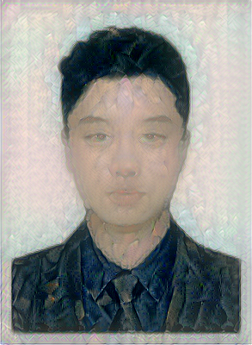
Case 2 – Generated Image

Slide 7
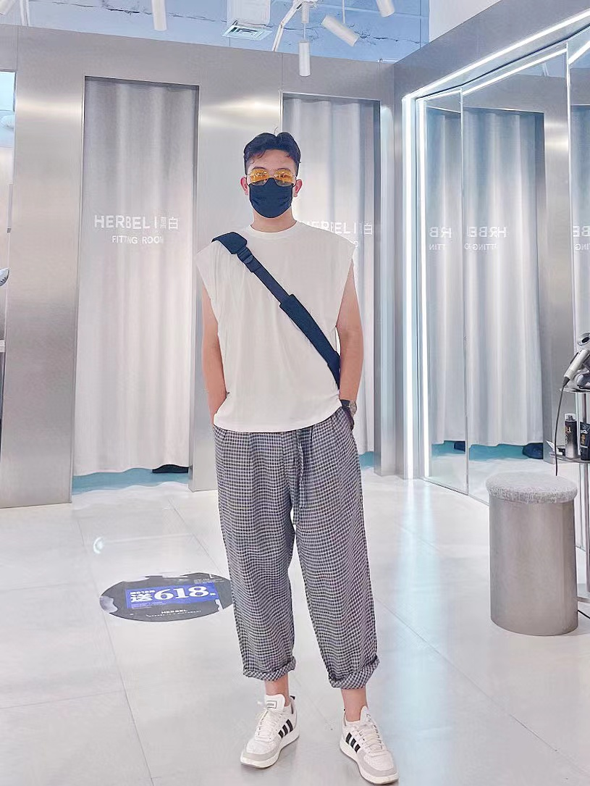
Case 3
Content image
Style image

Slide 8
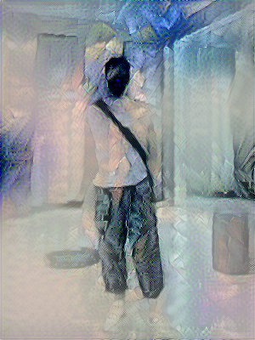
Case 3 – Generated Image

Slide 9

Case 4
Content image
Style image

Slide 10

Case 4 – Generated Image

