Slide 1
Data Science with Python
Lesson #4
19.09.2018

Slide 2
We want to learn…
… how to program in Python
… how to process data
… more about data science and machine learning
… real-world stuff
… want to start a career in Tech!

Slide 3
We already learned that …
A data scientist creates business value out of data
Python is a programming language to do data science stuff
A jupyter notebook makes coding easier
We share codes on Github.com using Git

Slide 4
As a Python programmer, I use …
Variables of different data types types
Data structures like lists and dictionaries
Python Pandas library for extra cool data science stuff
Dataframes as starting point

Slide 5
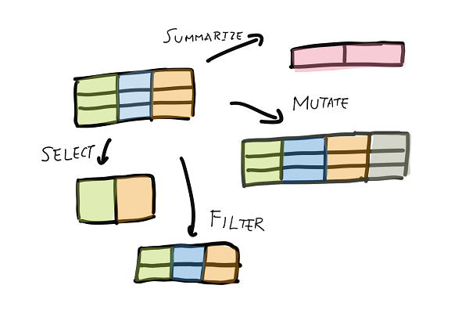
Yesterday, we learned …
How to get data into python dataframes
How to select data
How to use summary functions

Slide 6
Today, we will learn some important pandas basics

Slide 7
What we have learned today

Slide 8
Next week

