Slide 1
ekosystem .NET i Visual Studio

Slide 2
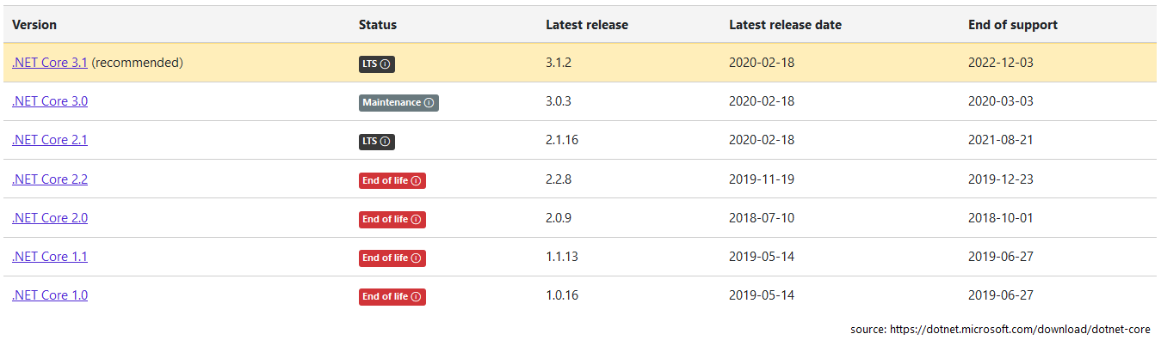
.NET
https://www.plukasiewicz.net/DotNet5/DotNet5Introduction

Slide 3
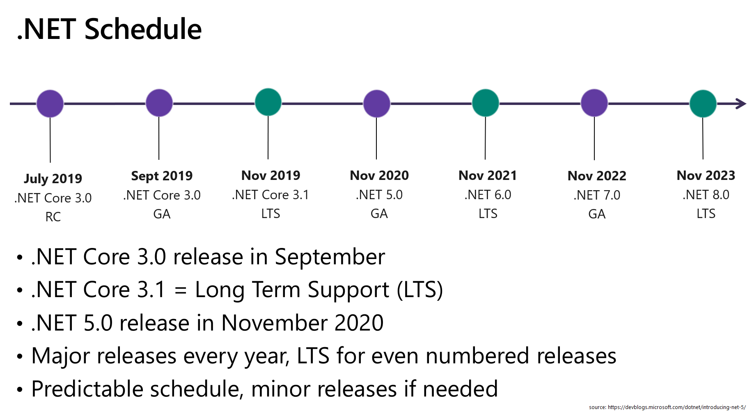
.NET

Slide 4
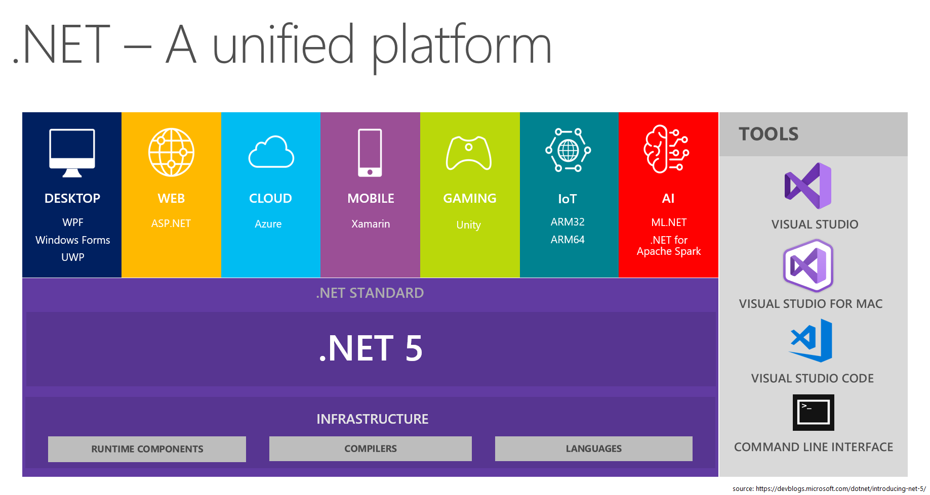

Slide 5
Visual Studio
Code generation and refactoring
https://docs.microsoft.com/en-us/visualstudio/ide/code-generation-in-visual-studio?view=vs-2019
Shortcuts

Slide 6
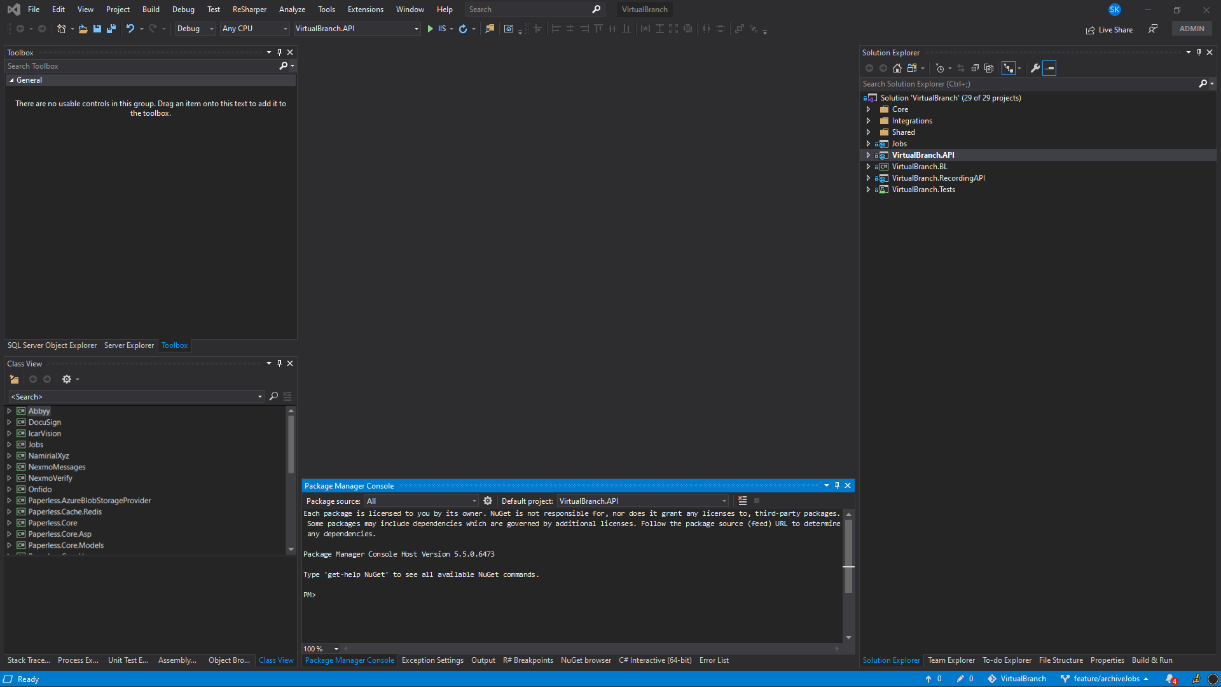
VS – docked Windows Proposition

Slide 7
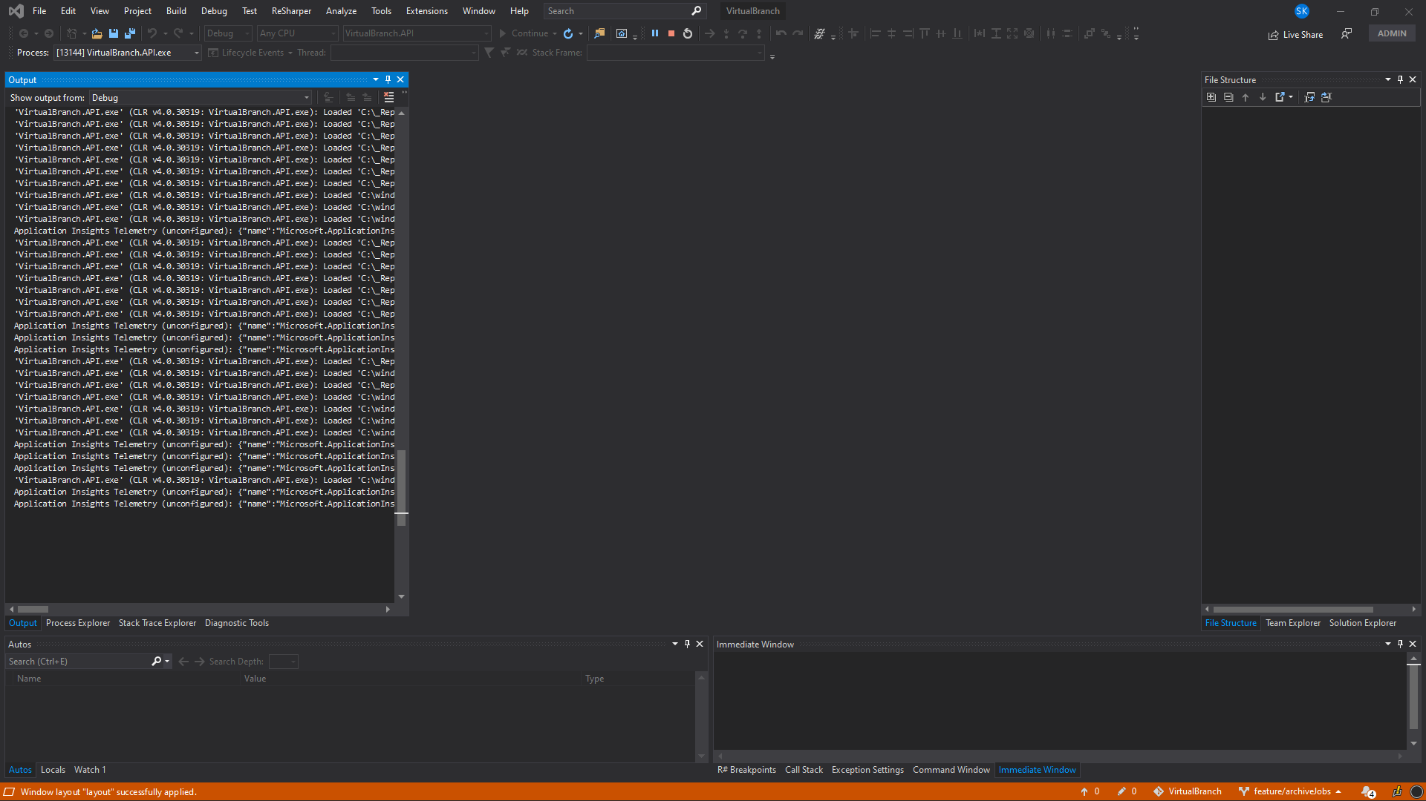
VS – docked Windows Proposition in debug mode

Slide 8
Źródła
https://www.plukasiewicz.net/DotNet5/DotNet5Introduction

