Slide 1
ekosystem .NET i Visual Studio

Slide 2
Compilation process

Slide 3
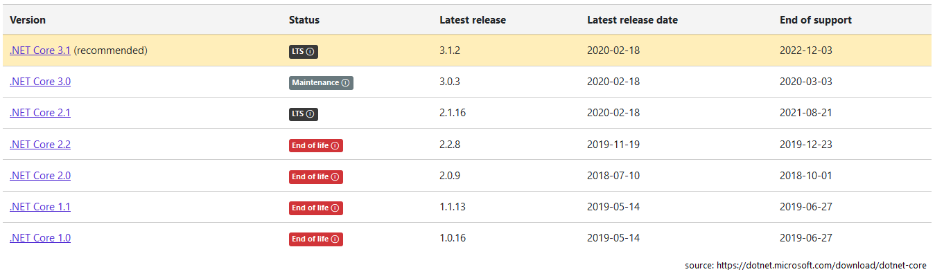
.NET
https://www.plukasiewicz.net/DotNet5/DotNet5Introduction

Slide 4
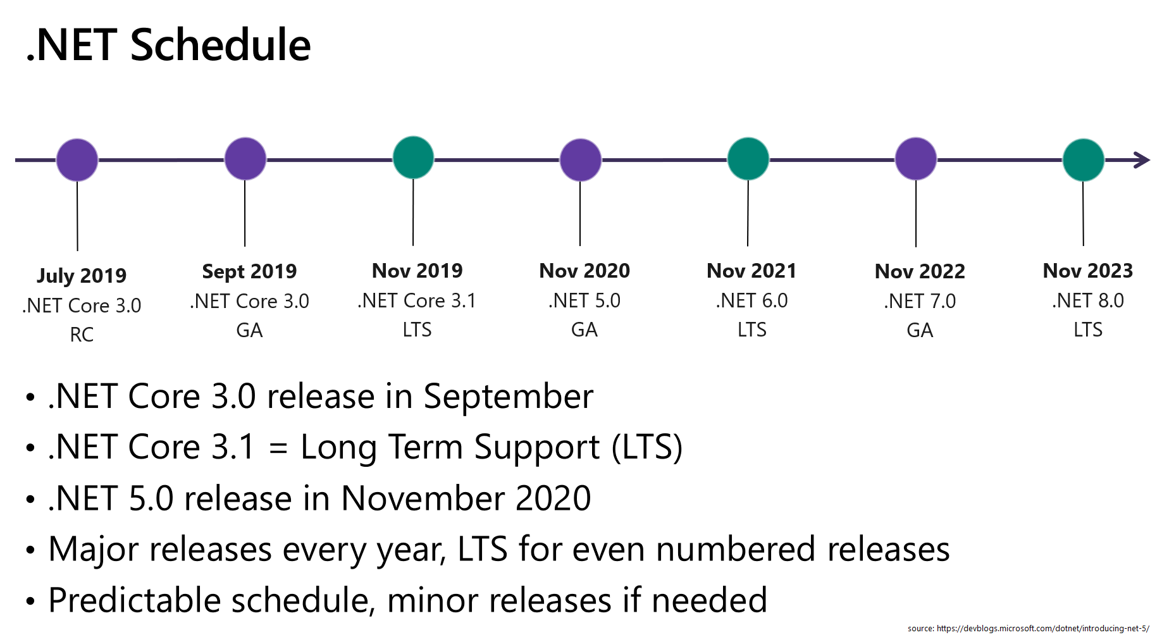
.NET

Slide 5
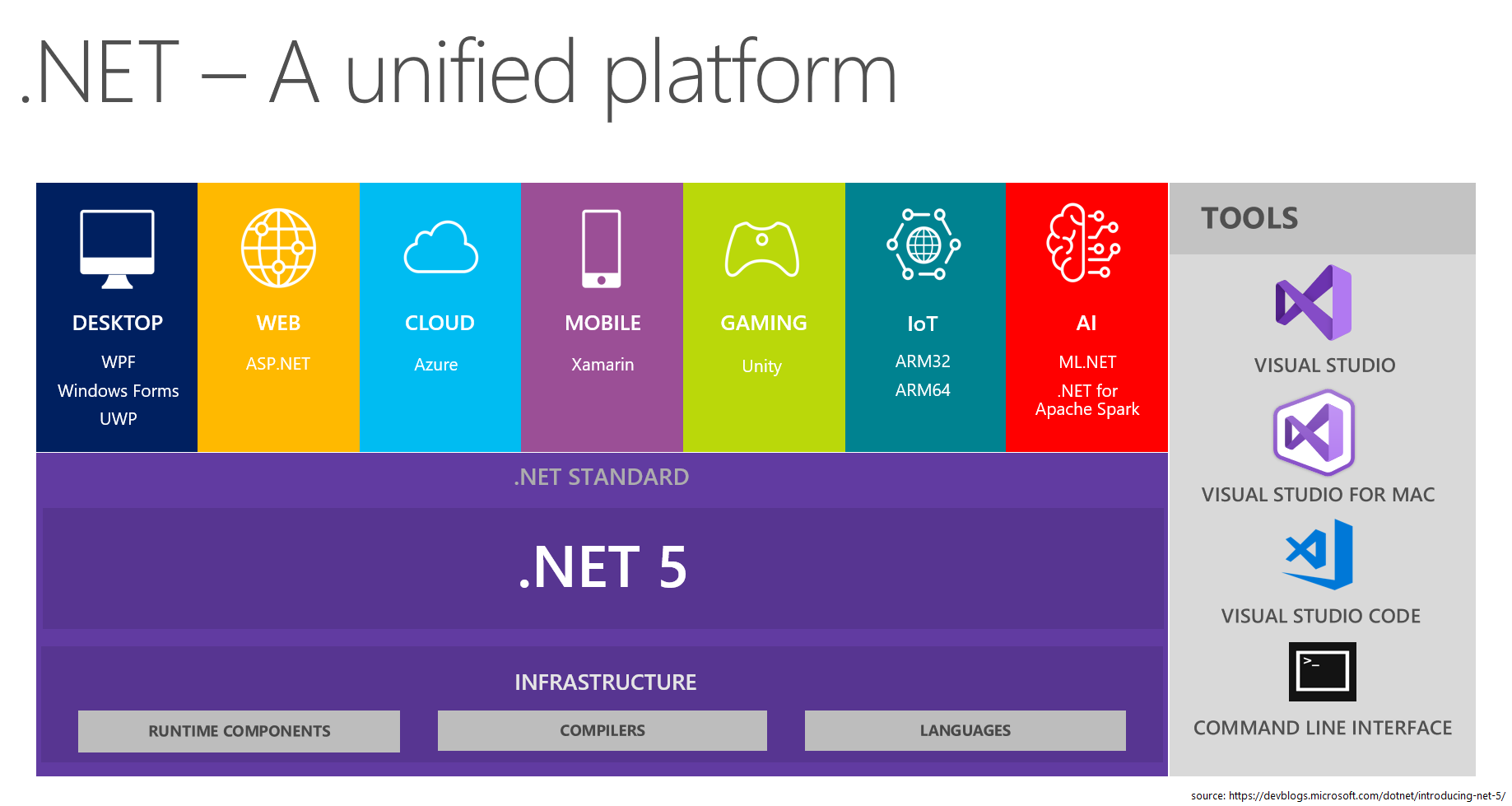

Slide 6
Visual Studio
Code generation and refactoring
https://docs.microsoft.com/en-us/visualstudio/ide/code-generation-in-visual-studio?view=vs-2019
Shortcuts

Slide 7
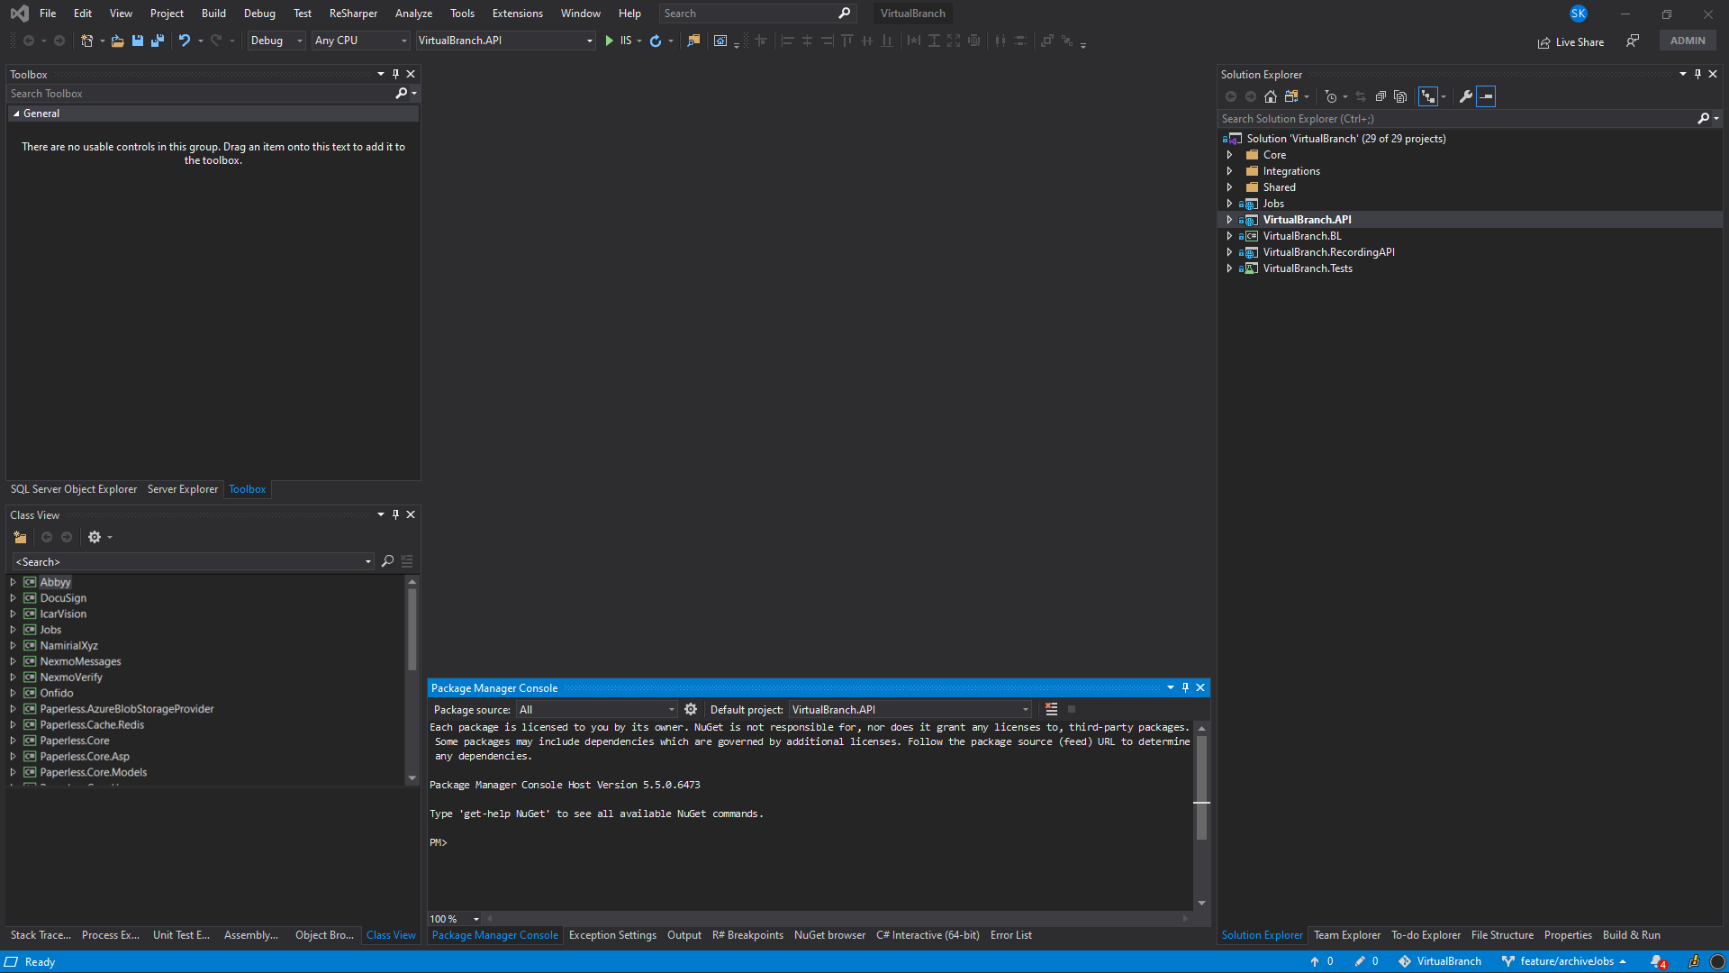
VS – docked Windows Proposition

Slide 8
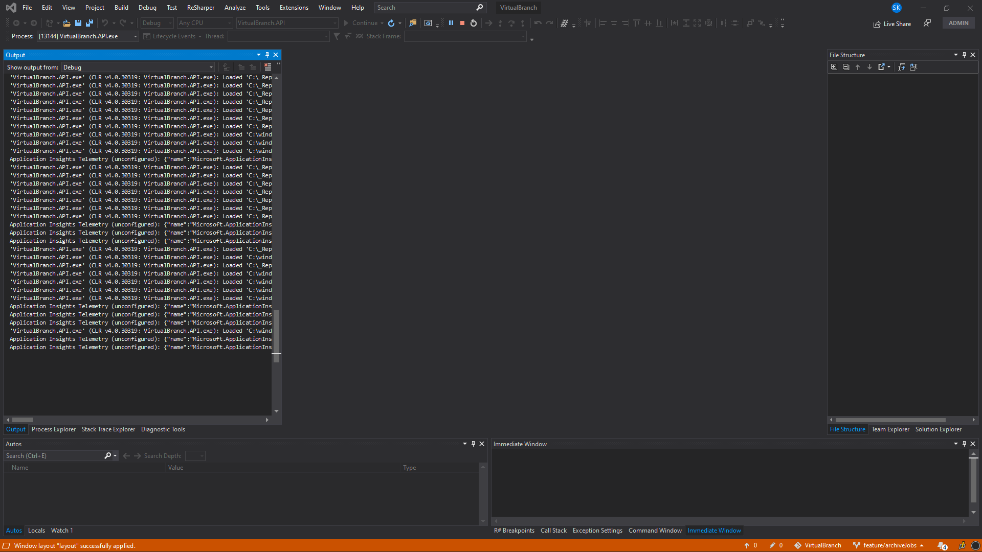
VS – docked Windows Proposition in debug mode

Slide 9
Źródła
https://www.plukasiewicz.net/DotNet5/DotNet5Introduction
https://codeasy.net/lesson/c_sharp_compilation_process

