Slide 1


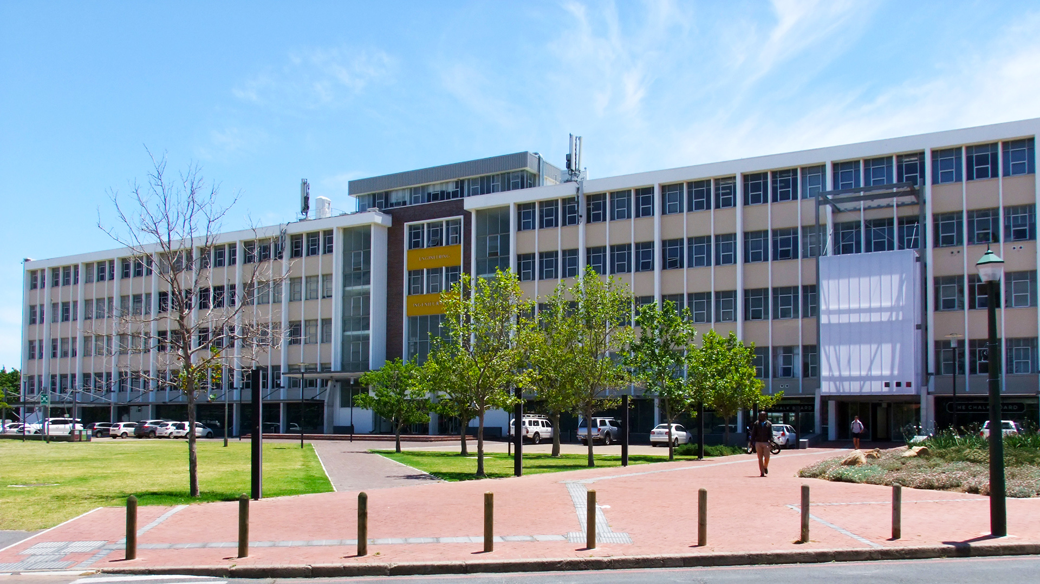
Development of a Hydrogel Extruder By Simon Craig Daniel
Photo by Stefan Els
Notes:
Picture placeholder slide layout
To change the picture:
Select the picture by clicking on it near the bottom of the slide (under the title placeholder), then click on the Picture Format tab.
Click on the Change Picture icon and choose the From a File/This Device… option.
Browse and select a picture and click on the Insert button.
Use the Crop command to adjust the image.
Click on the Crop command again to apply the changes.
Remember to add image attributions to photographs or artworks.

Slide 2
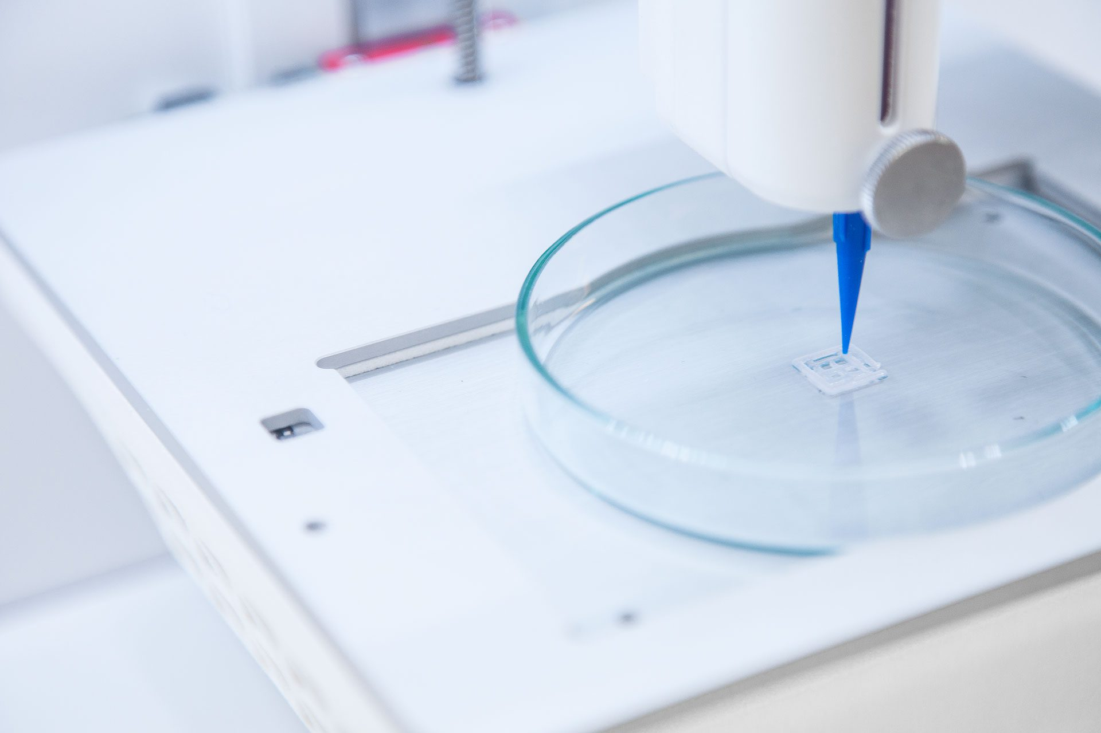
Background to Bioprinting
Applications
Fabricating tissue scaffolds for regenerative medicine
Creating 3D environments to study cell growth and disease progression in biomedical research
Serves as a calibration tool for characterizing bioinks
Challenge
To design a hydrogel printing system (primarily for GelMA):
That can print hydrogel scaffolds,
With controllable printing parameters
Photo by CELLINK

Slide 3
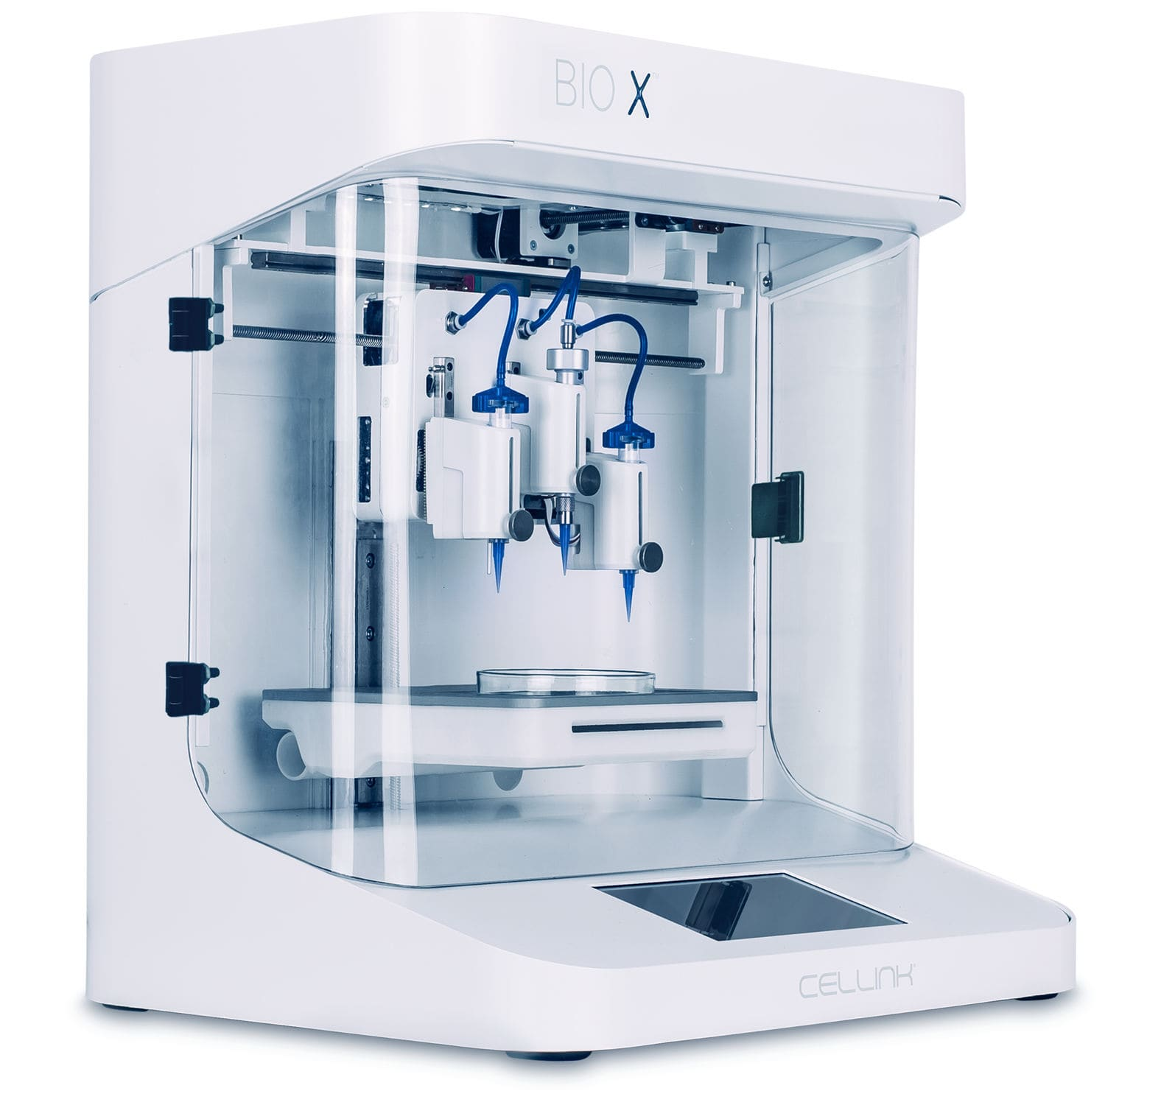
Objectives and Motivation
Objectives
Design and construct a gel extruder with a 3DOF gantry
Design and program an embedded control system
Develop and implement a calibration procedure to determine optimal print settings
Motivation
Commercial bioprinters are expensive and inaccessible
This creates the need for low-cost alternatives for characterizing bioinks
Photo by CELLINK

Slide 4
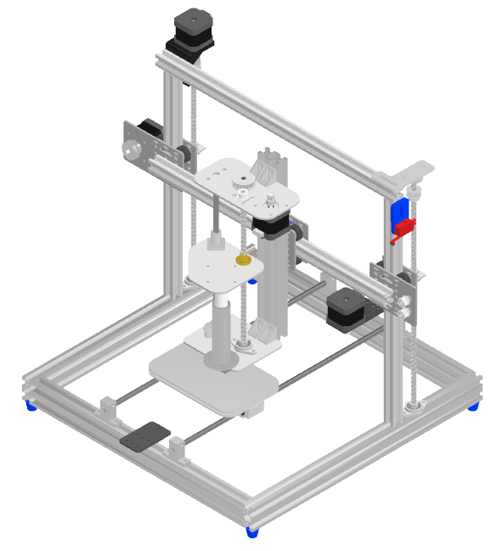
Mechanical System
Syringe-Based Extruder
Nozzle Heating
3DOF Gantry (Bed-slinger)
Bed cooling

Slide 5
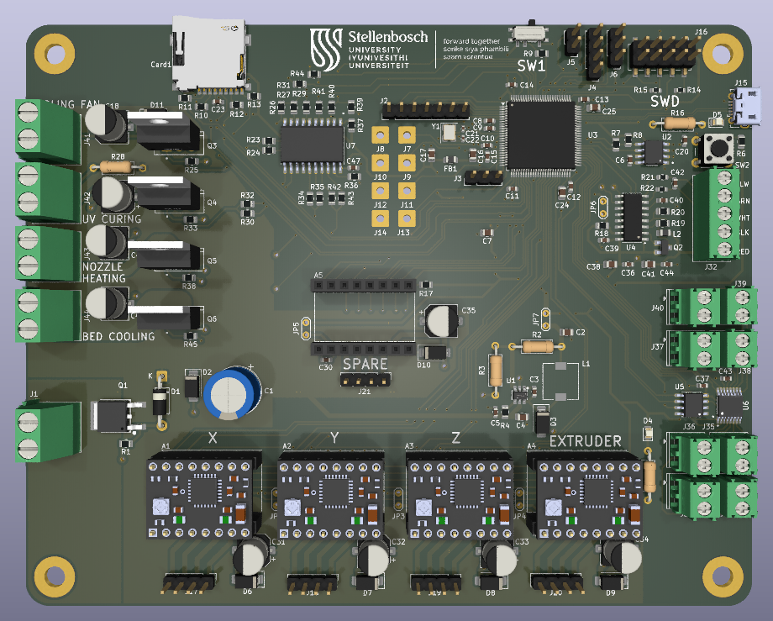
Embedded System
Stepper breakout modules (StepStick format)
MOSFETS for switching 12 V peripherals
Load cell and Thermocouple amplifier circuit
USB and MicroSD for external communication

Slide 6
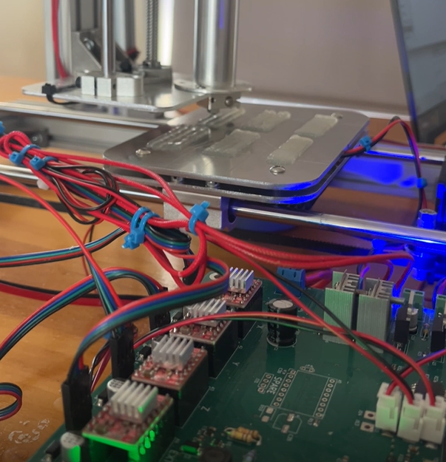
Experimental Design
4.5 % w/v agar gel used as a GelMA substitute
6 stages: nozzle height; print speed; circles, line spacing; layer stacking; repeatability
1) MATLAB task generation, 2) Printing, 3) Photograph, 4) GIMP analysis

Slide 7
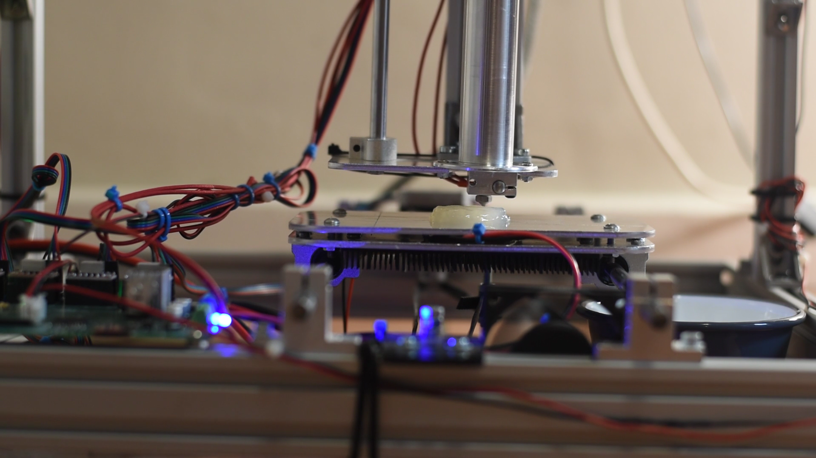
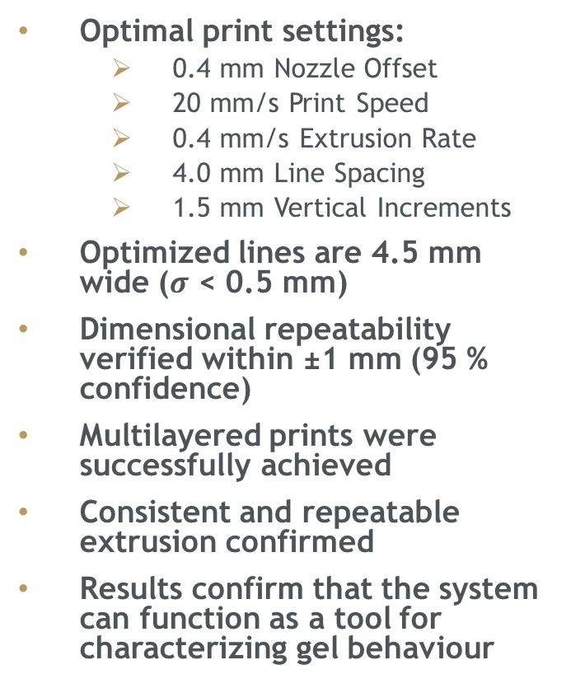
Results
Optimal print settings:
0.4 mm Nozzle Offset
20 mm/s Print Speed
0.4 mm/s Extrusion Rate
4.0 mm Line Spacing
1.5 mm Vertical Increments
Optimized lines are 4.5 mm wide ($σ$ < 0.5 mm)
Dimensional repeatability verified within ±1 mm (95 % confidence)
Multilayered prints were successfully achieved
Consistent and repeatable extrusion confirmed
Results confirm that the system can function as a tool for characterizing gel behaviour

Slide 8
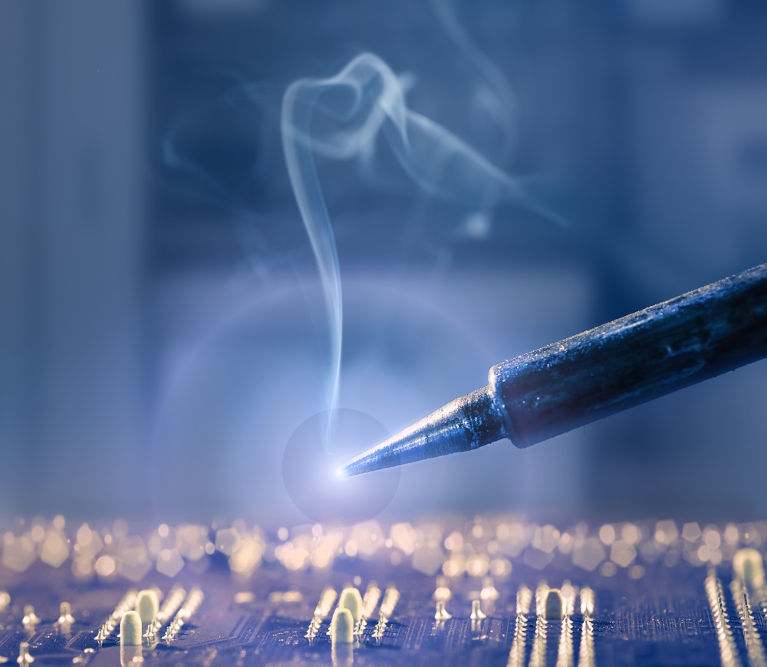
Safety
Work was conducted safely outside of a laboratory
Current-limited stepper drivers and reverse-polarity protection were implemented to prevent electrical faults.
Hot surfaces were only handled after cooling.
Pinch points were avoided during system operation.
Soldering was performed in a ventilated workspace.

Slide 9
Future Work
Potential for Future Work and Upgrades
Implement closed-loop regulation of extrusion pressure and nozzle temperature.
Replace the current representative LED with a UV curing light for real gelation control.
Begin direct printing trials using bioinks such as GelMA.
Add a second extruder with active cooling for handling Matrigel (dual extrusion).

Slide 10
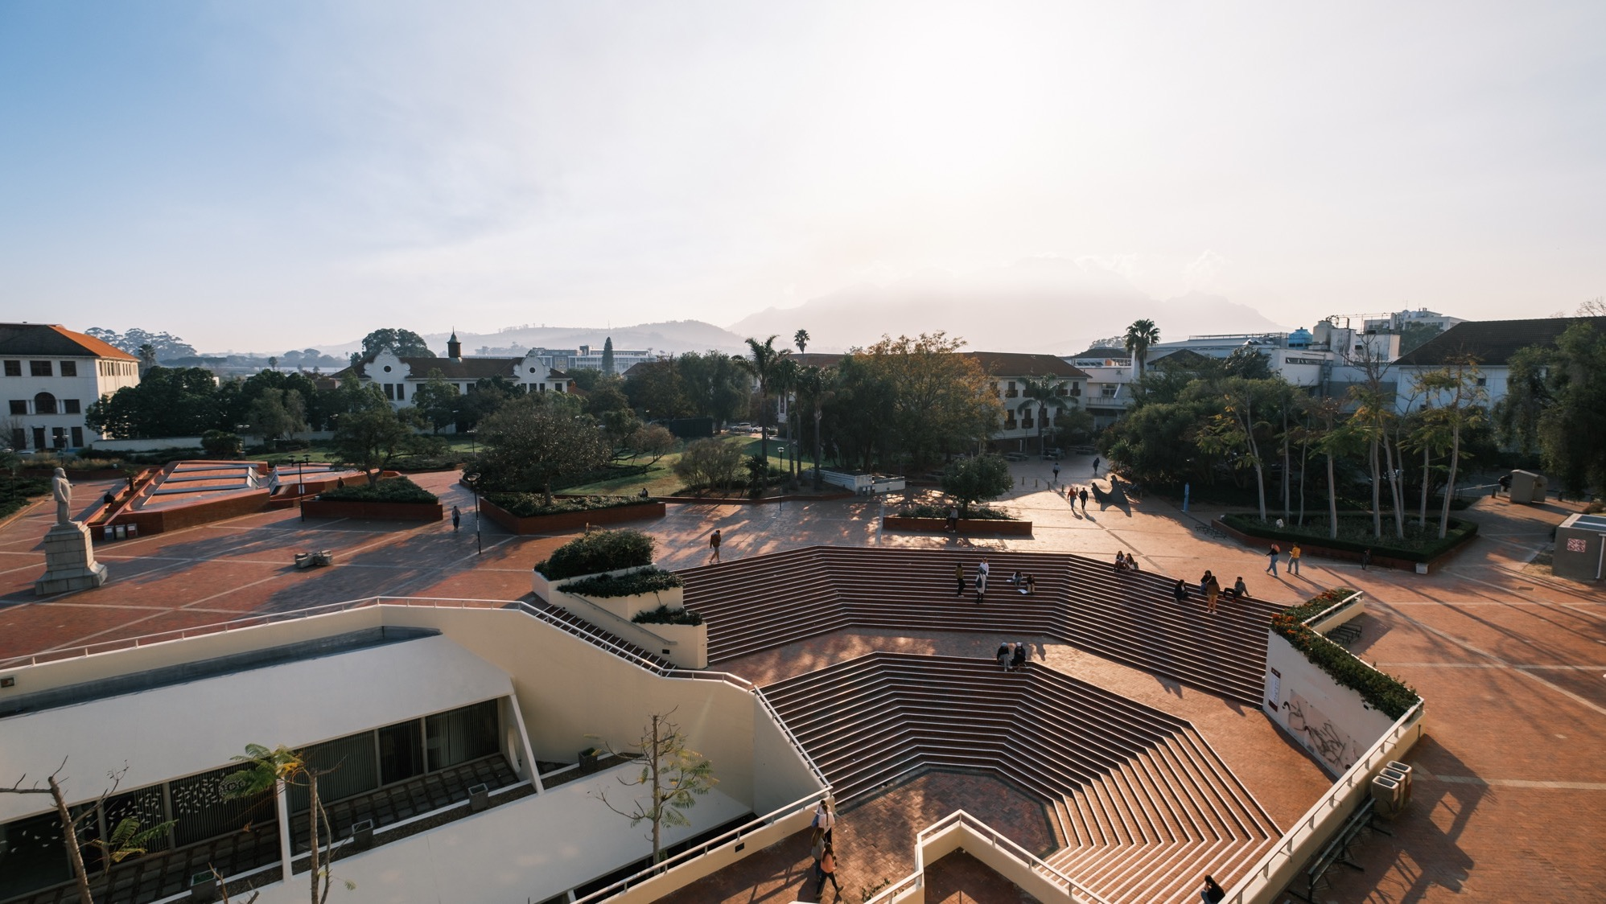

Thank you Enkosi Dankie
Photo by Stefan Els
Notes:
Cover/End slide layout
To change the picture:
Select the picture by clicking on it near the bottom of the slide (under the title placeholder), then click on the Picture Format tab.
Click on the Change Picture icon and choose the From a File/This Device… option.
Browse and select a picture and click on the Insert button.
Use the Crop command to adjust the image.
Click on the Crop command again to apply the changes.
Remember to add image attributions to photographs or artworks.

Slide 11
Is Agar a good substitute for GelMA?
Pros
Agar powder is cheap
Both are shear-thinning
Both are thermoresponsive
Cons
Agar is not photo-curable
Agar solidifies slowly (as layer count increases, so does the likelihood of collapsing)
Photo by CELLINK

Slide 12
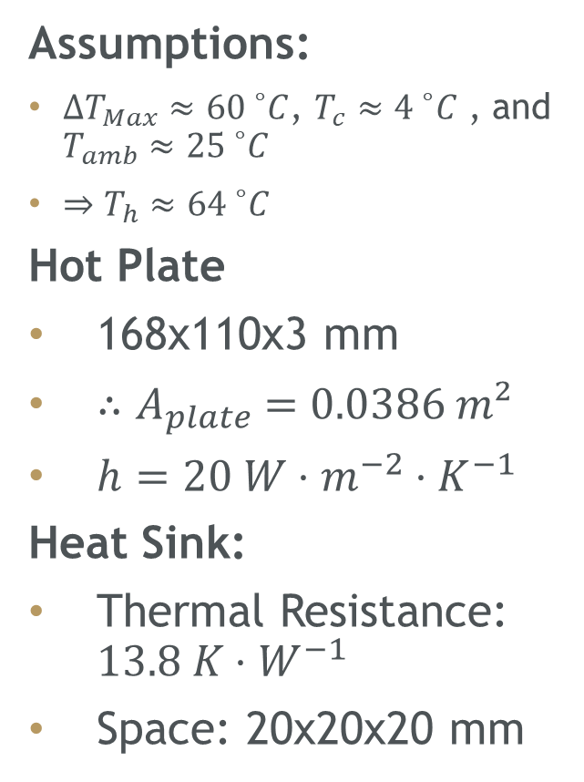
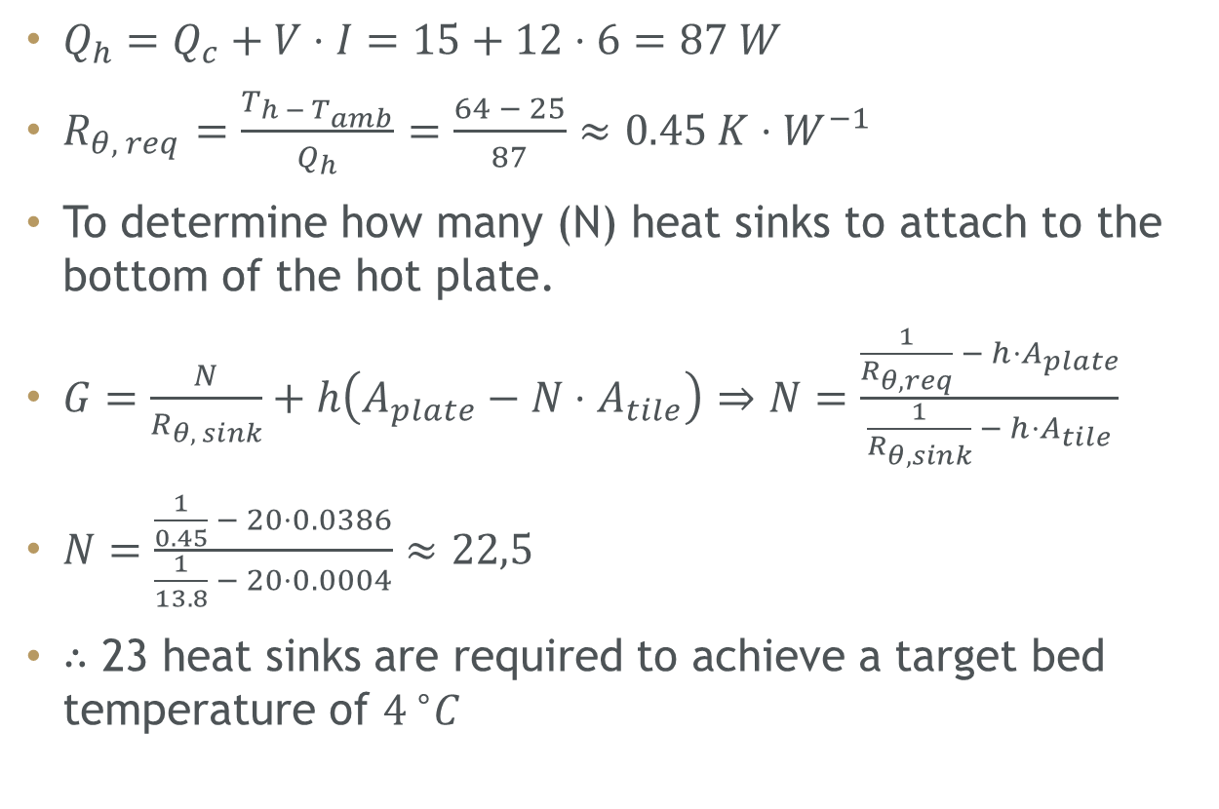
How was the Peltier heatsink designed?
Assumptions:
${ΔT}_{Max}≈{60 }^{∘}C$, $T_{c}≈{4 }^{∘}C$ , and $T_{amb}≈{25 }^{∘}C$
$⇒T_{h}≈{64 }^{∘}C$
Hot Plate
168x110x3 mm
${∴A}_{plate} =0.0386 m²$
$h=20 W⋅m^{−2}⋅K^{−1}$
Heat Sink:
Thermal Resistance: $13.8 K⋅W^{−1}$
Space: 20x20x20 mm
$Q_{h}=Q_{c}​+V⋅I=15+12⋅6=87 W$
$R_{θ, req}=\frac{T_{h − T_{amb}}}{Q_{h}}$ $=\frac{64 − 25}{87}≈0.45 K⋅W^{−1}$
To determine how many (N) heat sinks to attach to the bottom of the hot plate.
$G=\frac{N}{R_{θ, sink}}+h\left(A_{plate}−N⋅A_{tile}\right)$ $⇒N=\frac{\frac{1}{R_{θ,req}} − h⋅A_{plate}}{\frac{1}{R_{θ,sink}} − h⋅A_{tile}}$
$N=\frac{\frac{1}{0.45} − 20⋅0.0386}{\frac{1}{13.8} − 20⋅0.0004}≈22,5$
$∴$ 23 heat sinks are required to achieve a target bed temperature of ${4 }^{∘}C$

Slide 13
Causes for the unimplemented feedback loops
Large Scope
Mechanical Design
Embedded System Design
Experimental Procedure
Large design range in capabilities (extrusion, positioning, sd card, usb communication, etc.)
Project delays. Damage to the PCB during testing occurred 2-3 weeks before the project deadline. A new board need to be soldered.
The system was enabled to receive measurements with the breakout version of the chips.
Damage to the bare chips, during soldering, prevented them from being integrated with the existing PCB.

Slide 14
More upgrade possibilities
Experimental
Test setup with lab-grade bioink (GelMA, PEGDA, etc.)
Extend procedure to calibrate with a faster solidify gel to test more complex print structures such as overhangs
Test with smaller nozzle diameters
Implement tangential acceleration as an additional parameter to be calibrated
Hardware
Add User-interface
Implement UV curing
Design for additional sterilizability (UV-C lamp)
Temperature controlled enclosure
Dual extrusion (one for cell-seeded Matrigel and one for structural scaffolding)
Photo by CELLINK

