Slide 1
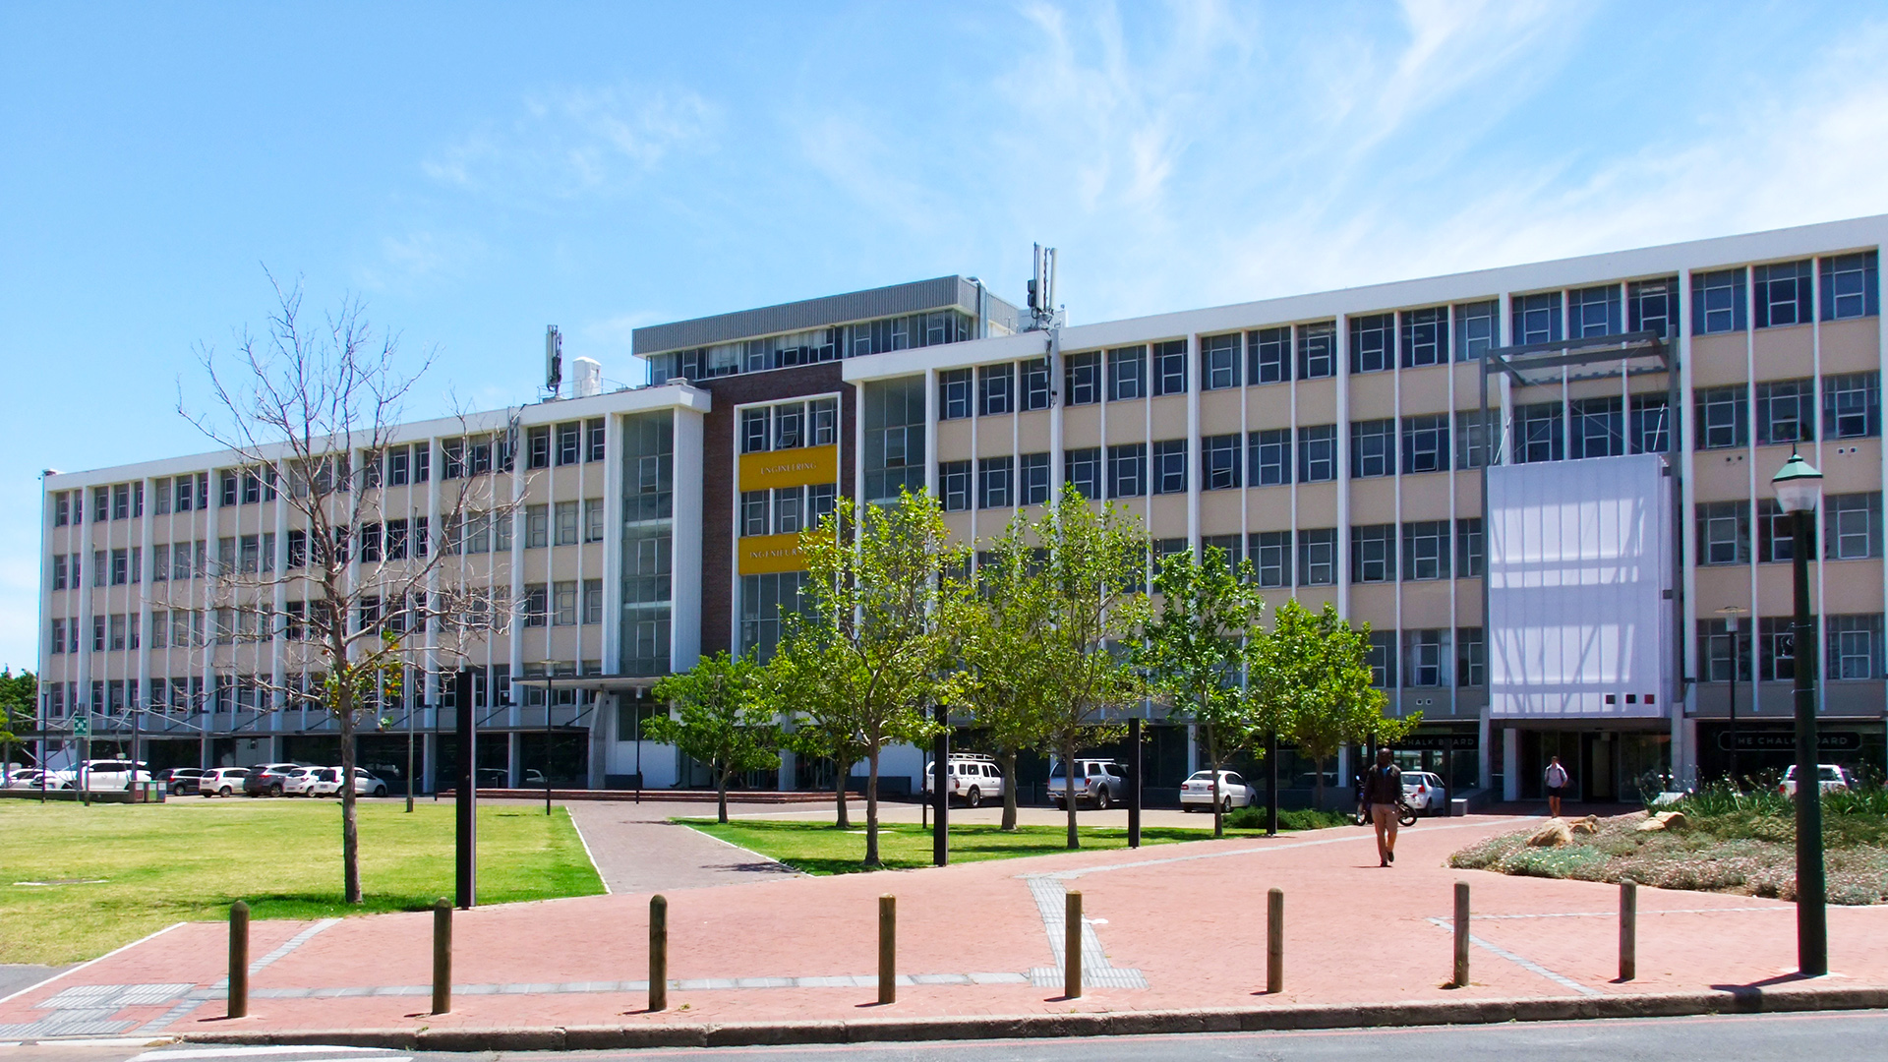
Development of a Hydrogel Extruder By Simon Craig Daniel
Photo by Stefan Els
Notes:
Picture placeholder slide layout
To change the picture:
Select the picture by clicking on it near the bottom of the slide (under the title placeholder), then click on the Picture Format tab.
Click on the Change Picture icon and choose the From a File/This Device… option.
Browse and select a picture and click on the Insert button.
Use the Crop command to adjust the image.
Click on the Crop command again to apply the changes.
Remember to add image attributions to photographs or artworks.

Slide 2
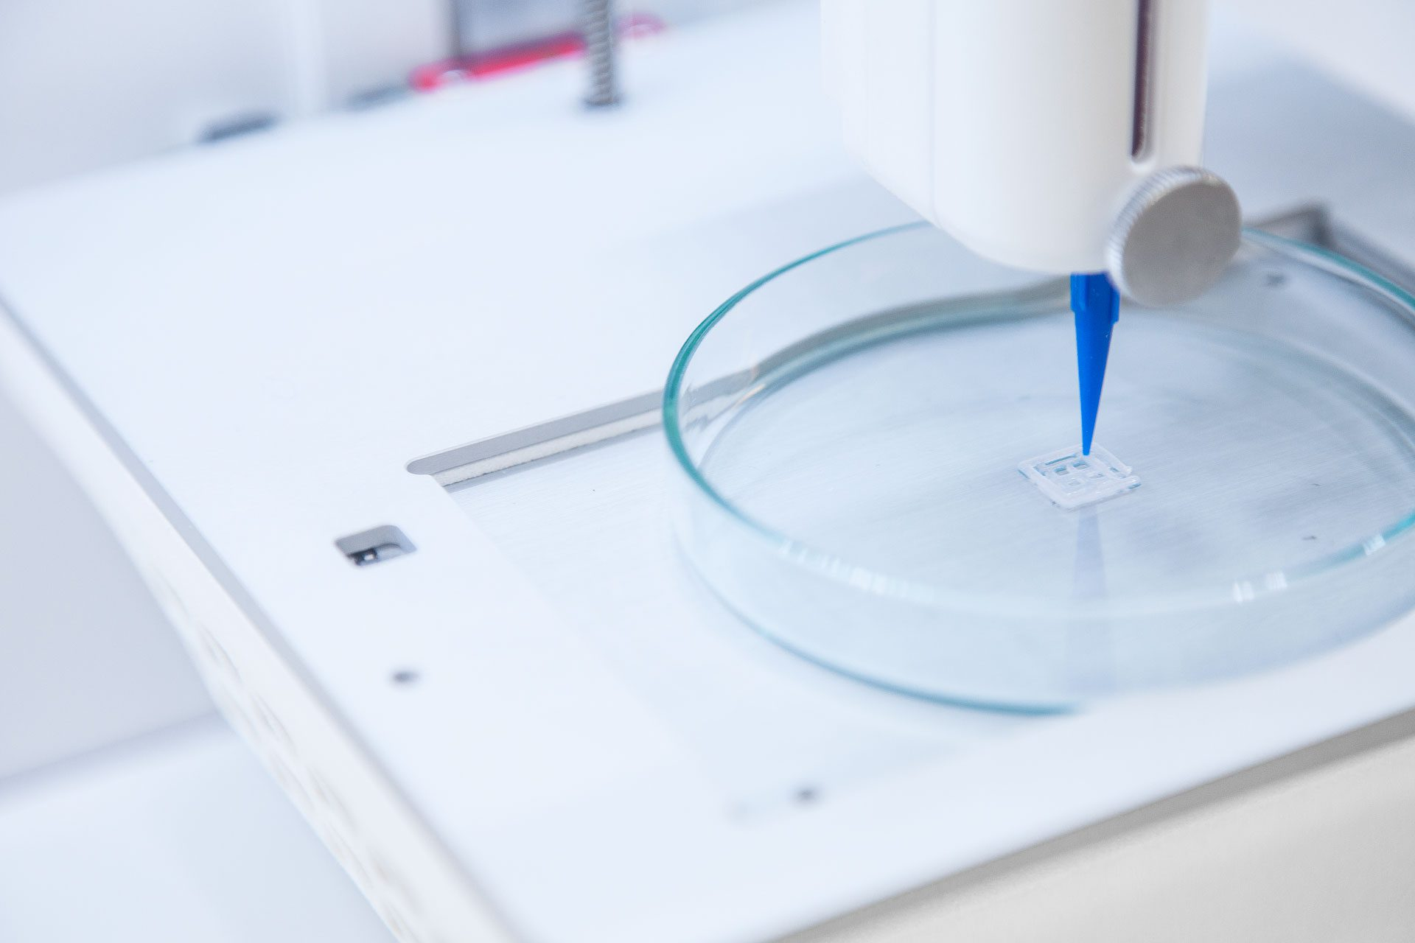
Background to Bioprinting
Applications
Fabricating tissue scaffolds for regenerative medicine
Creating 3D environments to study cell growth and disease progression in biomedical research
Serves as a calibration tool for characterizing bioinks
Challenge
To design a hydrogel printing system (primarily for GelMA):
That can print hydrogel scaffolds,
With controllable printing parameters
Photo by CELLINK

Slide 3
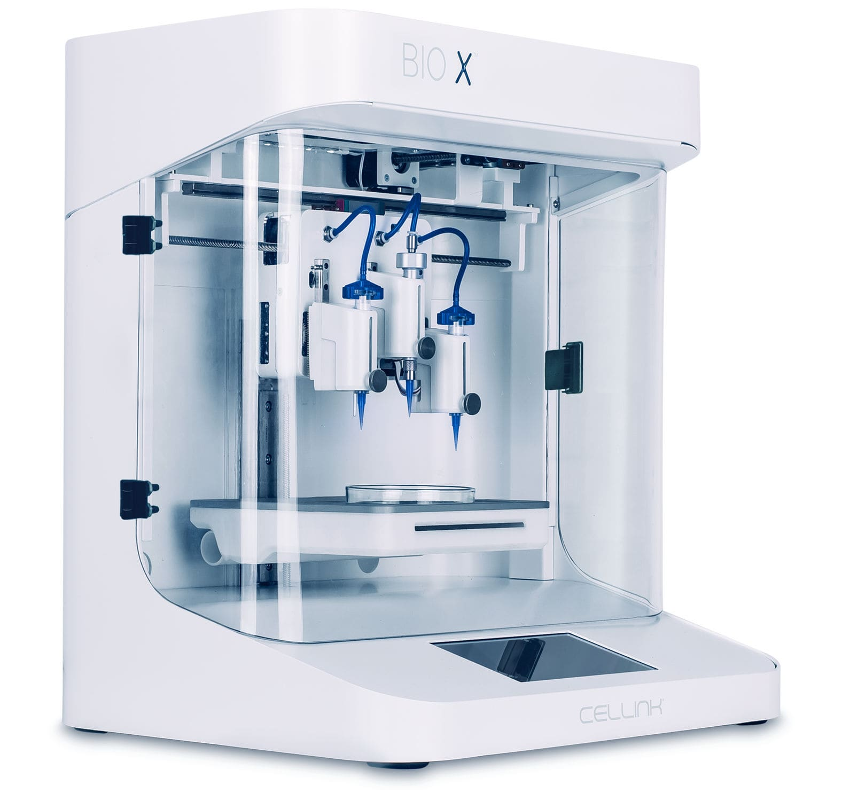
Objectives and Motivation
Objectives
Design and construct a gel extruder
Integrate the extruder into a standard 3D printer body
Develop and implement a calibration procedure to determine optimal print settings
Motivation
Commercial bioprinters are expensive and inaccessible
These printers make use of proprietary gels
The designed printer allows for the calibration of non-proprietary gels
Photo by CELLINK

Slide 4
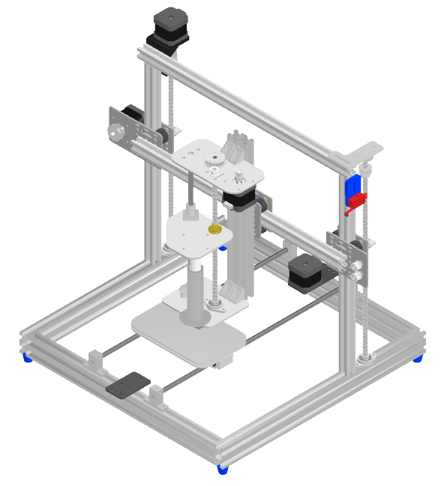
Designed System
Syringe-Based Extruder
Nozzle Heating
Ender-style 3D printer body
Bed cooling
SD card to input print tasks

Slide 5
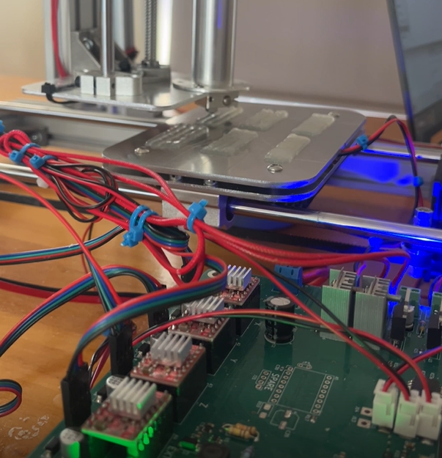
Printer Usage Design
Initially calibrated with agar gel used as a GelMA substitute
6 stages: nozzle height; print speed; circles, line spacing; layer stacking; repeatability
1) MATLAB task generation, 2) Printing, 3) Photograph, 4) GIMP analysis
Print tasks: https://github.com/SimonDaniel605/Hydrogel-3D-Printer/tree/main/Experiments

Slide 6
Future Work
Potential for Future Work and Upgrades
Implement closed-loop regulation of extrusion pressure.
Replace the current representative LED with a UV curing light for real gelation control.
Add a second extruder with active cooling for handling Matrigel (dual extrusion).

Slide 7
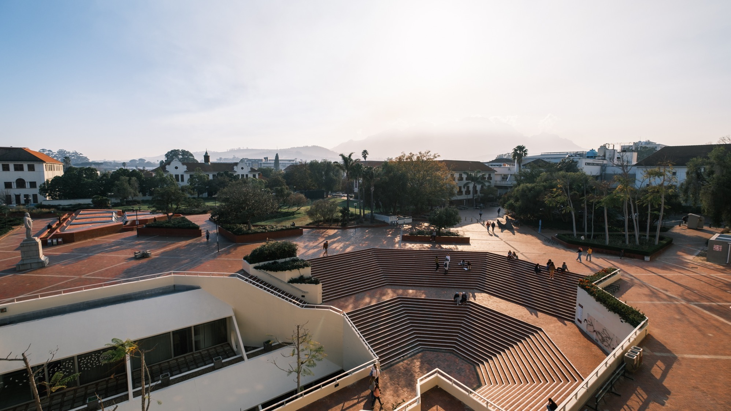
Thank you Enkosi Dankie
Photo by Stefan Els
Notes:
Cover/End slide layout
To change the picture:
Select the picture by clicking on it near the bottom of the slide (under the title placeholder), then click on the Picture Format tab.
Click on the Change Picture icon and choose the From a File/This Device… option.
Browse and select a picture and click on the Insert button.
Use the Crop command to adjust the image.
Click on the Crop command again to apply the changes.
Remember to add image attributions to photographs or artworks.

