Slide 1
ACOUSTIC MODEM
ENSTA Bretagne – UFRGS Internship
Simon STEPHAN

Slide 2


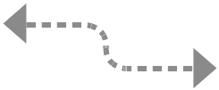
Objectives
Create an acoustic channel of transmission
Using FSK modulation
Transmit ASCII characters
UFRGS - Acoustic Modem
14/08/2014

Slide 3
Message structure
Implement a communication protocol
 | Comment | Size
HEADER | Control data | 8 bits
 | ID.source | 4 bits
 | ID.destination | 4 bits
 | Data size (Bytes) | 4 bits
DATA | N * ASCII | N * 8 bits
END |  | x bits
14/08/2014
UFRGS - Acoustic Modem

Slide 4
Error detection & correction
Add redundancy to protect information
  Channel code (3,1)
      Each bit is repeated 3 times
  Hamming code (7,4)
      Linear error-correcting code
      Correct 1 bit error
  Reed-Solomon code (208,192)
      Non-binary cyclic error-correcting codes
      Correct 2 bytes error
UFRGS - Acoustic Modem
14/08/2014

Slide 5
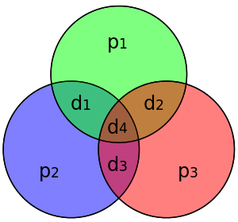
Hamming Code
  D = [ d1, d2, d3, d4 ]
Encode
  C = [p1, p2, d1, p3, d2, d3, d4]
p1 = d1 + d2 + d4
p2 = d1 + d3 + d4
p3 = d2 + d3 + d4
Decode
V1 = p1 + d1 + d2 + d4
V2 = p2 + d1 + d3 + d4
V3 = p3 + d2 + d3 + d4
Error on bit V3.V2.V1
Exemple
    D = [ 1, 0, 1, 0 ]
    C = [ 1, 0, 1, 1, 0, 0, 0 ]
  V1 = 1+1+0+0 = 0
  V2 = 0+1+0+0 = 1
  V3 = 1+0+0+0 = 1
  Error on bit 110 = 6
UFRGS - Acoustic Modem
14/08/2014

Slide 6
Message structure
Update the communication protocol
 | Comment | Size
HEADER | Control data | 8 bits
 | ID.source | 7 bits
 | ID.destination | 7 bits
 | Data size (Bytes) | 7 bits
DATA | N * ASCII | N * 14 bits
END |  | x bits
14/08/2014
UFRGS - Acoustic Modem

Slide 7
Frequency-shift keying
Modulation
Demodulation

Slide 8
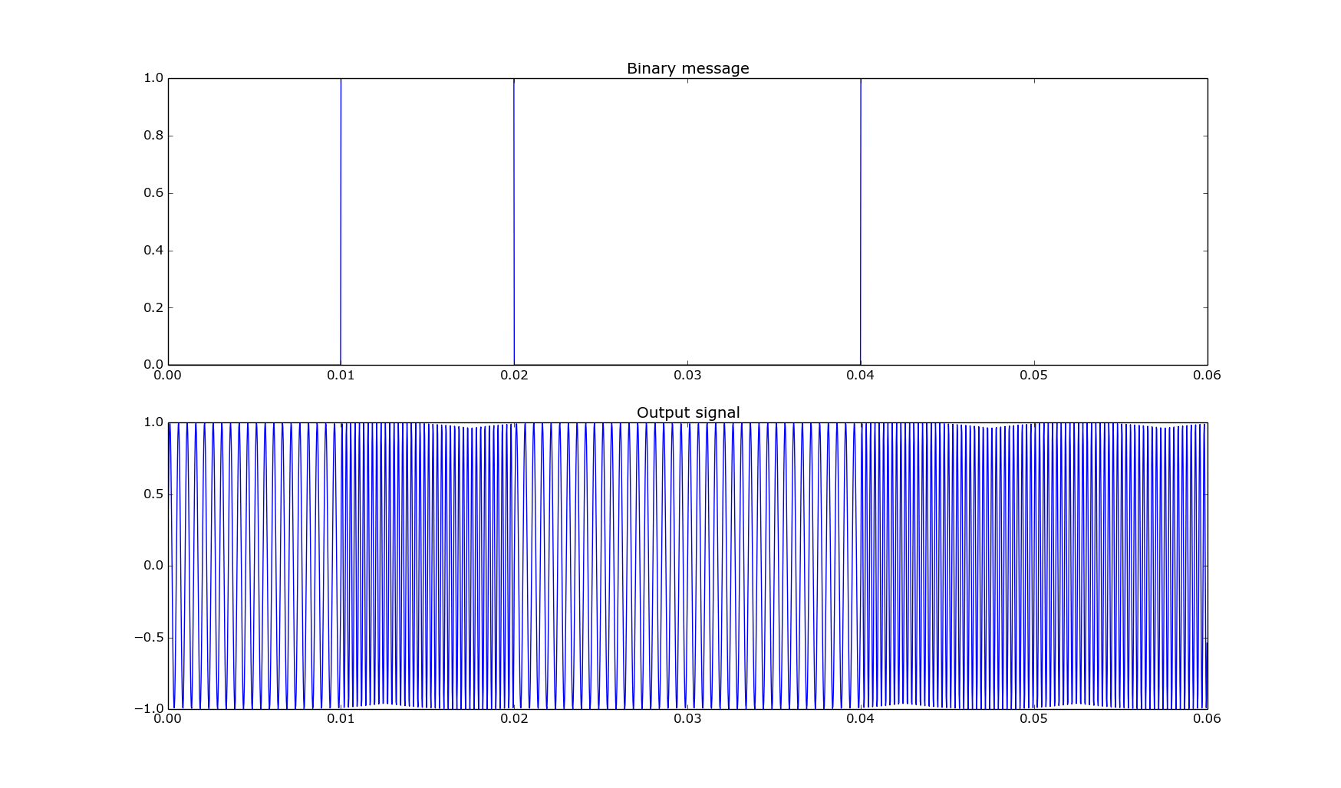
Modulation
FSK 2
    0 → 10 ms / 2 kHz 1 → 10 ms / 4 kHz
0
1
0
0
1
1
UFRGS - Acoustic Modem
14/08/2014

Slide 9
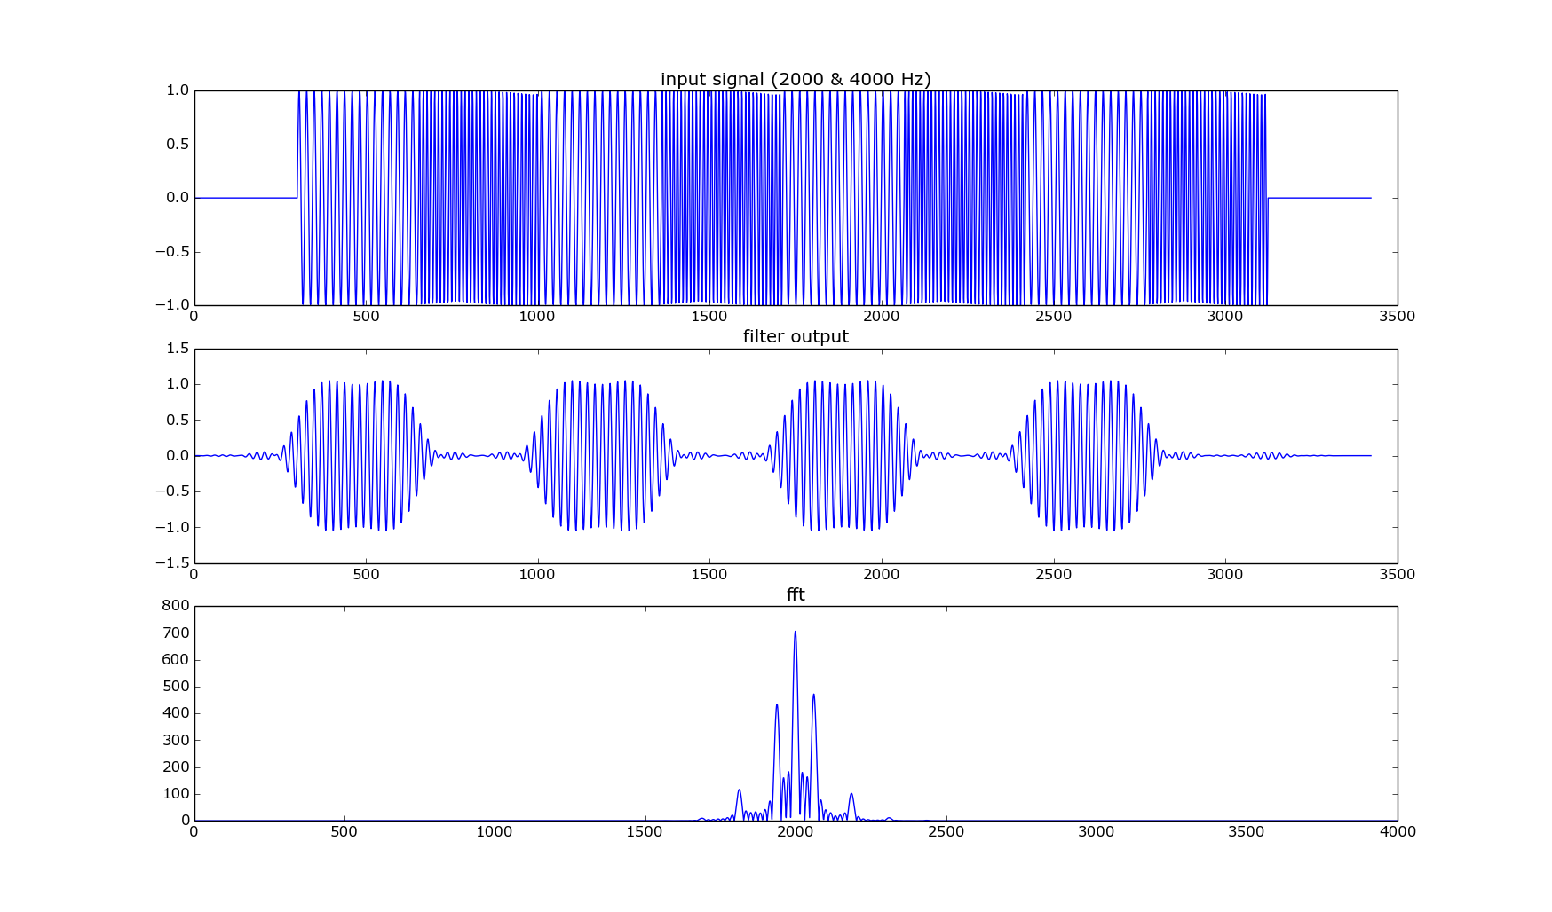
Demodulation
UFRGS - Acoustic Modem
14/08/2014

Slide 10
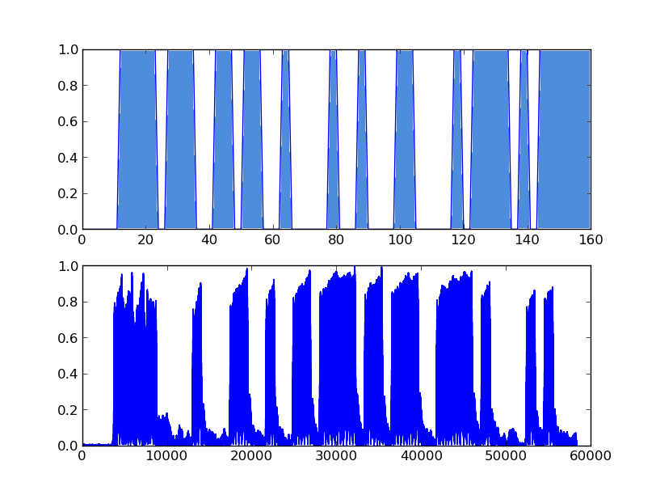
Message received
UFRGS - Acoustic Modem
14/08/2014

Slide 11
Frequency-shift keying
 | FSK 2 | FSK 4
Frequencies (kHz) | 2, 4 | 2, 4, 6, 8
Rate (bits/s) | 100 1 b = 10 ms | 200
Hamming | (7,4) | (7,4)
Rate (bits/s) | 57 | 114
Bip (kHz) | 8 | 10
UFRGS - Acoustic Modem
14/08/2014

Slide 12
Real time communication
Sound card problem
    ALSA lib pcm.c:7843:(snd_pcm_recover) underrun occurred
Real time : loss of data
Delayed time : high quality recording / processing time
Need a bip to switch recording mode
UFRGS - Acoustic Modem
14/08/2014

Slide 13
Conclusion
Improve the flow rate
    FSK 8, PSK, <10 ms...
Improve real time processing
    Code optimization, ALSA...

Slide 14
Chirp integration
Combining communication and positioning
  Sending a special message that call the 'chirp function'
UFRGS - Acoustic Modem
14/08/2014

