Slide 1
Mars Habitat Power Consumption Constraints, Prioritization, and Optimization
Ansley Barnard, Esteco North America Inc.,
Simon Engler and Prof. Kim Binsted, University of Hawaii
Contact me: simon.engler@hawaii.edu

Slide 2
Hawaii Space Exploration Analog and Simulation
NASA funded long term isolation experiment focusing on crew cohesion and crew selection
Five missions lasting 4-mon, 4-mon, 8-mon,1-yr,8-mon
PRIMARY RESEARCH
Team Processes and Team Effectiveness
Self-Guided Stress Management and Resilience Training
MENTALBLOCK
Effectiveness of a Shared Social Behavioral Task as a Team-Building Exercise in Isolated, Confined, and Extreme Environments
Crew Communication in Debriefs
Autonomous Behavioral Countermeasures for Spaceflight
Numerous opportunistic research projects

Slide 3
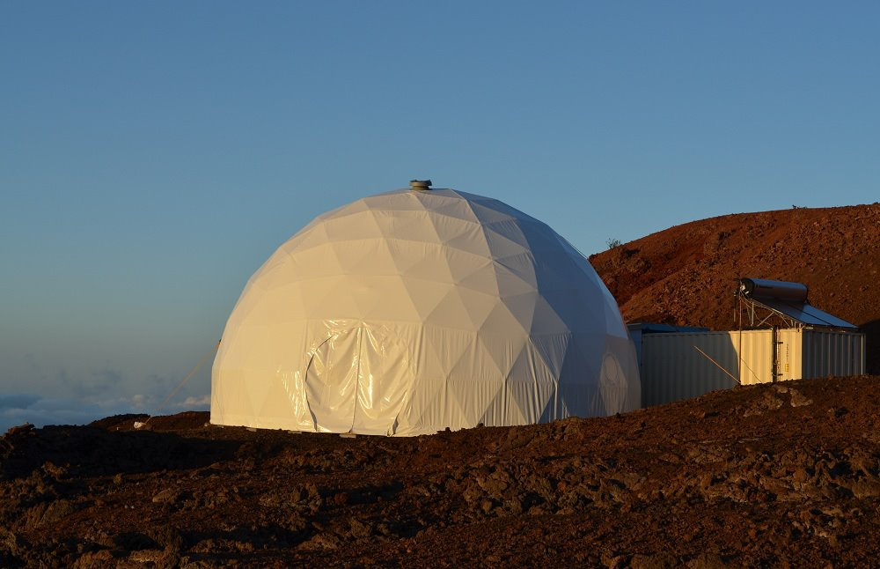
HI-SEAS HABITAT
32-foot Diameter Dome
6 Bedrooms
Upstairs/Downstairs Bathroom
Lab
Airlock/Sea container
Living area
Dining Room
Kitchen
Washing Area

Slide 4
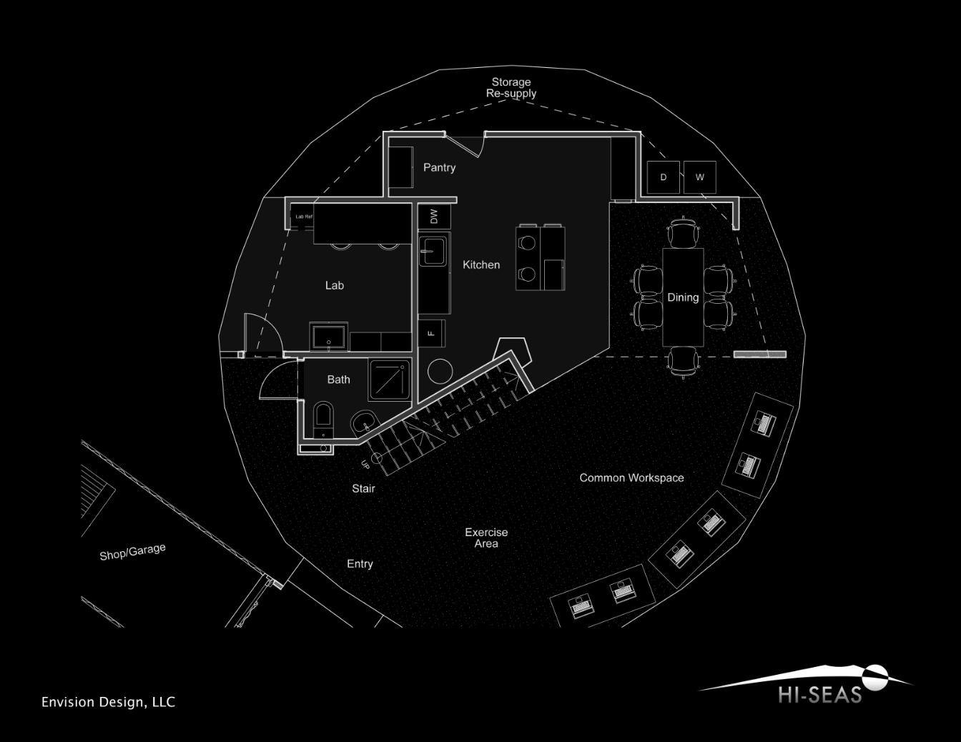
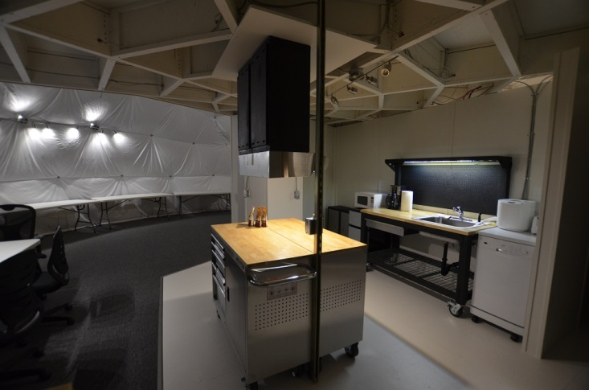
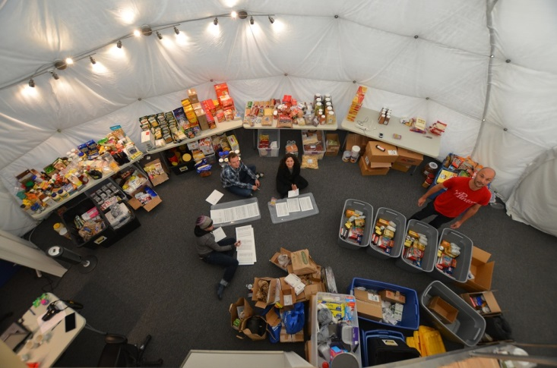
MAIN FLOOR HABITAT

Slide 5
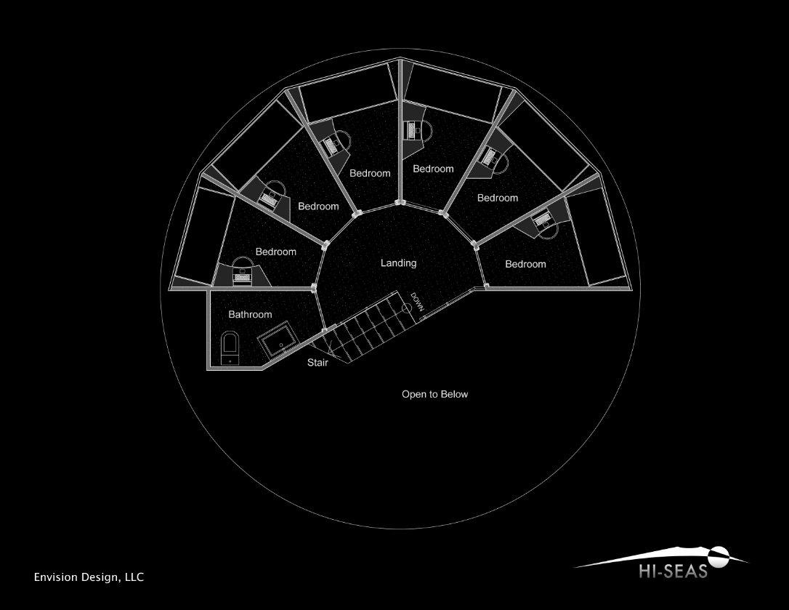
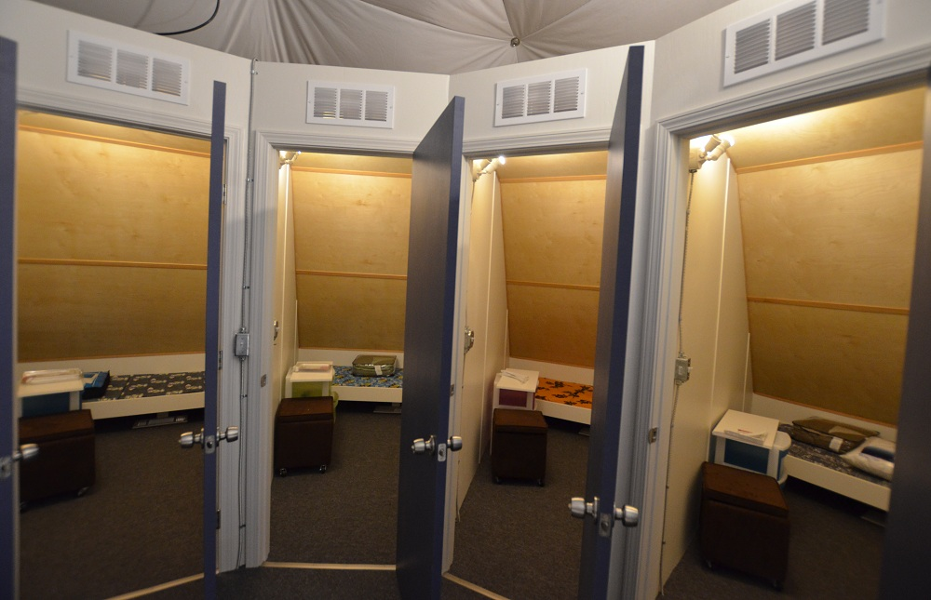
SECOND FLOOR HABITAT

Slide 6
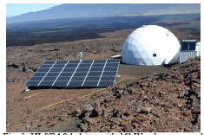
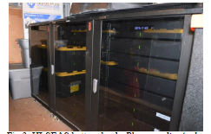
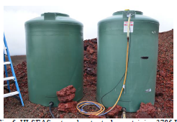
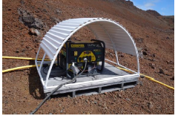
HI-SEAS POWER SYSTEMS

Slide 7
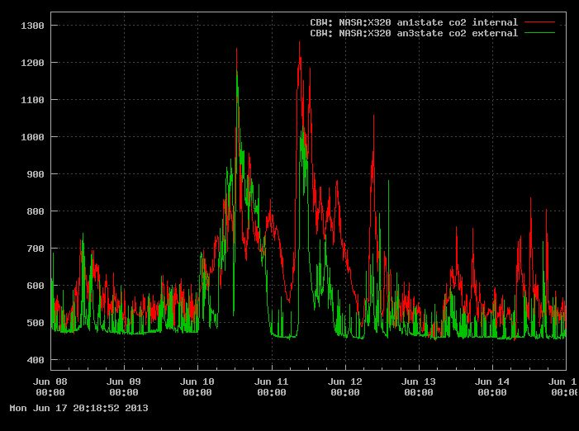
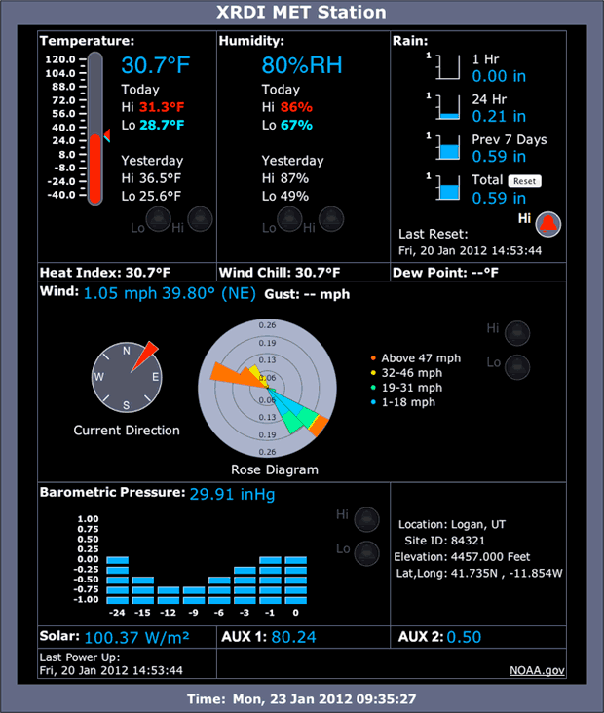
Sensor System
Water level sensor
CO2 /Humidity Sensors
3x Temperature Sensors
Power consumption Sensors
X320M Controllers updating data under 5 minute intervals
Weather Station
Wind Direction
Humidity
Solar Radiation
Rain Water
7

Slide 8
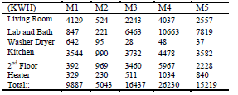
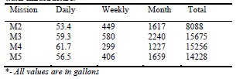
MISSION POWER AND WATER CONSUMPTION
POWER
WATER

Slide 9
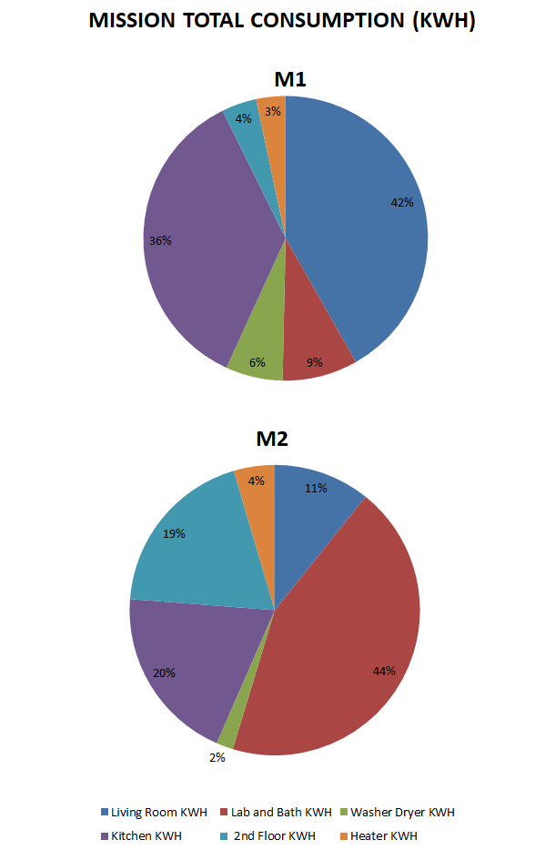
M1 AND M2 POWER USAGE DISTRIBUTION

Slide 10
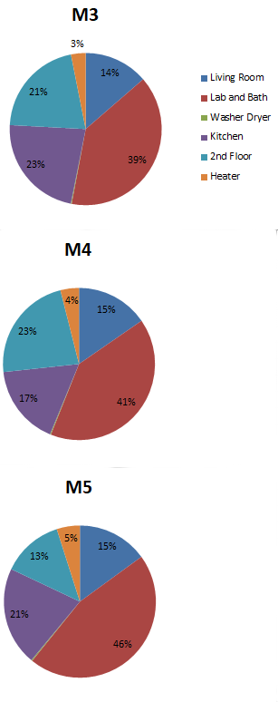
M3, M4, M5 POWER USEAGE DISTRIBUTION
TAKE NOTE OF THE NEAR EQUAL DISTRIBUTION OF POWER USAGE ACROSS THREE MISSIONS
REPEATED AND COMPARABLE ENERGY DATA
PLEASE CONTACT US FOR DATA TO USE IN YOUR RESEACH

Slide 11
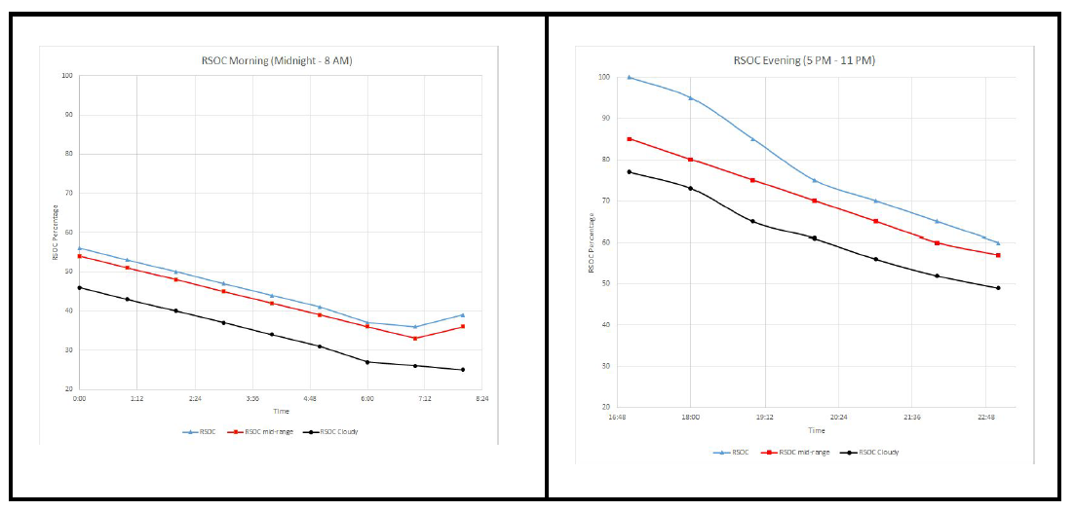
Residual State of Charge (RSOC)

Slide 12
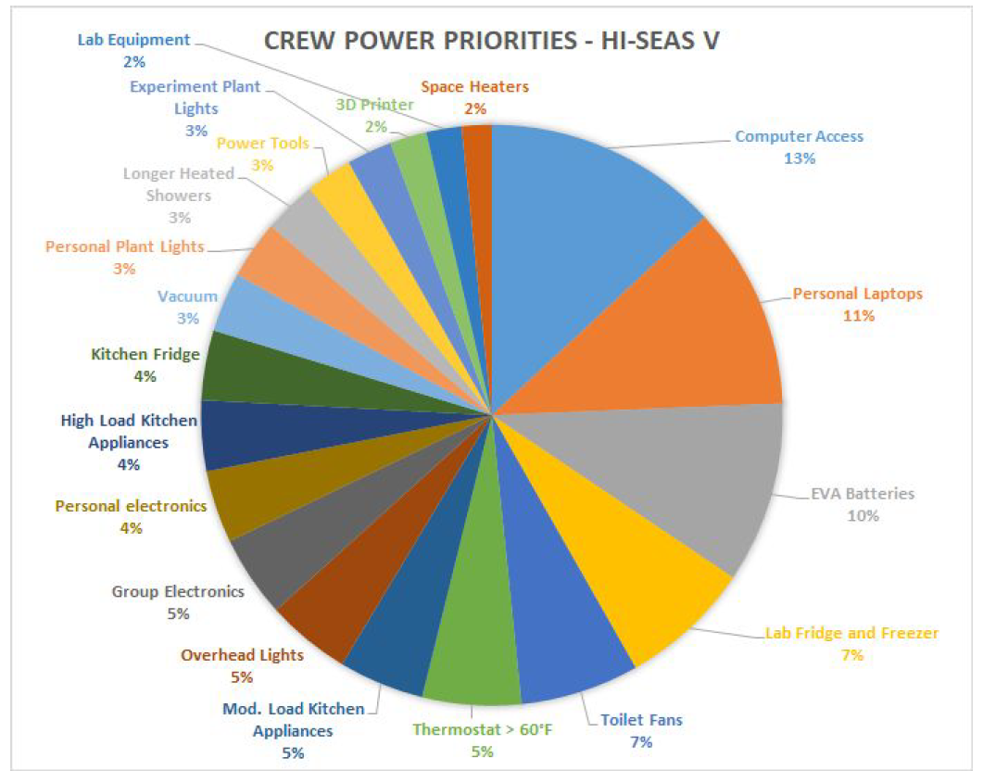
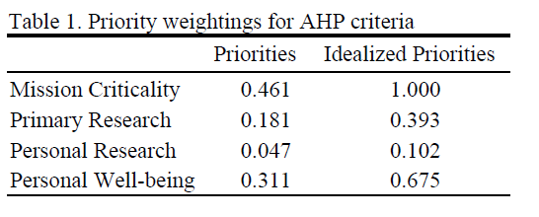
Analytical Hierarchy Process (AHP)

Slide 13
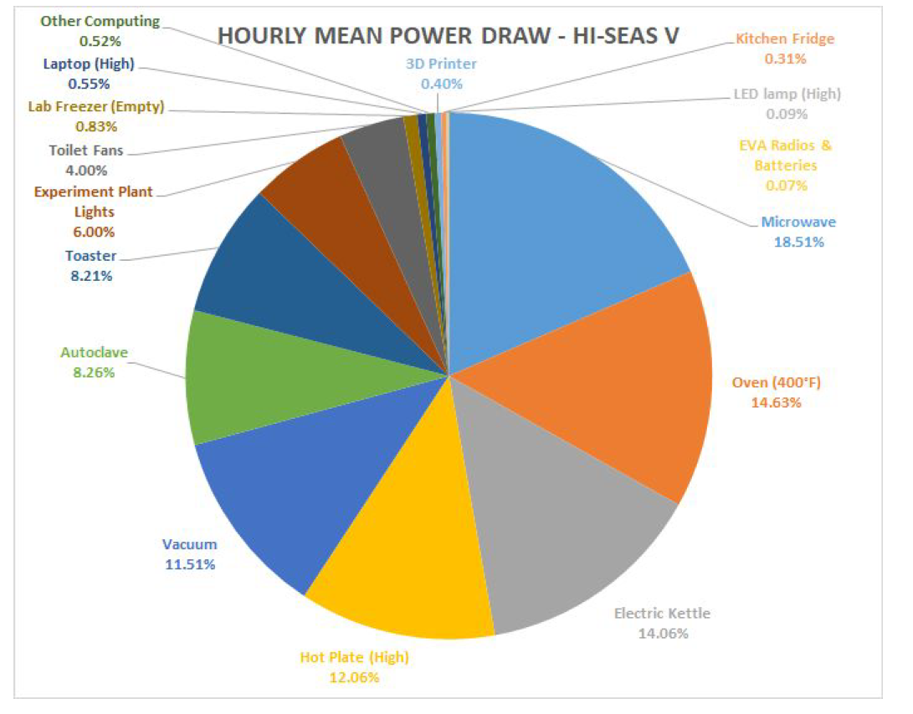
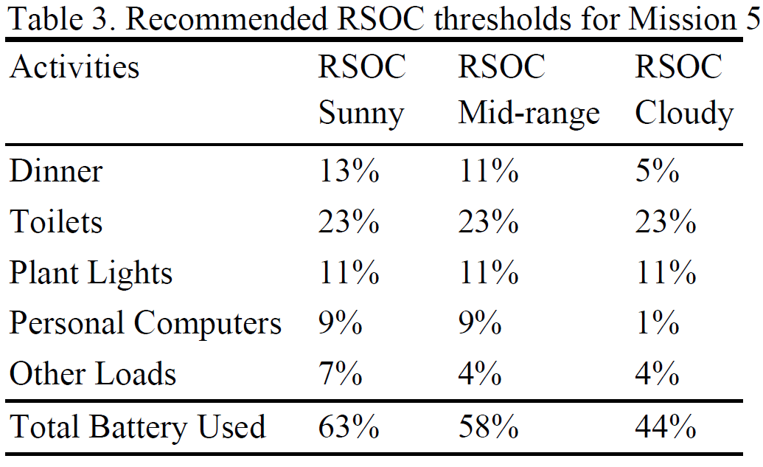
Multi-Criteria Decision Making (MCDM)

Slide 14
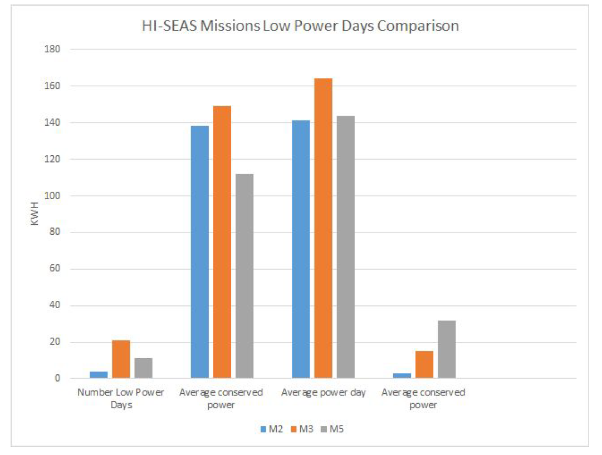
LOW POWER PRODUCTION COMPARISON

Slide 15
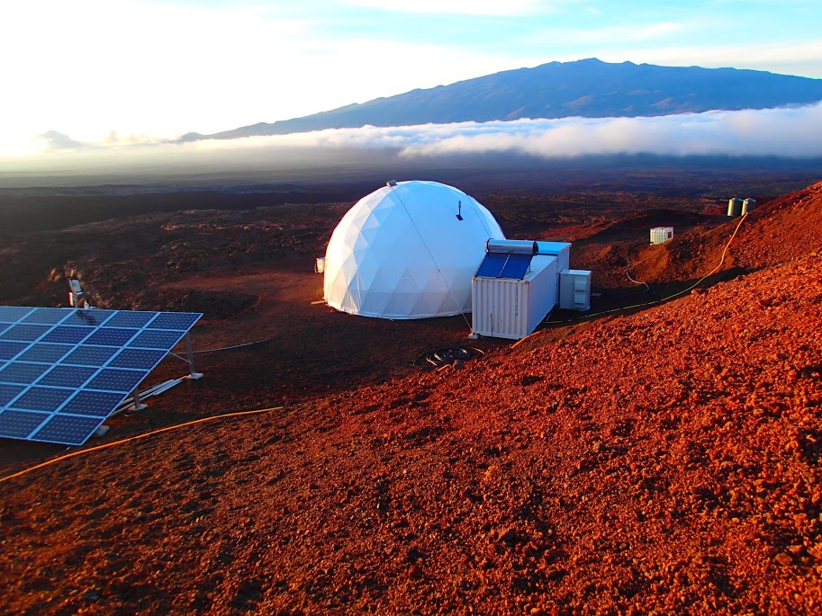
CONCLUSIONS

