Slide 1
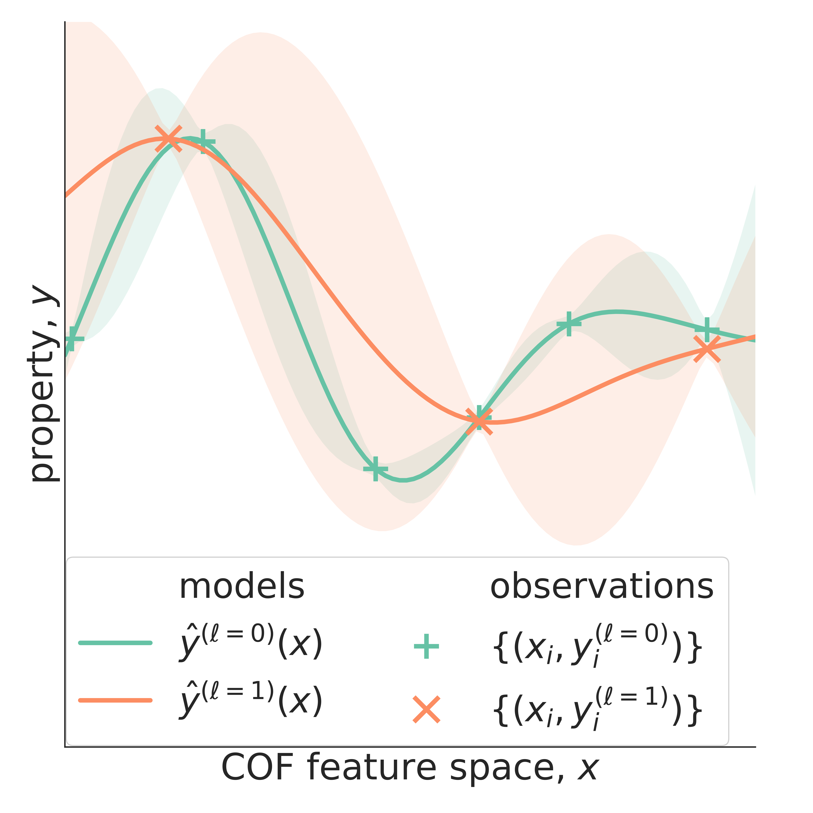
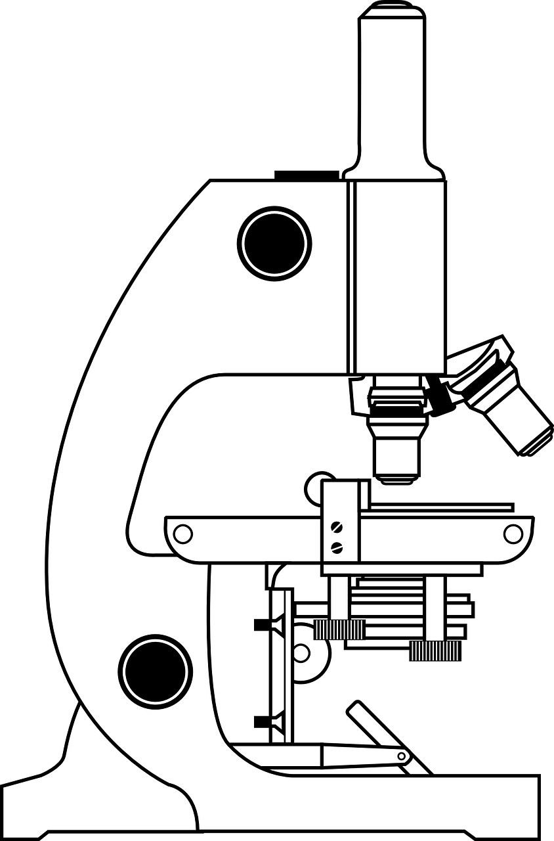
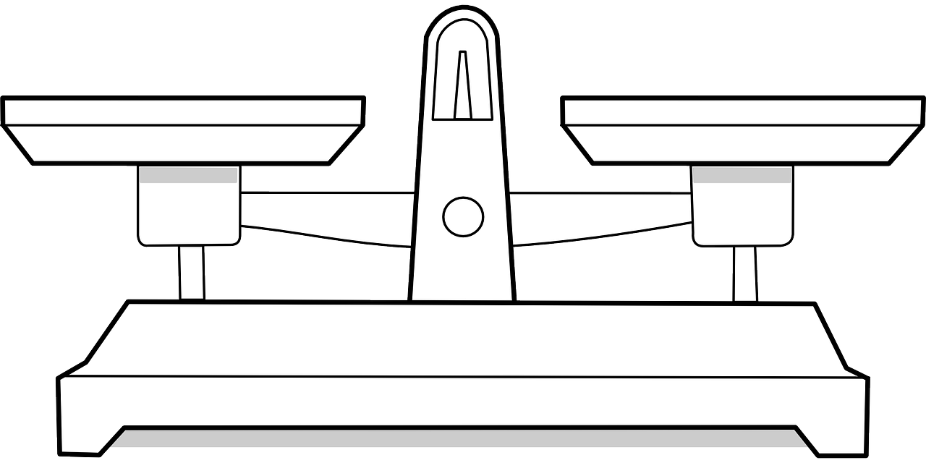







new data
surrogate model
$$\left(x_{n}, f^{\left(ℓ_{n}\right)}\left(x_{n}\right)\right)$$
$${\left\{{\hat{y}}^{(ℓ)}(x)\right\}}_{ℓε\left\{0,1\right\}}$$
experiment
update model
acquisition
high-fidelity: $ℓ_{n}=1$
$$\left(x_{n+1},ℓ_{n+1}\right)=\underset{xεX, ℓε\left\{0,1\right\}}{argmax}{A\left({x,ℓ ;\hat{y}}^{(ℓ)}\left(x\right)\right)}$$
$$
low-fidelity: $ℓ_{n}=0$
$
exploration
exploitation
$$\left(x_{n+1},ℓ_{n+1}\right)$$
new experimental design

