Slide 1

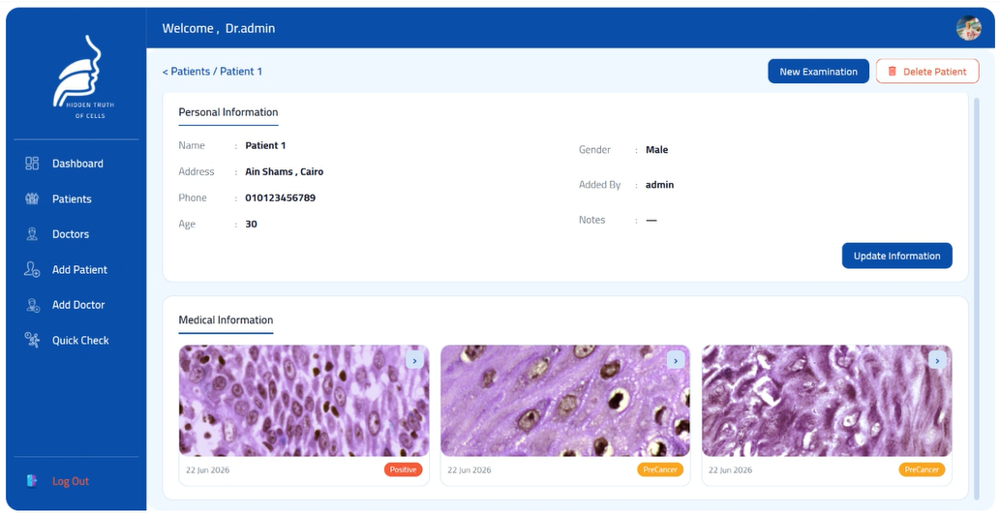

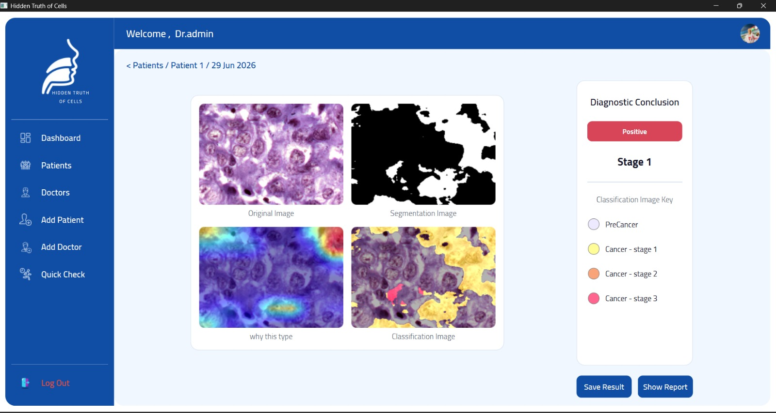
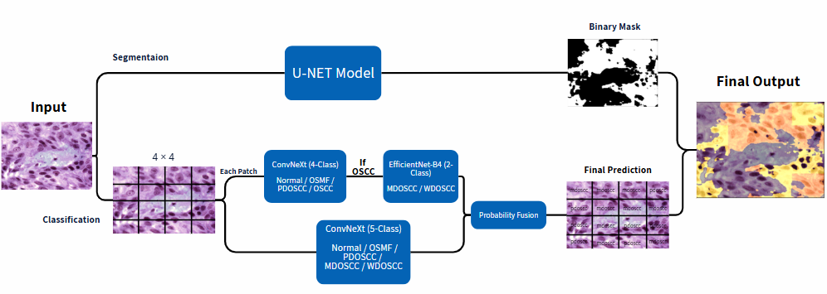
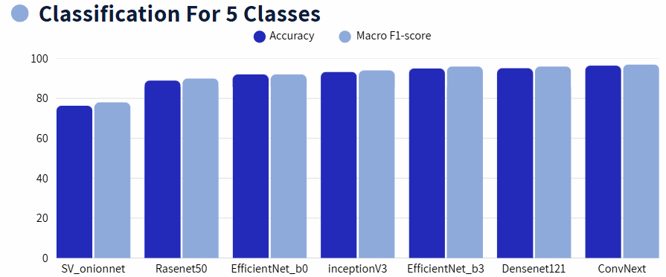
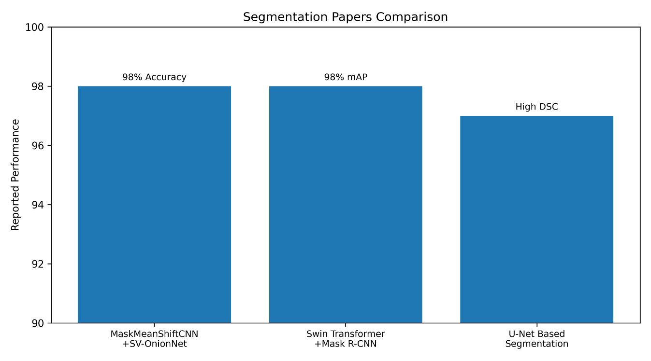
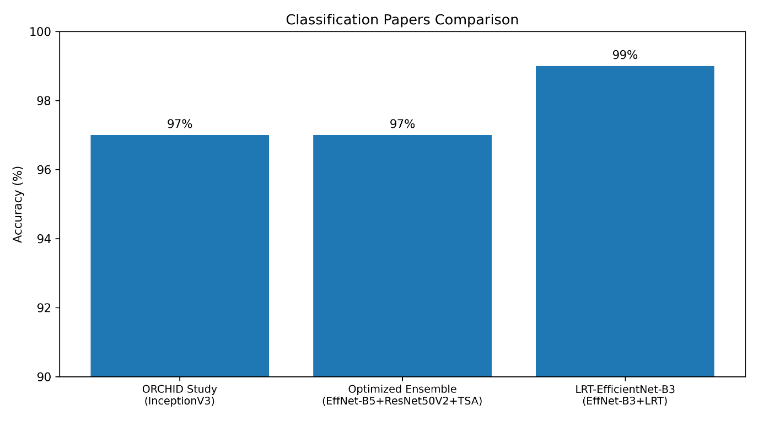
Hidden Truth of Cells
Microscopic Detection of Oral Cancer
By: Mariem Naeem, Simon Hanna, Amira Tharwat, Mina Makram, Mina Ashraf, Momen Tarek
Supervised by: Dr. Maryam Al-berry, TA. Manar Sultan
Faculty of Computer and Information Sciences - Ain Shams University
Comparison between the Related Studies
Introduction
Results
Oral cancer is one of the most common and life-threatening cancers . Early diagnosis is essential for improving patient survival; however, manual histopathological examination is time-consuming and highly dependent on the expertise of pathologists. [1]
This project presents an AI-based computer-aided diagnostic system for oral cancer analysis using microscopic histopathological images. The proposed framework combines U-Net segmentation for detecting suspicious tissue regions with deep learning classification models to categorize images into five pathological classes: Normal, OSMF, PDOSCC, WDOSCC, and MDOSCC.
By integrating segmentation, classification, and visualization into a user-friendly desktop application, the system aims to improve diagnostic accuracy, reduce subjectivity, and support clinicians in making faster and more reliable decisions.
Methods
Figure 3. Oral Cancer Diagnostic Application Interface
The proposed framework consists of four main stages. Histopathological images from the ORCHID dataset [2] are first processed using a U-Net model to segment the tumor region and remove irrelevant background information. The image is then divided into a 4 × 4 grid (16 patches) to capture fine-grained cellular features. Each patch is classified using ConvNeXt and EfficientNet-B4, and probability fusion is applied to improve the robustness and accuracy of the final prediction. Finally, the patch-level predictions are reconstructed into a color-coded diagnostic map, allowing visualization of lesion locations and classification results. The system classifies oral histopathological images into five categories: Normal, OSMF, WDOSCC, MDOSCC, and PDOSCC.
The proposed framework demonstrated strong performance in both segmentation and classification tasks.
Segmentation
U-Net achieved a Dice Score of 84.8%, outperforming Trans U-Net (78.6%).
Classification
ConvNeXt Tiny (4-Class) achieved 98.6% Accuracy and 98% Macro F1-Score.
EfficientNet-B4 (2-Class) achieved 93% Accuracy for distinguishing MDOSCC and WDOSCC.
The Hierarchical Model (ConvNeXt Tiny + EfficientNet-B4) achieved 96.5% Accuracy and 97% Macro F1-Score.
ConvNeXt Tiny (5-Class) achieved 96.4% Accuracy and 97% Macro F1-Score.
The proposed Probability Fusion Framework achieved the best overall performance with 97.3% Accuracy and 97.4% Macro F1-Score.
Key Finding
Combining hierarchical classification and direct five-class prediction through probability fusion improved robustness and produced the most reliable diagnostic results.
Model | Dice
Trans U-NET | 78.600%
U-NET | 84.800%
Table 1: Results of Segmentation
Table 2: Results of Classifiaction
Conclusions
Figure 1. System Architecture
A deep learning-based framework for automated oral lesion analysis was developed by integrating U-Net segmentation, patch-based analysis, hierarchical classification, and probability fusion. The proposed system accurately identified suspicious tissue regions and classified lesions into five pathological categories: Normal, OSMF, PDOSCC, MDOSCC, and WDOSCC.
Experimental results demonstrated strong performance, achieving a Dice Score of 84.8% for segmentation and 97.3% Accuracy with a 97.4% Macro F1-Score for classification. The proposed framework can support pathologists by improving diagnostic reliability, reducing manual workload, and enabling earlier detection of oral cancer.
References
[1] High-resolution AI image dataset for diagnosing oral submucous fibrosis and squamous cell carcinoma
[2] Optimized deep learning ensemble for accurate oral cancer detection using CNNs and metaheuristic tuning
[3] Enhancing Early Detection of Oral Squamous Cell Carcinoma: A Deep Learning Approach with LRT-Enhanced EfficientNet-B3 for Accurate and Efficient Histopathological Diagnosis
Figure 2. Comparison between the Related Studies
Previous studies achieved high performance using different deep learning architectures; however, most focused on either segmentation or classification independently. Our proposed framework integrates both tasks into a unified pipeline for more reliable oral cancer grading. [3]

