Slide 1
Unlocking Legacy: A Practical use of Session Types and Session Instances
Professor Steve Ross-Talbot
Dr Bippin Makhoond
zdlc.co
zdlc@cognizant.com

Slide 2
Legacy is often encoded corporate knowledge
char rahc [ ] = "\n/”, redivider[ ]="Able was I ere I saw elbA”, *deliver,reviled=1+1,niam ;
main( ){/*\}\*/
int tni=0x0,rahctup,putchar( ),LACEDx0 = 0xDECAL,rof ;
for(;(int) (tni););
for ((int)(tni)++,++reviled;reviled* *deliver;deliver++,++(int)(tni))
rof=(int) -1- (tni);
reviled--;
--deliver;
(tni) = (int)- 0xDECAL + LACEDx0 - rof ;
for(reviled--,(int)--(tni);(int)(tni);(int)--(tni),--deliver)
rahctup = putchar(reviled* *deliver);
rahctup * putchar((char) * (rahc));
/*\{\*/}(int) (tni)= reviled ; deliver = redivider
This Palindromic C program was the winner of 1987's Obfuscated C Code Contest.

Slide 3
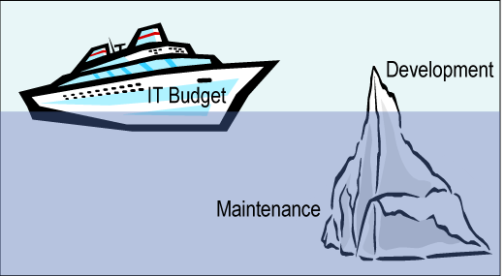
Why is shifting legacy so important
What can we do to unlock more than the 8%?
Maintenance is 92% of TCO *
* Andy Kyte. “A Framework for the Lifetime Cost of Ownership of an Application.” Gartner. 30 March 2010.

Slide 4

How has our industry been addressing this?
Screen scrape
Data map
Re-write process
Wrap process
Service Enable process

Slide 5

What can we and what can we not prove?
Confidence
Hybrid
Leveraging statistics and algebra
HL Requirements
Feasibility
Algebraically Provable
LL Requirements
Architecture & Design
Build
Test
Deploy & Maintain

Slide 6
A new way to migrate from OLD to NEW
This is about cost and risk
If we could:
Increased Speed
Reduced Effort
Reliable Predictability
Then we reduce both cost and risk

Slide 7
A new way to migrate from OLD to NEW
Reducing cost is about reducing effort through automation which also increases speed.
Reducing risk is about predictability and confidence in what results.
We need to have more than blind faith in our automation. We need mathematical proof!
In mathematics, a proof is a demonstration that if some fundamental statements (axioms) are assumed to be true, then some mathematical statement is necessarily true.

Slide 8
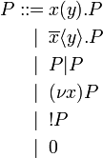
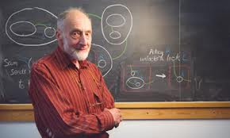
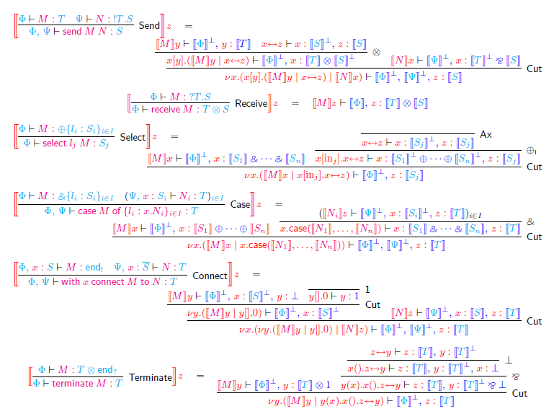
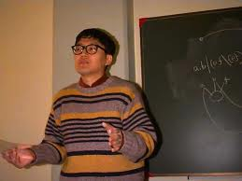
The Techie Ah Ha is all in the maths
Pi-calculus
A language for describing the fundamental interactions between things that is complete and able to be reasoned over.
Turing Award in 1991 Professor Robin Milner
Session Types
An extension of pi-calculus specifically to capture the notion of behavior as a type.
A session type might be a BPMN2 model or a CDL model. A session instance might be a process flow diagram or sequence diagram.
ETAP inaugural prize for outstanding contribution 2012. Dr Kohei Honda

Slide 9
How We Do It (Smart Technology Migration)
Listen to the Voice of the Machine
Harvest the session instance from observations
Translate into AS-IS Model
Generate the session type from the instances
Validate the AS-IS Model
Test the session instances against the session type
Extend the AS-IS Model to incorporate the Voice of the Business into a TO-BE Model
Incorporate new requirements, new session instances
Validate the TO-BE Model
Test the session instances against the session type

Slide 10
A closer look

Slide 11
Thank you for listening.
Professor Steve Ross-Talbot
zdlc.co
zdlc@cognizant.com

