Slide 1
Meal Recommend System By M18Q Brainstorm Hanyue Jiang z5228748, Han Yan z5298115, Xueqing Ren z5290496, Shiyu Nie z5319735, Zening Wang z52295651
COMP9900 Final Project Demo

Slide 2
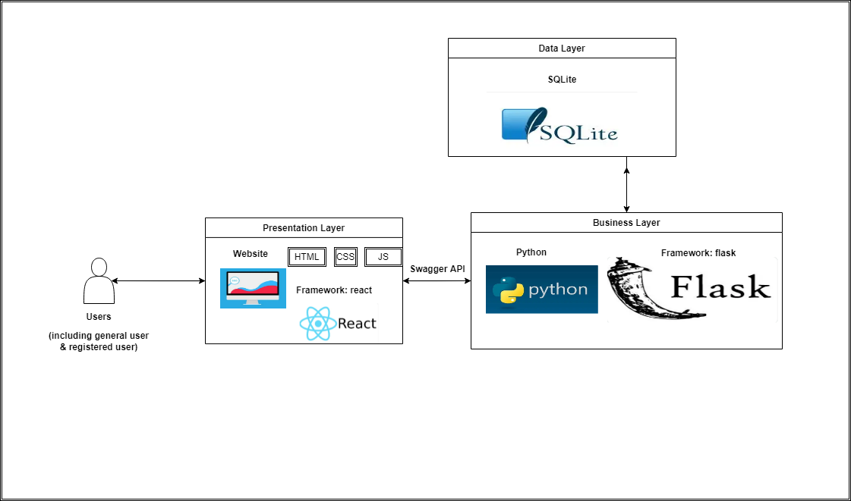
System Architecture
Separate Backend and Frontend System
Interact with each other through Http Request/Response JSON.

Slide 3





System Architecture
Web Browser
……
Presentation Layer (Frontend)
HTML
CSS
JS
Framework: React
Main component : antd
Presentation Layer
Header
component
Content
component
Click
component
HTTP Request
JSON Response

Slide 4



HTTP Request
JSON Response
System Architecture
Business Layer (Backend)
Code structure :
Factory Mode
Connect sperate API
with Namespace
Business Layer
Users
Module
Recipe
Module
Follow
Module
Language: Python
Framework: Flask
Extension: Flask-RESTX
Test Framework: unittest
…
URL
URL
URL
ORM : Flask-SQLAlchemy
Migrate: Flask-Migrate
Data Layer

Slide 5
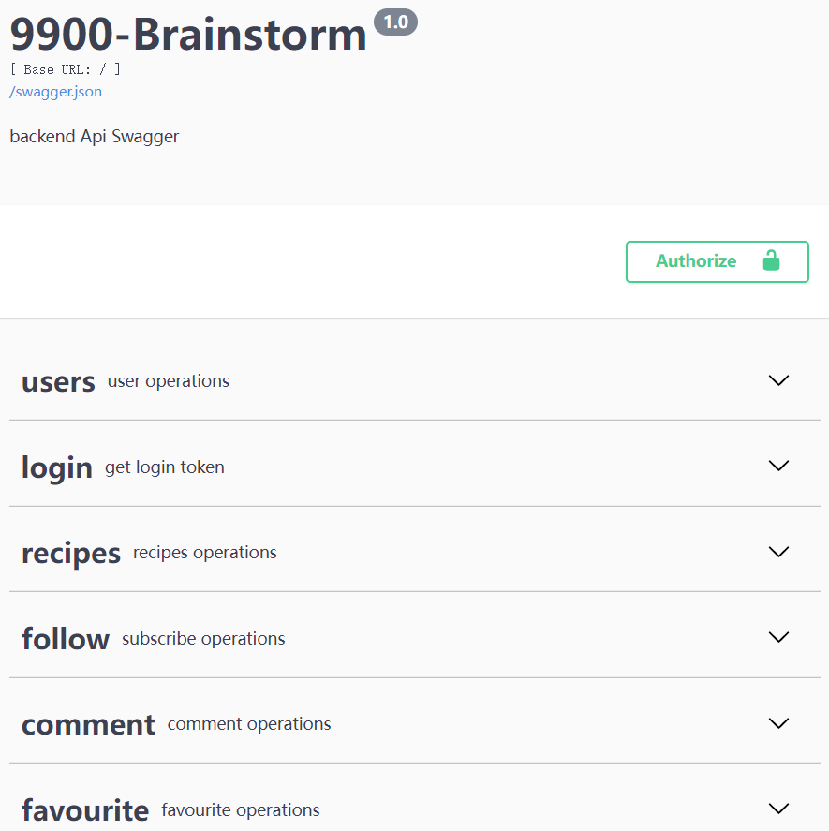
System Architecture
Business Layer (Backend)
Language: Python
Framework: Flask
Extension: Flask-RESTX
(produce Swagger automatically)
Test Framework: unittest

Slide 6
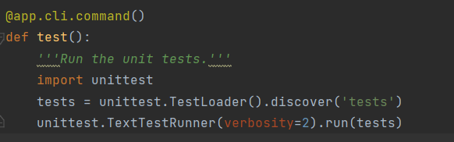
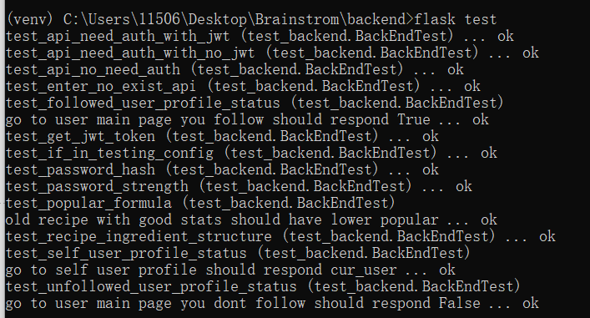
System Architecture
Business Layer (Backend)
Language: Python
Framework: Flask
Extension: Flask-RESTX
(produce Swagger automatically)
Test Framework: unittest

Slide 7
HTTP Request
JSON Response
System Architecture
Data Layer (Backend)
Code structure :
Factory Mode
Connect sperate API
with Namespace
Business Layer
Users
Module
Recipe
Module
Follow
Module
Database: SQLite
1. store all text data in Relational Tables
2. store pictures in flask static folder
and store pic URL to database
…
URL
URL
URL
ORM : Flask-SQLAlchemy
Migrate: Flask-Migrate
Data Layer

Slide 8
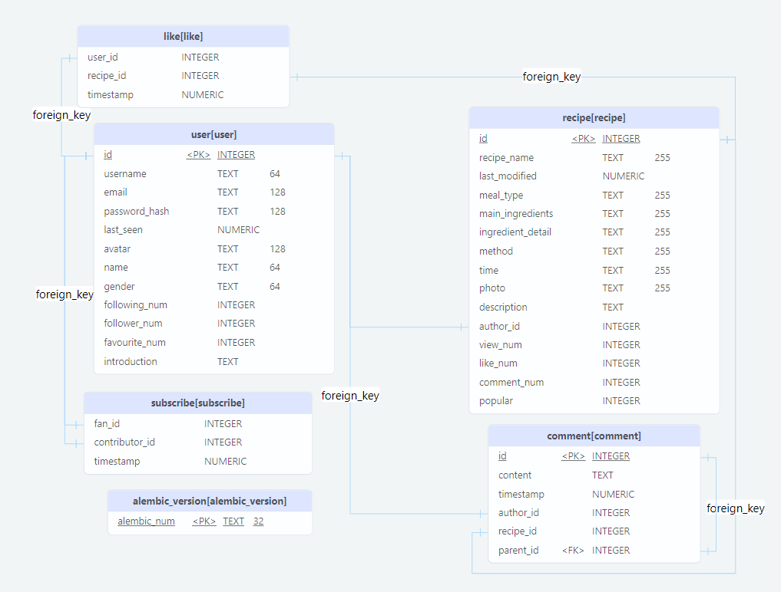
System Architecture
Data Layer (Backend)
Database: SQLite
1. store all text data in Relational Tables
2. store pictures in flask static folder
and store pic URL to database

Slide 9
Project objectives / functionalities
Recipes Maintaining
User Registration & Validation & Profile
Favorites Module
Like & Comment on Recipes
Subscribe Module (Novel)
Searching Module
Recipes Ranking (Novel)
Recommendation System

Slide 10

Project objectives / functionalities
Recipes Ranking (Novel) ---- Ranked by Popular rate
Different Dimensions have different impact on Popular
Time → popular should decreases with time
Interaction (views, likes, comments) → popular should increase with increasing interactions
User → More popular awarded to popular users
Formula : P = $\frac{\text{(}\text{100 + 1∗}\text{V}\text{ + 5}\text{∗}\text{L}\text{ + 10}\text{∗}\text{C}\text{)}\text{∗}{1.1}^{log(F+1)}}{Exp(k ∗(T−T_{last}))}$

Slide 11
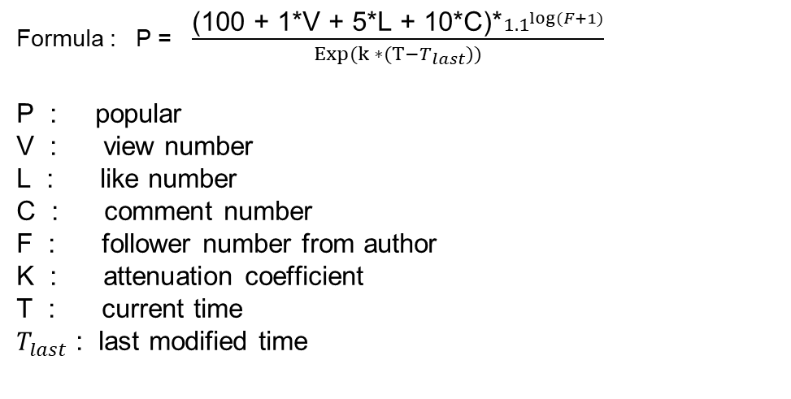
Project objectives / functionalities
Recipes Ranking (Novel) ---- Ranked by Popular rate
Formula : P = $\frac{\text{(}\text{100 + 1∗}\text{V}\text{ + 5}\text{∗}\text{L}\text{ + 10}\text{∗}\text{C}\text{)}\text{∗}{1.1}^{log(F+1)}}{Exp(k ∗(T−T_{last}))}$
P : popular
V : view number
L : like number
C : comment number
F : follower number from author
K : attenuation coefficient
T : current time
$T_{last}$ : last modified time

Slide 12

Project objectives / functionalities
Recommendation System
Make recommendation depend on Ingredients
How to calculate similarity : Jaccard Similarity
Example
Set A = { beef, butter, red wine, onion}
Set B = { beef, carrot, garlic, mushroom}
Jaccard(Set A , Set B) = 1 / 7

