Slide 1
Chicago Crime
Deep Dive Project 5
Simon Kato, Tanishq Khurana, Aakash Narayan, Shivanshu Shekhar

Slide 2
Introduction, Motivation, and Dataset

Slide 3
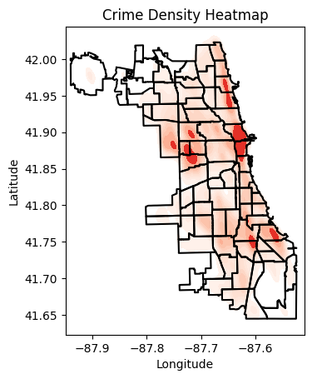
Introduction and Motivation
Chicago Crime
Violent Crime – Higher than national average [1]
Property Crime – Higher than national average [1]
Can we leverage deep learning to address crime
Predict the next category of crime
Predict the next location of crime
Aid in the allocation of resources
Combat bias in police departments
[1] https://realestate.usnews.com/places/illinois/chicago/crime

Slide 4
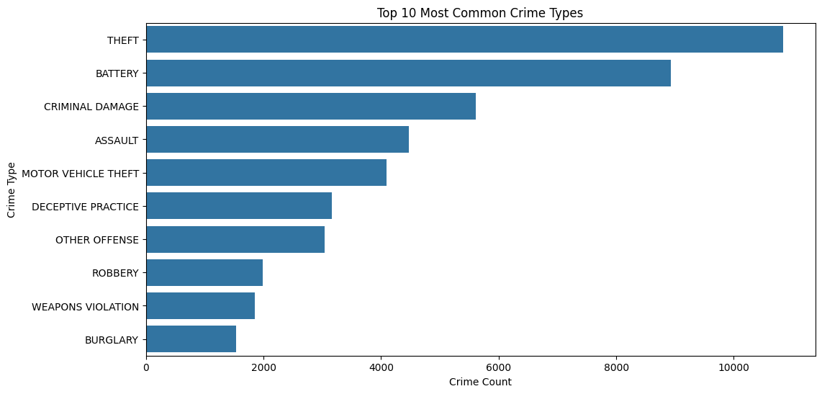
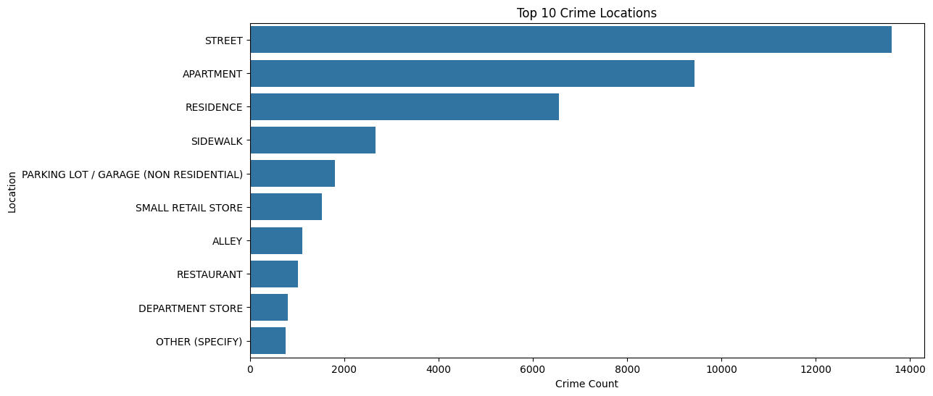
Dataset
Time span: 2020-2024
Datapoints: 50,000
Features:
Date
Block
Location description and location
Arrest
Domestic
District, ward, and community code
Target:
Crime Type

Slide 5
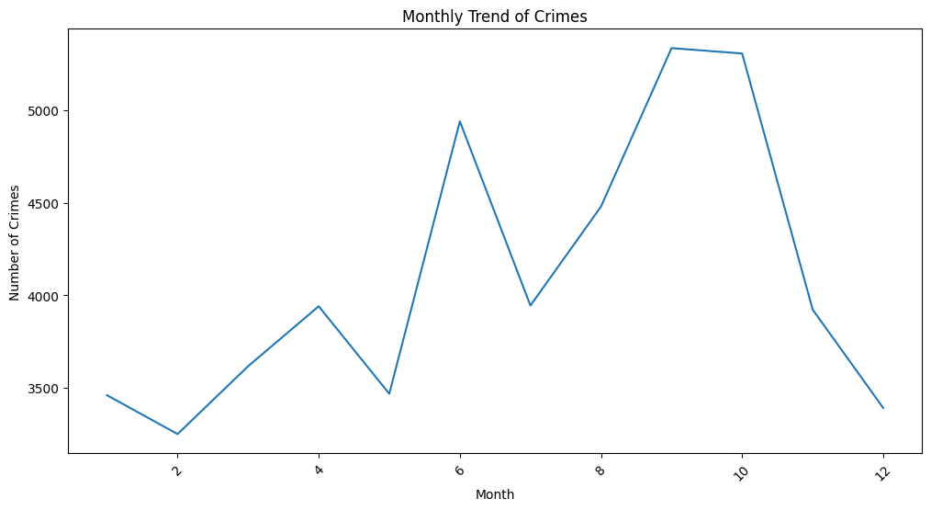
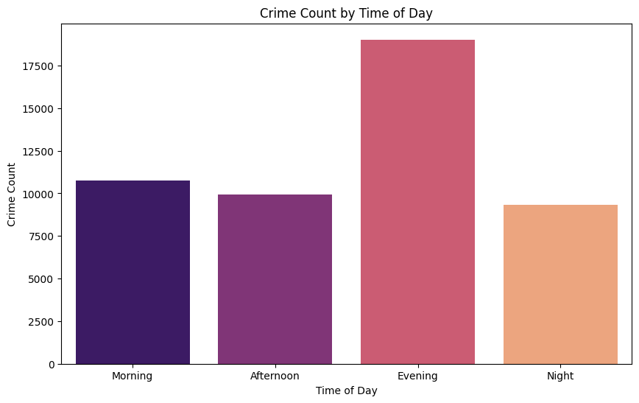
Dataset
Time span: 2020-2024
Datapoints: 50,000
Features:
Date
Block
Location description and location
Arrest
Domestic
District, ward, and community code
Target:
Crime Type

Slide 6
Adapting Categorical Data for ML Models
Why?
Models require numerical inputs, but categorical data is common.
Techniques Used:
One-Hot Encoding
Converts categories into binary columns (e.g., hour_0, day_1).
Suitable for non-ordinal data.
Label Encoding
Maps categories to numeric labels (e.g., "Park" → 1, "Street" → 2).
Ideal for target variables or high-cardinality features.

Slide 7
Model Architecture and Design
Classify crime types based on temporal and contextual features

Slide 8
Core Design
LSTM Layer: Processes sequential data (time-related features)
Fully Connected Layers: Extract high-level patterns and enable classification
Dropout Layer: Reduces overfitting by randomly dropping neurons during training
Activation Functions: ReLU for non-linear transformations and model expressiveness

Slide 9
Implementation Details
Input Features:
One-hot encoded time-based features (hour, day)
Normalized latitude/longitude and encoded categorical attributes (e.g., location)
Hyperparameters:
Hidden size: 128
Dropout: 0.5
Batch size: 64
Optimizer: Adam
Model Components:
LSTM processes input sequences
Fully connected layers transform outputs for final classification
Batch normalization ensures stable learning

Slide 10
Training Pipeline
Details
Training Workflow:
Loss Function: Cross-Entropy Loss for multi-class classification
Optimizer: Adam, chosen for efficient convergence and superior performance.
Data split: 90% training, 10% testing.
10 Epochs: Balanced between speed and convergence.
Metrics: Monitored accuracy and loss per epoch.

Slide 11
2 Bulleted Sections

Slide 12
Quote

Slide 13
Content and Photo (1)

Slide 14
Content and Photo (2)

Slide 15
Photo Left

Slide 16
Photo Right

Slide 17
Photo

Slide 18
Heading (2)

Slide 19
Presentation Title (3)

Slide 20
Presentation Title (4)

Slide 21
Heading (3)

Slide 22
Heading (4)

Slide 24
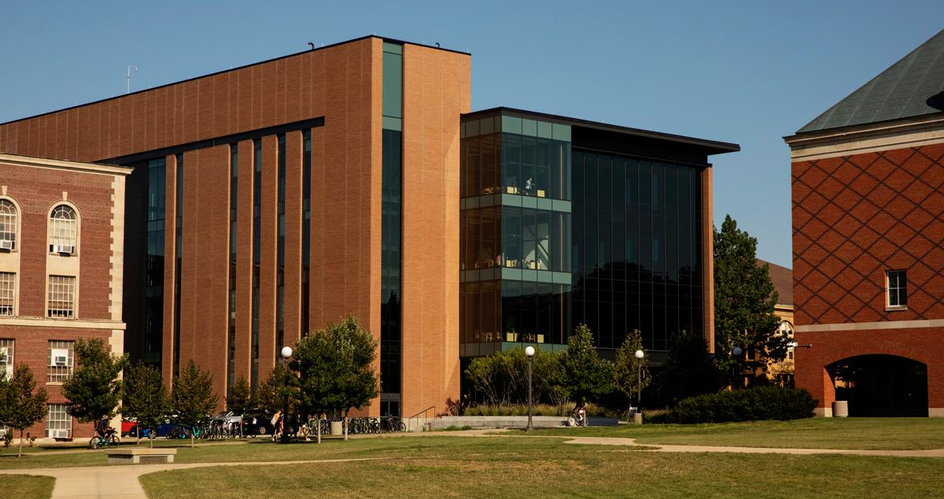

Section Photo (1)
*NOTE*
(please delete)
Use a photo cropped to size for the entire slide like the example slide. Send the photo to the back so the blue box, Block I and footer text are not covered.

Slide 25

Section Photo (2)
*NOTE*
(please delete)
Use a photo for the entire slide like this example slide. Send the photo to the back so the blue box, gradient box, Block I and footer text are not covered.

Slide 26

Section Photo (3)
*NOTE*
(please delete)
Use a photo for the entire slide like this example slide. Send the photo to the back so the blue box, gradient box, Block I and footer text are not covered.

Slide 27
Chart
*NOTE*
(please delete)
Please insert charts through PowerPoint to ensure they follow University Brand standard colors. If using a personal chart, please ensure chart colors match with Brand standards.

Slide 28
Thank You (1)

Slide 29
Thank You (2)

Slide 30

Illinois Blue

Slide 31

Illinois Orange

Slide 32
Illinois Blue Photo

Slide 33
Illinois Orange Photo

