Slide 1
Chicago Crime
Deep Dive Project 5
Simon Kato, Tanishq Khurana, Aakash Narayan, Shivanshu Shekhar

Slide 2
Introduction, Motivation, and Dataset

Slide 3
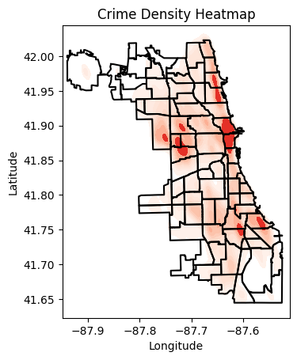
Introduction and Motivation
Chicago Crime
Violent Crime – Higher than national average [1]
Property Crime – Higher than national average [1]
Can we leverage deep learning to address crime
Predict the next category of crime
Predict the next location of crime
Aid in the allocation of resources
Combat bias in police departments
[1] https://realestate.usnews.com/places/illinois/chicago/crime. Contributed: Simon Kato

Slide 4
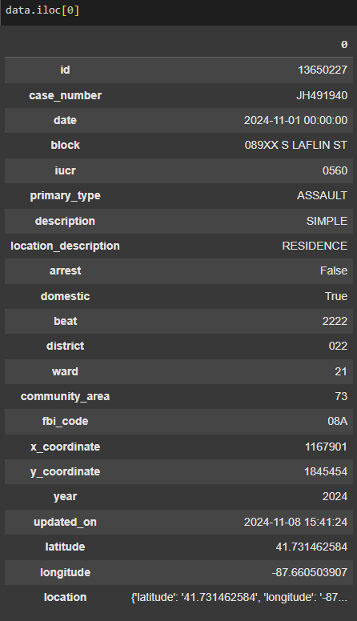
Dataset
Time span: 2020-2024
Datapoints: 50,000
Features:
Date
Block
Location description and location
Arrest
Domestic
District, ward, and community code
Target:
Crime Type
Contributed: Simon Kato

Slide 5
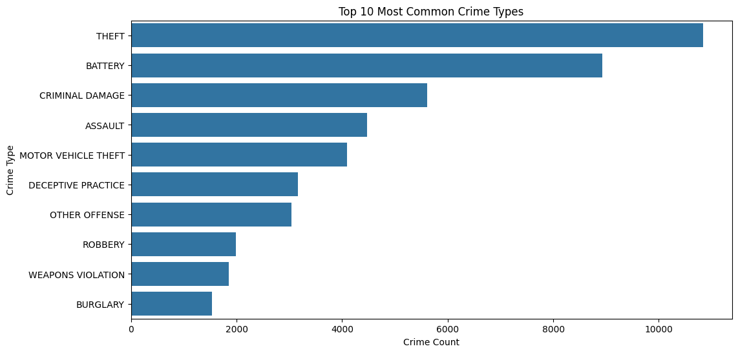
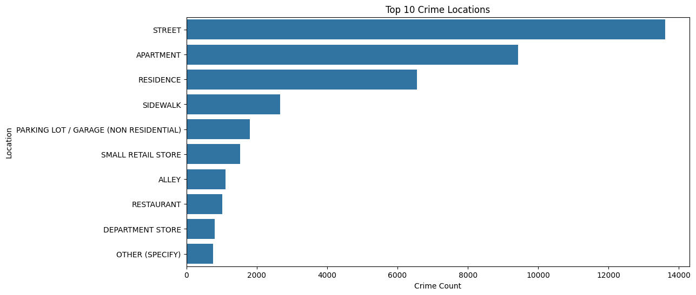
Dataset
Time span: 2020-2024
Datapoints: 50,000
Features:
Date
Block
Location description and location
Arrest
Domestic
District, ward, and community code
Target:
Crime Type
Contributed: Simon Kato

Slide 6
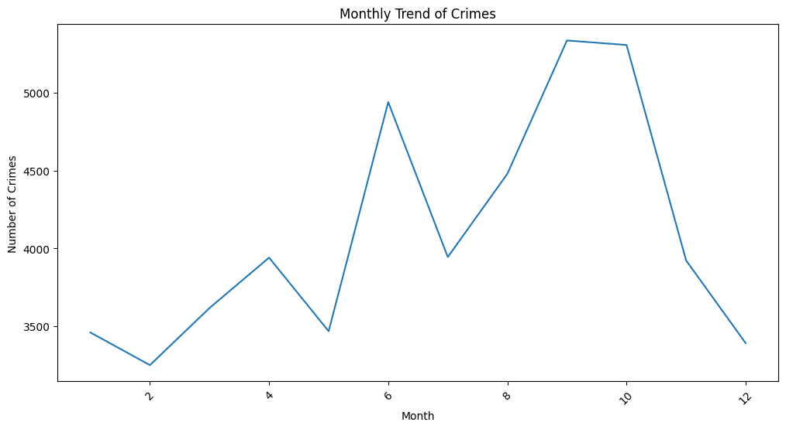
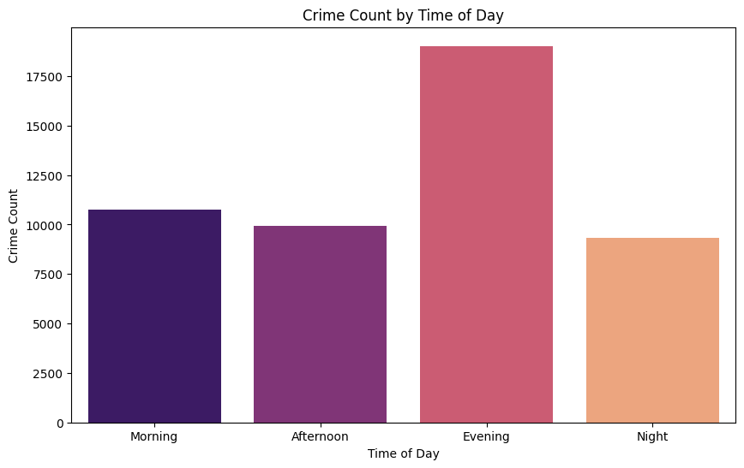
Dataset
Time span: 2020-2024
Datapoints: 50,000
Features:
Date
Block
Location description and location
Arrest
Domestic
District, ward, and community code
Target:
Crime Type
Contributed: Simon Kato

Slide 7
Model Architecture and Design
Tanishq Khurana

Slide 8
Core Design
LSTM Layer: Processes sequential data (time-related features)
Fully Connected Layers: Extract high-level patterns and enable classification
Dropout Layer: Reduces overfitting by randomly dropping neurons during training
Activation Functions: ReLU for non-linear transformations and model expressiveness
Tanishq Khurana

Slide 9
Implementation Details
Input Features:
One-hot encoded time-based features (hour, day)
Normalized latitude/longitude and encoded categorical attributes (e.g., location)
Hyperparameters:
Hidden size: 128
Dropout: 0.5
Batch size: 64
Optimizer: Adam
Model Components:
LSTM processes input sequences
Fully connected layers transform outputs for final classification
Batch normalization ensures stable learning
Tanishq Khurana

Slide 10
Training Pipeline
Details
Training Workflow:
Loss Function: Cross-Entropy Loss for multi-class classification
Optimizer: Adam, chosen for efficient convergence and superior performance.
Data split: 90% training, 10% testing.
10 Epochs: Balanced between speed and convergence.
Metrics: Monitored accuracy and loss per epoch.
Tanishq Khurana

Slide 11
Adapting Categorical Data for ML Models
Why?
Models require numerical inputs, but categorical data is common.
Techniques Used:
One-Hot Encoding
Converts categories into binary columns (e.g., hour_0, day_1).
Suitable for non-ordinal data.
Label Encoding
Maps categories to numeric labels (e.g., "Park" → 1, "Street" → 2).
Ideal for target variables or high-cardinality features.
Shivanshu Shekhar

Slide 12
Adapting Categorical Data for ML Models
Assumptions
Drawbacks
Hour: We assume that every day follows a similar pattern across different hours hence we encoded the hours as one-hot vectors.
Days of Week: We also assume that every the distribution of crimes across a week follows similar pattern, hence we encoded the days as one-hot.
Special Events: Patterns may break during anomalies like COVID-19 or festivals, leading to underrepresented data.
Limited Context: One-hot encoding hours ignores temporal dependencies; grouping hours (e.g., 6 PM–12 AM) could capture patterns better.
Shivanshu Shekhar

Slide 13
Feature Importance and Conclusions
Aakash Narayan

Slide 14
Conclusions and Next Steps
Model accuracy 33.25%
Much better than 2-3% of Logistic Regression baseline, but not enough to give very strong recommendations
Provide police with focus areas to increase awareness and outreach programs, increase vigilance at certain times
Consider decision tree methods with Random Forests/Boosting?
Aakash Narayan

Slide 15
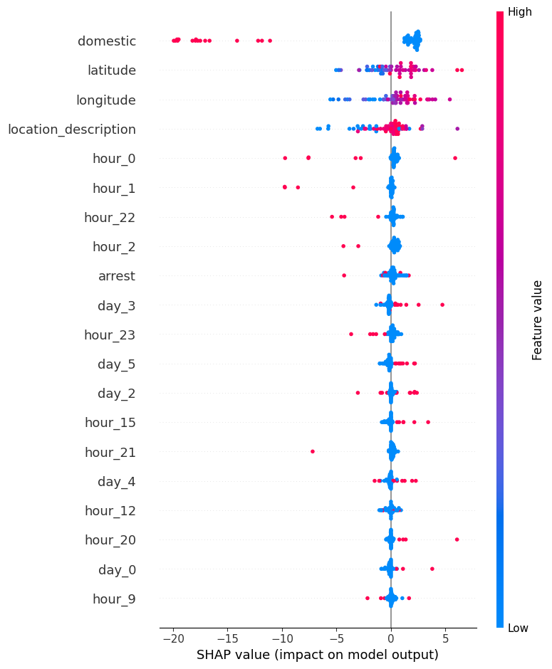
Most Important Predictors
Domestic Crimes: Very accurate when relevant, but not widely applicable
Locations: Lat/Long were good predictors, description also provided some insight
Hours: Hours not closer to midnight tended to rule out certain crimes
Days of the Week: Not particularly important, with most days providing essentially 0 SHAP Value
Aakash Narayan

Slide 16
2 Bulleted Sections

Slide 17
Quote

Slide 18
Content and Photo (1)

Slide 19
Content and Photo (2)

Slide 20
Photo Left

Slide 21
Photo Right

Slide 22
Photo

Slide 23
Heading (2)

Slide 24
Presentation Title (3)

Slide 25
Presentation Title (4)

Slide 26
Heading (3)

Slide 27
Heading (4)

Slide 29
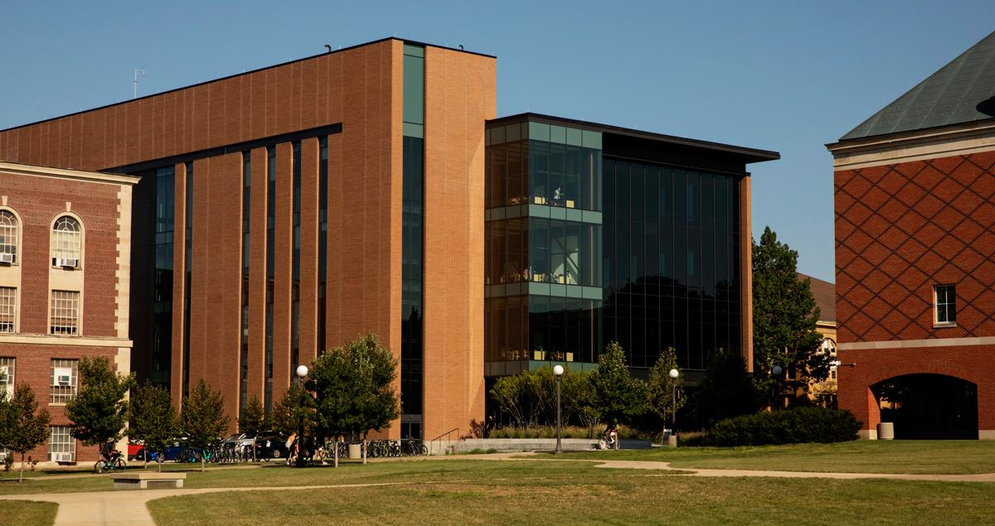

Section Photo (1)
*NOTE*
(please delete)
Use a photo cropped to size for the entire slide like the example slide. Send the photo to the back so the blue box, Block I and footer text are not covered.

Slide 30
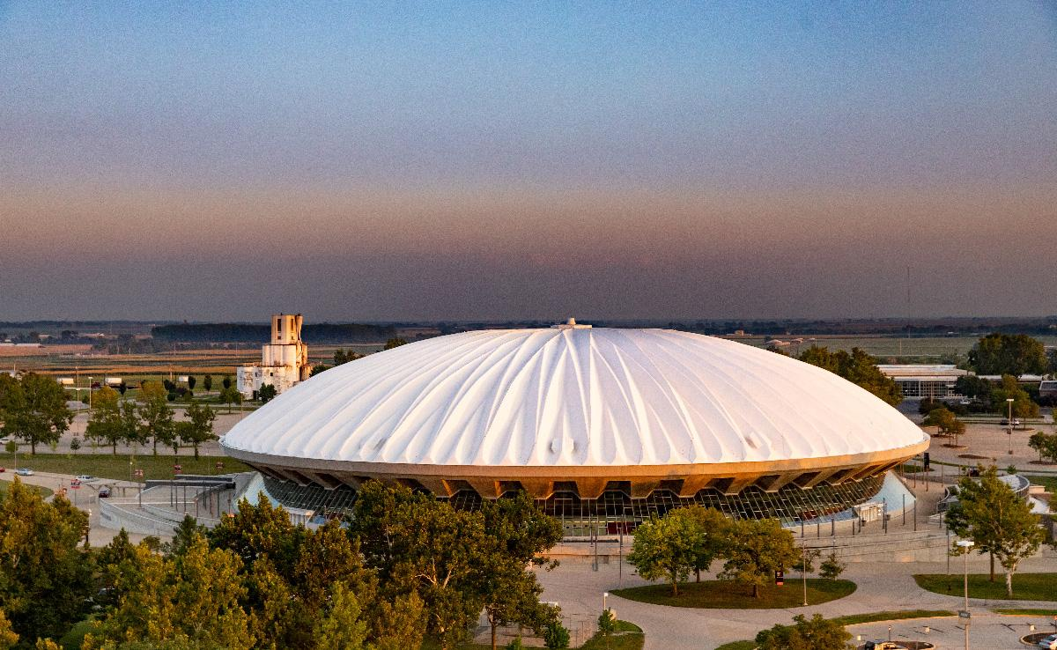
Section Photo (2)
*NOTE*
(please delete)
Use a photo for the entire slide like this example slide. Send the photo to the back so the blue box, gradient box, Block I and footer text are not covered.

Slide 31

Section Photo (3)
*NOTE*
(please delete)
Use a photo for the entire slide like this example slide. Send the photo to the back so the blue box, gradient box, Block I and footer text are not covered.

Slide 32
Chart
*NOTE*
(please delete)
Please insert charts through PowerPoint to ensure they follow University Brand standard colors. If using a personal chart, please ensure chart colors match with Brand standards.

Slide 33
Thank You (1)

Slide 34
Thank You (2)

Slide 35

Illinois Blue

Slide 36

Illinois Orange

Slide 37
Illinois Blue Photo

Slide 38
Illinois Orange Photo

