Slide 1
Netflix im Wandel der Zeit
Márk Reichmann, Simon Keil, Daniel Henke

Slide 2
Tibble modifizieren (1)
unser Datensatz (die interessanten Variablen):
## # A tibble: 12,187 x 4 ## Title year Genre country ## <chr> <int> <chr> <chr> ## 1 Lets Fight Ghost 2008 Crime, Drama, F~ Thailand ## 2 ANNE+ 2016 Drama Belgium,Netherlands ## 3 Moxie 2011 Animation, Shor~ Lithuania,Poland,France,Ic~ ## 4 Gleboka woda 2011 Drama Poland ## 5 Instynkt 2011 Crime Poland ## 6 Snowroller 1985 Comedy Lithuania,Poland,France,It~ ## 7 Sunes Summer 2018 Comedy, Family,~ Lithuania,Poland,France,It~ ## 8 The Invisible 2007 Crime, Drama, F~ Lithuania,Poland,France,It~ ## 9 The Simple Minded Murderer 1985 Drama Lithuania,Poland,France,It~ ## 10 The Stig-Helmer Story 2011 Comedy, Drama Lithuania,Poland,France,It~ ## # ... with 12,177 more rows

Slide 3
Tibble modifizieren (2)
year und Title sind nur zusammen eindeutig
## # A tibble: 2 x 3 ## Title year `Series or Movie` ## <chr> <int> <chr> ## 1 Cloudy with a Chance of Meatballs 2017 Series ## 2 Cloudy with a Chance of Meatballs 2009 Movie

Slide 4
Tibble modifizieren (3)
leider gibt es Duplikate:
data %>% count(Title, year)%>% filter(n>1)
## # A tibble: 150 x 3 ## Title year n ## <chr> <int> <int> ## 1 A Bride for Rip Van Winkle 2016 2 ## 2 A Love So Beautiful 2017 2 ## 3 A Perfect Day 2016 2 ## 4 About Time 2013 2 ## 5 Aftermath 2017 2 ## 6 Aliens 1986 2 ## 7 Alone 2008 2 ## 8 Anastasia 1997 2 ## 9 Anohana: The Flower We Saw That Day 2011 2 ## 10 Another 2012 2 ## # ... with 140 more rows

Slide 5
Tibble modifizieren (4)
das sind diejenigen Filme, die mehrmals auf Netflix releast wurden
## # A tibble: 2 x 4 ## Title year Genre country ## <chr> <int> <chr> <chr> ## 1 A Perfect Day 2016 Comedy, Drama, War Italy ## 2 A Perfect Day 2016 Comedy, Drama, War Romania,Poland
Lösung:
data %>% filter(Title == "A Perfect Day") %>% select(Title, year, country)%>% separate_rows(country, sep = ",")%>% distinct(.keep_all = TRUE)
## # A tibble: 3 x 3 ## Title year country ## <chr> <int> <chr> ## 1 A Perfect Day 2016 Italy ## 2 A Perfect Day 2016 Romania ## 3 A Perfect Day 2016 Poland

Slide 6
Tibble modifizieren (5)
selbiges auch mit Genre
## # A tibble: 3 x 3 ## Title year country ## <chr> <int> <chr> ## 1 A Perfect Day 2016 Italy ## 2 A Perfect Day 2016 Romania ## 3 A Perfect Day 2016 Poland
## # A tibble: 3 x 3 ## Title year Genre ## <chr> <int> <chr> ## 1 A Perfect Day 2016 Comedy ## 2 A Perfect Day 2016 Drama ## 3 A Perfect Day 2016 War
diese beiden Tibbles werden jetzt an Title, year gejoint

Slide 7
Tibble modifizieren (6)
data_tidy <- full_join(countries, genres, by = c("year", "Title")) data_tidy
## # A tibble: 9 x 4 ## Title year country Genre ## <chr> <int> <chr> <chr> ## 1 A Perfect Day 2016 Italy Comedy ## 2 A Perfect Day 2016 Italy Drama ## 3 A Perfect Day 2016 Italy War ## 4 A Perfect Day 2016 Romania Comedy ## 5 A Perfect Day 2016 Romania Drama ## 6 A Perfect Day 2016 Romania War ## 7 A Perfect Day 2016 Poland Comedy ## 8 A Perfect Day 2016 Poland Drama ## 9 A Perfect Day 2016 Poland War
data_tidy %>% group_by(Title, year, country) %>% summarise(Genre = paste(Genre, collapse = ", ")) %>% group_by(Title, year, Genre) %>% summarise(country = paste(country, collapse = ", ")) %>% ungroup()
## # A tibble: 1 x 4 ## Title year Genre country ## <chr> <int> <chr> <chr> ## 1 A Perfect Day 2016 Comedy, Drama, War Italy, Poland, Romania

Slide 8
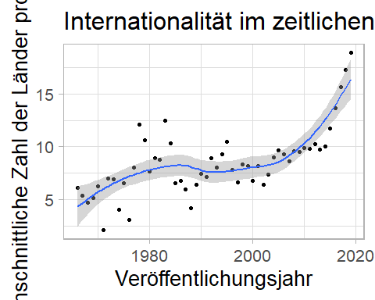

Slide 9
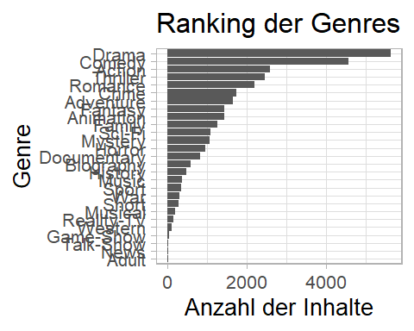

Slide 10
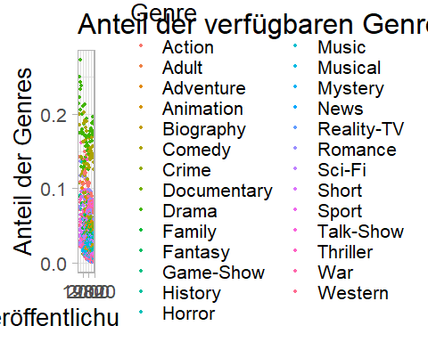

Slide 11
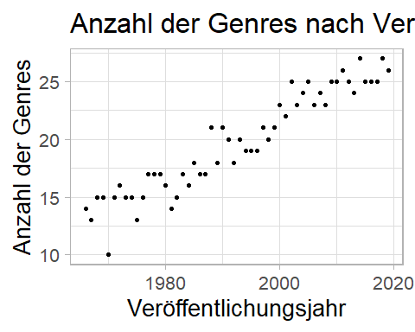

Slide 12
