Slide 1
Introduction
Slide 1

Slide 2
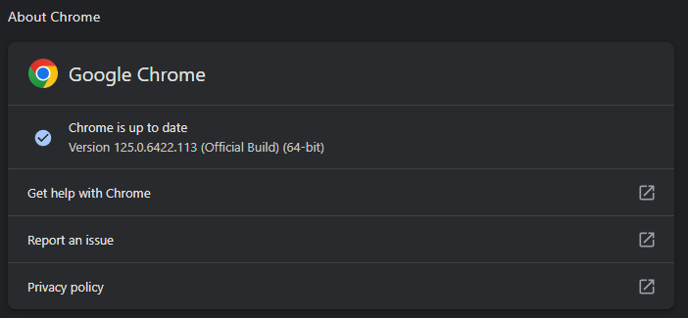
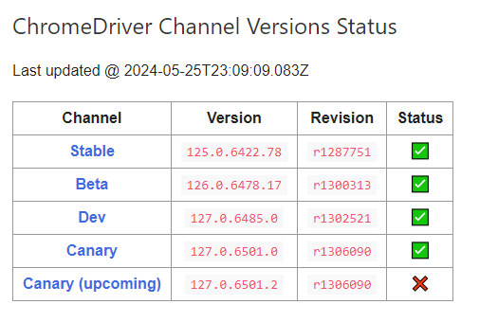
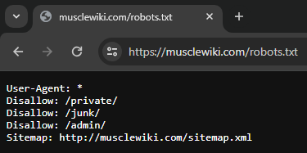

Slide 2

Slide 3


Slide 3
MuscleWiki.com’s Muscle Directory

Slide 4

Slide 4

Slide 5
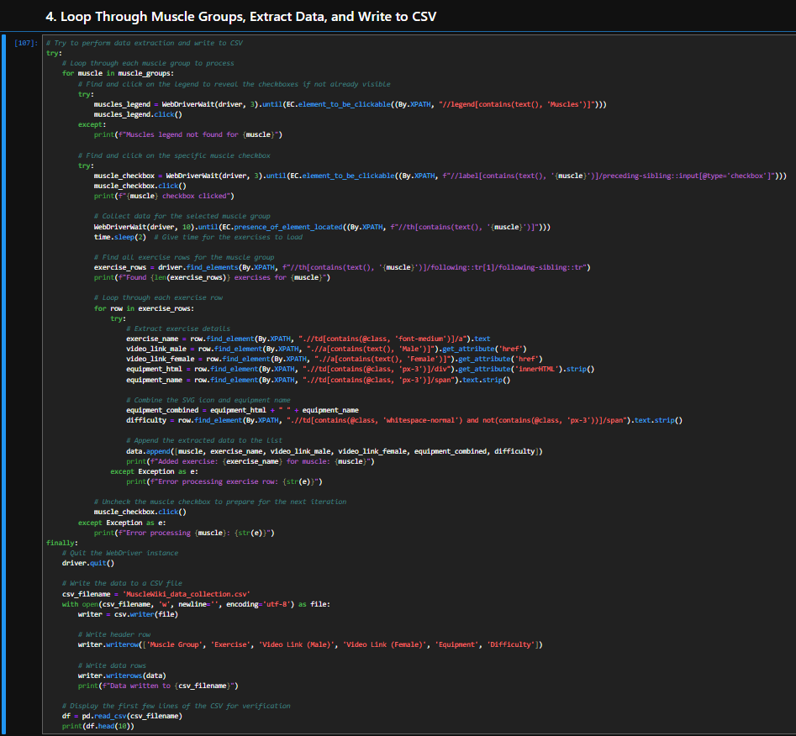



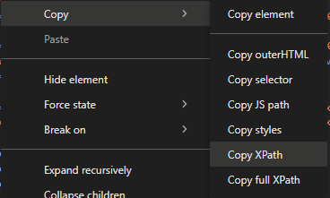
Slide 5

Slide 6
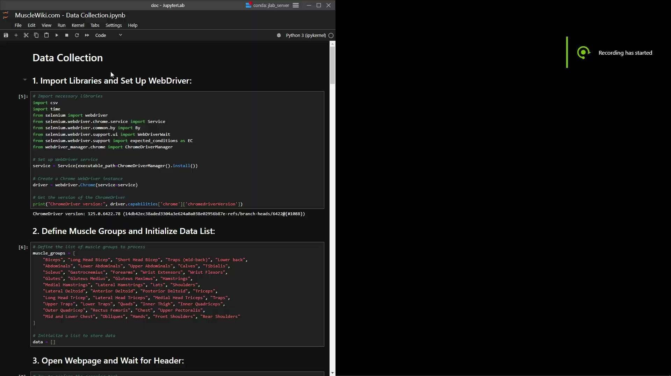
Slide 6
Brief preview of Selenium and ChromeDriver being used

Slide 7
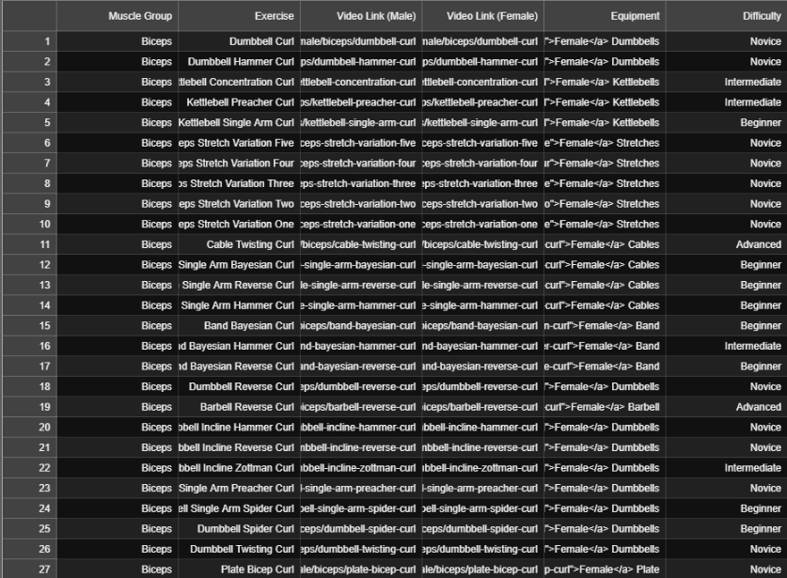
Slide 7
Sample of the collected data

Slide 8
Streamlit script breakdown with detailed explanations
Slide 8

Slide 9

Slide 9

Slide 10
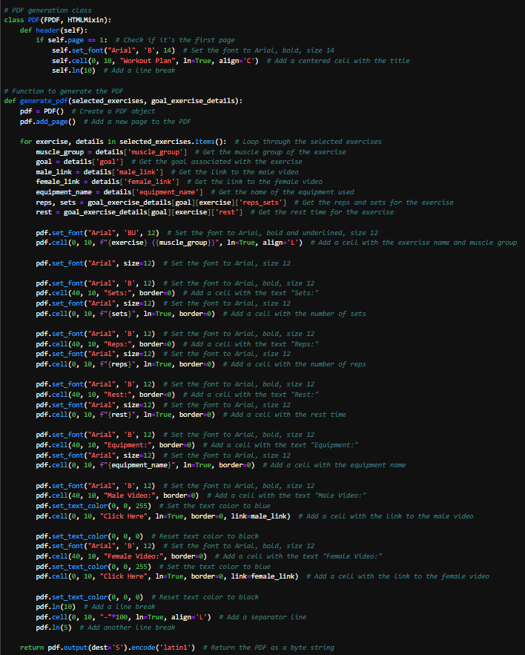
Slide 10

Slide 11
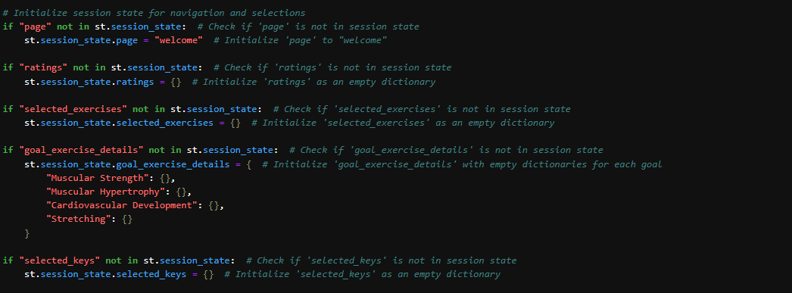
Slide 11

Slide 12

Slide 12

Slide 13
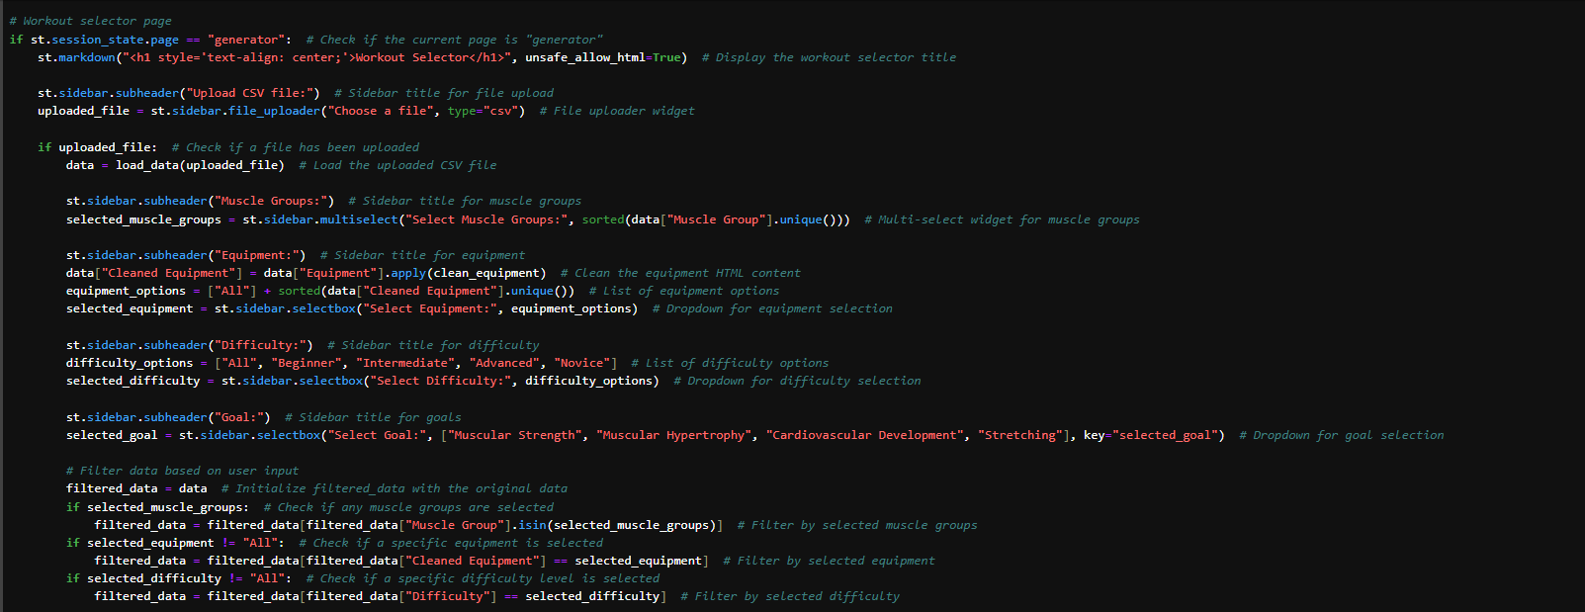
Slide 13

Slide 14
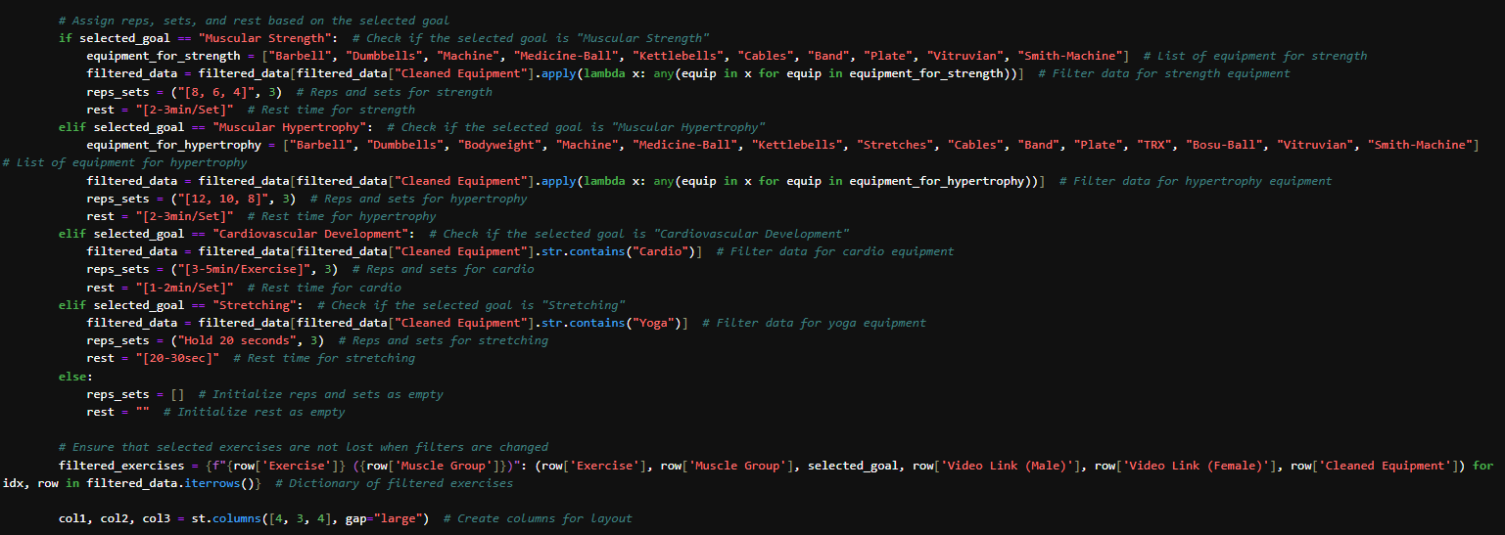
Slide 14

Slide 15
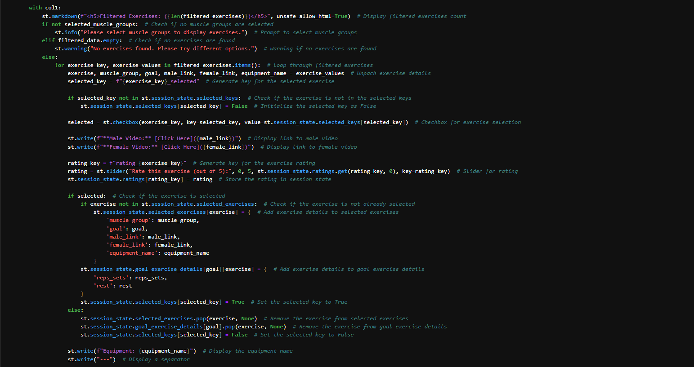
Slide 15

Slide 16
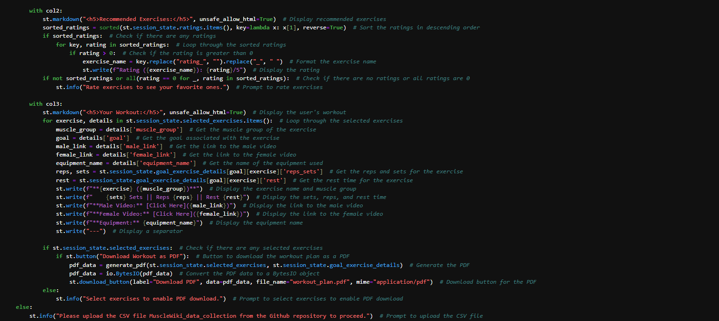
Slide 16

Slide 17
Streamlit app
Slide 17
Click Here

Slide 18
Conclusion
Slide 18

