Slide 1
Depth Esimation
Segmentation
Input Image
Stroke generation Per segment

Slide 2
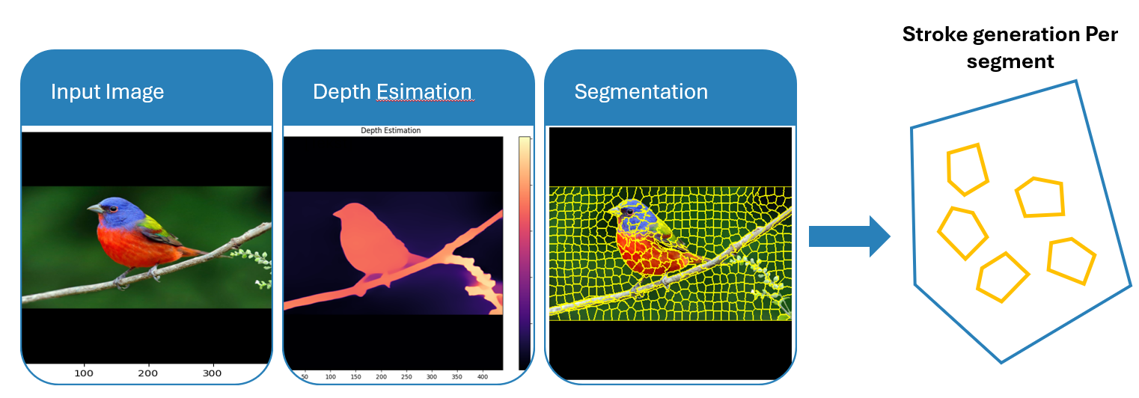
Stroke reordering

Slide 3
Expand $⊥∇ f$
Expand ⊥∇ f
Accepted?
Find start position
1.000 times
See also stop-criterium
Stroke Generation Supervisor

Slide 4
Order buckets by pigment
Partition in Buckets

Slide 5
Bucket Partitioning
Sort strokes into color buckets
Render strokes per segment
1
2
3

Slide 6
Bucket Ordering
2
More to less pigment
Queue 1 | Queue 2 | Queue 3

