Slide 1






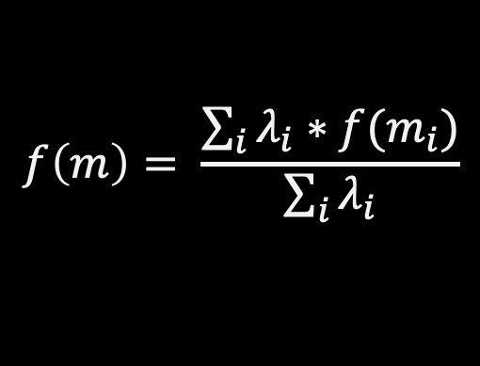
p = 0
$$f\left(m\right)= \frac{\sum_{i}{λ_{i}∗f(m_{i})}}{\sum_{i}{λ_{i}}}$$
m = ?
$$λ_{i}=\frac{1}{d_{i}^{p}}$$
d₃ = 3
m₃ = 2
d₁ = 1
d₂ = 2
m₁ = 1
m₂ = 3

Slide 2

p = 1
$$f\left(m\right)= \frac{\sum_{i}{λ_{i}∗f(m_{i})}}{\sum_{i}{λ_{i}}}$$
m = ?
$$λ_{i}=\frac{1}{d_{i}^{p}}$$
d₃ = 3
m₃ = 2
d₁ = 1
d₂ = 2
m₁ = 1
m₂ = 3

Slide 3
p = 2
$$f\left(m\right)= \frac{\sum_{i}{λ_{i}∗f(m_{i})}}{\sum_{i}{λ_{i}}}$$
m = ?
$$λ_{i}=\frac{1}{d_{i}^{p}}$$
d₃ = 3
m₃ = 2
d₁ = 1
d₂ = 2
m₁ = 1
m₂ = 3

