Slide 1
PyTorch

Slide 2
PyTorch
PyTorch is a framework based on the Torch library, used for applications such as computer vision and natural language processing, primarily developed by Facebook's AI Research lab (FAIR).
provides two high-level features:
Tensor computing (like NumPy) with strong acceleration via graphics processing units (GPU)
Deep neural networks built on a type-based automatic differentiation system

Slide 3
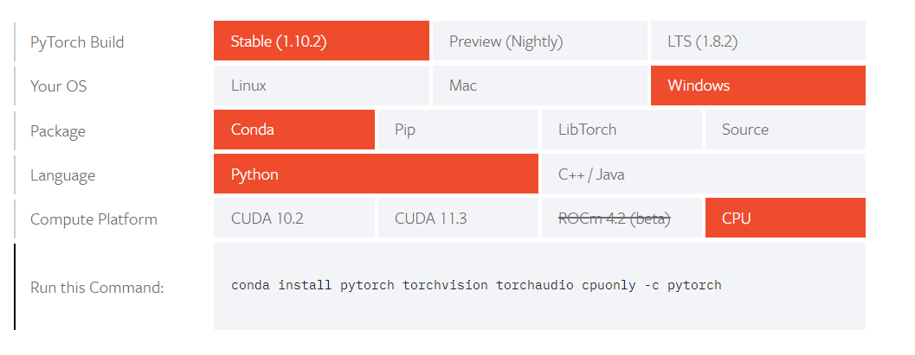
Installation
Install it from pytorch.org

Slide 4
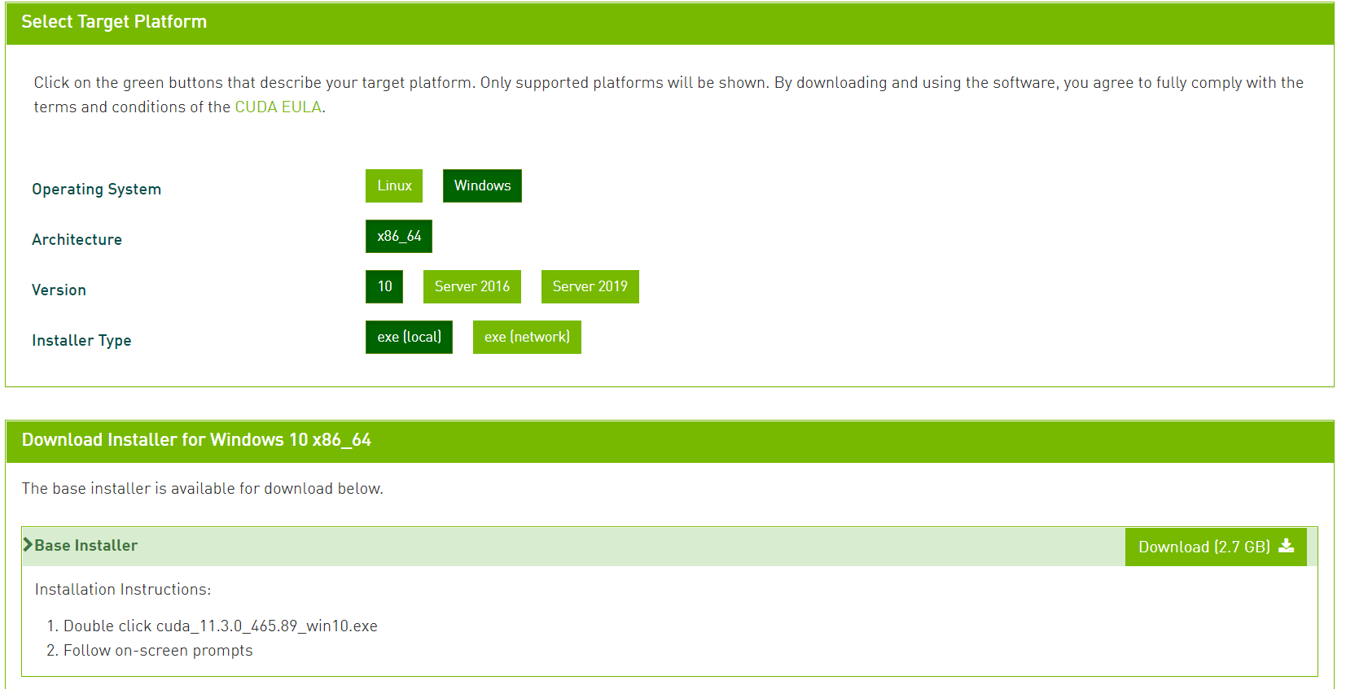
CUDA Installation
Install CUDA toolkit from https://developer.nvidia.com/cuda-downloads

Slide 5
Three Levels of Abstraction
Tensor: Imperative N-Dimensional Array running on GPU.
Variable: Node in Computational Graph. To store data and gradient.
Module: Neural network Layer- Stores state or learnable weights.

Slide 6
Tensor: Imperative N-Dimensional Array running on GPU.
It is a container of Data, which helps to store different dimensions of Data in Neural Networks.
For importing Torch in python:
=> import torch

Slide 7
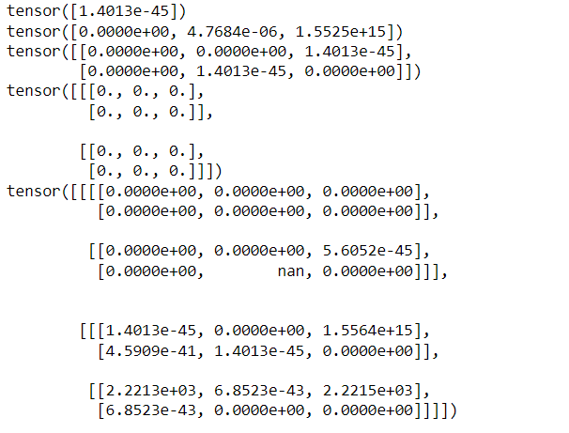
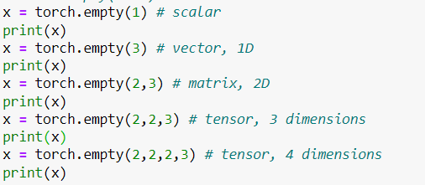
Tensors

Slide 8
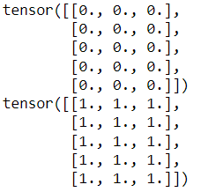
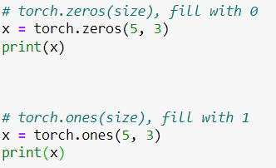
Tensors
Creating tensors with zeroes and ones:

Slide 9
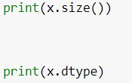

Tensors
For checking size and data type:

Slide 10
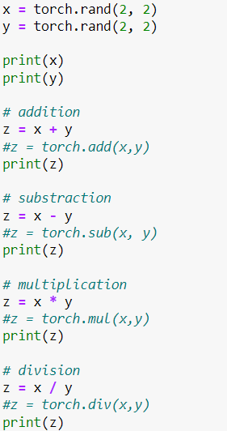
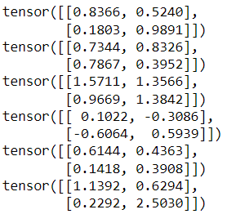
Tensors
Basic Calculations:

Slide 11
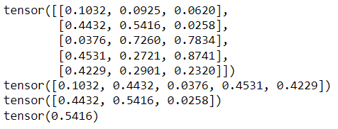
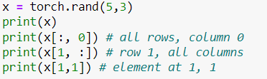
Tensors
Slicing

Slide 12
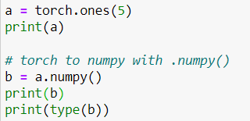

Tensors
Torch to NumPy

Slide 13
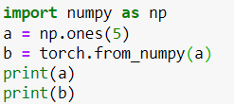

Tensors
NumPy to Torch

Slide 14


Tensors
Change in NumPy or Torch will affect the other.

Slide 15
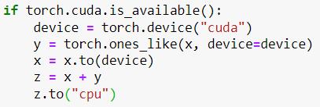
Tensors
CPU to GPU and GPU to CPU

Slide 16
Three Levels of Abstraction
Tensor: Imperative N-Dimensional Array running on GPU.
Variable: Node in Computational Graph. To store data and gradient.
Module: Neural network Layer- Stores state or learnable weights.

Slide 17
Variable: Node in Computational Graph. To store data and gradient
They act like a node in the computational graph itself so basically it is used for storing all the data.
For importing variable from Torch:
from torch.autograd import Variable

Slide 18
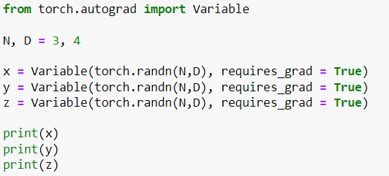
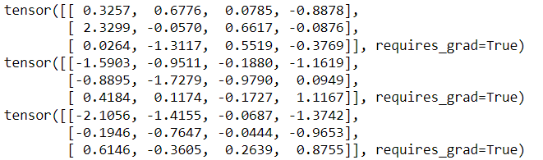
Variable
For creating computational graphs:

Slide 19
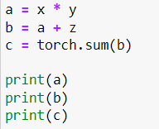
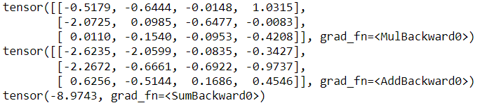
Variable
Computations

Slide 20
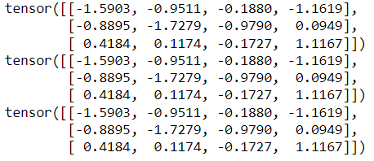
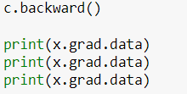
Variable
Backward() computes all gradients.

Slide 21
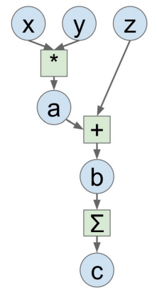
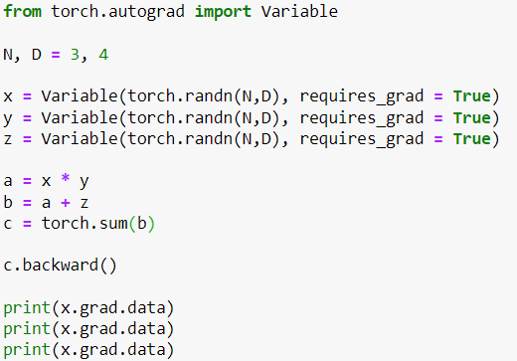
Variable
Program and graph

Slide 22
Three Levels of Abstraction
Tensor: Imperative N-Dimensional Array running on GPU.
Variable: Node in Computational Graph. To store data and gradient.
Module: Neural network Layer- Stores state or learnable weights.

Slide 23
Module: Neural network Layer- Stores state or learnable weights
It is for storing state and for learnable weights altogether.
PyTorch uses modules to represent neural networks. Modules are: Building blocks of stateful computation.

Slide 24
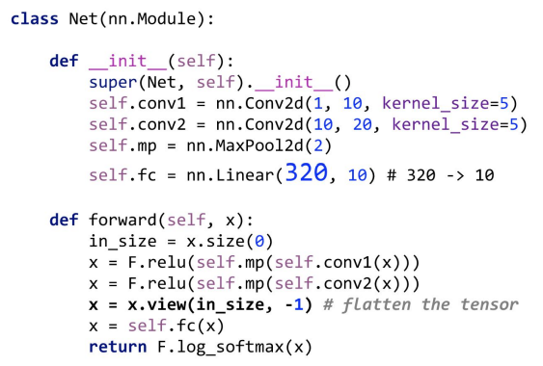
Module
Creating Layers using module

Slide 25
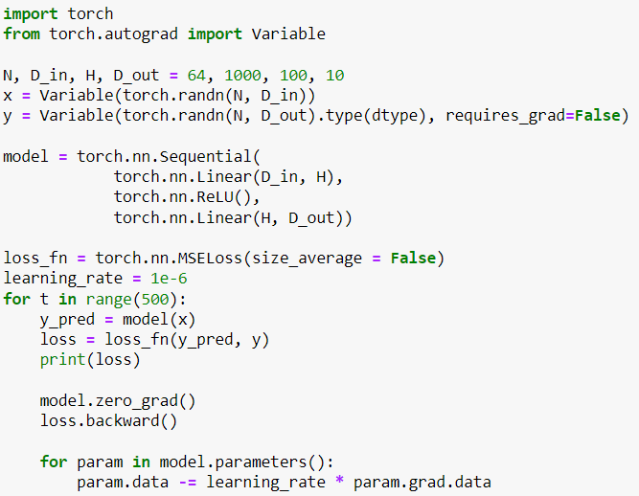
Simple NN using PyTorch
Program

Slide 26
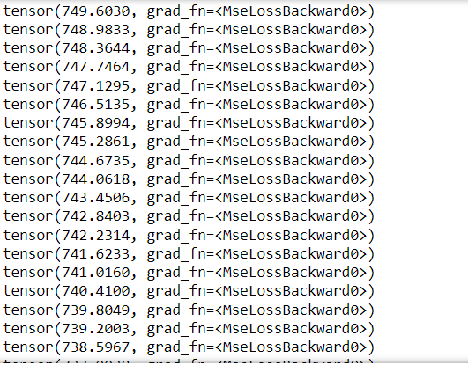
Loss values
The loss values from the model:

Slide 27
Thank you

