Slide 1
Image Colorization
AI project
CSI 4106
Introduction to Artificial Intelligence
W2022
Topics
Coloring grayscale images within LAB color space
Images processing with OpenCV
Deep learning with CNN model with TensorFlow

Slide 2
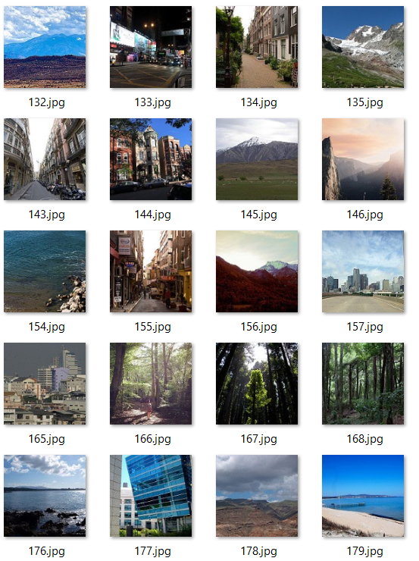
Dataset

Slide 3
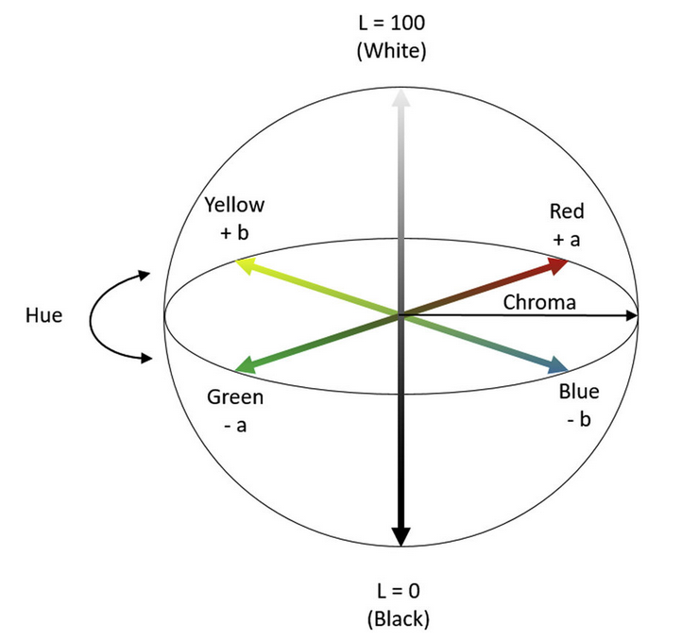
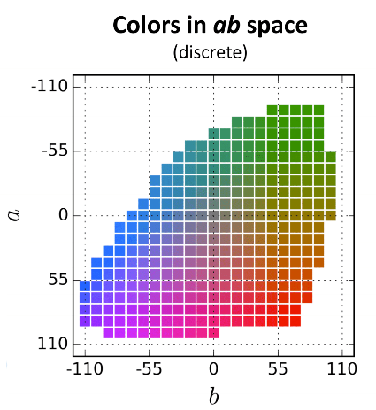
LAB color space

Slide 4
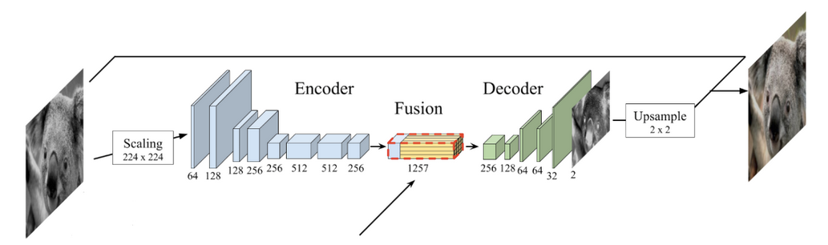
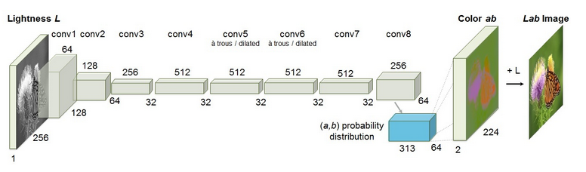
Proposed solution
Regression Task
Classification Task

Slide 5
Coding See the notebook
Image Preprocessing
Image Colorization Models
Hyperparameters

Slide 6
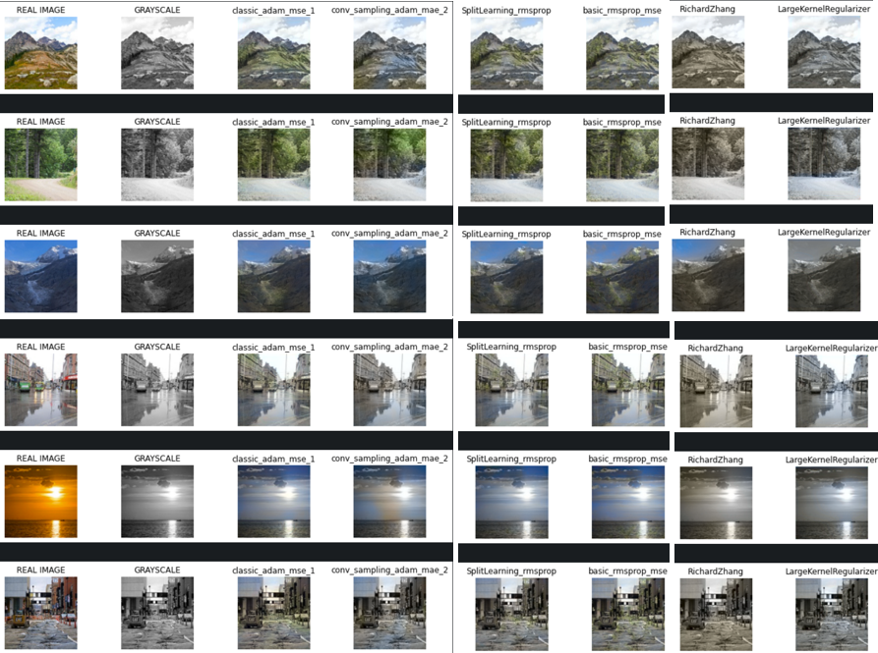
My results

