Slide 1
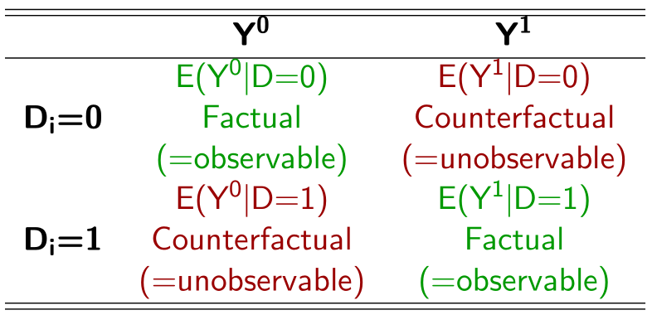
ATT

Slide 2
ATT
Naive estimator

Slide 3
Baseline difference regarding the ATT
ATT
Naive estimator

Slide 4
ATNT

Slide 5
ATNT
Naive estimator

Slide 6
Baseline difference regarding the ATNT
ATNT
Naive estimator

Slide 7
Baseline difference regarding the ATT
Baseline difference regarding the ATNT

Slide 8
ATNT x (1-π)
+
ATT x π
=
ATE

