Slide 1
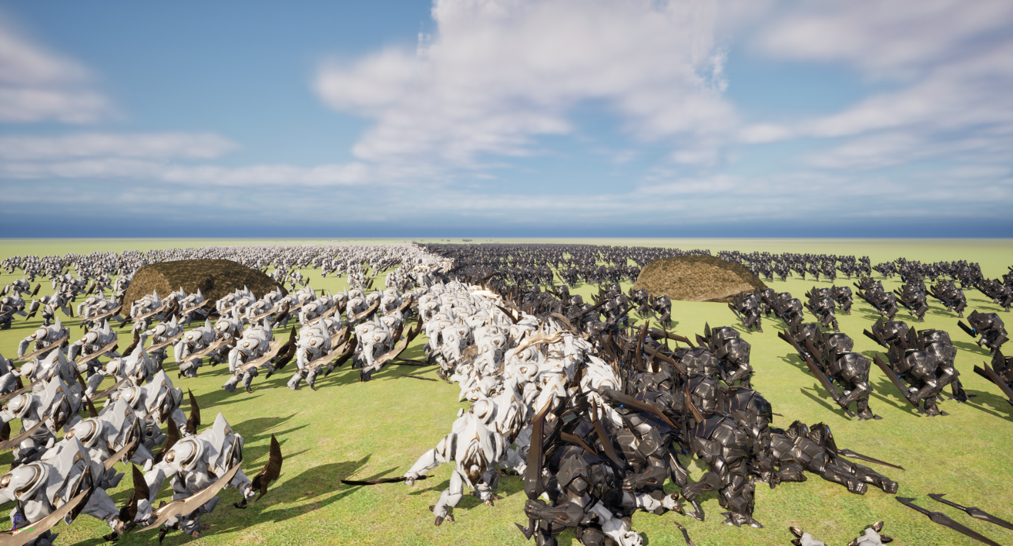
Simulating massive amounts of AI agents in video games

Slide 2
Introduction
Who am I?

Slide 3
Demo Showcase

Slide 4
Research Topic
How to optimize
Many different topics

Slide 5
Literature Study

Slide 6
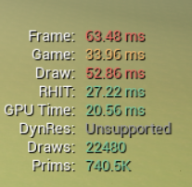
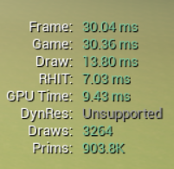
Case study

Slide 7
Results

Slide 8
Future Work

Slide 9
Reflection

Slide 10
Questions?

