Slide 1
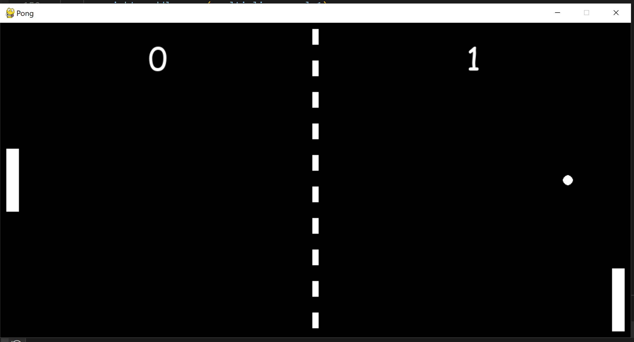
M5 Pong Results
Gesture 1:
Continuous multiplier based on y axis from accelerometer
Results Accuracy: average of +/-5% error for intended angle multiplier of -1, -.5, 0, .5, and 1 over 10 runs
Lags with BLE reads, quick movements make it susceptible to noise
Gesture 2:
3 States based on Z axis accelerometer
State 1: Flip up (UP)
State 2: Flip Down (Down)
State 3: Flip Flat (Steady)
Accuracy: 100%
Cons: Only has 3 states so not as useful for moving as Gesture 1
Conclusion: Gesture 1 wins!!!!

