Slide 1
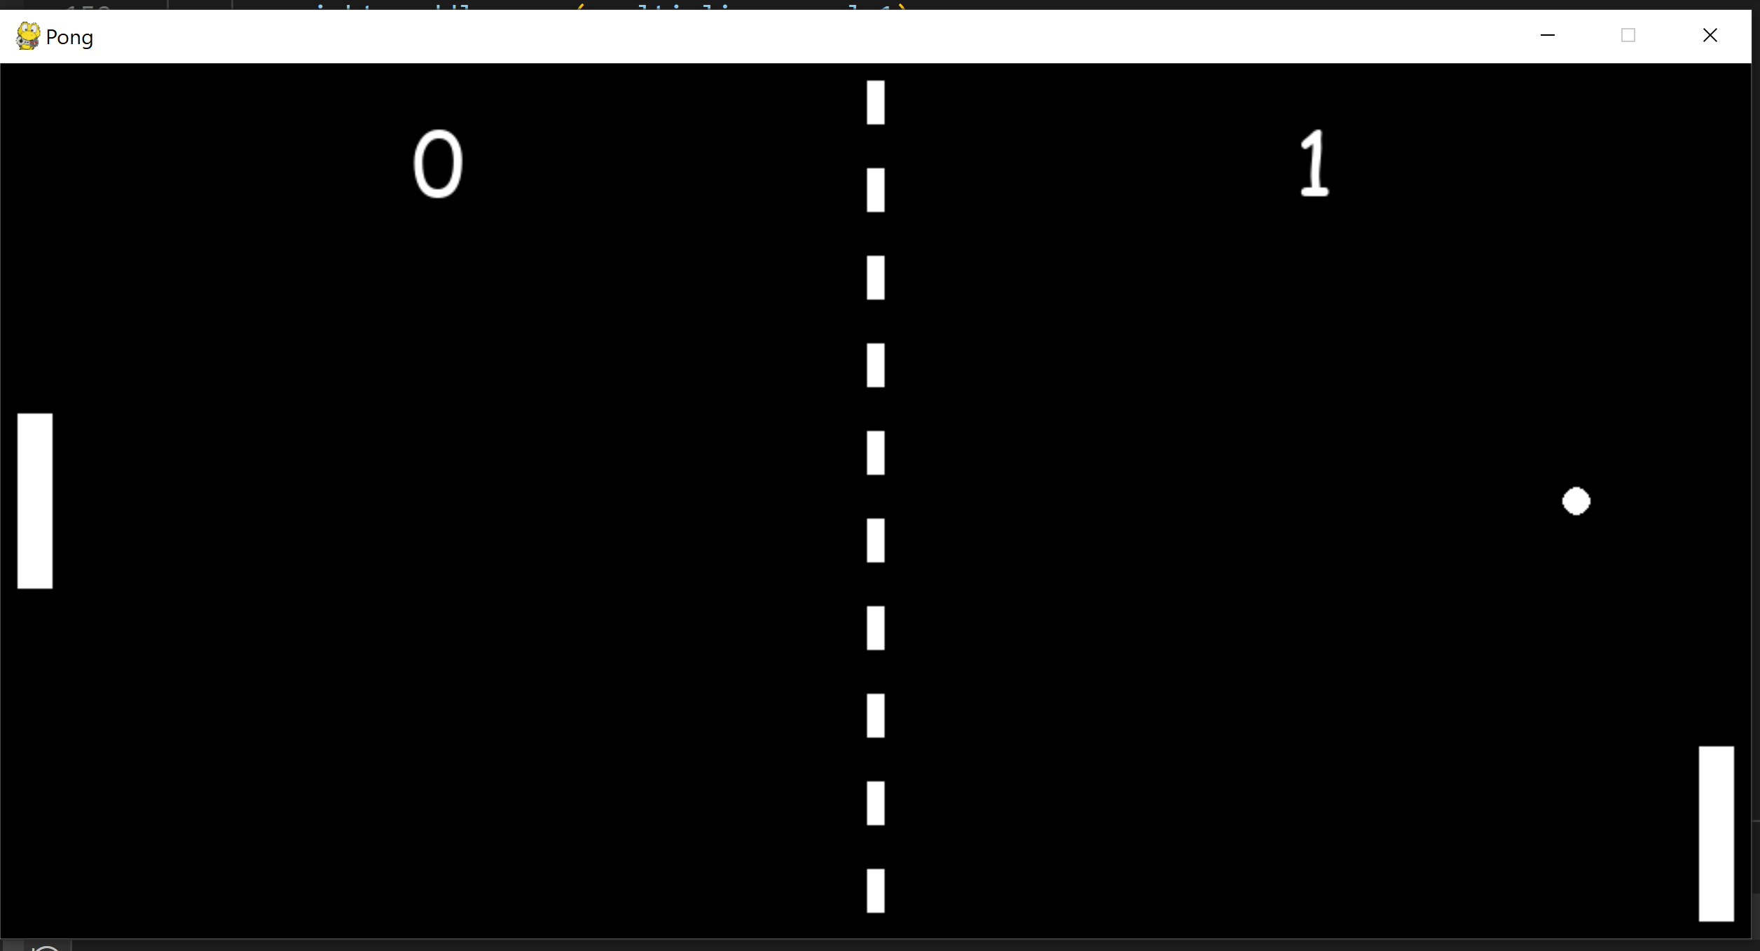
M5 Pong Results
Gesture 1:
What: Continuous movement range multiplier based on y axis from accelerometer
Accuracy: average error of .08 for multipliers of intended angles: 0, 45, 90, 35, and 180 (multipliers= -1, -.5, 0, .5, and 1 )
Con: Lags with BLE reads, quick movements make it susceptible to noise
Gesture 2:
What: 3 States based on Z axis accelerometer
State 1: Flip up (UP)
State 2: Flip Down (Down)
State 3: Flip Flat (Steady)
Accuracy: 100% (Measured 15 Flip up, 15 Flip down, and 15 Flip Flat for 2 users)
Con: Only has 3 states so not as useful for moving as Gesture 1
Conclusion: Gesture 1 wins! It is more dynamic and was rated easier to use in user preference study

