Slide 1
GeoFF – Visualizing geodata in Eclipse and on your website
Eclipse DemoCamp Frankfurt 2nd Dec. 2014
Erdal Karaca

Slide 2
Overview
Fundamental answers
What is it?
Why does it exist?
How does it work?
Demo
A set of Eclipse plugins that provide mapping features
Q&A

Slide 3
What is it?
A small framework provided as Eclipse plugins
Visualization of geo data
Geocoding API (frontends/facades)

Slide 4
Why does it exist?
Lots of mature frameworks to visualize geo data in the browser
OpenLayers 2/3, Leaflet, …
Need for a simple to use visualization component within Eclipse applications
Bridge existing mature rendering engines to Eclipse applications
No need to deal with scripting issues

Slide 5
How does it work?
Uses OpenLayers 3 as rendering engine
Uses SWT Browser widget to bridge Java and JavaScript worlds
Model driven approach
Uses Eclipse Modeling Framework (EMF) as its core to provide a meta model for designing layered geo maps
Integrates into SWT
GeoMapComposite derived from standard SWT Composite
Provides Frontends to existing geocoding services
Google, OpenStreetMap

Slide 6
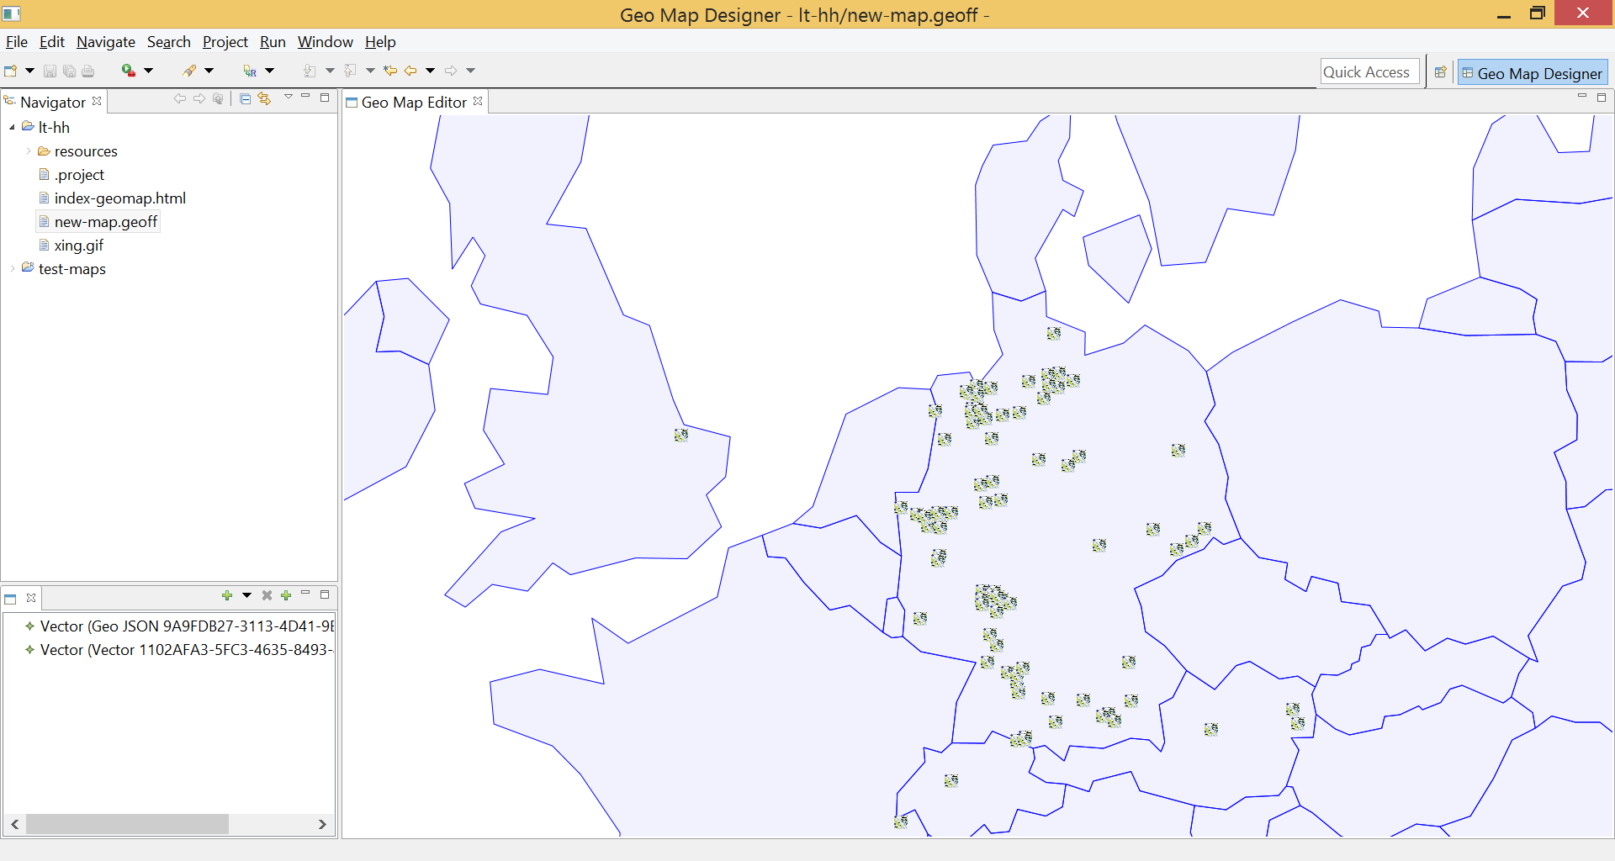
Demo

Slide 7
Q&A
Any questions?
Project website
http://www.locationtech.org/projects/technology.geoff
Mailing list
geoff-dev@locationtech.org

