Slide 1
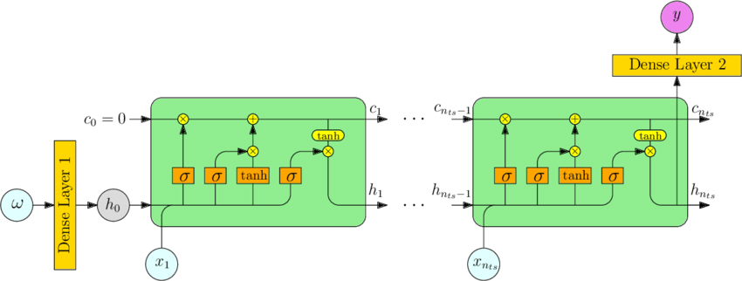
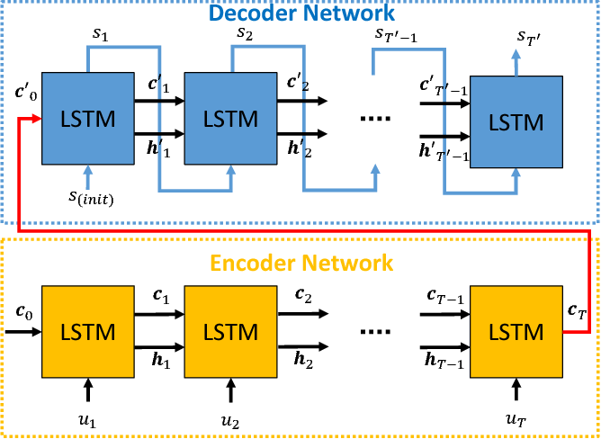
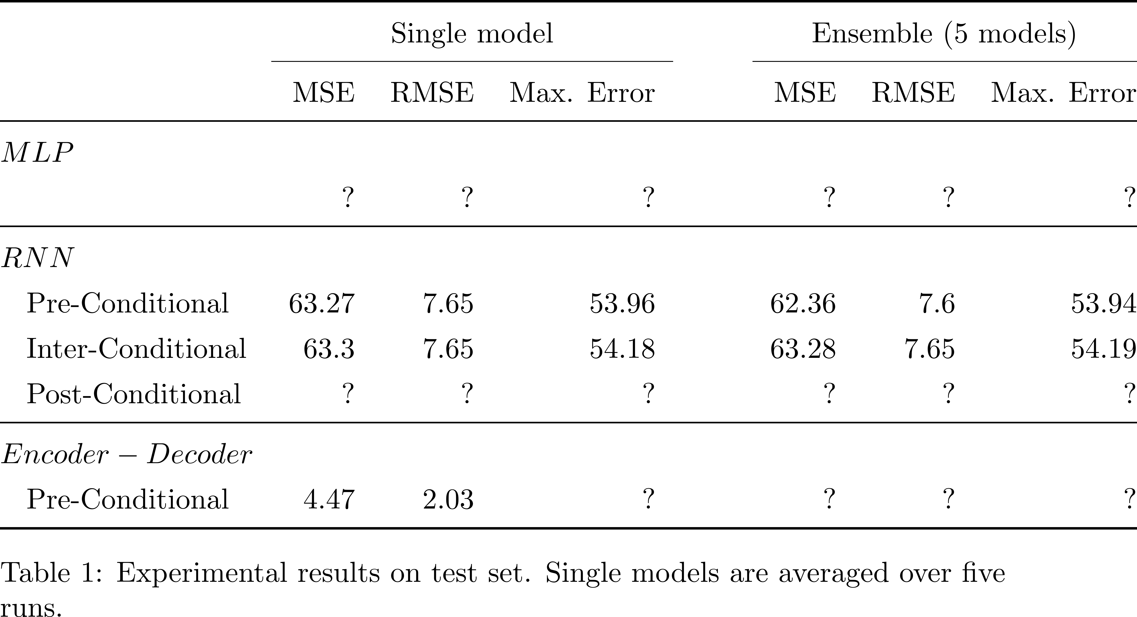
Conditional Performance Prediction Sven Hauns, Sambit Mohapatra & Simon Schrodi
Project goals
Predict validation accuracy at the end of training
Leverage hyperparameter information
Provide reliable fidelities (e.g. learning curve prediction)
Related Work
Parametric learning curve models (Domhan et al. 2014)
Bayesian Neural Network using hyperparameters as input (Klein et al. 2017)
Probabilistic Rollouts & treating learning curves as sequential data (Gargiani et al. 2019)
Architectures
MLP
Pre-Conditional RNN
Inter-Conditional RNN
Post-Conditional RNN
Pre-Conditional RNN Encoder-Decoder
Experimental Results
Outlook & Future Work
Visualizing relevances of hyperparameters
Using multivariate temporal input
Estimate upper and lower bounds of validation accuracy

