Slide 1
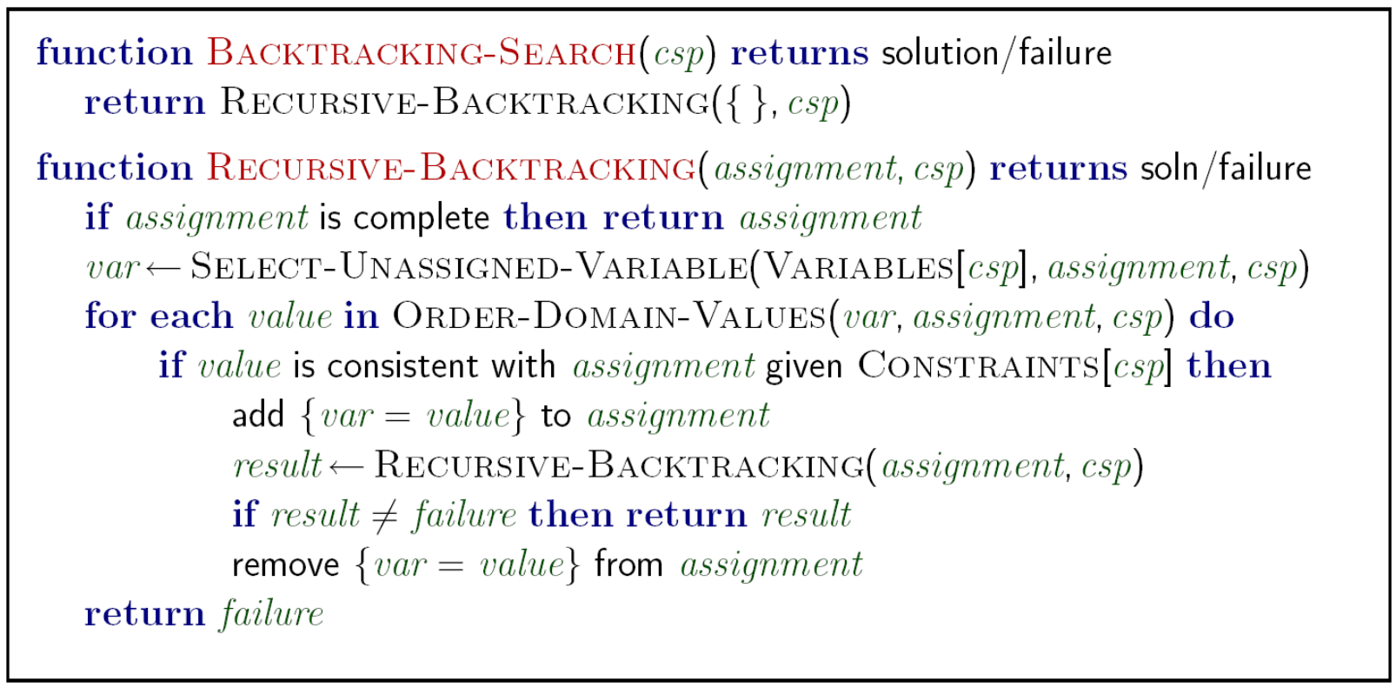
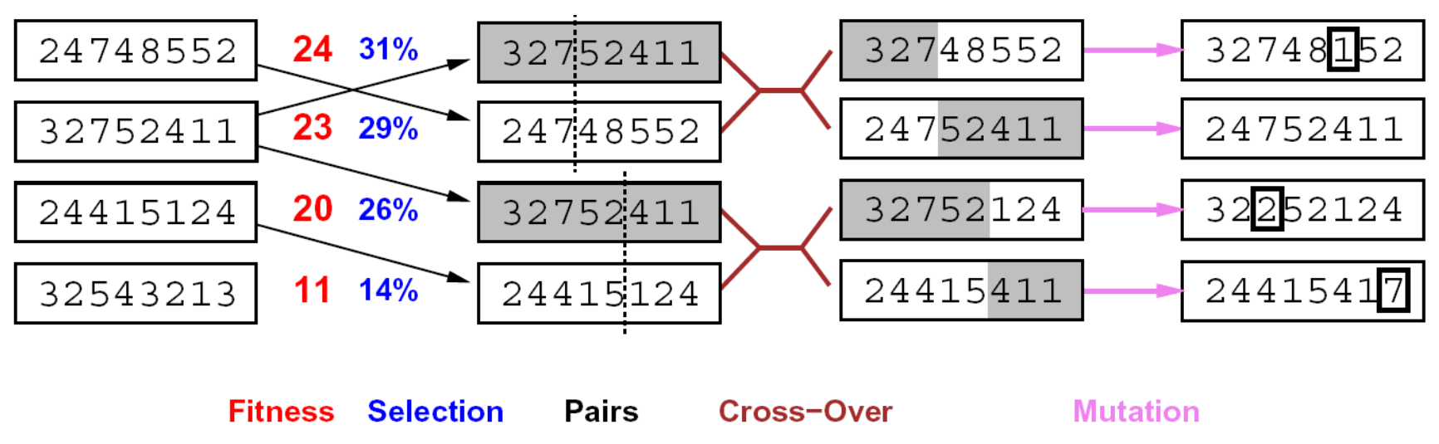


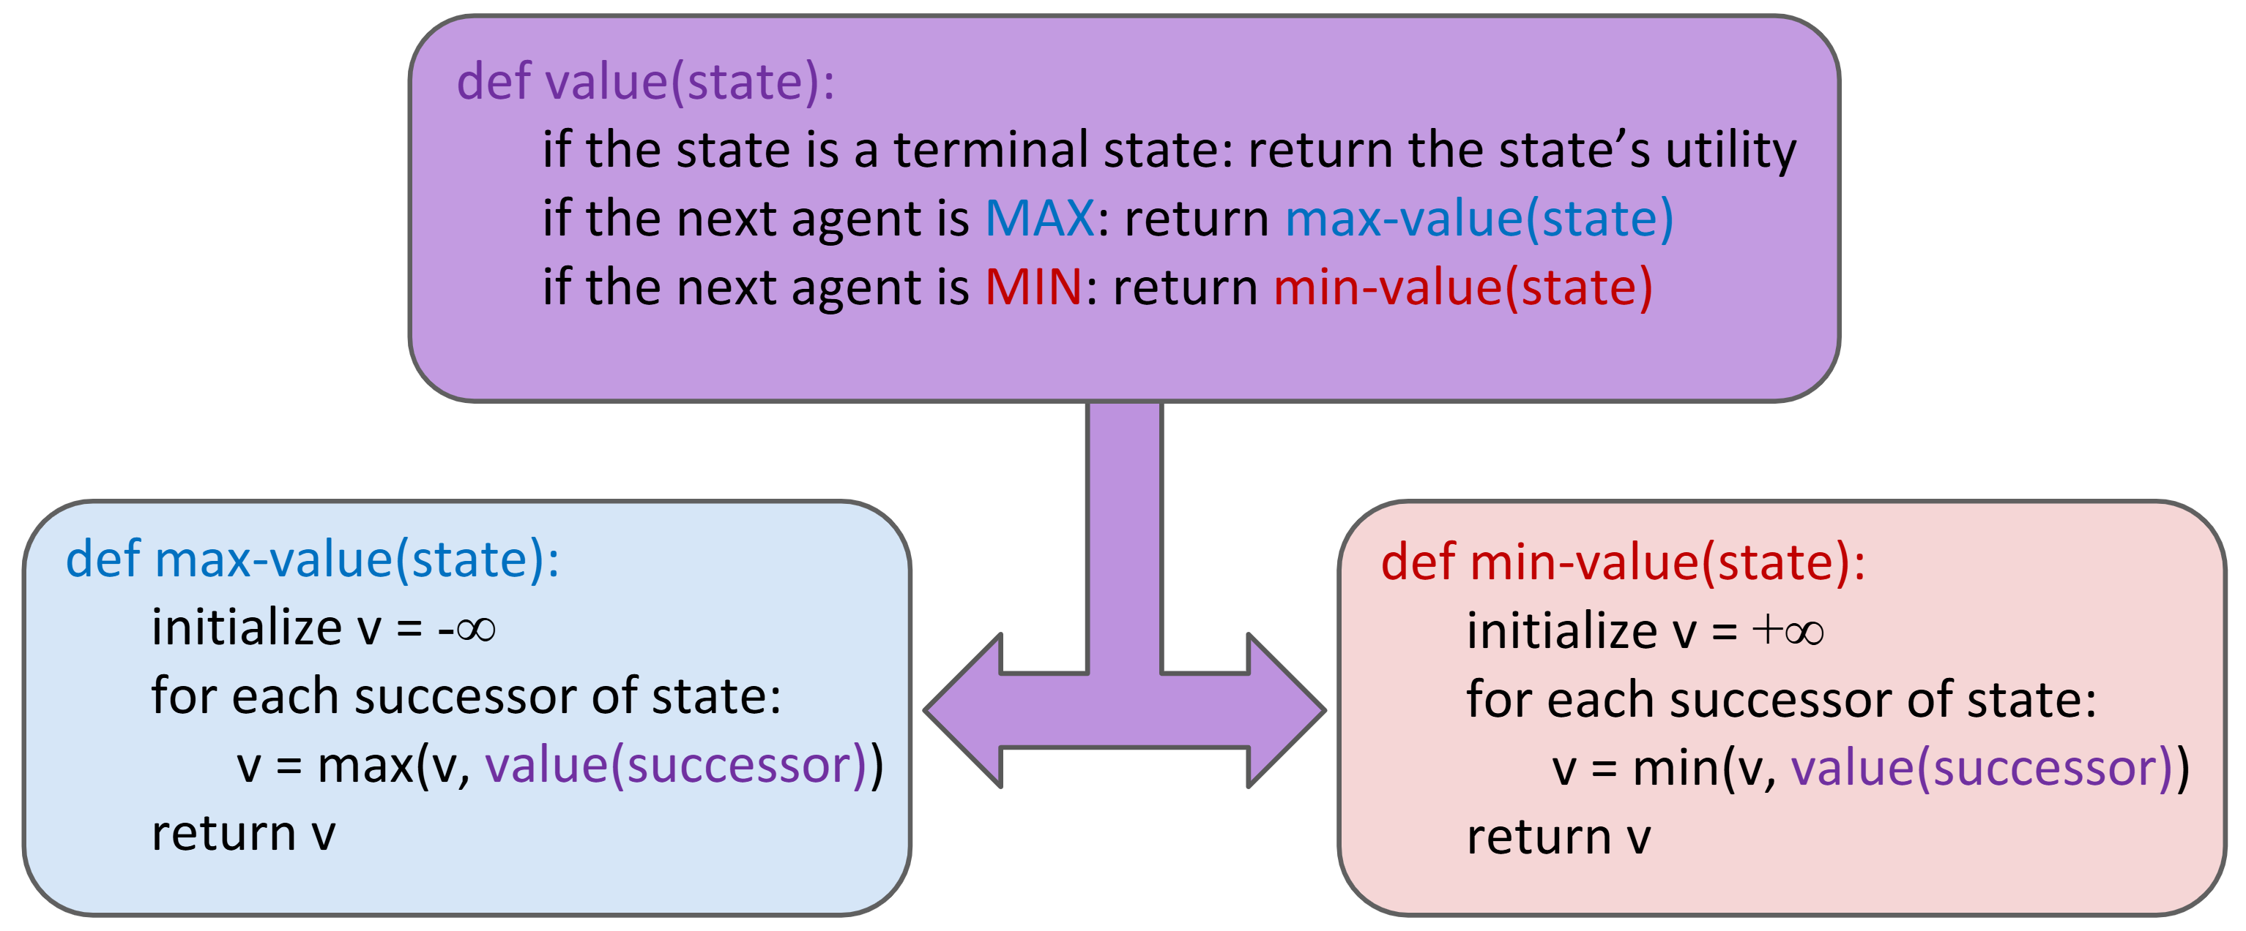

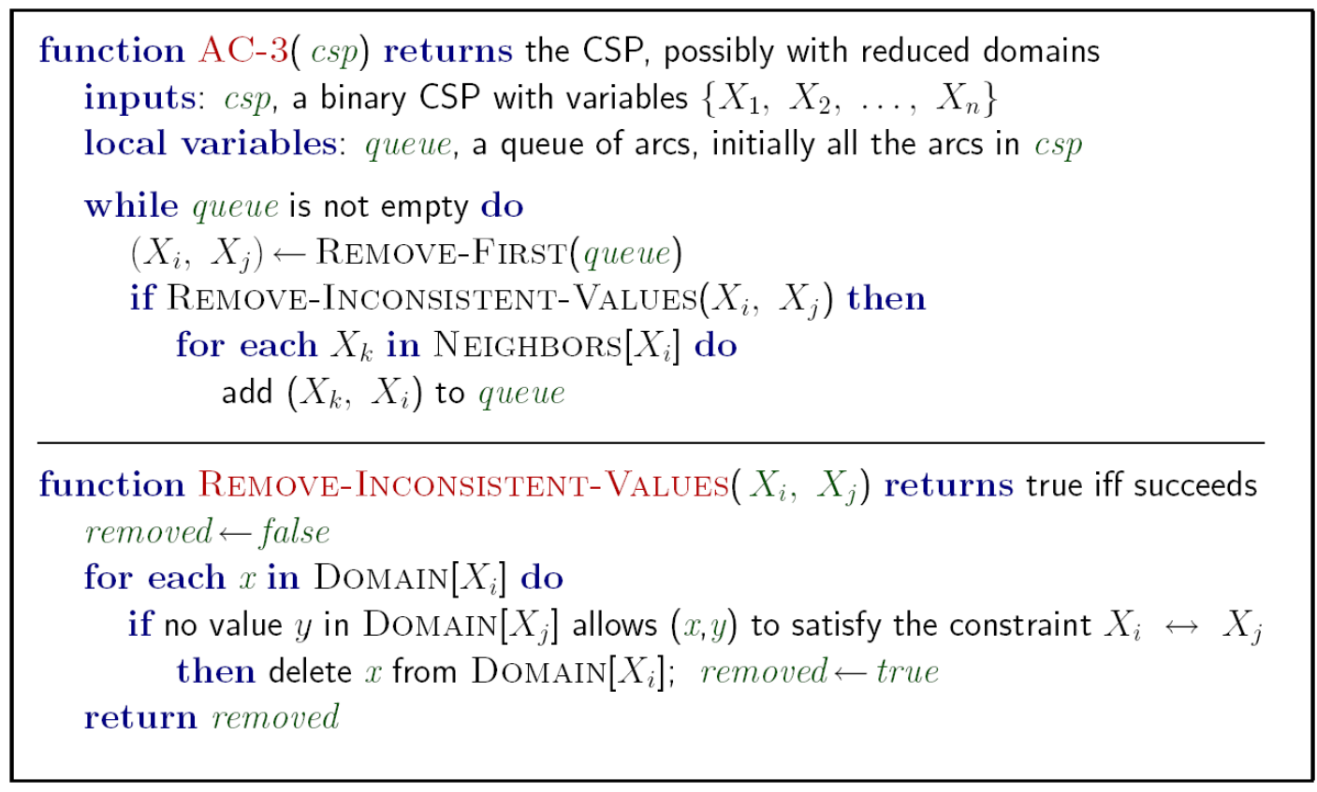
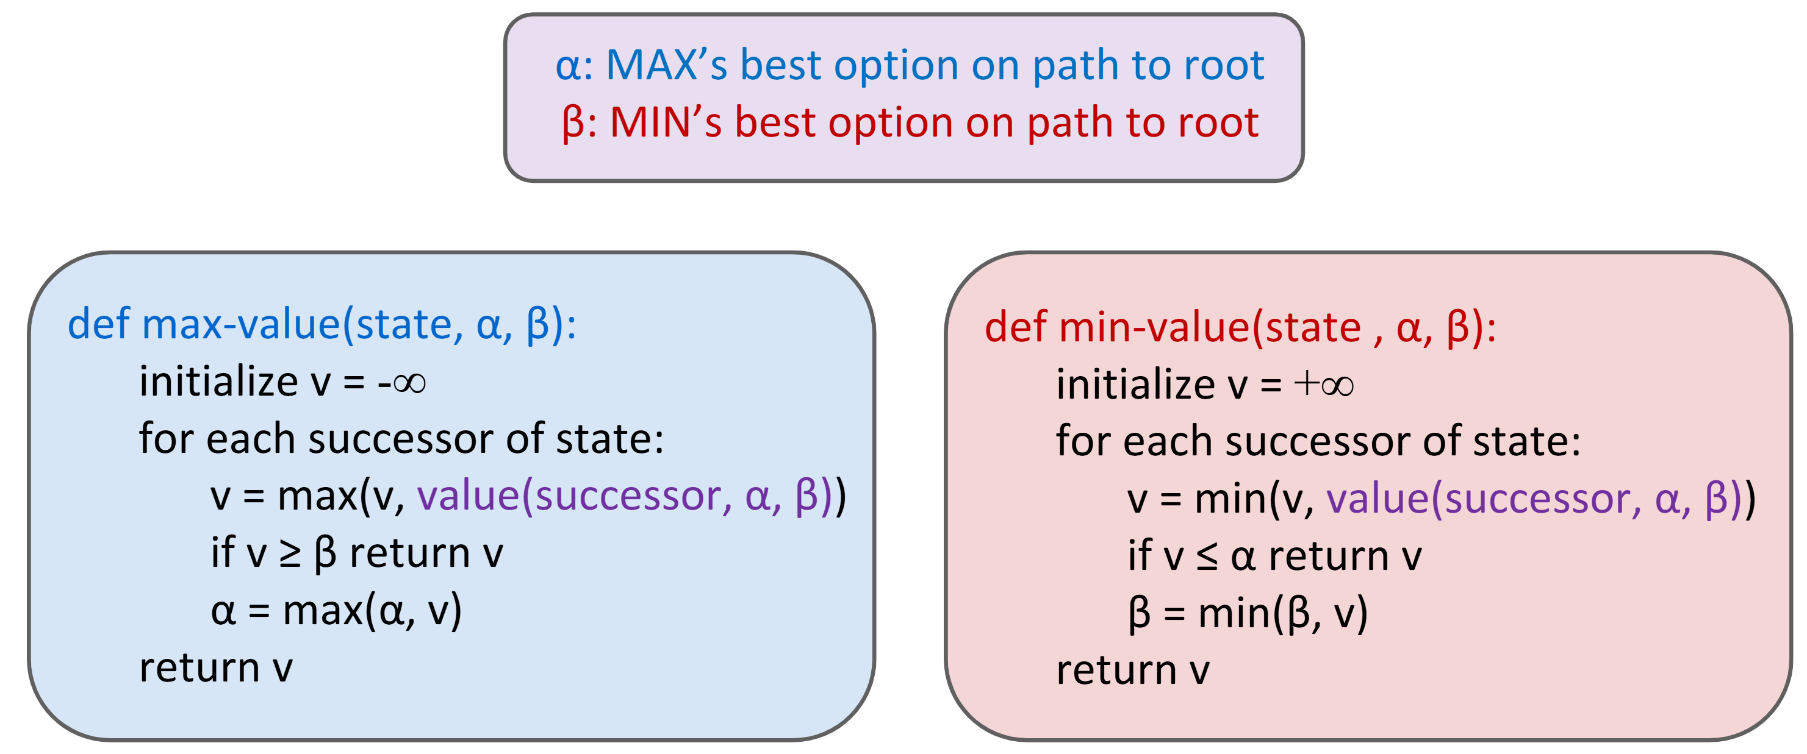
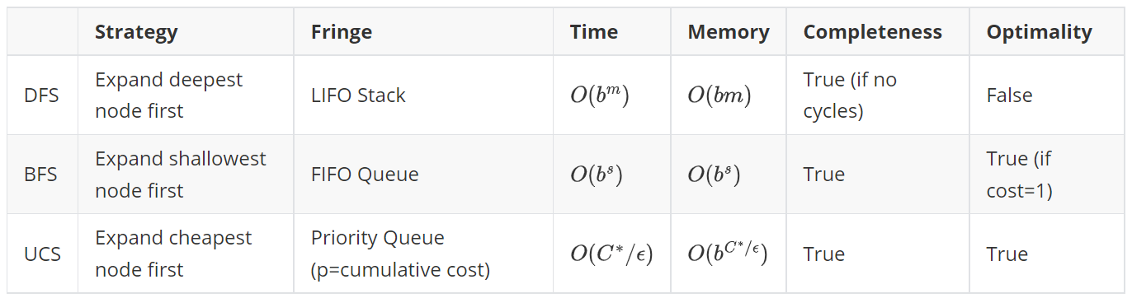
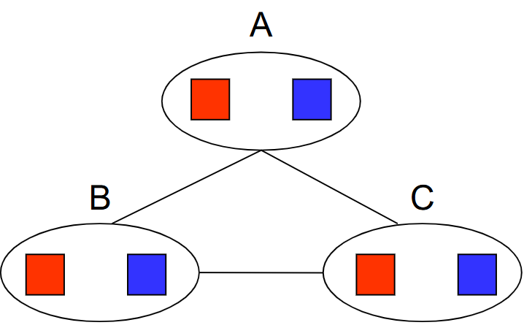
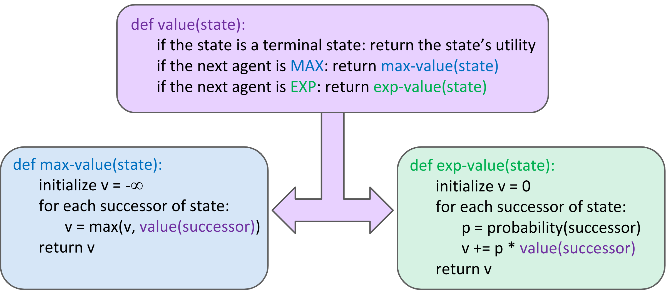
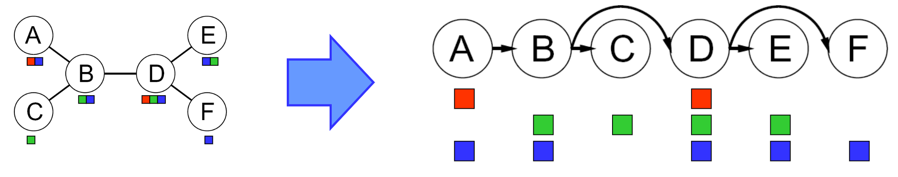

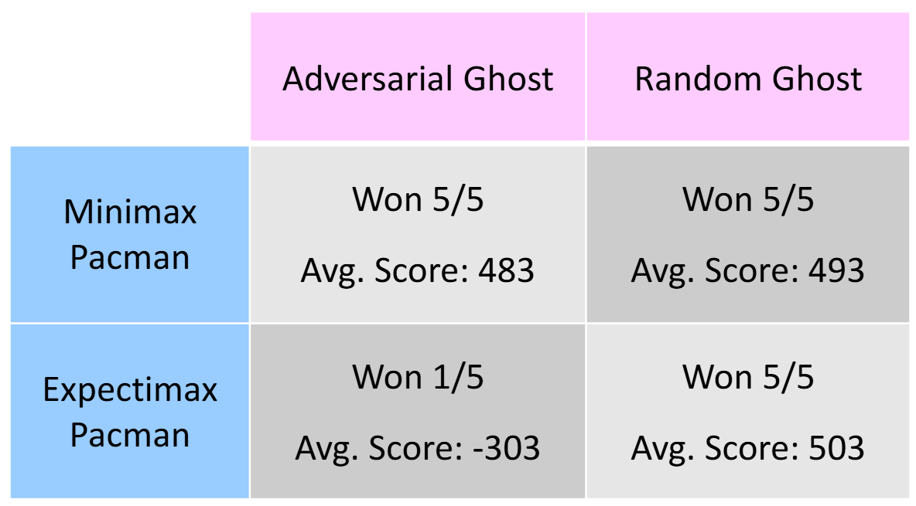

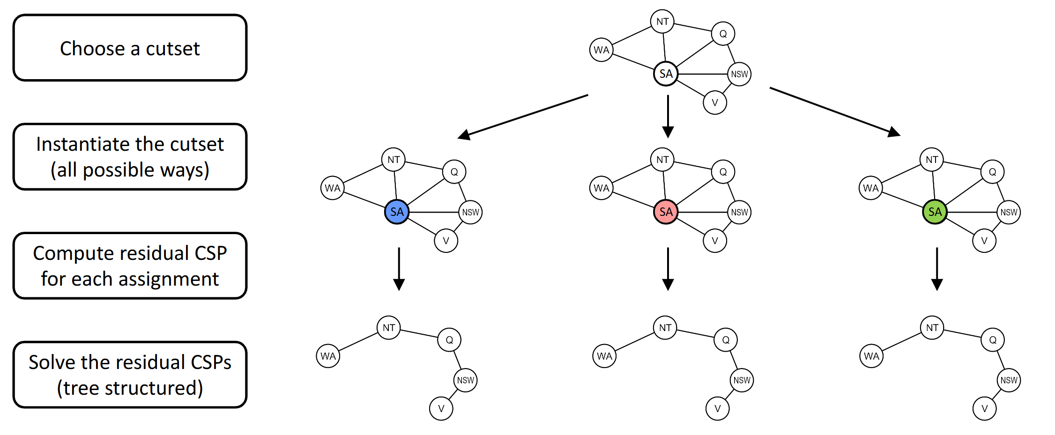
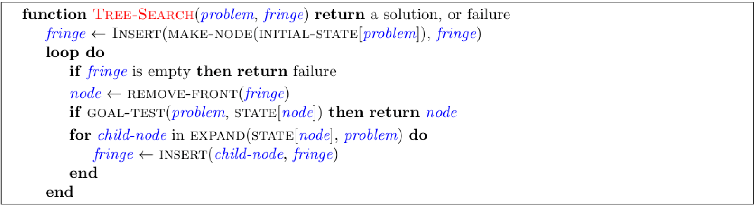
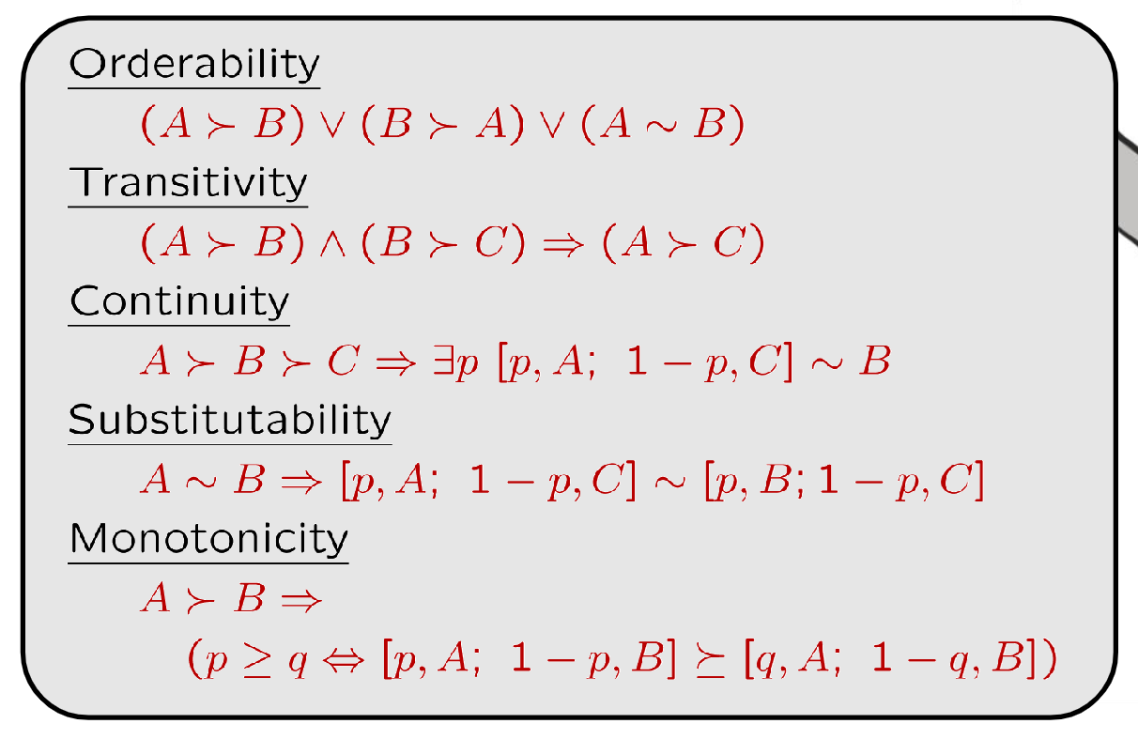
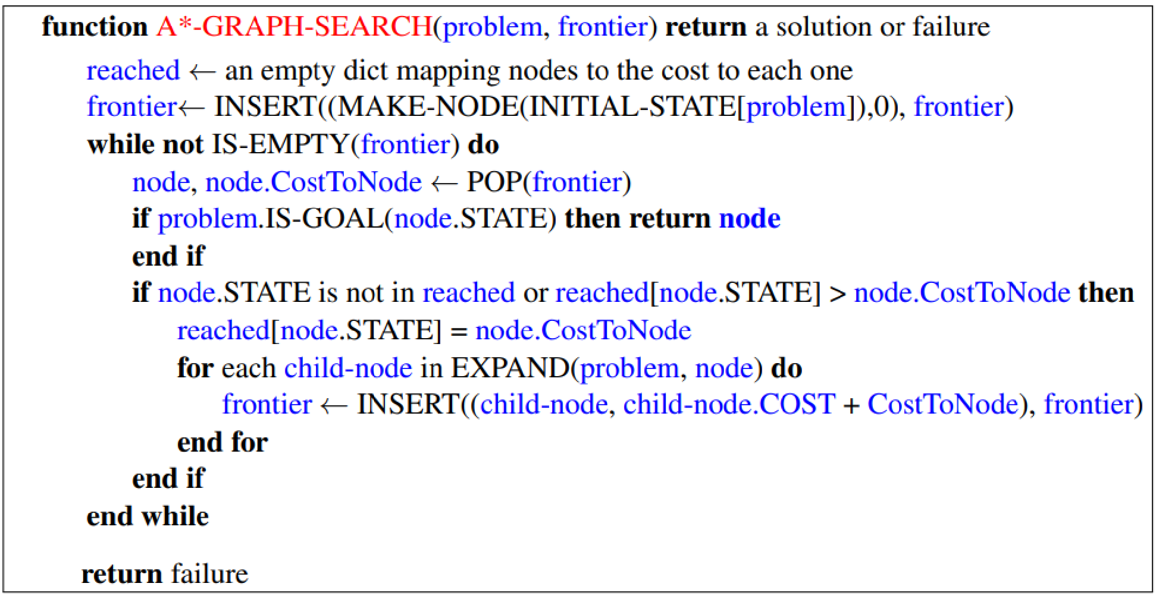
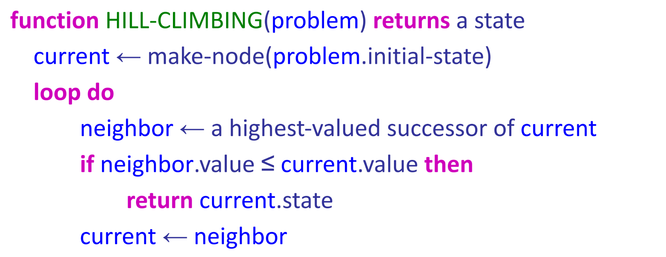
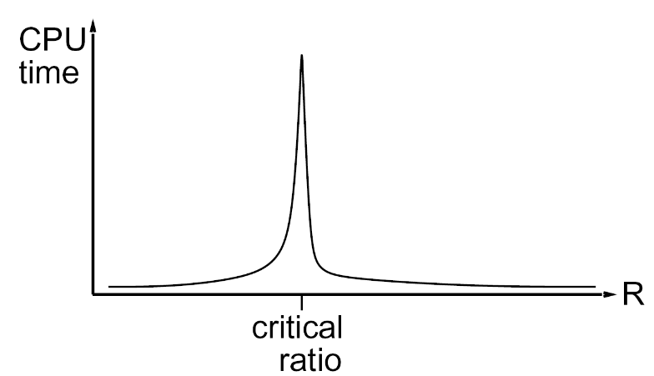
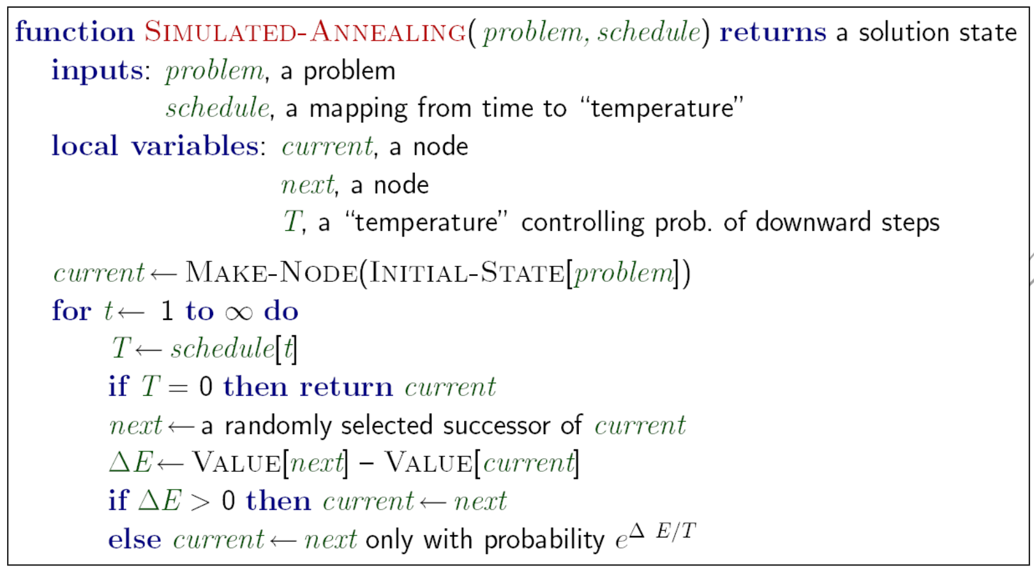
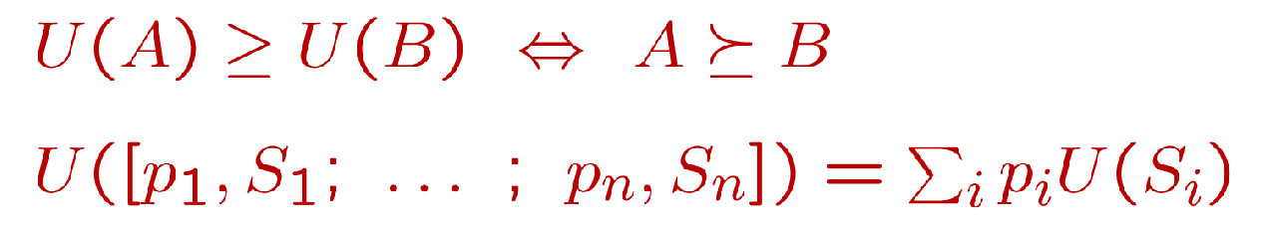

CS188 Midterm Cheat Sheet
simonxie2004.github.io
4. Genetic Algorithms
Lec1: Introduction
Lec2: Uninformed Search
1. Reflex Agents V.S. Planning Agents:
1. Reflex Agents: Consider how the world IS
2. Planning Agents: Consider how the world WOULD BE
2. Properties of Agents
1. Completeness: Guaranteed to find a solution if one exists.
2. Optimality: Guaranteed to find the least cost path.
3. Definition of Search Problem:
`State Space`, `Successor Function`, `Start State` & `Goal Test`
4. Definition of State Space: World State & Search State
5. State Space Graph: Nodes = states, Arcs = successors (action results)
6. Tree Search
1. Main Idea: Expand out potential nodes; Maintain a fringe of partial plans under consideration; Expand less nodes.
2. Key notions: Expansion, Expansion Strategy, Fringe
3. Common tree search patterns
(Suppose b = branching factor, m = tree depth.)
Nodes in search tree?
(For BFS, suppose s = depth of shallowest solution)
(For Uniform Cost Search, suppose solution costs C*, min(arc_cost) = eps
4. Special Idea: Iterative Deepening
Run DFS(depth_limit=1), DFS(depth_limit=2), ...
5. Example Problem: Pancake flipping; Cost: Number of pancakes flipped
7. Graph Search
1. Idea: never expand a state twice
2. Method: record set of expanded states where elements = (state, cost).
If a node popped from queue is NOT visited, visit it.
If a node popped from queue is visited, check its cost.
If the cost if lower, expand it. Else skip it.
Lec6: Game Trees (MiniMax)
1. Zero-Sum Games V.S. General Games: Opposite utilities v.s. Independent utilities
1. Examples of Zero-Sum Games: Tic-tac-toe, chess, checkers, ...
2. Value of State: Best achievable outcome (utility) from that state.
1. For MAX players
For MIN players, min...
3. Search Strategy: Minimax
6. Filtering & Arc Consistency
1. Definition: Arc X->Y is consistent if
that could be assigned. (Basically X is enforcing constraints on Y)
2. Filtering: Forward Checking: Enforcing consistency of arcs pointing to each new assignment
3. Filtering: Constraint Propagation: If X loses a Value, neighbors of X need to be rechecked.
4. Usage: run arc consistency as a preprocessor or after each assignment
5. Algorithm with Runtime O(n^2d^3)
4. Minimax properties:
1. Optimal against perfect player. Sub-optimal otherwise.
2. Time: O(b^m), Space: O(bm)
5. Alpha-Beta Pruning
1. Algorithm:
7. Advanced Definition: K-Consistency
1. K-Consistency: For each k nodes,
Any consistent assignment to k-1 nodes can be extended to kth node.
2. Strong K-Consistency: also k-1, k-2, ..., 1-Consistent;
Can be solved immediately without searching / backtracking
3. Problems of Arc-consistency: only considers 2-consistency
4. Example of being NOT 3-consistent:
Lec3: Informed Search
2. Properties:
1. Meaning of Alpha: maximum reward for MAX players, best option so far for MAX player
2. Meaning of Beta: minimum loss for MIN players, best option so far for MIN player
3. Have no effect on root value; intermediate values might be wrong.
4. With perfect ordering, time complexity drops to O(b^(m/2))
6. Depth-Limited Minimax: replace terminal utilities with an evaluation function for non-terminate positions
1. Evaluation Functions: weighted sum of features observed
7. Iterative Deepening: run minimax with depth_limit = 1, 2, 3, ... until timeout
Definition of heuristic:
Function that estimates how close a state is to a goal; Problem specific!
Example heuristics: (Relaxed-problem heuristic)
Pancake flipping: heuristic = the number of largest pancake that is still out of place
Dot-Eating Pacman: heuristic = the sum of all weights in a MST (of dots & current coordinate)
Classic 8 Puzzle: heuristic = number of tiles misplaced
Easy 8 Puzzle (allow tile to be piled intermediately): heuristic = total Manhattan distance
Remark: Can't use actual cost as heuristic, since have to solve that first!
Comparison of algorithms:
Greedy Search: expand closest node (to goal);
Orders by forward cost h(n); suboptimal
UCS: expand closest node (to start state);
Orders by backward cost g(n); suboptimal
A* Search: orders by sum f(n) = g(n) + h(n)
A* Search
When to stop: Only if we dequeue a goal
Admissible (optimistic) heuristic:
A* Tree Search is optimal if heuristic is admissible.
Proof: Suppose A is optimal, B is suboptimal. B is on fringe.
Claim: n will be expanded first. Because f(n) = g(n) + h(n) < f(A) < f(B)
3. Consistent heuristic:
A* Graph Search is optimal if heuristic is consistent.
6.Semi-Lattice of Heuristics
Dominance: define
Heuristics form semi-lattice because:
Bottom of lattice is zero-heuristic. Top of lattice is exact-heuristic
8. Advanced Arc-Consistency: Ordering
1. Variable Ordering: MRV (Minimum Remaining Value):
Choose the variable with fewest legal left values in domain
2. Value Ordering: LCV (Least Constraining Value):
Choose the value that rules out fewest values in remaining variables.
(May require re-running filtering.)
9. Advanced Arc-Consistency: Observing Problem Structure
1. Suppose graph of n variables can be broken into subproblems with c
variables: Can solve in O(n/c * d^c)
2. Suppose graph is a tree: Can solve in O(nd^2). Method as follows
1. Remove backward: For i = n : 2, apply RemoveInconsistent(Parent(Xi),Xi)
2. Assign forward: For i = 1 : n, assign Xi consistently with Parent(Xi)
3. *Remark: After backward pass, all root-to-leaf are consistent.
Forward assignment will not backtrack.
Lec7: Game Trees (Expectimax, Utilities)
1. Expetimax Algorithm:
10. Advanced Arc-Consistency: Improving Problem Structure
1. Idea: Initiate a variable and prune its neighbors' domains.
2. Method: instantiate a set of vars
such that remaining constraint graph is a tree (cutset conditioning)
3. Runtime: O(d^c * (n-c)d^2) to solve CSP.
2. Assumptions vs Reality:
Rational & Irrational Agents
11. Iterative Methods:
1. Local Search
1. Algorithm: While not solved, randomly select any conflicted variable.
Assign value by min-conflicts heuristic.
2. Performance: can solve n-queens in almost constant time for arbitrary n
with high probability, except a few of them.
2. Hill Climbing
3. Axioms of Rationality
3. Hill Climbing
Remark: Stationary distribution: p(x) propto e^(E(x)/kT)
4. MEU Principle
Given any preferences satisfying these constraints,
there exists a real valued function U s.t.:
Lec4-5: CSP Problems
5. Risk-adverse v.s. Risk-prone
1. Def. L = [p, X, 1-p, Y]
2. If U(L) < U(EMV(L)), risk-adverse
Where U(L) = pU(X) + (1-p)U(Y), U(EMV(L)) = U(pX + (1-p)Y)
i.e. if U is concave, like y=log2x, then risk-adverse
3. Otherwise, risk-prone.
i.e. if U is convex, like y=x^2, then risk-prone
1. Definition of CSP Problems: (A special subset of search problems)
1. State: Varibles {Xi}, with values from domain D
2. Goal Test: set of constraints specifying allowable combinations of values
2. Example of CSP Problems:
1. N-Queens
Formulation 1: Variables: Xij, Domains: {0, 1}, Constraints:
Formulation 2: Variables Qk, Domains: {1, ..., N}, Constraints:
2. Cryptarithmetic
3. Constraint Graph:
1. Circle nodes = Variables; Rectangular nodes = Constraints.
2. If there is a relation between some variables,
They are connected to a constraint node.
4. Simple Backtracking Search
1. One variable at a time
2. Check constraints as you go. (Only consider constraints not conflicting to previous assignments)
5. Simple Backtracking Algorithm = DFS + variable-ordering + fail-on-violation
Lec8-9: Markov Decision Process
1. MDP World: Noisy movement, maze-like problem, receives rewards.
1. "Markov": Successor only depends on current state (not the history)
2. MDP World Definition:
1. States, Actions
2. Transition Function T(s, a, s') or Pr(s' | s, a), Reward Function R(s, a, s')
3. Start State, (Probably) Terminal State
3. MDP Target: optimal policy pi*: S -> A

Slide 2
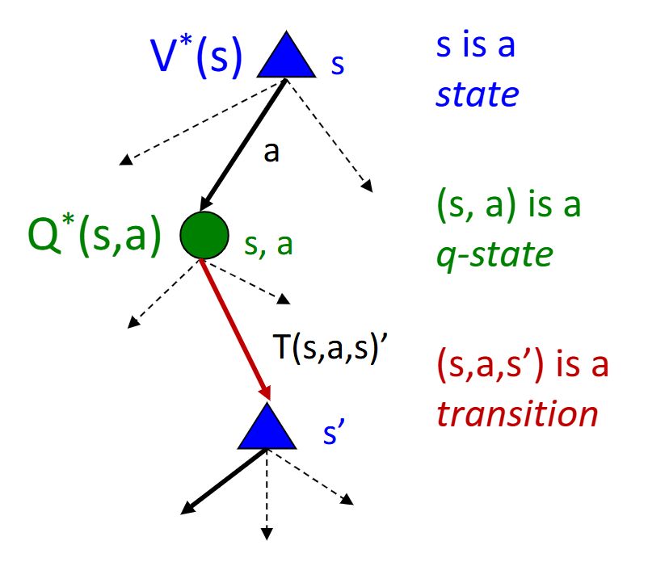



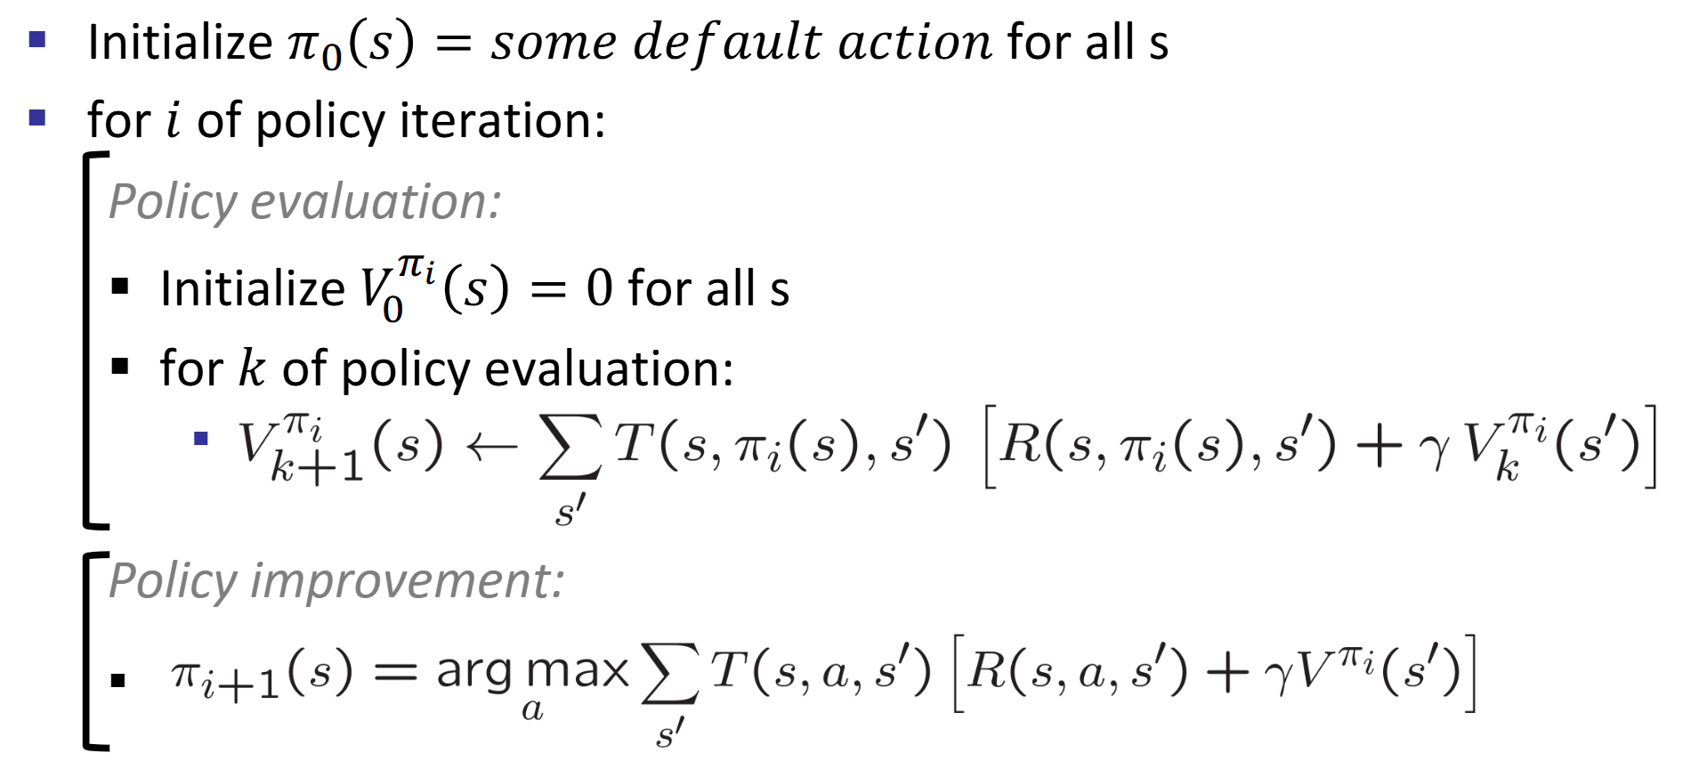
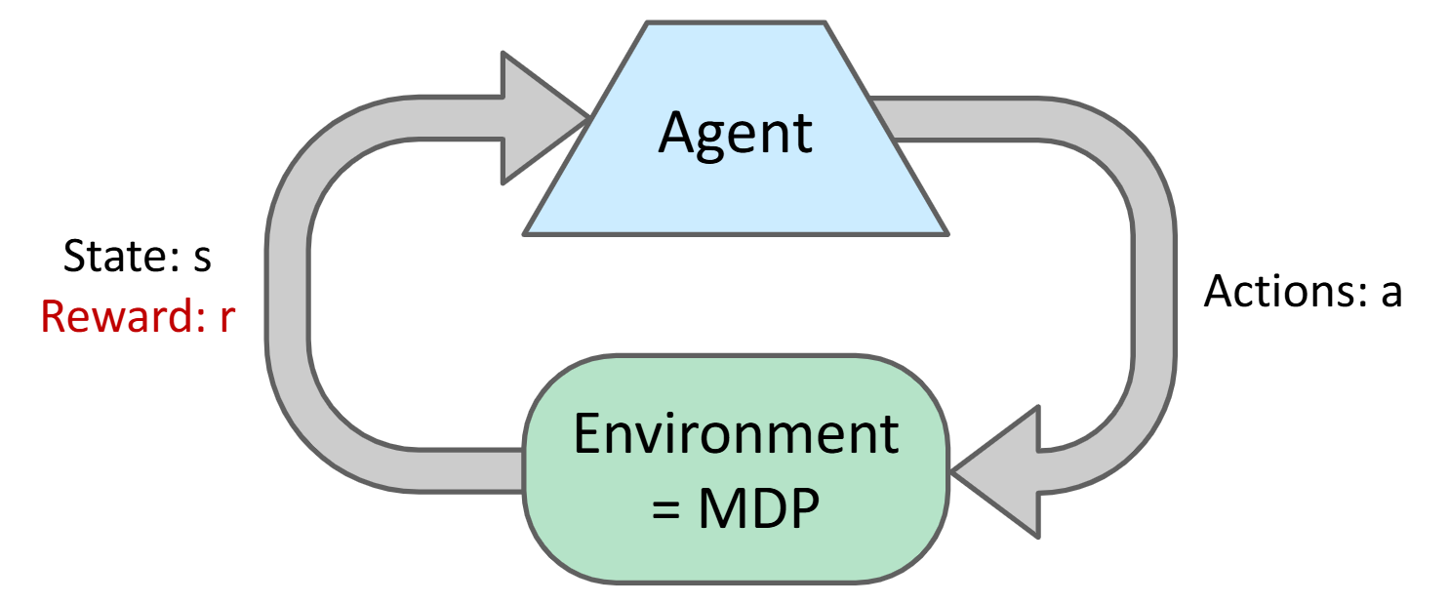
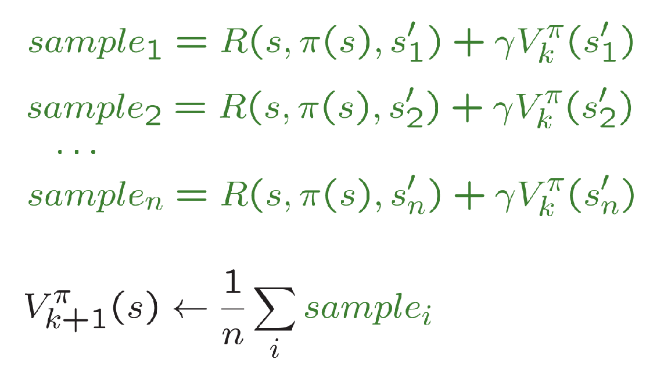
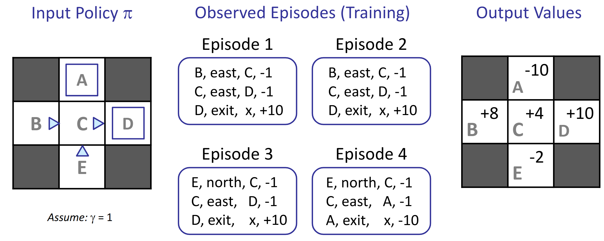

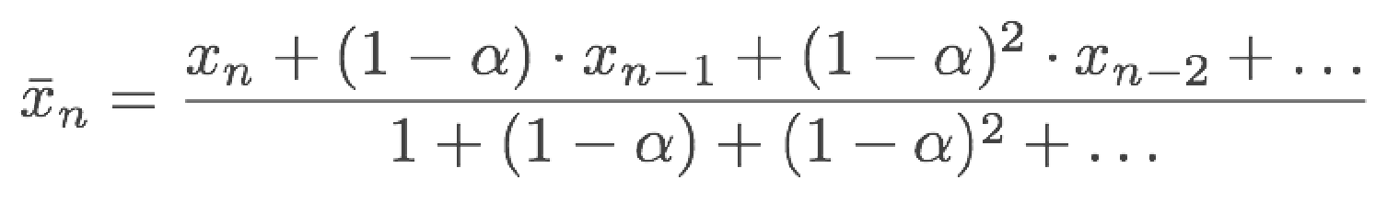
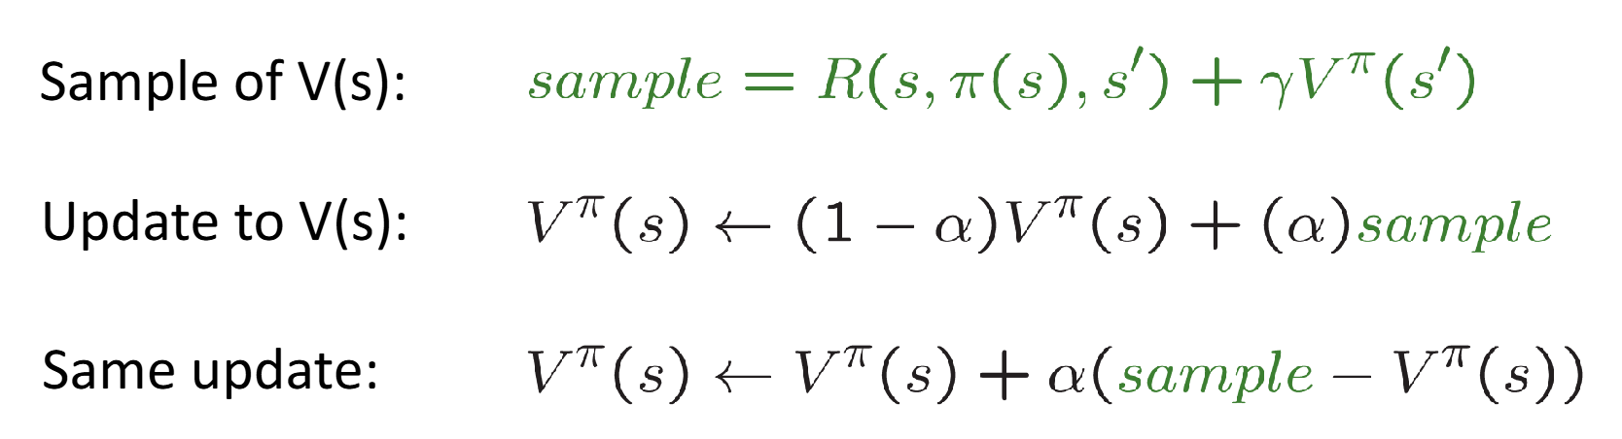

4. Discounting: Earlier is Better! No infinity rewards!
5. MDP Search Trees:
1. Value of State: expected utility starting in s and
acting optimally.
2. Value of Q-State: expected utility starting out
having taken action a from state s and
(thereafter) acting optimally.
3. Optimal Policy:
7. Scaling up RL: Approximate Q Learning
1. State space too large & sparse?
Use linear functions to approximately learn Q(s,a) or V(s)
2. Definition:
3. Q-learning with linear Q-fuctions:
Transition := (s, a, r, s')
Difference :=
Approx. Update weight:
6. Solving MDP Equations: Value Iteration
1. Bellman Equation:
2. Value Calculation:
3. Policy Extraction:
4. Complexity (of each iteration): O(S^2A)
5. Must converge to optimal values. Policy may converge much earlier.
7. Solving MDP Equations: Q-Value Iteration
1. Bellman Equation:
2. Policy Extraction:
8. MDP Policy Evalutaion: Evaluating V for fixed policy
1. Idea 1: remove the max'es from Bellman, iterating
2. Idea 2: is a linear system. Use a linear system solver.
9. Solving MDP Equations: Policy Iteration
1. Idea: Update Policy & Value meanwhile, much much faster!
2. Algorithm:
Lec 10-11: Reinforcement Learning
1. Intuition: Suppose we know nothing about the world. Don't know T or R.
2. Passive RL I: Model-Based RL
1. Count outcomes s' for each s, a; Record R;
2. Calculate MDP through any iteration
3. Run policy. If not satisfied, add data and goto step 1
3. Passive RL II: Model-Free RL (Direct Evaluation, Sample-Based Bellman Updates)
1. Intuition: Direct evaluation from samples.
Improve our estimate of V by computing averages of samples.
2. Input: fixed policy pi(s)
3. Act according to pi. Each time we visit a state,
write down what the sum of discounted rewards turned out to be.
4. Average the samples, we get estimate of V(s)
5. Problem: wastes information about state connections.
Each state learned separately. Takes long time.
4. Passive RL II: Model-Free RL (Temporal Difference Learning)
1. Intuition: learn from everywhere / every experience.
Recent samples are more important.
2. Update:
3. Decreasing learning rate (alpha) converges
4. Problem: Can't do policy extraction, can't calculate Q(s, a) without T or R
5. Idea: learn Q-values directly! Make action selection model-free too!
5. Passive RL III: Model-Free RL (Q-Learning + Time Difference Learning)
1. Intuition: Learn as you go.
2. Update:
1. Receive a sample (s, a, s', r)
2. Let sample =
3. Incorporate new estimate into a running average:
4. Another representation:
where diff = sample - orig
3. This is off-policy learning!
6. Active RL: How to act to collect data
1. Exploration schemes: eps-greedy
1. With probability eps, act randomly from all options
2. With probability 1 – eps, act on current policy
2. Exploration functions: use an optimistic utility instead of real utility
1. Def. optimistic utility
suppose u = value estimate, n = visit count
2. Modified Q-Update:
3. Measuring total mistake cost: sum of difference between expected rewards and suboptimality rewards.

