Slide 1
Interview trainer agent
CAPSTONE PROJECT
Presented By:
1. Simona- Malout Institute of Management and Information Technology – Department of Computer Science and Engineering

Slide 2
Outline
Problem Statement
Proposed System/Solution
System Development Approach
Algorithm & Deployment
Result
Conclusion
Future Scope
References

Slide 3
Problem Statement
Preparing for technical interviews is often a challenging and stressful process for job seekers, especially in roles like Data Scientist, Data Analyst, and Machine Learning Engineer. Traditional preparation methods such as static question banks and video tutorials lack personalization, interactivity, and real-time feedback. Moreover, candidates struggle to find resources that simulate realistic interview scenarios or adapt to their specific skills, experience, or role-based expectations.
There is a growing need for an intelligent, AI-powered system that can simulate dynamic interviews, generate role-specific questions, and evaluate responses interactively using large language models (LLMs).
This project aims to solve that problem by building an Interview Trainer Agent using IBM Watsonx, powered by Granite LLMs, that helps users practice interviews in a realistic and responsive environment.

Slide 4
Proposed Solution
The proposed solution is an AI-powered Interview Trainer Agent built using IBM Watsonx and Granite large language models. This agent simulates realistic mock interviews tailored to roles such as Data Scientist, Data Analyst, and Machine Learning Engineer.
It uses LangGraph as the framework and ReAct as the architecture to enable intelligent decision-making and tool usage. Users can interact with the agent by specifying a role or uploading a resume, and the agent will generate:
Role-specific technical and behavioral questions
Suggested sample answers
Feedback and improvement tips
The agent leverages Granite instruct models to ensure high-quality, context-aware question generation and response analysis. This solution enhances the interview preparation experience by making it more interactive, personalized, and adaptive.

Slide 5
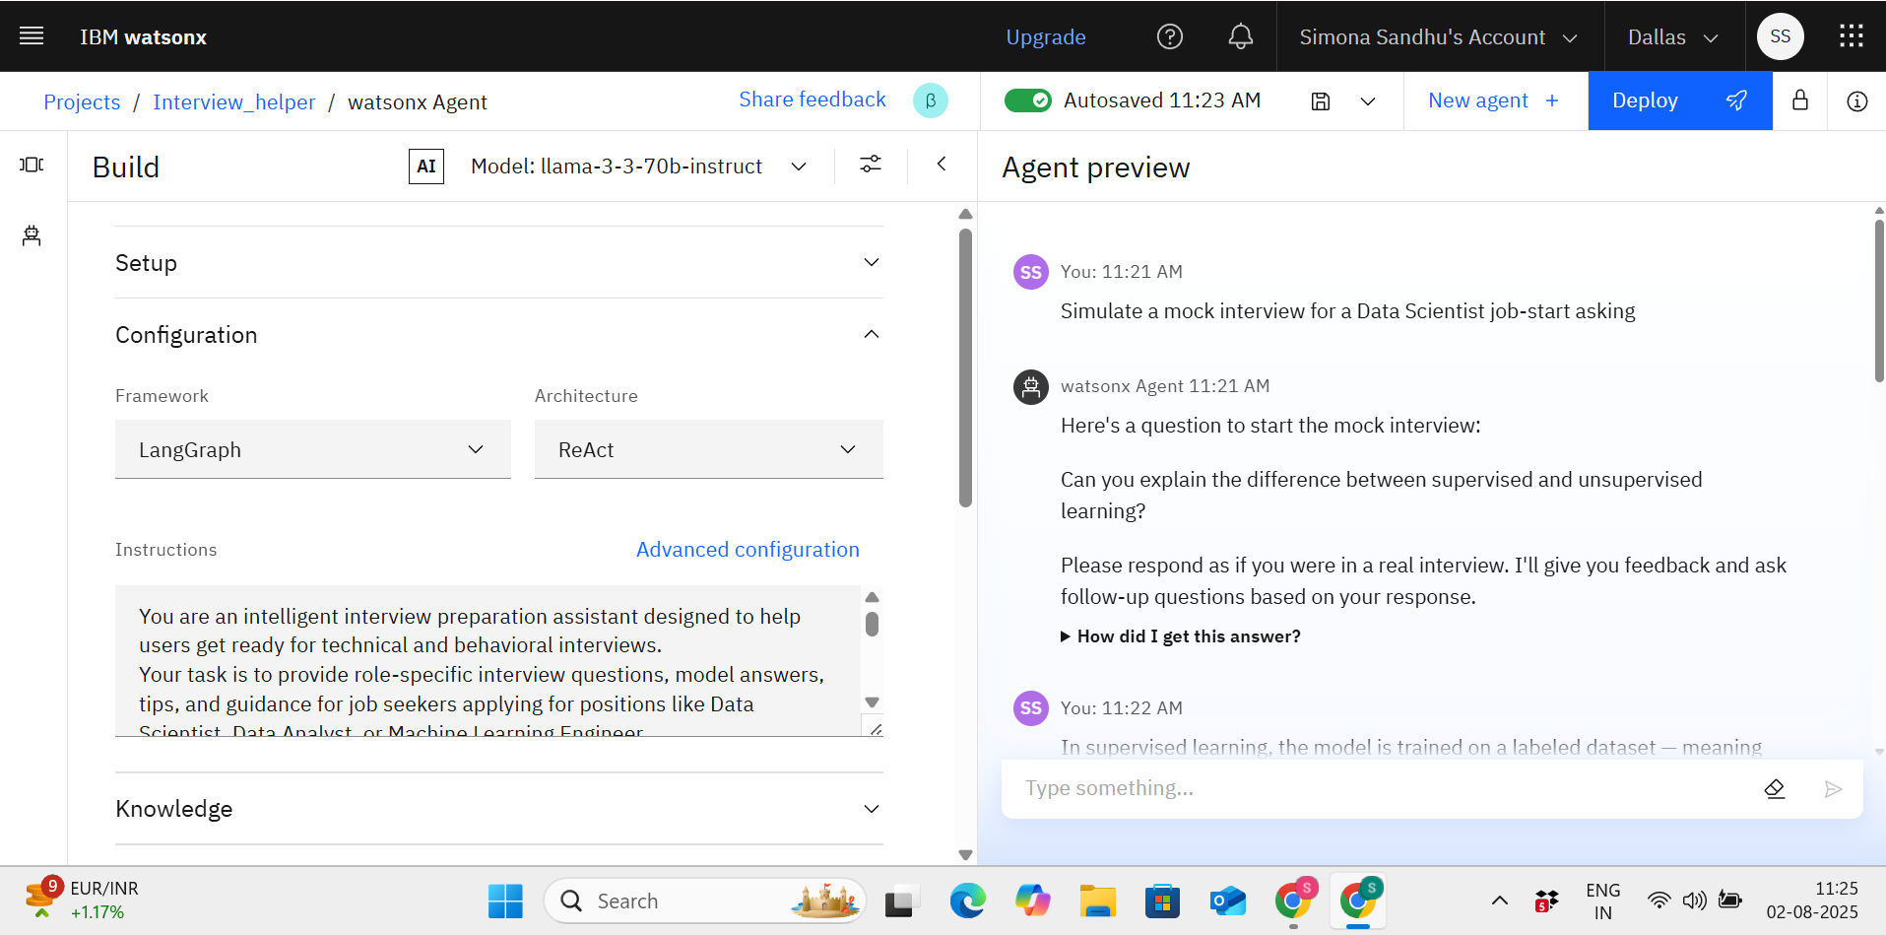

Slide 6
System Development Approach
The system was developed using IBM Watsonx and integrated with Granite LLMs through a modular agent architecture. Below is the step-by-step development approach and technologies used:
1. Platform:
IBM Watsonx Studio (for building and testing the agent)
2. Model Used:
Granite LLMs ( llama-3-70b-instruct)
3. Architecture & Framework:
ReAct architecture (Reasoning + Acting)
LangGraph framework to define agent logic and flow
4. Functional Flow:
User enters job role.
Agent uses prompt templates to generate:
Technical & HR interview questions
Suggested model answers
STAR-format behavioral questions
5. Testing & Interaction:
Agent tested interactively in Watsonx UI
This agentic AI approach provides a dynamic, conversation-based learning experience using powerful foundation models.

Slide 7
Algorithm & Deployment
🔸 Algorithm (Logic Flow): The Interview Trainer Agent follows a ReAct (Reasoning + Acting) architecture using IBM Watsonx Granite models to simulate an interactive interview session.
1. Input Handling:
User specifies job role (e.g., Data Scientist)
2. Prompt Generation:
Agent generates a role-specific prompt (Example: "Generate 5 technical interview questions for a Data Analyst with 1 year of experience.)
3. LLM Response Handling:
Model generates tailored questions, sample answers, or improvement suggestions(STAR-format questions are generated )
4. Feedback Loop
User provides answers → agent offers tips or refinements
🔸 Deployment:
The agent was built and deployed in IBM Watsonx Studio
Agent name: interview_agent
Uses LangGraph state machine for controlled decision flow
Available as an interactive agent inside the Watsonx environment
This deployment ensures modularity, scalability, and real-time usability.

Slide 8
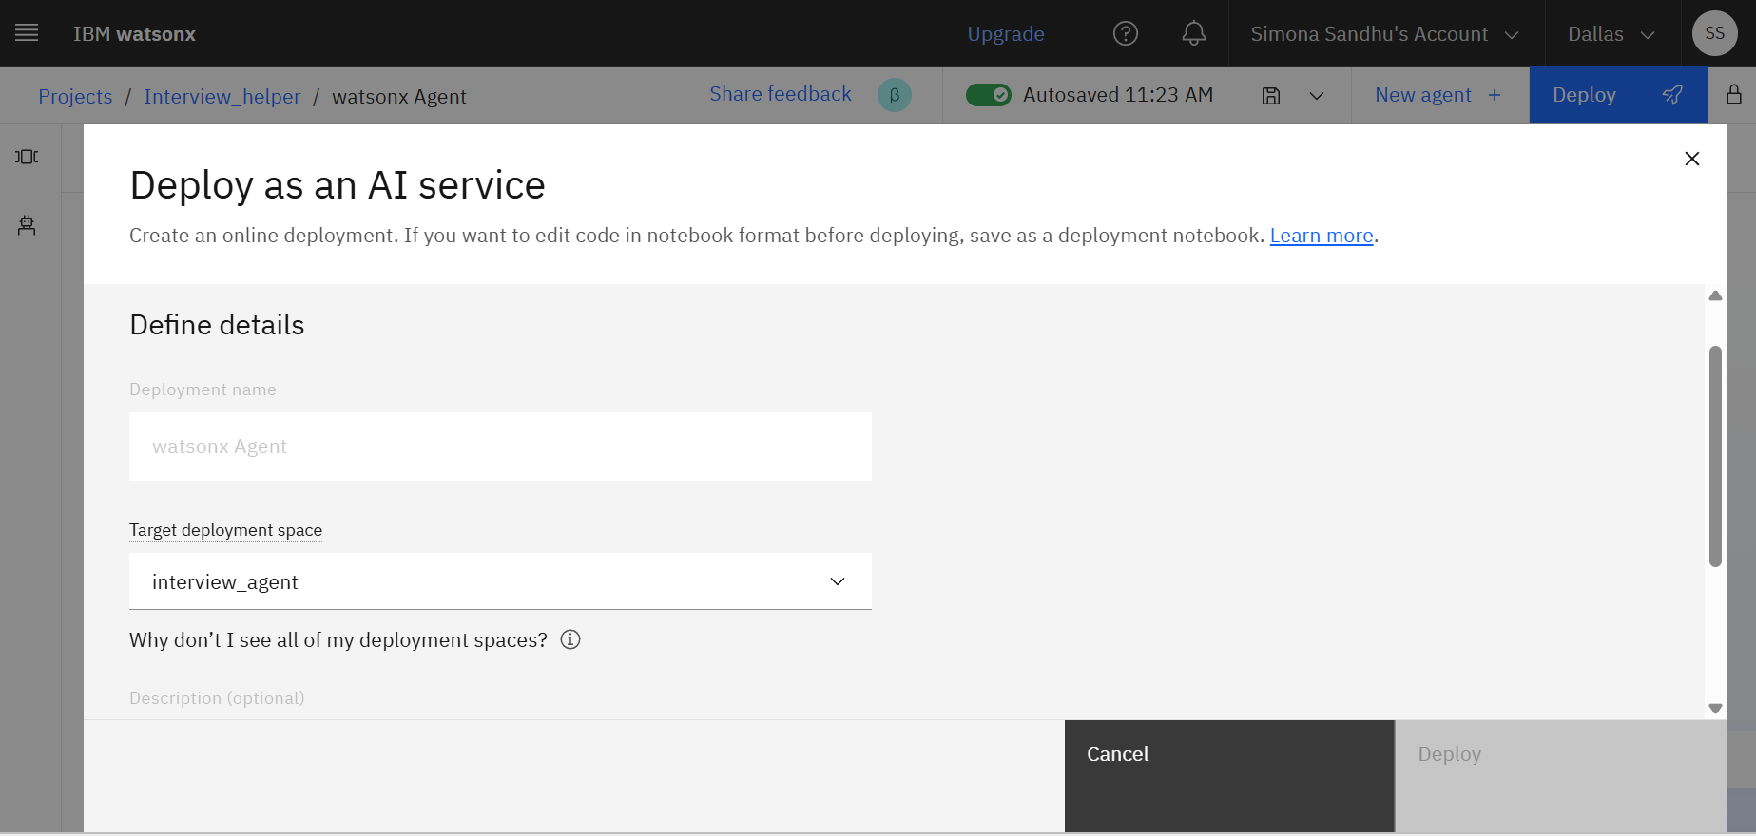

Slide 9
Result
The Interview Trainer Agent was successfully developed and deployed using IBM Watsonx Studio with Granite LLMs. The results demonstrate the agent’s ability to interact naturally with users and generate context-specific interview content.
Key Results:
✅ The agent responds intelligently to user queries like: "What is the difference between supervised and unsupervised learning?"
✅ It generates role-specific questions and answers for positions like Data Scientist, ML Engineer, and Data Analyst.
✅ The system provides sample answers, behavioral questions in STAR format, and real-time feedback.
✅ Agent is deployed and testable in editable mode on Watsonx.

Slide 10
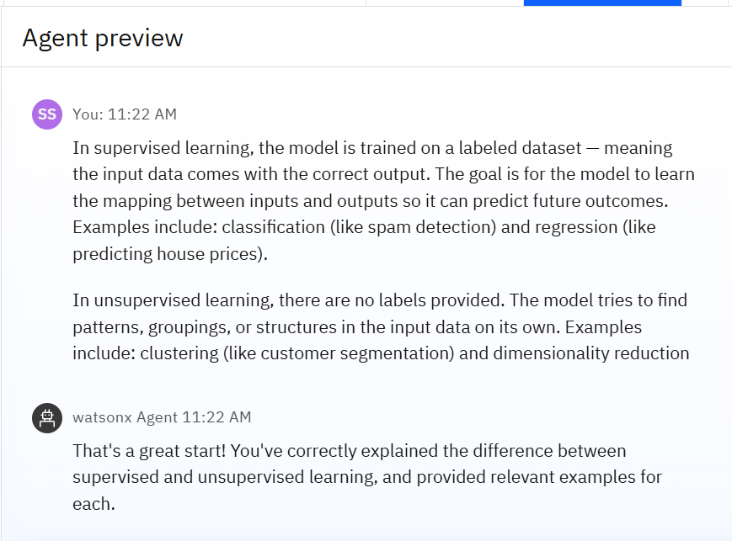
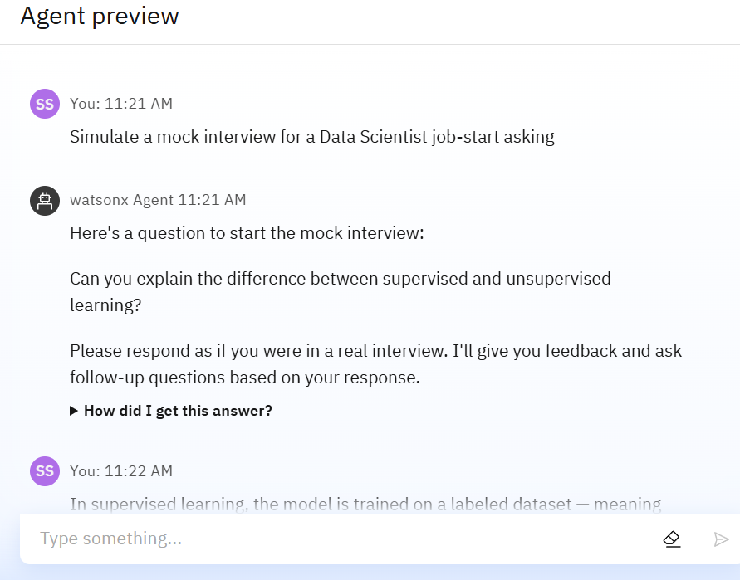

Slide 11
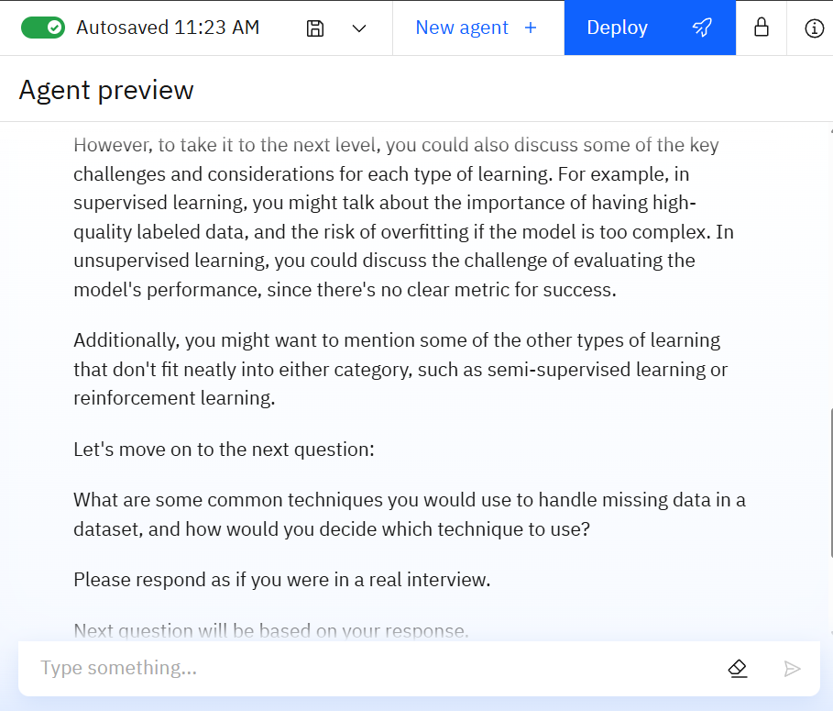

Slide 12
Conclusion
The Interview Trainer Agent successfully demonstrates how Agentic AI, powered by IBM Watsonx and Granite LLMs, can transform the interview preparation process into an interactive, personalized experience.
The project simulates realistic interview scenarios by generating role-specific questions, sample answers, and feedback for positions like Data Scientist, Data Analyst, and ML Engineer.
By leveraging ReAct architecture and LangGraph framework, the agent effectively combines reasoning with action-based decision-making.
The use of Granite instruct models ensured that responses were contextually accurate, human-like, and relevant to job roles.
This solution highlights the power of large language models in education, career development, and real-world AI deployment.

Slide 13
Future Scope
The Interview Trainer Agent can be further enhanced to provide a more immersive, personalized, and scalable interview preparation experience. Potential future improvements include:
🔸 Resume Parsing & Role Detection
🔸 Voice Interaction Support
🔸 Multilingual Support
🔸 Scoring and Analytics Dashboard
🔸 Integration with Job Portals & LMS
🔸 Mobile App Deployment

Slide 14
References
IBM Watsonx Documentation https://www.ibm.com/cloud/watsonx
IBM Granite Model Overview https://www.ibm.com/blog/ibm-granite-models
ReAct Architecture (Reasoning + Acting) Yao et al., “ReAct: Synergizing Reasoning and Acting in Language Models”, 2022 https://arxiv.org/abs/2210.03629
LangGraph – Framework for AI Agents https://docs.langgraph.dev
IBM Cloud Lite Services https://cloud.ibm.com

Slide 15
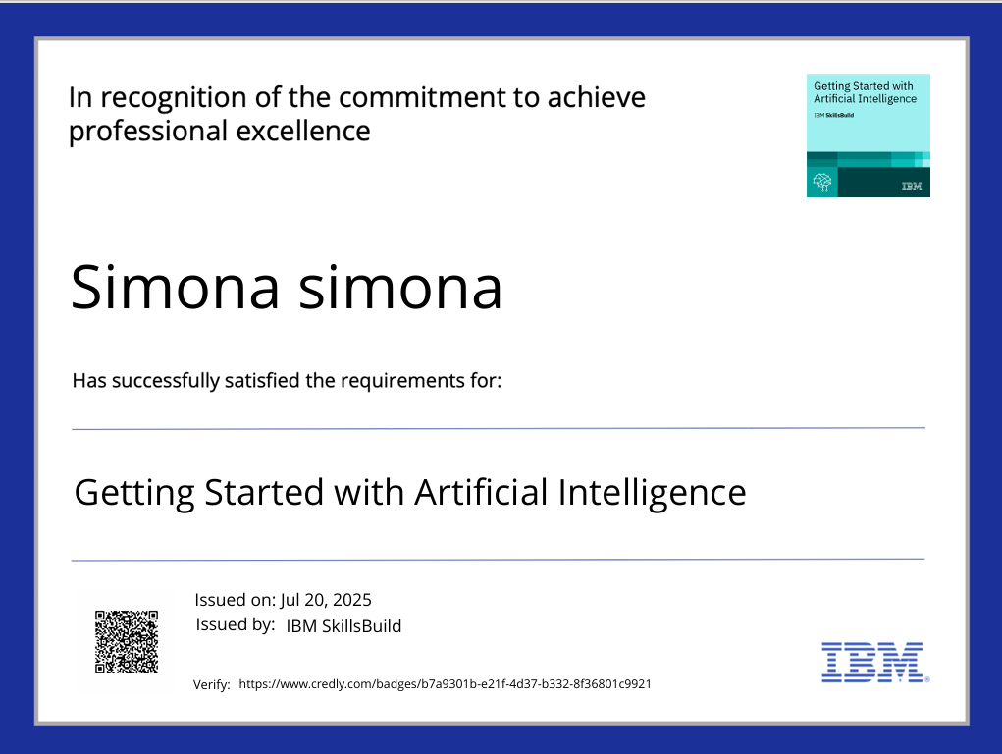
IBM Certifications

Slide 16
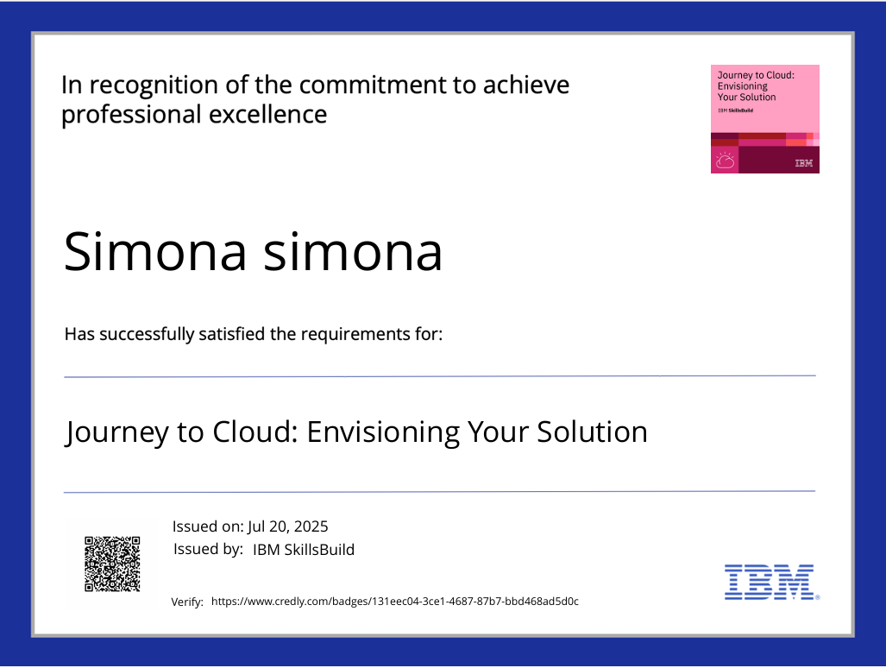
IBM Certifications

Slide 17
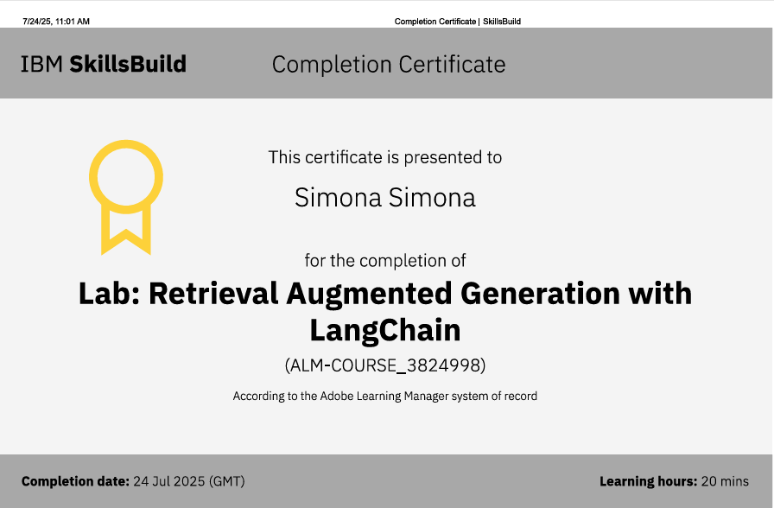
IBM Certifications

Slide 18
THANK YOU

