Slide 1

Power-Law Distributions in Binned Empirical Data: An R Implementation
Authors:
Cattari Simona, Toscano Giuseppe Vincenzo Dylan, Trivelli Matteo
Based on:
“Power-law distributions in binned empirical data” by Virkar and Clauset
Statistics for Data Science - A.A. 2024/25

Slide 2

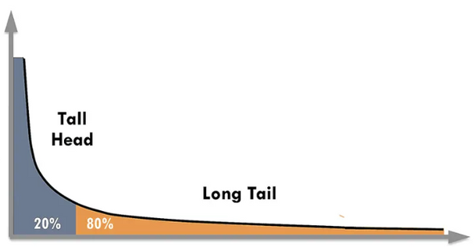

What does the paper address?
Fitting power-law models to binned data
Classical estimation methods fail
The goal → develop a robust and generalizable framework for:
The authors propose a statistical procedure based on Maximum Likelihood Estimation (MLE), Kolmogorov–Smirnov (KS) statistic, and semi-parametric bootstrap, specifically designed to work on binned datasets.
Accurately estimating power-law parameters from histogram
Testing the plausibility of a power-law
HOW?
Avoiding false positives caused by binning
What is a Power-law distribution?
α > 1 is the scaling parameter
x ≥ bₘᵢₙ is the threshold
C is a normalization constant
Where do power-law appears?
Nature:
Society:
Our case:
Earthquakes, solar flares
Wealth, web traffic
Wildfire sizes, City sizes

Slide 3
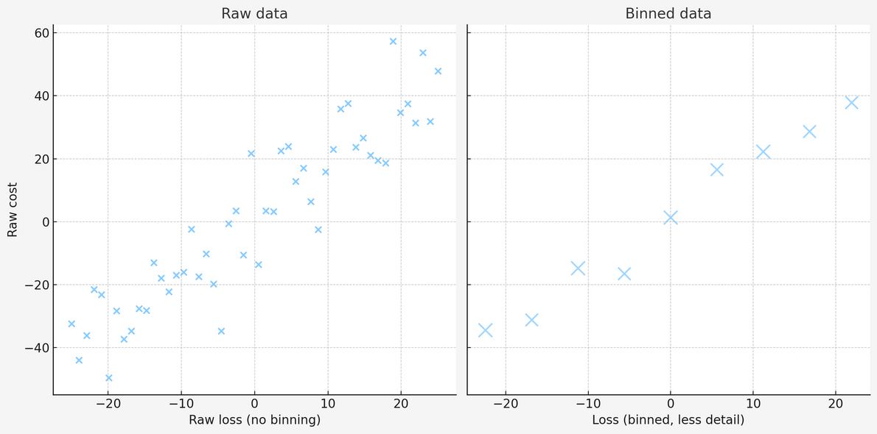
The Problem - Working with Bins
What happens with binned data?
1
Loss of details
2
Hidden patterns
3
Biased estimations
4
Increased uncertainty
Our challenge:
How do we test for power laws when data comes in bins?

Slide 4






Methodology
Our Task: Full R implementation of the Virkar & Clauset framework
Data
Synthetic data
Real-world datasets
Linear
Logarithmic
Three Main Step:
Bin Schemes
1
Fit
Fit
Estimate the best-fitting parameters: scaling exponent α and bmin
2
Test
Test
Evaluate the goodness of fit using a p-value (model accepted if p ≥ 0.1)
log-normal
exponential
stretched exponential
power-law with cutoff
Alternative Models
Evaluation
3
Compare
Test the power-law model to alternative distributions
Result

Slide 5
What We Developed
8 Custom R Functions:
Core Tools:
Statistical Tests:
Additional model fitters:
getPDF: compute probability density values
bplpva: perform gof test for power-law model
bplcutfit: Power-law + Cutoff
bstexpfit: Stretched Exponential
bplfit: estimate power-law parameters
blrtest: compare different models
bexpnfit: Exponential
blgnormfit: Log-normal

Slide 6
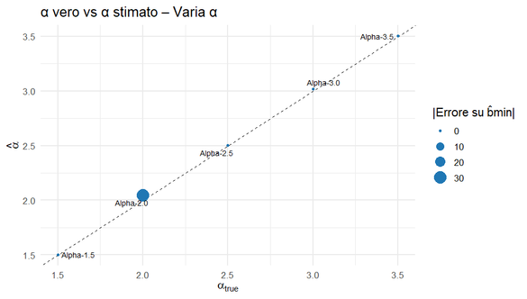
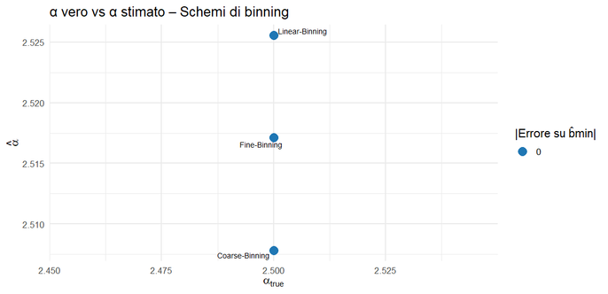
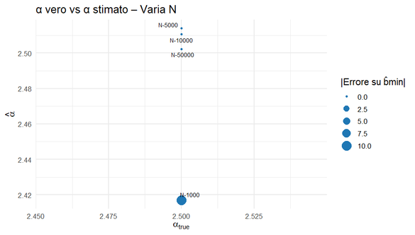
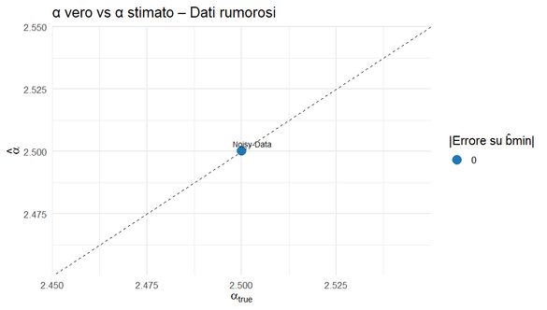
Main functions
Estimating PL parametes (bplfit)
What it does:
Estimates the power-law exponent α and the lower bound bₘᵢₙ from binned data throw Maximun Likelihood Estimation (MLE) and Kolmogorov-Smirnov (KS) statistic respectively.
How it works:
For each candidate bₘᵢₙ:
Estimates α via MLE on data ≥ bₘᵢₙ
Computes the empirical and theoretical CCDFs
Calculates KS statistics between them
Selects the bₘᵢₙ that minimizes KS
How we tested it:
Test 1: Base case → α = 2.512 (err 0.012), bₘᵢₙ = 10 ✅
Test 2: Different α values → Errors < 0.05 for all tested α ∈ [1.5, 3.5], average error:0.138 ✅
Test 3: Binning schema → Fine - Coarse - Linear → Linear binning slightly overestimates α 📉
Test 4: Sample size effect → Error drops from 0.083 (N=1k) to 0.002 (N=50k) ✅
Test 5: Robustness to noise → No degradation: α = 2.500, bmin = 10 ✅

Slide 7
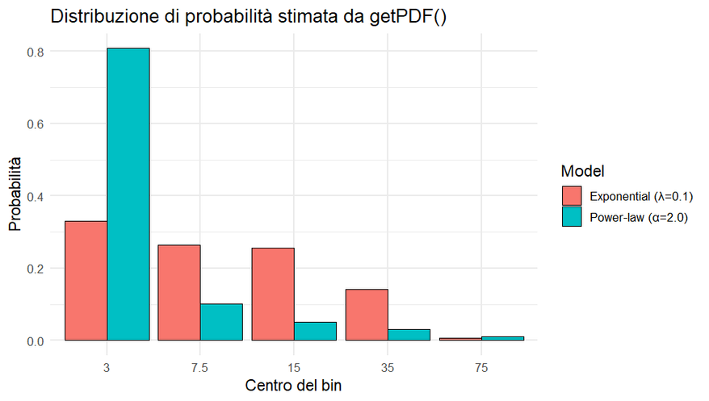
Main functions
Theoretical PDF over Binned Data (getPDF)
What it does:
Computes the theoretical PDF over user-defined bins, supports 5 models: Power-law, Exponential, Log-normal, Stretched Exp, Power-law+Cutoff
How it works:
For each bin [li,ui) ≥ bmin:
Computes the theoretical probability as the difference of CDF values
Normalizes to ensure ∑pᵢ = 1
Handles edge cases (empty bins, extreme parameters)
How we tested it:
Test 1: Power-law → Matches exact formula, sum = 1.0 ✅
Test 2: Exponential → Handles small and large λ, sum = 1.0 ✅
Test 3: Log-normal → Stable even with skewed or narrow shape ✅
Test 4: Stretched Exp → Robust to shape/scale parameters ✅
Test 5: Power-law + Cutoff → Correct trapezoidal approximation ✅
Test 6: Edge cases → Small & wide bins: handled without NaN or negative probs ✅
Test 7: bmin consistency → Changing bmin trims bins, preserves normalization ✅

Slide 8
Statistical Tests - Does it Fit?
Testing Power Laws (bplpva)
Compare Models (blrtest)
What it does:
Tests whether a power-law distribution is a good fit for binned data using a Kolmogorov-Smirnov (KS) test with semi-parametric bootstrap.
How it works:
Computes the KS distance between the observed data and the fitted power-law model.
Generates 1000 synthetic datasets from the estimated power-law.
Compares the observed KS distance with the ones from the synthetic datasets
The p-value is the fraction of synthetic KS distances that are worse than the observed one
How we tested it:
Test 1: Data from a true power law (α = 2.5) → Expected high p-values
Result: Average p-value = 0.452, 90% accepted (p ≥ 0.1) ✅
Test 2: Data from a log-normal distribution → Expected low p-values
Result: Average p-value = 0.000, 100% rejected ✅
Uniformity check: p-values from power-law data tested with
KS test → p = 0.846 ✅
What it does:
Compares two models (e.g., power law vs log-normal) using the Vuong test to see which one fits the binned data better.
How it works:
Calculates the log-likelihood ratio R for each bin
Normalizes R using its standard deviation
If the norm of normR is greater than a critical threshold → one model is significantly better
If normR > 0, the first model is favored; if normR < 0, the second model is favored
How we tested it:
Test 1: Power law vs log-normal on power-law data → Expected: power law is better
Result: normR = 5.283, p < 0.001 (power law wins) ✅
Test 2: Power law vs log-normal on log-normal data → Expected: log-normal is better
Result: normR = -156.9, p < 0.001 (log-normal wins) ✅
Test 3: Power law vs exponential → Power law always wins on power-law data ✅
Robustness test: Showed that at least N > 5000 is needed for reliable results ✅

Slide 9
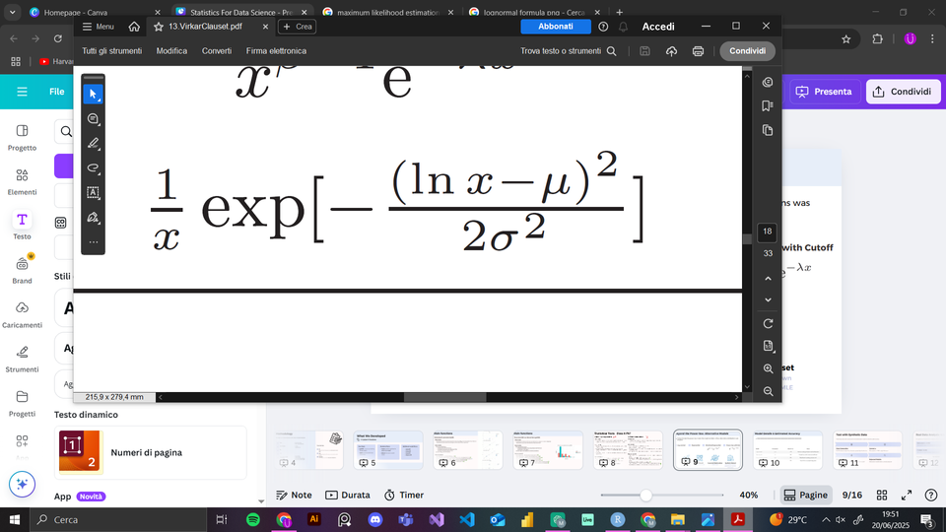
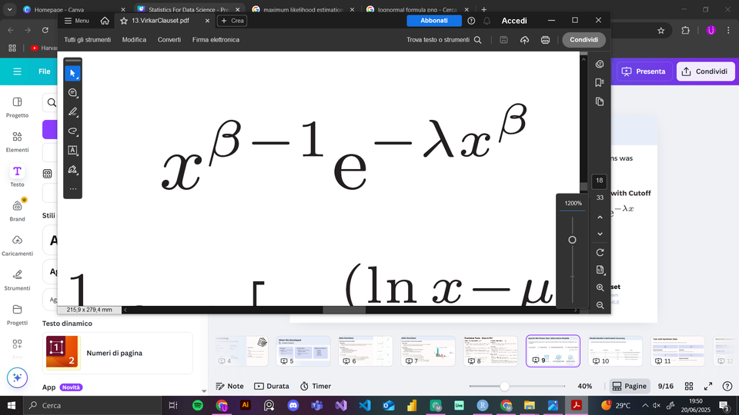
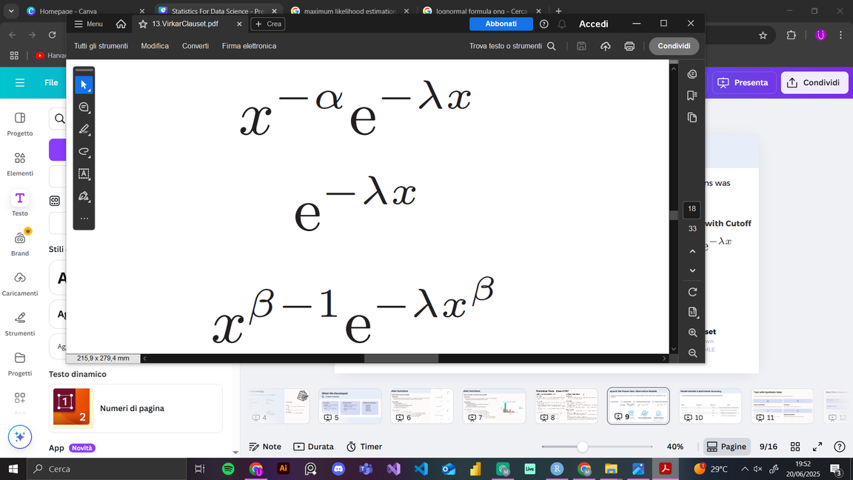
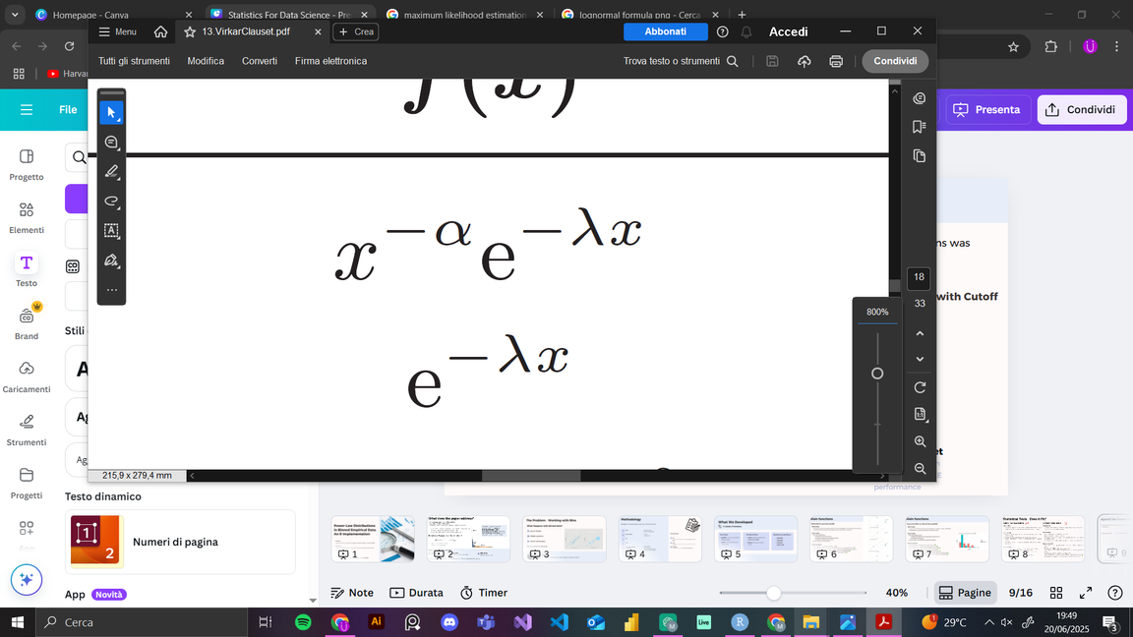
Beyond the Power-law: Alternative Models
To benchmark the power-law model, the implementation of four alternative distributions was adopted:
Log-normal
Stretched Exponential
Exponential
Power-law with Cutoff
MLE
Grid Search
Numerical Optimization
Synthetic Dataset
Tail-constrained and adapted to binned data
Over parameter space
Nelder-Mead
Generated from known distributions

Slide 10
Model Details & Estimated Accuracy
Model
Parameters
Estimation Method
Notes
Log-normal
μ, σ
Grid Search
Most accurate; handles flexible tails
Exponential
λ
Closed-form MLE
Robust and efficient
Stretched Exponential
λ, β
Grid Search
Harder to fit
Power-law + Cutoff
α, λ
Optimization + Grid Fallback
Good for truncated heavy tails
Mean Error results:
Log-normal
<1%
Stretched Exponential
6%
Exponential
4%
Power-law with Cutoff
2%
All accuracy estimates are derived from controlled synthetic tests (see test_blgnormfit, test_bexpnfit, test_bplcutfit, test_bstexpnfit), ensuring correctness even under noisy or sparse data conditions.

Slide 11




Test with Synthetic Data
Preliminary tests were conducted on simulated data in order to verify the code accuracy
Data Generation
Correct α
10 000 values drawn from a known power-law distribution
Estimated α = 2.512, only 0.4% error
Excellent Fit
Rejected Models
p-value = 0.93 confirms good adherence to the model
Alternative models were correctly rejected

Slide 12
Real Data Analysis: U.S. City Sizes
We applied our framework to a dataset of 19,447 U.S. cities to evaluate power-law behavior
Estimated α = 2.376
Lower Bound (bmin) = 65.536
Scaling parameter of the fitted power-law model
Power-law behavior applies to cities above this size
P-value = 0.939
Support Moderate
Indicates a strong fit between model and data
The distribution fit with power law
Parameter
Our Estimate
Paper Results
Match
α
2.376
2.38
✅
bmin
65.536
65.536
✅
support
Moderate
Moderate
✅

Slide 13
Real Data Analysis: Wildfires Acres
We applied our framework to a dataset of 203,785 sizes in acres of wildfires occurring on US federal land between 1986 and 1996
Estimated α = 1.482
Lower Bound (bmin) = 2
Scaling parameter of the fitted power-law model
Power-law behavior applies to wildfires above this size
P-value = 0.000
Support None
Model rejected
The best model is the Power Law with cutoff
Parameter
Our Estimate
Paper Results
Match
α
1.482
1.482
✅
bmin
2
2
✅
support
None
None
✅

Slide 14
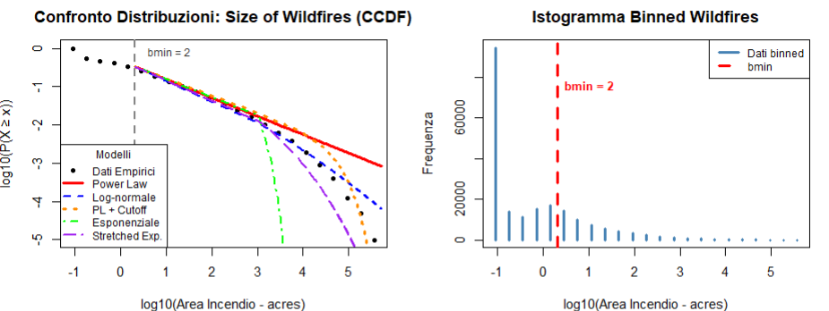
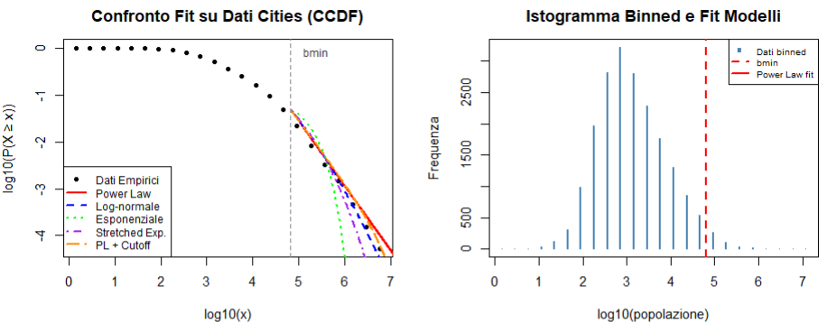
Real Data Plot Analysis
Why CCDF is Essential:
Linear scaling in log-log space makes power laws appear as straight lines
Robust to binning noise - smooths out fluctuations in individual bins
Standard in literature - enables comparison with published results
Visual Diagnostic Power:
Clear deviation patterns reveal where power law breaks down
Alternative models show distinct curvature signatures
Threshold selection (bmin) visually interpretable as change in slope

Slide 15






What We Learned
Technical Wins
Statistical Lessons
Complete R Toolkit
Binning Challenges
We built a robust R package. It provides all necessary functions.
Binned data complicates statistical testing. More data is often required.
Numerical Stability
Method Impact
Our toolkit handles complex numerical challenges effectively. It ensures precise calculations.
Choosing the correct statistical method is vital. It can drastically alter results.
Validated Functions
Rarity of True Power Laws
All implemented functions passed rigorous testing. They are fully operational.
Pure power laws are seldom observed in nature. Many phenomena do not perfectly fit.

Slide 16
Conclusions
Our project successfully built and tested different functions. They matched original findings and delivered meaningful results on real data.
Paper:
Virkar, Y. & Clauset, A. (2014).
True Dataset:
The sizes in acres of wildfires occurring on US federal land between 1986 and 1996.
The human population of U.S. cities in the 2000 U.S. Census.
Thanks for the attention!

