Slide 1
Heroku
Enășoae Simona - 258
Service Oriented Architecture

Slide 2


Content
1. Introduction
2. Architecture
3. Subscription options
4. Deploying with Git
5. Deploying with Docker
6. Dashboard Heroku
7. Demo

Slide 3

Introduction
What is Heroku?
a cloud platform as a service (PaaS)
supports Java, Node.js, Scala, Python, PHP, Go, Clojure
polyglot platform
features to build, run and scale applications

Slide 4
Architecture
all Heroku applications run in a collection of lightweight Linux containers called dynos
different type of dynos are available depending on the resources size (Memory and CPU share)
dyno supports deploying with Git and Docker

Slide 5
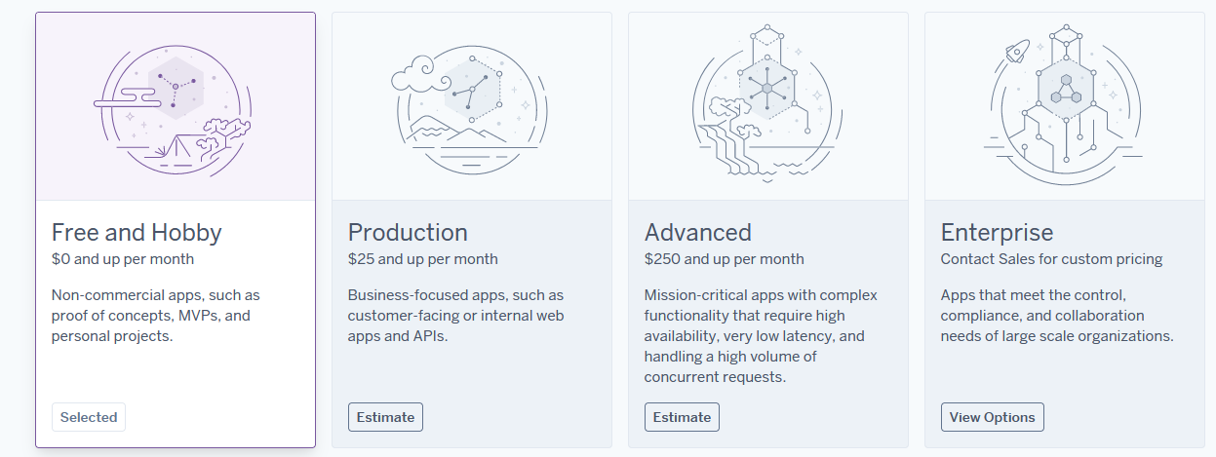
Subscription options

Slide 6

Deploying with Git
git init - initialize the repo
heroku create - creates a new empty application on Heroku, along with an associated empty Git repository
git add . - add files
git commit - m "message" - make the commit
git push heroku master - command to deploy the app
heroku ps:scale web=1 - command to ensure that at least one instance of the app is running
heroku open - shortcut command to open the website

Slide 7
Deploying with Docker
1. Create a Heroku app:
heroku create app-name-test
2. Build the image and push to Container Registry:
heroku container:push web --app app-name-test
3. Release the image to your app:
heroku container:release web –-app app-name-test
4. Open the app in your browser:
heroku open

Slide 8
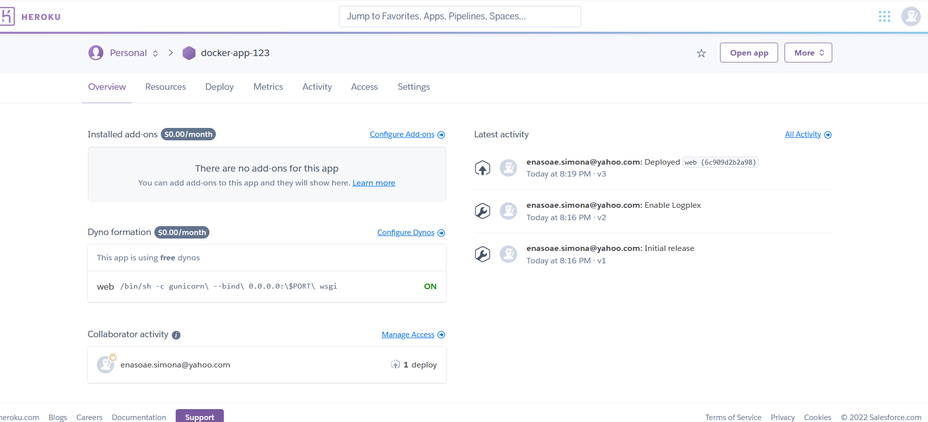
Dashboard Heroku

Slide 9

Demo

Slide 10

Thank You!
Questions?

