Slide 1
https://glovoapp.com/it/it/?utm_source=google&utm_medium=cpc&utm_campaign=google_search_brandprotection_newusers_IT_Exact_digitalbudget_italian_BPincrementality&utm_campaignid=21157733699&utm_adgroupid=162224975682&utm_term=glovo&utm_matchtype=e&utm_device=c&gad_source=1&gclid=Cj0KCQjwkZm_BhDrARIsAAEbX1ESD9JRdsiKec1Fp2d9TANV1jRJ24mT02YXvWqJkqUDC1q91SsUEQoaAt3tEALw_wcB

Slide 2
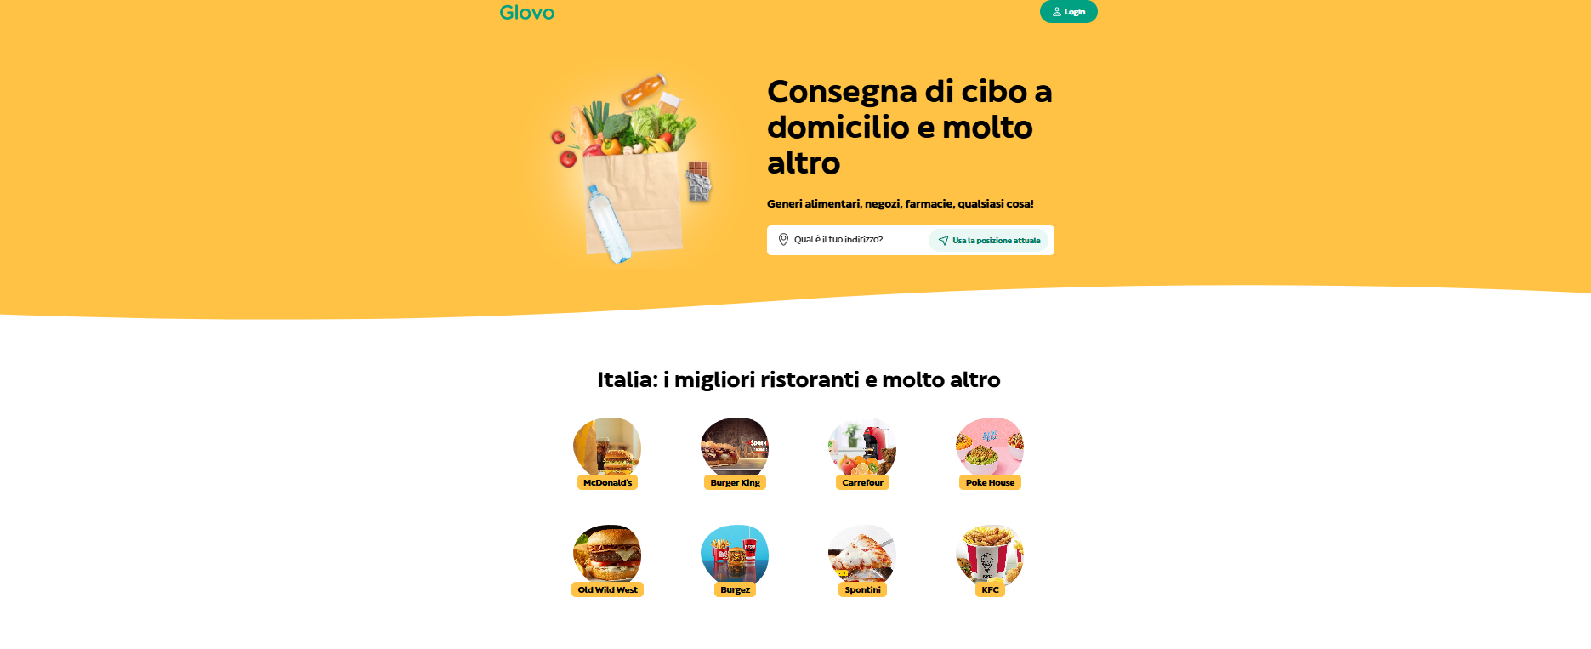

Slide 3


