Slide 1


Game DNA
Visual Analytics for Video Game Market Positioning
Visual Analytics — Final Project
Simone Amoriello
Sapienza University of Rome
Fall 2026
Notes:
1

Slide 2
Problem, Goal & Intended User
Problem
Main analytical questions
Steam games differ simultaneously in popularity, appreciation, engagement, price, age and market reach. Looking at each variable separately does not reveal their overall market positioning.
1
Which multidimensional market groups emerge?
2
Which Game DNA dimensions distinguish a selected group?
Goal
Build an interactive Visual Analytics system that makes multidimensional market structure explorable and interpretable.
3
Which titles have the most similar market profile?
Intended user
Can similar market positions occur across different genres?
Game-market analyst working for a small or medium-sized PC developer or publisher.
4
Game DNA
September 2026
Page 2

Slide 3
Dataset & Game DNA Representation
Curated Steam sample and six market-oriented dimensions
Dataset pipeline
125,855
→
18,170
→
5,000
AS = 5,000 × 6 = 30,000
raw Steam entries
candidate games
final stratified sample
Six Game DNA dimensions
Popularity
Appreciation
Engagement
Total Reviews
Positive Ratio
Average Playtime
Commercial Position
Maturity
Market Reach
Base Price
Release Age
Language Count
Feature preparation: log(1+x) on strongly right-skewed variables, then z-score standardization on all six dimensions.
Game DNA
September 2026
Page 3
Notes:
3

Slide 4
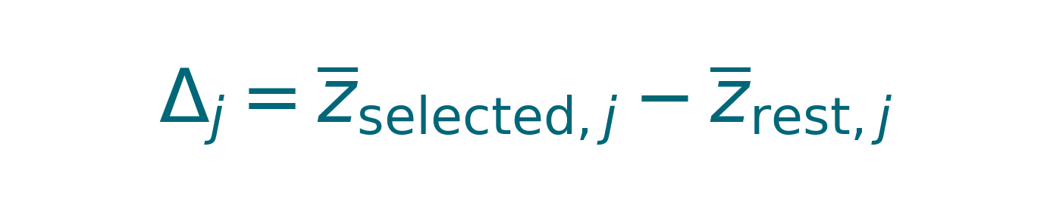
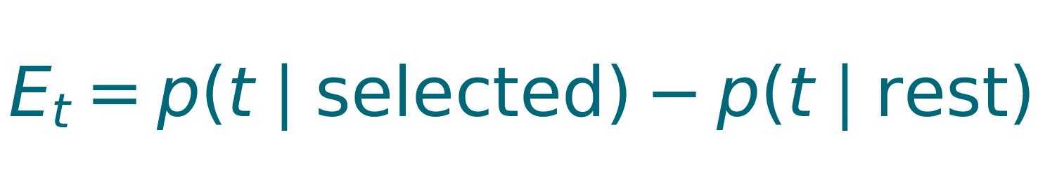
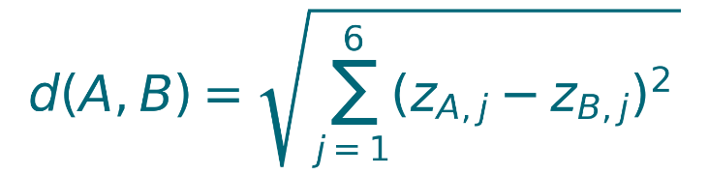
Dimensionality Reduction & Analytical Functions
PCA for overview; full six-dimensional space retained for analysis
Three analytical functions
Principal Component Analysis
Group Characterization
PC1 — Market Presence
33.83%
Compares the six standardized dimensions.
PC2 — Market Legacy
Tag Enrichment
20.00%
53.83%
variance preserved
in the 2D Game Map
Finds over- and under-represented Steam tags.
Game Similarity
The remaining information is not discarded: the complete standardized 6-D representation is used for Parallel Coordinates and similarity.
Returns the five nearest market profiles.
Game DNA
September 2026
Page 4
Notes:
4

Slide 5
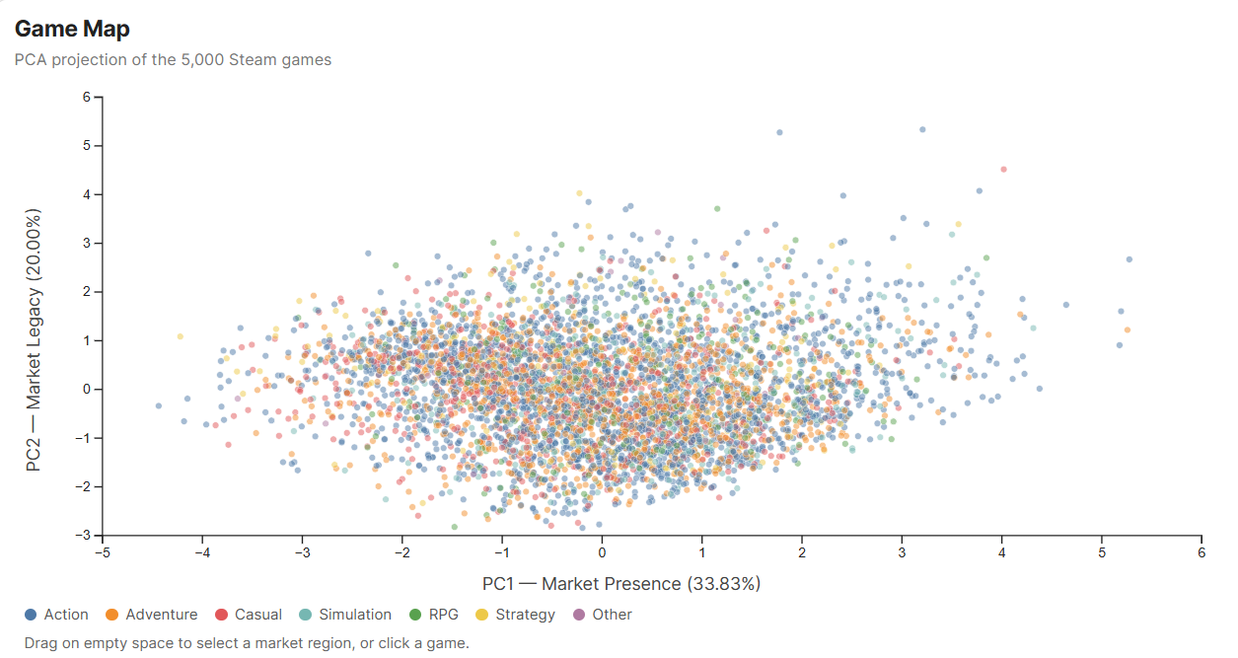
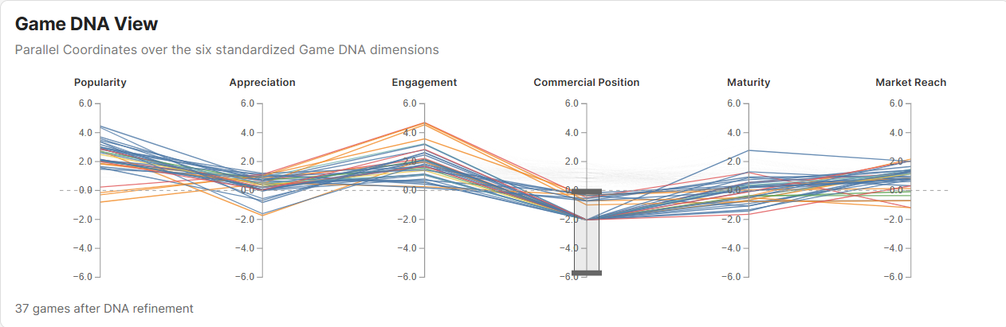
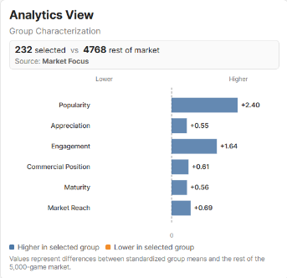
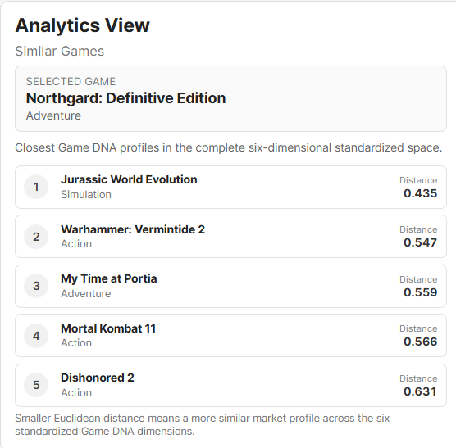
Visual System
Four coordinated views: overview, multidimensional profile and analytical interpretation
Game Map
Game DNA View
PCA market overview
Parallel Coordinates over the six standardized dimensions
Analytics View
Tag Analysis View
Group differences or nearest Game DNA profiles
Most enriched and depleted Steam tags in the current group
Free to Play
+60.5
Multiplayer
+48.7
PvP
+39.3
Indie
-20.8
Puzzle
-12.8
Game DNA
September 2026
Page 5
Notes:
5

Slide 6
Representative Findings I
Market segments discovered through group-level exploration
1
High presence → Free-to-Play multiplayer subsegment
Recent segment with strong reach
2
PCA Market Focus: 232 games → 37 after Commercial Position refinement
Lower-right PCA Market Focus: 149 games
Popularity +2.37; Engagement +1.98; Commercial Position −1.60
Maturity −1.32; Market Reach +1.21; Commercial Position +0.91
Free to Play +60.5 pp; Multiplayer +48.7 pp; PvP +39.3 pp
Popularity only +0.12 relative to the rest of the market
INTERPRETATION
INTERPRETATION
A broad high-presence region contains a distinct low-price / F2P multiplayer subsegment.
Recent titles can show broad reach and strong commercial positioning before accumulating high popularity.
Game DNA
September 2026
Page 6

Slide 7
Representative Findings II
Individual similarity and highly appreciated low-presence profiles
Cross-genre market similarity
4
High appreciation ≠ high market presence
3
Mixed-genre Market Focus: 63 games; Northgard: Definitive Edition selected
Low-presence region refined by high Appreciation → 51 games
4 of the 5 nearest Game DNA profiles belong to different DisplayGenre categories
Appreciation +1.11; Popularity −0.88; Engagement −1.69; Market Reach −0.79
Similarity is computed in the complete standardized six-dimensional space
Cute +24.8 pp; Casual +17.6 pp; Stylized +16.7 pp among enriched tags
INTERPRETATION
INTERPRETATION
Genre and multidimensional market similarity capture different properties of a game.
Strong user reception does not necessarily imply broad visibility, reach, or recorded engagement.
Game DNA
September 2026
Page 7

Slide 8
Conclusions
What Game DNA demonstrates and what the system is designed to support
Multidimensional overview
PCA provides an interpretable market map, while the complete six-dimensional Game DNA representation preserves the detail needed for comparison.
1
Interaction-driven analytics
Coordinated views connect visual exploration with Group Characterization, Tag Enrichment and full-space Game Similarity.
2
Practical analytical value
The system reveals interpretable market segments and comparable titles, including similarities that cross conventional genre boundaries.
3
FINAL TAKEAWAY
Game DNA supports exploratory market positioning and comparable-product analysis; it is not a commercial-success prediction model.
Game DNA
September 2026
Page 8

