Slide 1
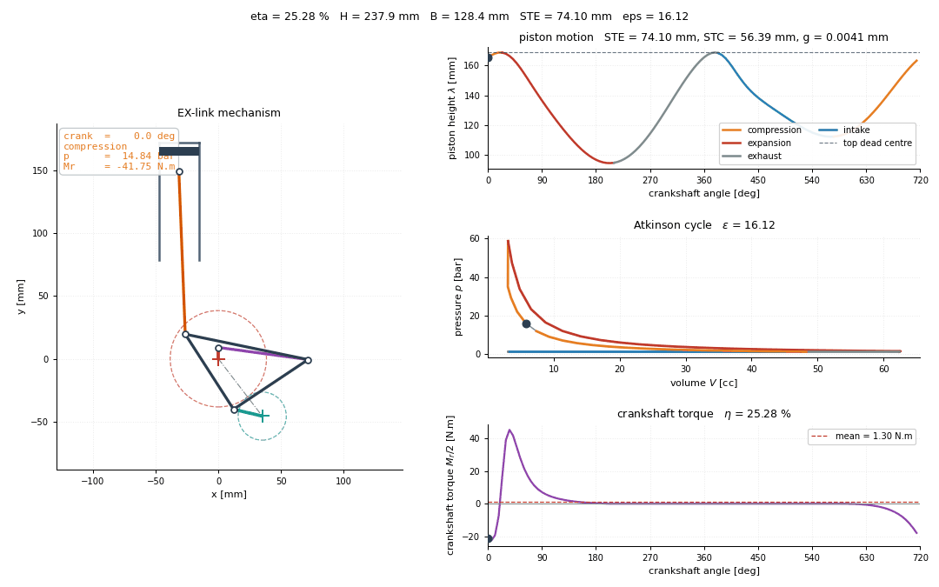



Range-optimal Atkinson engine linkage
SHELL ECO-MARATHON · MULTIDISCIPLINARY DESIGN · GEMSEO
An extended-expansion (EX-link) engine designed for range — distance per litre of fuel — pricing efficiency, envelope, torque ripple and structural mass at the rates the physics fixes.
3395 km/L
+17.6 %
range at failure probability 1.3 × 10⁻³
over a conventional engine (2888 km/L)
+19.3 %
12.9 kg
The design the study arrives at, through one cycle: 360° of the half-speed shaft, 720° of the crankshaft.
over a four-speed schedule (3260 vs 2733)
engine mass, against 16.9 kg conventional
Five coupled disciplines solved as MDF with a Gauss–Seidel MDA · exact analytic derivatives · FORM reliability over 17 uncertain parameters
The quasi-static optimum is the worst place to be
The topology is worth 17.6 %
Reliability decides which bounds are real
Ignoring inertia drives the linkage to its transmission-angle singularity: no feasible structure above 2000 rpm. Backed off, it weighs half as much and goes further.
Indicated efficiency 0.457 → 0.480, mechanical 0.787 → 0.865, mass 16.9 → 12.9 kg. Extended expansion is the smallest of the three.
The reference design misses a requirement 66.4 % of the time. Holding constraints and a reliability target during the search gives 3395 km/L at Pf = 10⁻³.
Notes:
One-page overview of the EX-link Atkinson-cycle engine study. The headline: optimising for range, rather than the conventional lever-arm quality measure, gives 3395 km/L at a failure probability of 1.3e-3, 17.6 % further than a conventional engine sized by the same models. Three findings: the quasi-static optimum sits at a singularity and cannot be built above 2000 rpm; the topology advantage comes mostly from mechanical efficiency and flywheel mass, not extended expansion; and reliability analysis shows which stated bounds actually bind.

