Slide 1
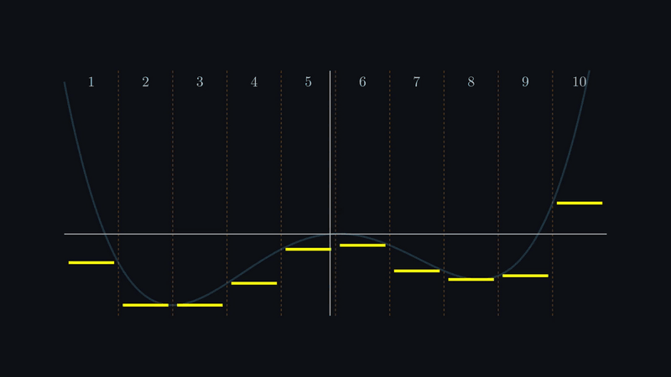
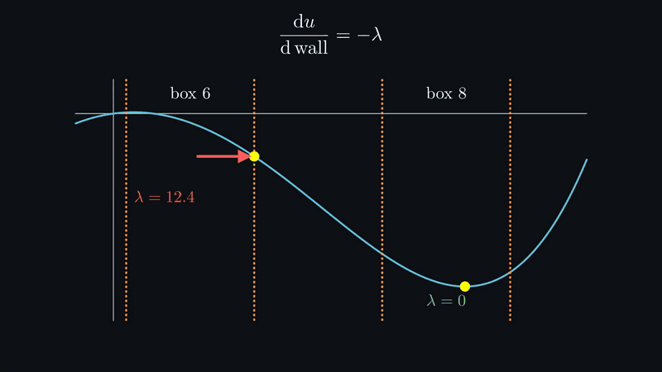
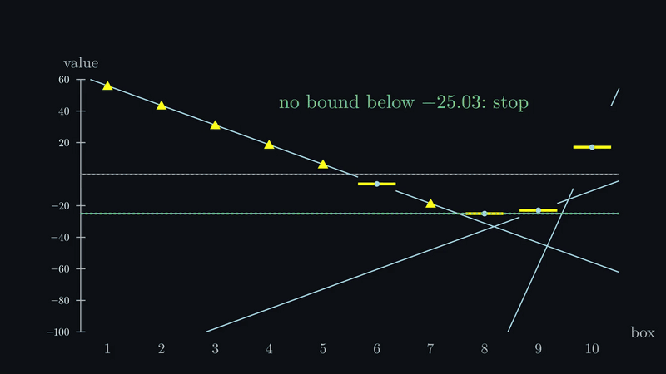
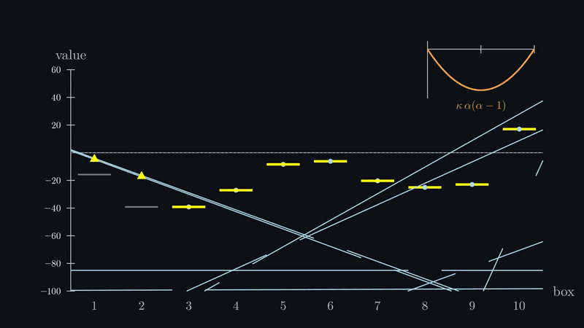
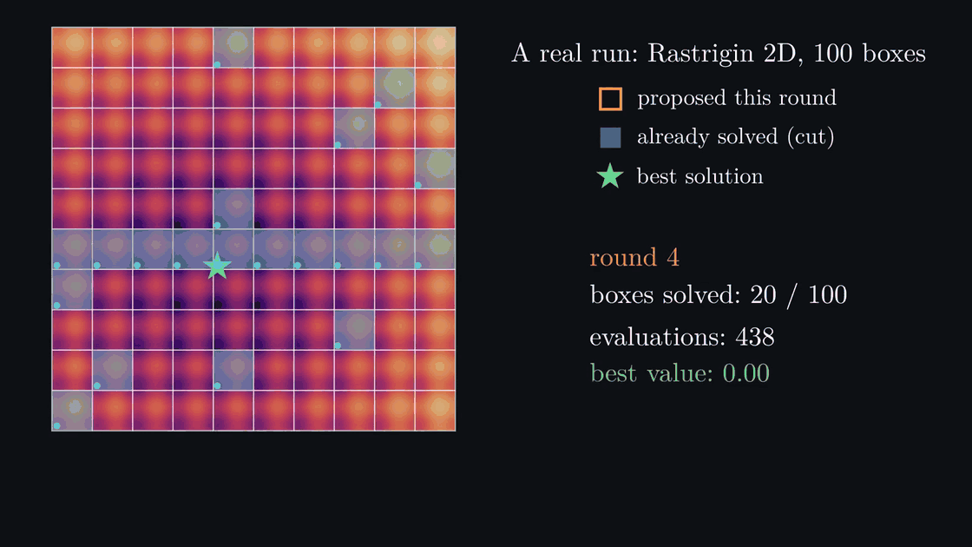
Box subdivision
Choosing where to look in a multimodal landscape, one local solve at a time
1 · Which box?
2 · A value and a slope
3 · Cuts steer the master
4 · Keep the cuts honest
Cut each axis into intervals; solve inside one box at a time. Boxes multiply, switches add.
Pressed on a wall, the multiplier λ says how fast the value drops beyond it.
Value + slope = a cut. Solve the box with the lowest bound; stop when none can beat the best.
Non-convex cuts lie. Lower them by κ, or sweep κ over parallel probes.
A real run, Rastrigin 2D, default settings, 4 probes per round: 0 after 154 evaluations, 20 of 100 boxes.
82.1
789
10⁵ boxes
bracket compliance, vs 84.0 for MMA
evaluations vs 2,340 for multistart (5D)
on 50 switches: Rastrigin 5D solved
It wins when the grid separates the valleys, and loses when it doesn’t.
gemseo-box-subdivision · pip install gemseo-box-subdivision · simoneconiglio.github.io/gemseo-box-subdivision
Notes:
One idea: let each local solve tell the optimizer where to look next. 1. A local solver only finds the valley it starts in, so turn “where should I start?” into “which box?”: cut each axis into intervals and solve inside one box at a time. A box is named by one row of switches per axis; boxes multiply with the dimension, switches add up: 100 000 boxes in five variables are only 50 switches. 2. Each solve gives a value and, for free, a slope: when the solution presses on a wall of its box, the Lagrange multiplier of that wall says how fast the value would drop if the wall moved. 3. Value plus slope draws a line of predictions through the other boxes, a cut. The master solves the box whose bound is lowest and stops when no bound can beat the best value: outer approximation. 4. On a non-convex landscape cuts lie and the master stops confidently at the wrong answer. Lower each cut by kappa away from its own box; too small still lies, too large enumerates, so the adaptive repair corrects only what the data contradict, and the sweep runs a ladder of kappa over the parallel probes, with nothing to tune. Bottom left, a real run with default settings: zero after 154 evaluations, 20 boxes of 100. Results: compliance 82.1 on the 108-variable bracket against 84.0 for MMA; 789 evaluations on Styblinski-Tang 5D against 2,340 for multistart; Rastrigin 5D solved with 100 000 boxes, which no baseline reached. It wins when the grid separates the valleys and loses when it doesn’t: on Ackley CMA-ES wins, Griewank defeats everyone.

