Slide 1


Flow simulation around bluff body:
k-ř RANS model
Computational Fluid Dynamics and Wind Engineering
Maccarone Giovanna s349134, Morandi Simone Domenico s336974
June 13, 2026
1/16

Slide 2

Table of Contents
1 Initial Problem
Initial Problem
Initializing the Simulation
Results
2/16

Slide 3
Project Overview & Objectives
1 Initial Problem
Flow Configuration:
Two-dimensional, incompressible flow past a sharp-edged square cylinder in a subcritic regime.
Physical Challenge:
Accurately predicting:
Shear layer separation
Flow reattachment
Unsteady wake dynamics (vortex shedding)
Project Objective:
Compare the performance of two RANS turbulence models:
k − ϵ RNG
k − ω Standard
3/16

Slide 4
Flow Configuration & Boundary Setup
1 Initial Problem
Flow Properties:
Unsteady, 2D flow past a square cylinder (reference dimension B).
Subcritical regime: Re ≈ 2.2 × 10⁴.
Non-dimensionalized using ρ = 1 kg/m³, ν = 4.545 × 10⁻⁵ kg/(m·s), and U∞.
Boundary Conditions:
Inlet: Velocity-inlet, Turbulence Intensity = 2%, Length Scale = 0.5B.
Outlet: Dirichlet condition on pressure (p_{rel} = 0).
Upper/Lower Limits: Periodic conditions.
Cylinder Surface: Smooth edge (roughness = 0), no-slip (u = v = 0).
Initialization:
Uniform initial condition matching inlet values across the entire domain.
4/16

Slide 5
Spatial Discretization
1 Initial Problem
Domain Partitioning:
The computational domain is divided into distinct macro-zones.
Mesh Strategy:
Outer Area (EUL Region): Mapped meshing, structured grid of quadrilateral cells.
Inner Area (ALE Region): Unstructured mesh of triangular cells.
Grid Boundary Layer: Finer layer of quadrilateral cells directly around the solid walls.
5/16

Slide 6
Turbulence Modeling: RANS & k − ϵ RNG
1 Initial Problem
RANS Approach:
Non-scale resolving models.
Uses the Boussinesq hypothesis to estimate a ”turbulent viscosity” representing the average effect of turbulence.
The Closure Problem: Requires transport equations for turbulent kinetic energy (k) and its dissipation rate (ϵ).
Standard k − ϵ vs. RNG Variant:
STD Issue: Overestimates k near the front wall of bluff bodies.
RNG Solution: Fixes the coefficients and makes k production dependent on flow vorticity.
6/16

Slide 7
Turbulence Modeling: The k − ω Model
1 Initial Problem
Addressing Near-Wall Errors:
In order to fix near-wall errors present in k − ϵ formulations, the k − ω model is introduced.
The k − ω Model:
Uses the specific dissipation rate (ω) instead of ϵ.
Main Advantage:
The mathematical equations do not become unstable near solid walls.
The model remains robust even when k is very small.
7/16

Slide 8
Table of Contents
2 Initializing the Simulation
Initial Problem
Initializing the Simulation
Results
8/16

Slide 9
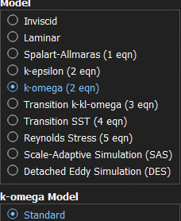
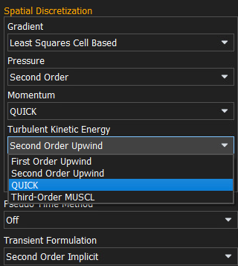
Changing Turbulence Model
2 Initializing the Simulation
We need to change the turbulence model from k − ϵ RNG to k − ω standard.
Then we re-set the correct discretization scheme for k.
9/16

Slide 10
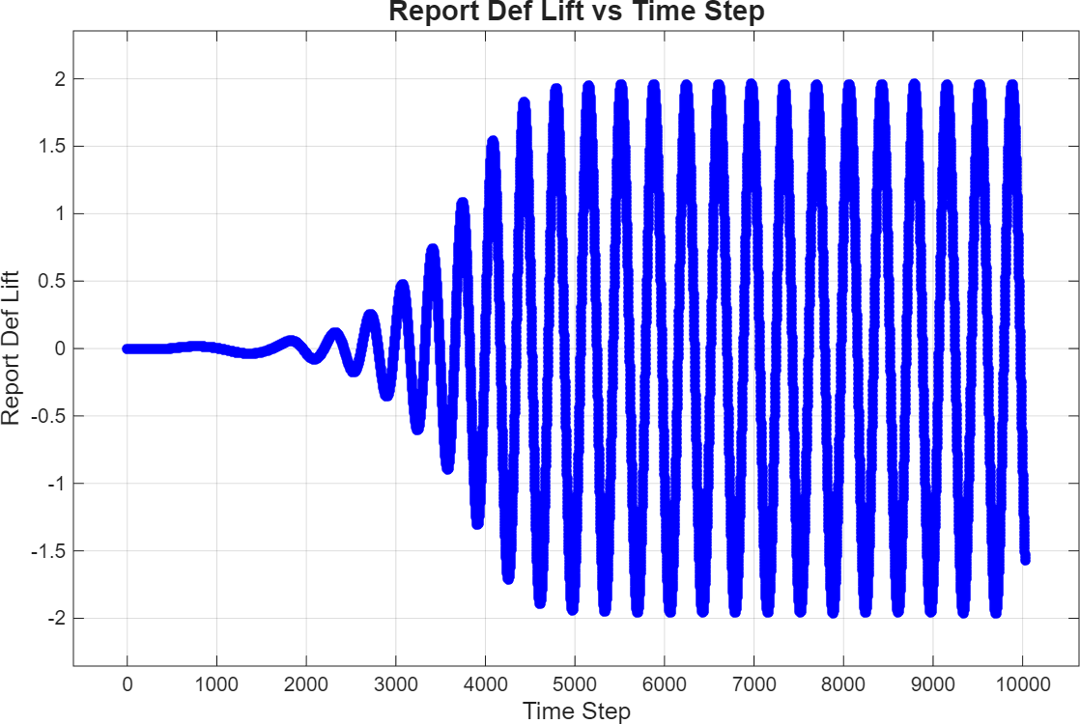
First Simulation
2 Initializing the Simulation
The behavior of C_{l} confirms that flow is full developed after ∼ 5800 time steps.
10/16
Figure: Values of C_{l} for each time step.

Slide 11
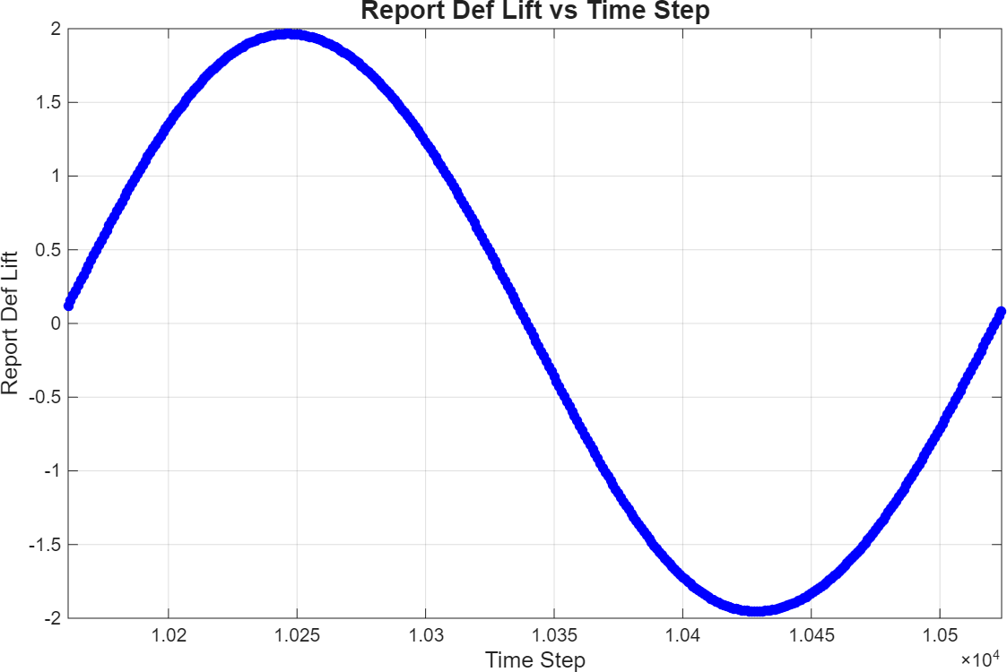
Simulation of one period
2 Initializing the Simulation
For a clean simulation, we perform an additional 161 steps in order to finish with C_{l} = 0.
Then we proceed with 363 steps, which cover a complete period.
Figure: C_{l} values throughout one period.

Slide 12
Table of Contents
3 Results
Initial Problem
Initializing the Simulation
Results

Slide 13
Retrieved Data
3 Results
After the simulation, we get the following data:
Reports
C_{l} C_{d} C_{m} u on x = 0 u on y = 0.5
Statistics
u, v statistics on x = 0 C_{p}, σ (C_{p}) u, v statistics on y = 0.5

Slide 14
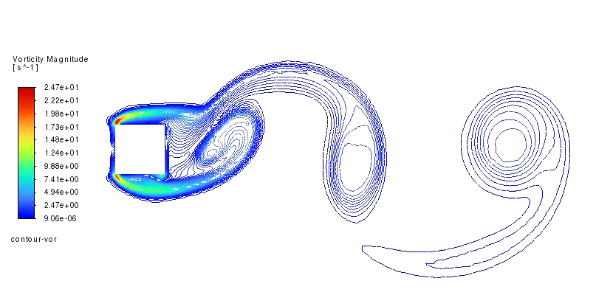
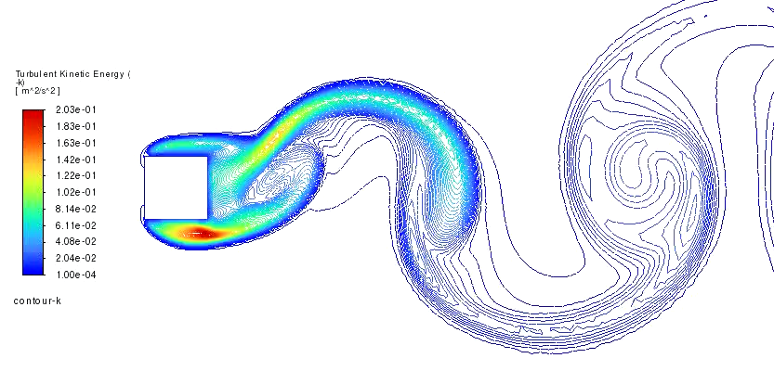
Contour plots
3 Results
Movie 1: Contour plot of the vorticity.
Movie 2: Contour plot of k.

Slide 15
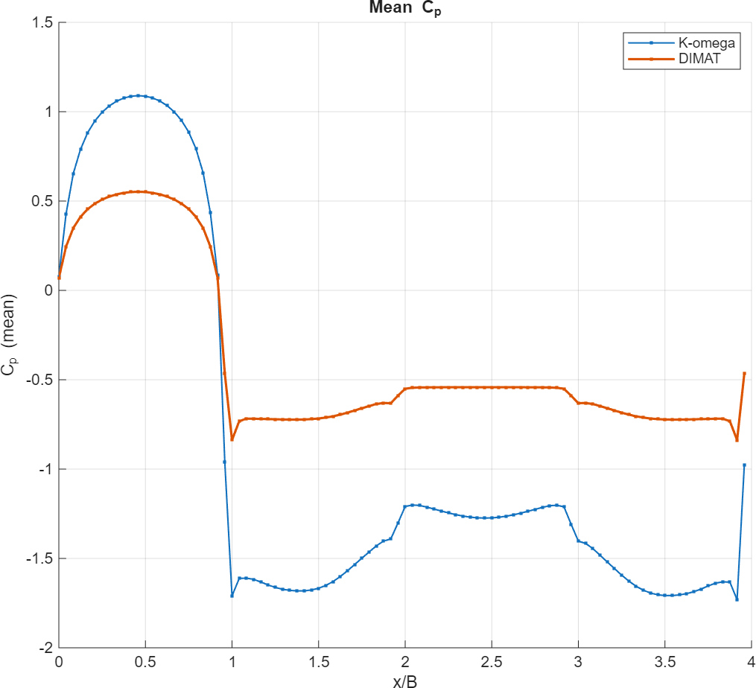
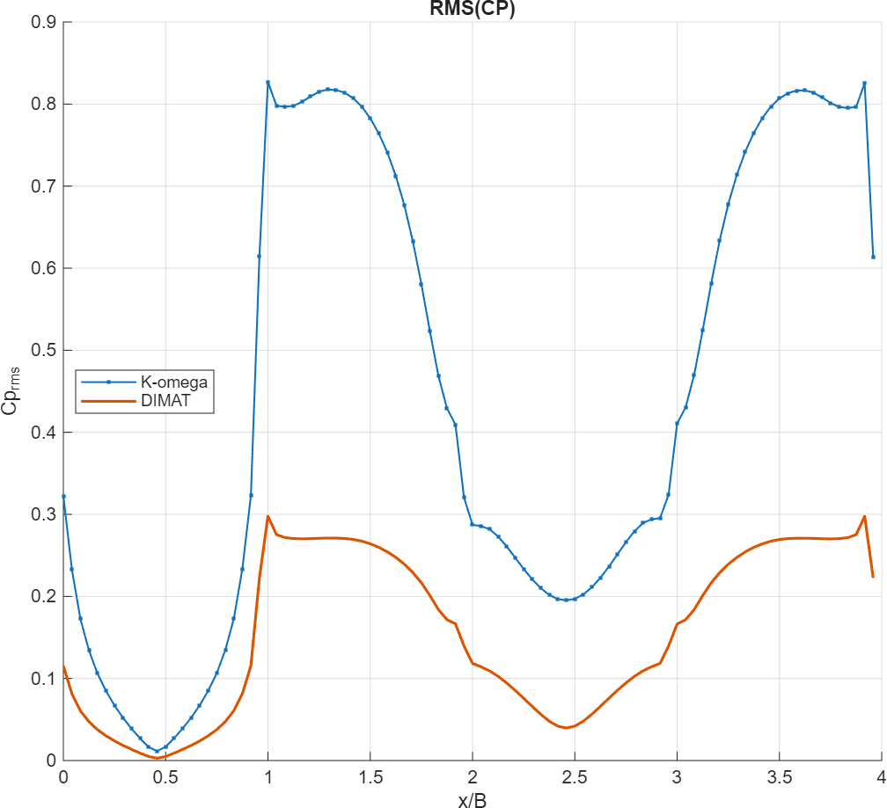
Comparison with DIMAT
3 Results
We can analyze and compare the data for C_{p} and σ (C_{p}).

Slide 16
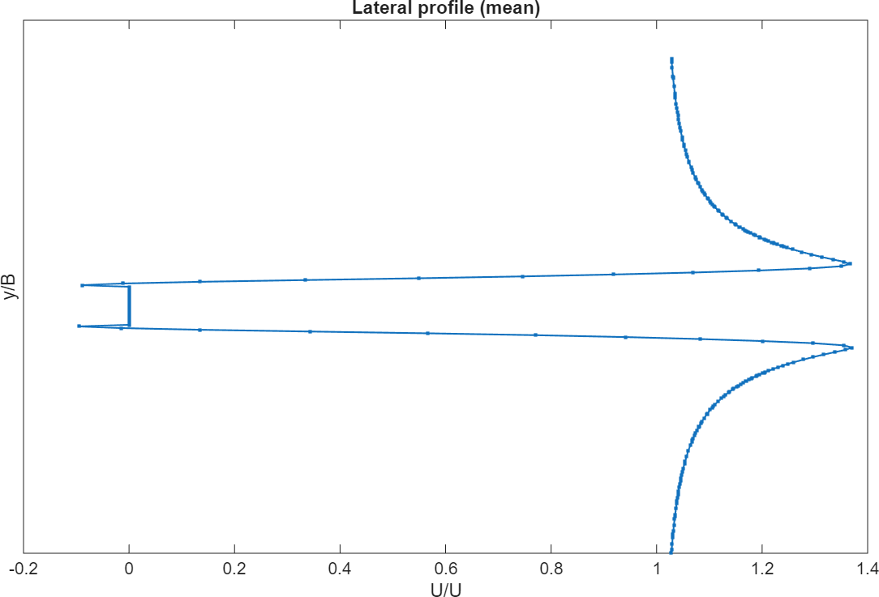
Lateral Velocity
3 Results
We can take a look at the mean velocity along y = 0.5.

