Slide 1
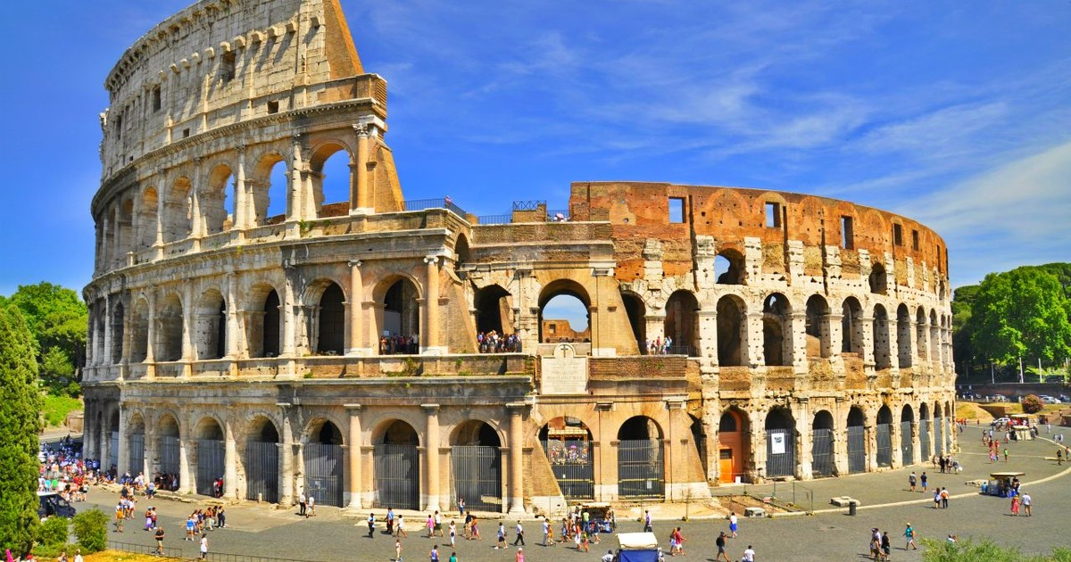

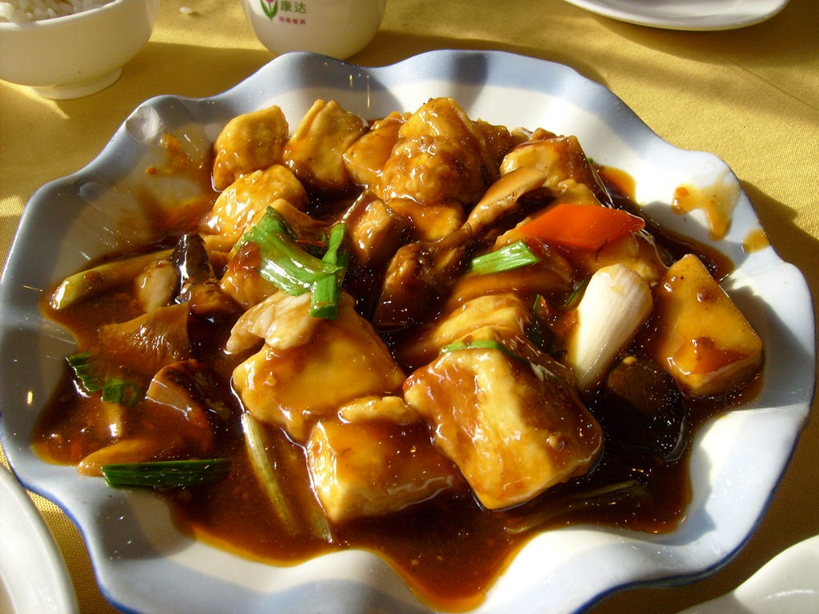
A Chinese restaurant in Rome
IBM Capstone project – The Battle of Neighborhoods
Simone De Gasperis

Slide 2
Presentation plan
Background and problem statement
Data aqcuisition and cleaning
Methodology
Discussions and Results
Conclusions and future improvements

Slide 3
Background and Problem statement
Rome is one of the most attractive metropolis in the world. during its three millennia of history, it has been the beating heart of one of the most ancient civilizations.
It can be the ideal place to open a shop like a restaurant but it can hide many pitfalls at the same time.
In such a complex scenario, in the present work I have tried to answer to the following question: “where could a typical Chinese restaurant be located?”

Slide 4
Data acquisition and cleaning
General informations about the administrative sub-division of the city of Rome from Wikipedia: https://en.wikipedia.org/wiki/Administrative_subdivision_of_Rome
Most common venues of a given Borough or Neighborhood from Foursquare:
https://developer.foursquare.com/
Data about green areas, historical sites and points of interest from: http://www.datiopen.it/it/catalogo-opendata/daticomuneromait
Boroughs and Neighborhood coordinates from Google Maps:
https://www.google.fr/maps
Data in most cases required offline treatment.

Slide 5
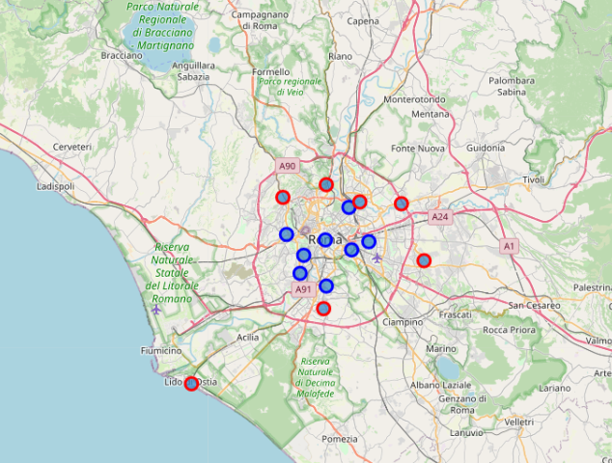
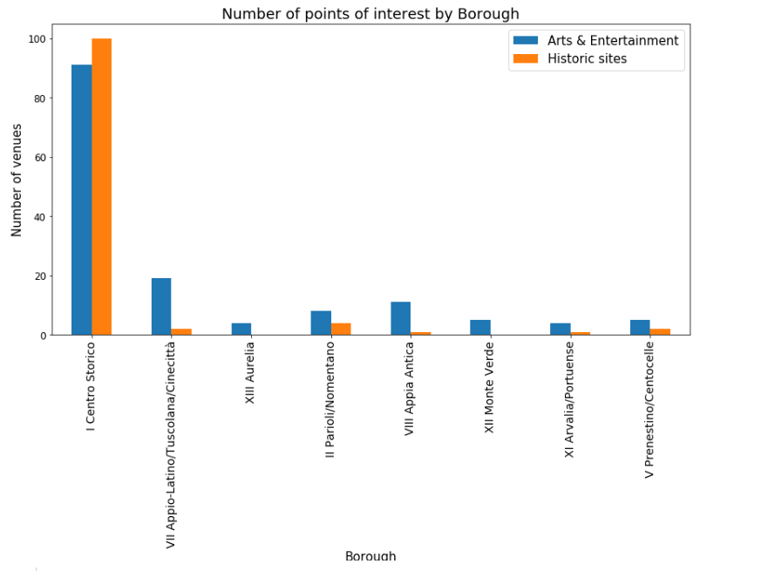
Methodology – Boroughs study
Selection of Boroughs within 6 km from the city center
Single Borough analysis through Foursquare API

Slide 6
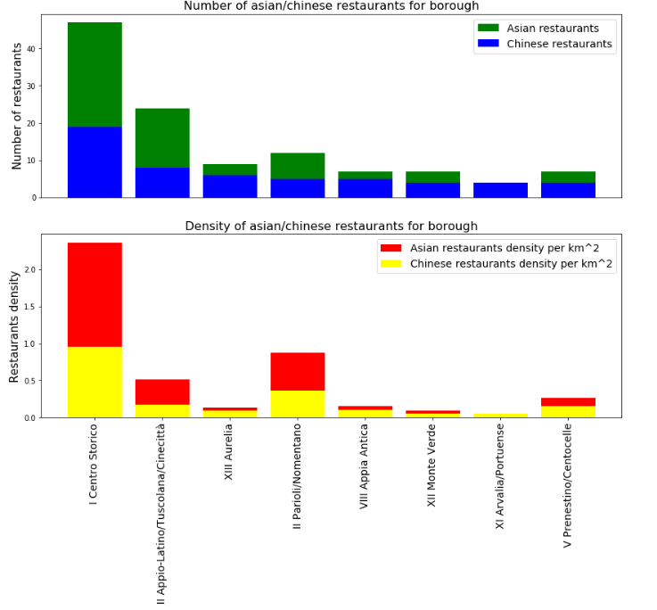
Methodology – Boroughs study
Analysis of business concurrence in single boroughs (number and density of similar restaurants)
Selection of specific Boroughs

Slide 7
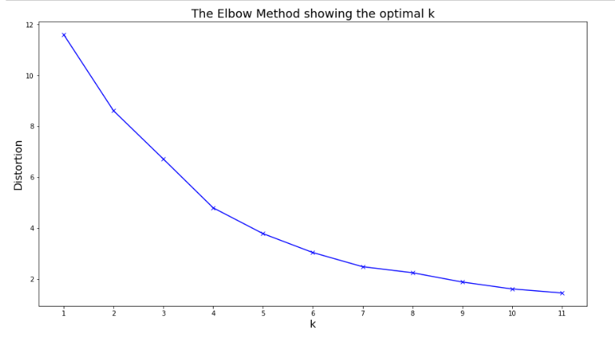
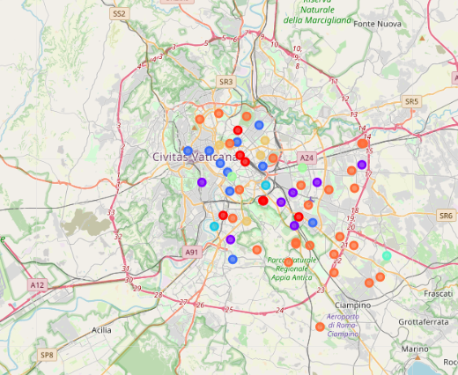
Methodology – Neighborhood study
Neighborhoods study with K-means algorithm.
Use of the elbow method to get the optimal K

Slide 8
Discussion and Results
Combining data from different sources it has been possible to identify best Borough candidate for this projet. Driving factors were the proximity to historic monuments, entertainment venues and business concurrence. 6 Boroughs were identified.
Then, The K-means method allowed to identify groups of neighborhoods within each Borough with specific features and to consider the group that best matched the imposed criteria.
The following analysis allowed to identify an optimal area for stakeholders. Indeed, the selected neighborhood that is the Neighborhood “1G Celio” is close to the historic city center and far from the competition of restaurant of the same type.

Slide 9
Conclusions and future improvements
The current work permitted to see how decisions can be made in presence of numerous variables and factors.
Data science techniques allowed to identify an optimal position for a Chinese restaurant in a city as vast as that of Rome.
Unsupervised machine learning algorithm of the k-means has been successfully used to identify an optimal neighborhood.
The analysis may be improved by considering other input data and by automating the data acquisition process.

