Slide 1

UNDERSTANDING GRAMMAR REPRESENTATION IN THE HUMAN BRAIN VIA INFORMATION-RESTRICTED LLMS
SIMONE ESPOSITO
ANUJA NEGI SUPERVISOR
PROF. DR. FATMA DENIZ FIRST EXAMINER
PROF. DR. KLAUS OBERMAYER SECOND EXAMINER

Slide 2
MOTIVATION AND BACKGROUND
How does the brain distinguish nouns and verbs?

Slide 3
MOTIVATION AND BACKGROUND
How does the brain distinguish nouns and verbs? It’s complicated…

Slide 4
MOTIVATION AND BACKGROUND
How does the brain distinguish nouns and verbs? It’s complicated…
Fronto-Temporal Dichotomy
Damasio and Tranel (1993)
Patients with brain lesions doing object and action naming tasks
→ Temporal regions involved in the retrieval of nouns
→ Frontal regions involved in the retrieval of verbs

Slide 5
MOTIVATION AND BACKGROUND
How does the brain distinguish nouns and verbs? It’s complicated…
Fronto-Temporal Dichotomy
Damasio and Tranel (1993)
Patients with brain lesions doing object and action naming tasks
→ Temporal regions involved in the retrieval of nouns
→ Frontal regions involved in the retrieval of verbs
What is driving the distinction?

Slide 6
MOTIVATION AND BACKGROUND
How does the brain distinguish nouns and verbs? It’s complicated…
Emergentist View
Bird et al. (2000), Vigliocco et al. (2011)
Noun / Verb distinction is not lexical but semantic
→ Nouns tend to be more imageable and related to objects
→ Verbs are less imageable and related to actions

Slide 7
MOTIVATION AND BACKGROUND
How does the brain distinguish nouns and verbs? It’s complicated…
Combinatorial View
Shapiro et al. (2003)
Noun / Verb distinction driven by computational processes
→ Pseudowords: he wugged and the wugs represented in distinct brain areas
→ Left Inferior Frontal Gyrus (LIFG) activation during verb inflection

Slide 8
MOTIVATION AND BACKGROUND
How does the brain distinguish nouns and verbs? It’s complicated…
Distributed Account
Crepaldi et al. (2013)
Theory-blind meta-analysis based on 36 neuroimaging studies
→ 32 reliable clusters:
3 for nouns (R-ITG, L-AG, L-IPG)
1 for verbs (R-MTG)
3 both nouns and verbs; Task dependent (L-IFG, R-IFG, L-Insula)
→ No support for Fronto-Temporal dichotomy or Embodied Cognition
→ Distributed processing of nouns and verbs

Slide 9
MOTIVATION AND BACKGROUND
Prior Methods
Block design
Picture naming
→ Does not necessarily reflect language processing in natural context

Slide 10
MOTIVATION AND BACKGROUND
Prior Methods
Block design
Picture naming
→ Does not necessarily reflect language processing in natural context
Current Approach
Naturalistic stimuli (narrative stories)
Voxelwise Encodig Framework

Slide 11
MATERIALS
Stimuli
11 stories from
The Moth Radio Hour
10-15 min per story
Listening and reading
fMRI Data
From Deniz et al. (2019)
9 subjects
Features
Listening
Phonemes + count
Reading
Letters + count
Word length variation
Both
Number of words
Number of pauses
Lexical (English1000)

Slide 12
CONTEXT MASKING
Stimulus
There're some scientists who say that the universe that we inhabit is not the only universe there is ...

Slide 13
CONTEXT MASKING
Stimulus
There're some scientists who say that the universe that we inhabit is not the only universe there is ...
POS tagging via spaCy
Attention Mask
There' |  | re |  | some | scientists |  |  | who | say | that | the | universe
that | we |  | inhabit |  | is | not | the | only | universe |  | there |  | is

Slide 14
CONTEXT MASKING
Stimulus
There're some scientists who say that the universe that we inhabit is not the only universe there is ...
POS tagging via spaCy
Attention Mask
There' |  | re |  | some | scientists |  |  | who | say | that | the | universe
that | we |  | inhabit |  | is | not | the | only | universe |  | there |  | is
GPT-2
Layer 1
...
Layer 8
...
Layer 12

Slide 15
CONTEXT MASKING
Stimulus
There're some scientists who say that the universe that we inhabit is not the only universe there is ...
POS tagging via spaCy
Attention Mask
There' |  | re |  | some | scientists |  |  | who | say | that | the | universe
that | we |  | inhabit |  | is | not | the | only | universe |  | there |  | is
H₈
1
GPT-2
Layer 1
2
...
Layer 8
3
...
Layer 12
768

Slide 16
CONTEXT MASKING
Stimulus
There're some scientists who say that the universe that we inhabit is not the only universe there is ...
POS tagging via spaCy
Attention Mask
There' |  | re |  | some | scientists |  |  | who | say | that | the | universe
that | we |  | inhabit |  | is | not | the | only | universe |  | there |  | is
H₈
1
e_{w}
1
GPT-2
Layer 1
2
2
...
Ø
Layer 8
3
3
...
Layer 12
768
768

Slide 17









PARTS OF SPEECH FREQUENCY IS CONSISTENT ACROSS STORIES

Slide 18
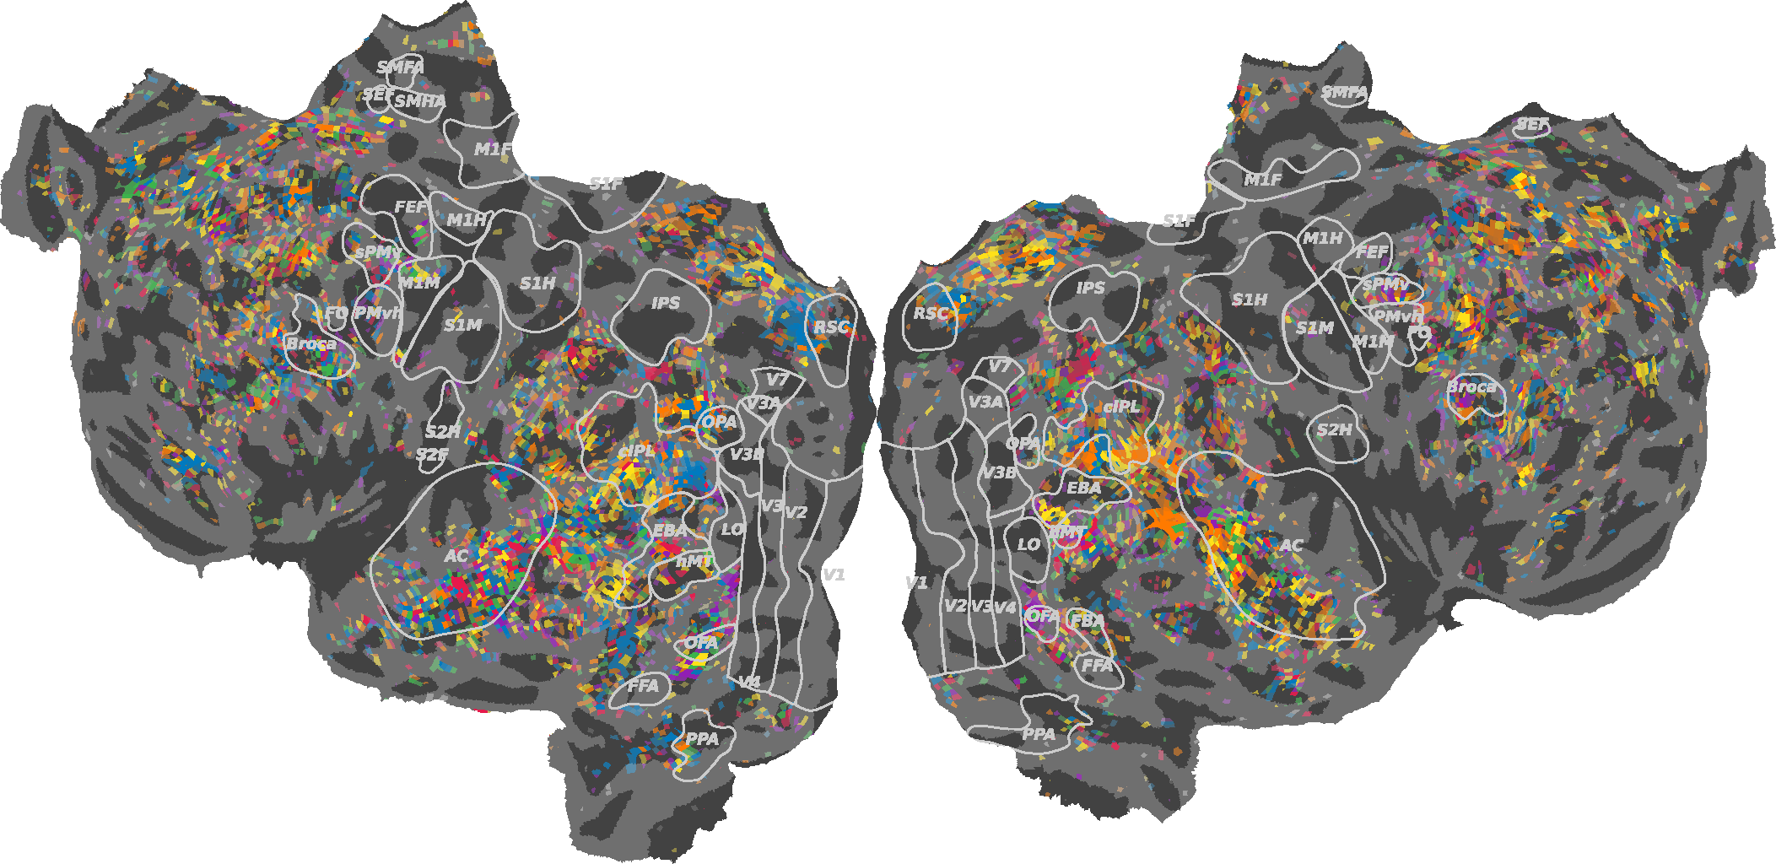
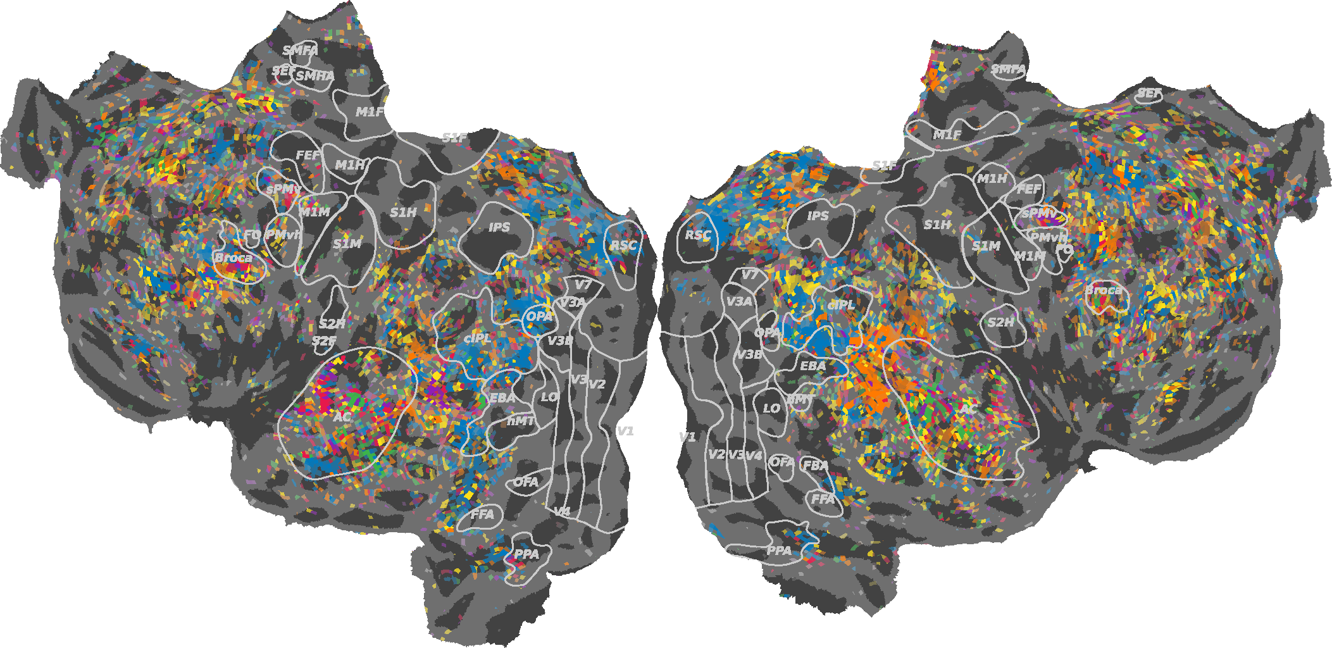
POS-MASKED CONTEXTUAL EMBEDDINGS REVEAL CLUSTERS OF POS SENSITIVITY ACROSS THE BRAIN
Subject 7 Reading Modality
Subject 7 Listening Modality

Slide 19
POS-MASKED CONTEXTUAL EMBEDDINGS REVEAL CLUSTERS OF POS SENSITIVITY ACROSS THE BRAIN
Subject 7 Reading Modality
Subject 7 Listening Modality

Slide 20

POS-MASKED CONTEXTUAL EMBEDDINGS REVEAL CLUSTERS OF POS SENSITIVITY ACROSS THE BRAIN
Subject 7 Reading Modality
Subject 7 Listening Modality

Slide 21
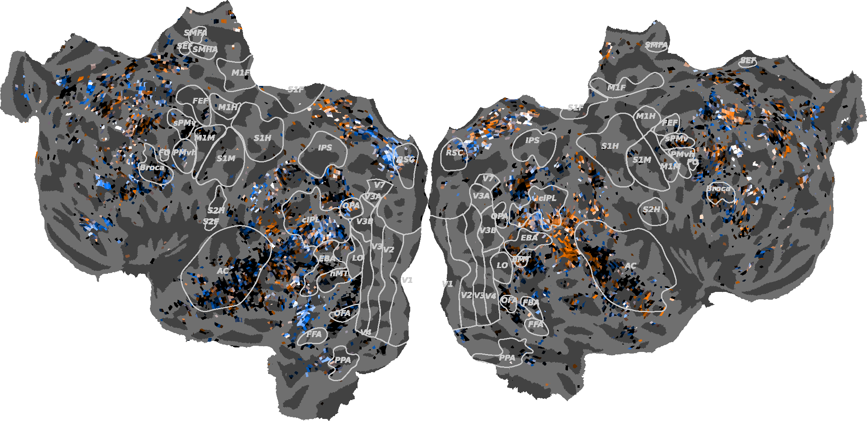
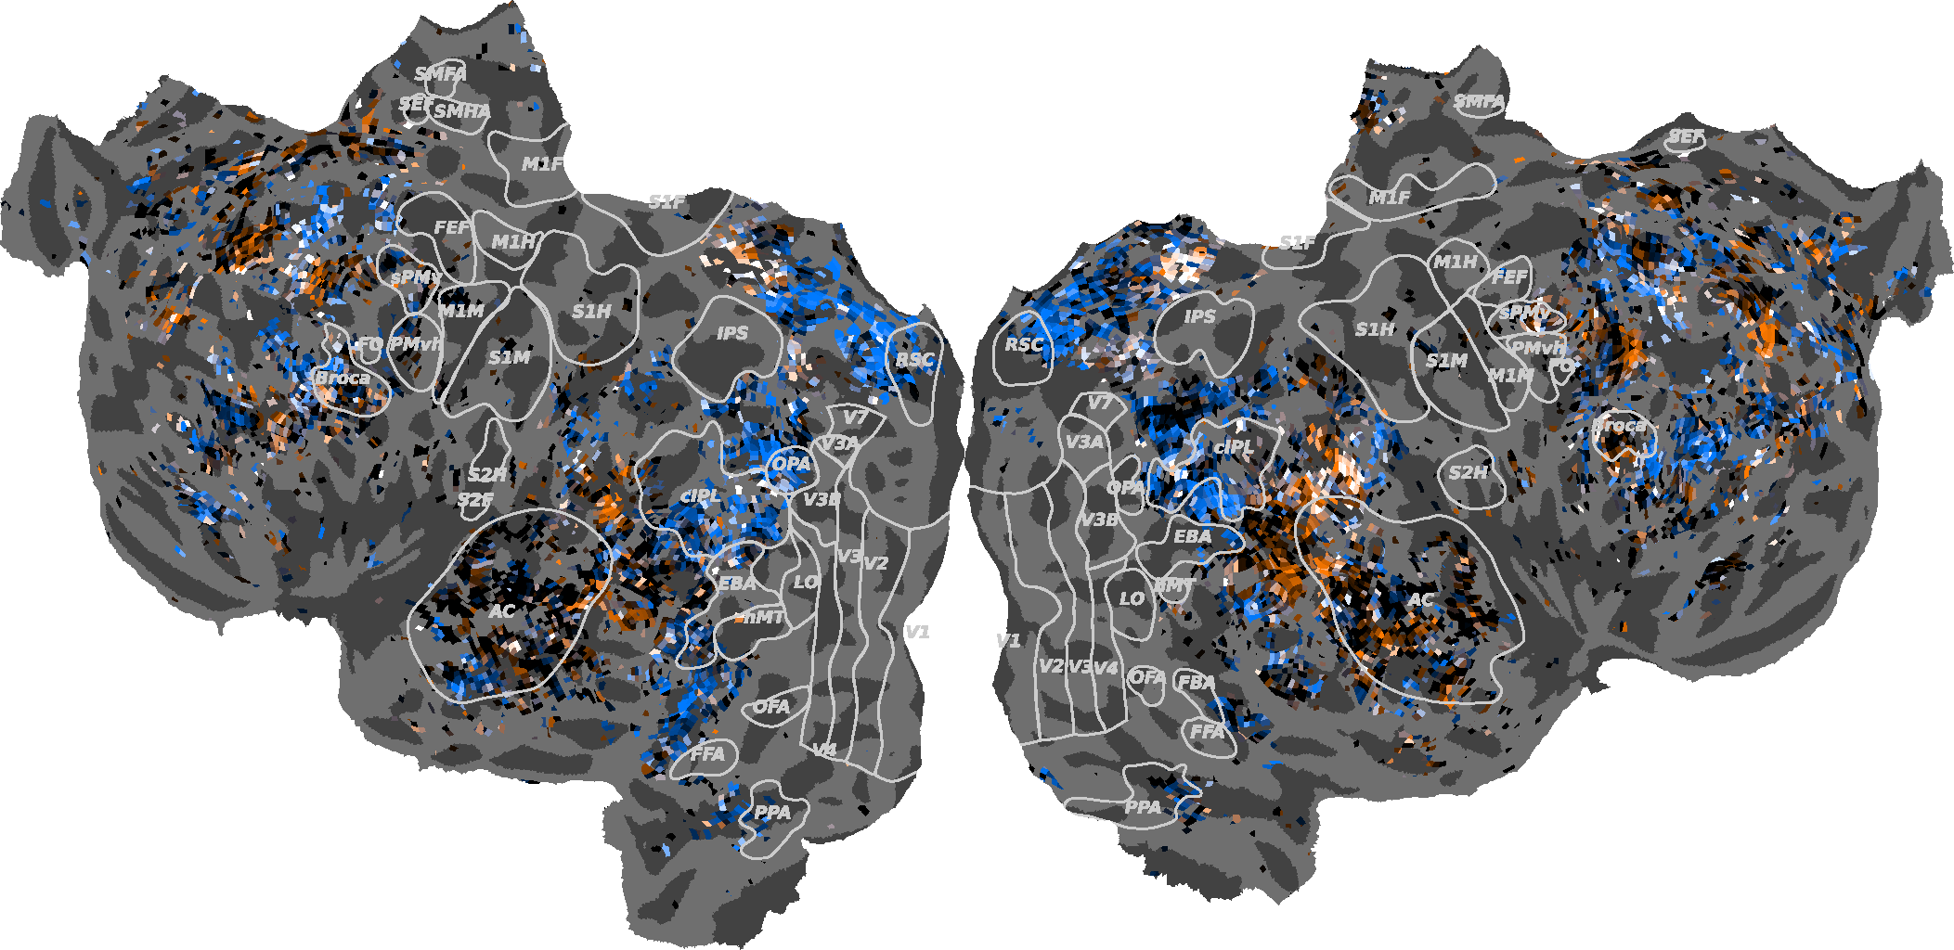
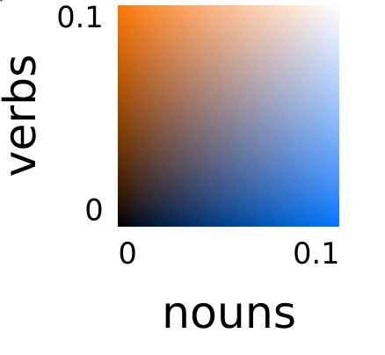
NOUNS AND VERBS SHOW DISTINCT PATTERNS OF SENSITIVITY ACROSS THE BRAIN
Subject 7 Reading Modality
Subject 7 Listening Modality

Slide 22
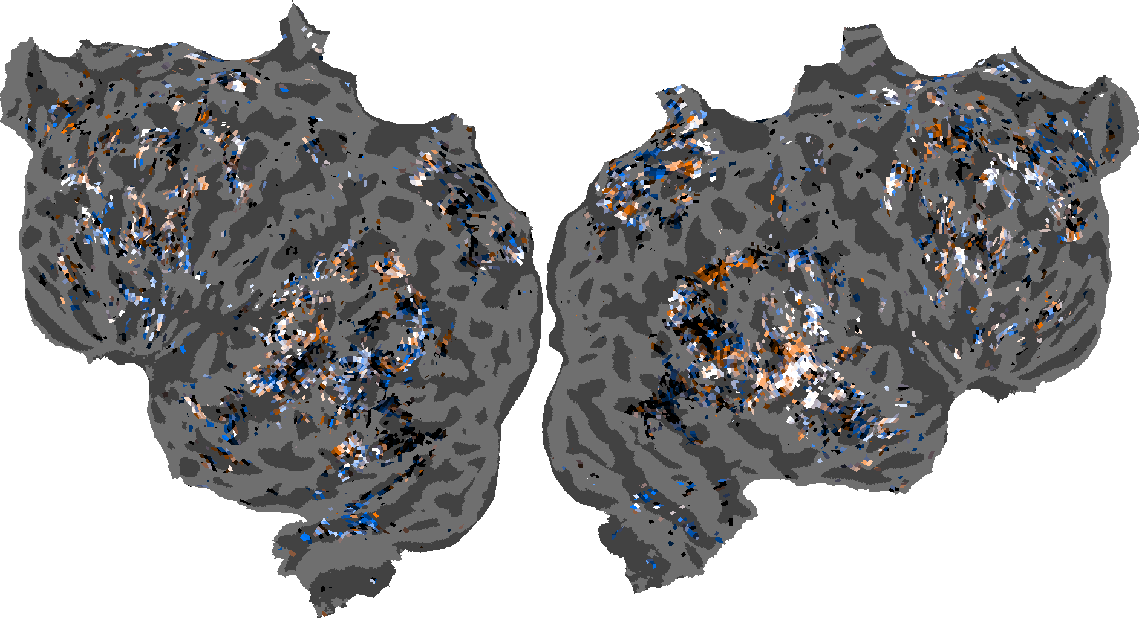
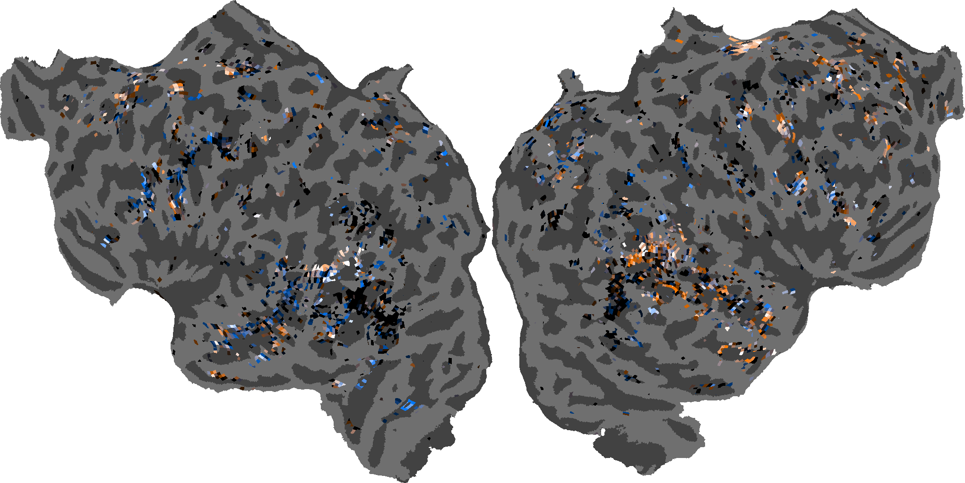
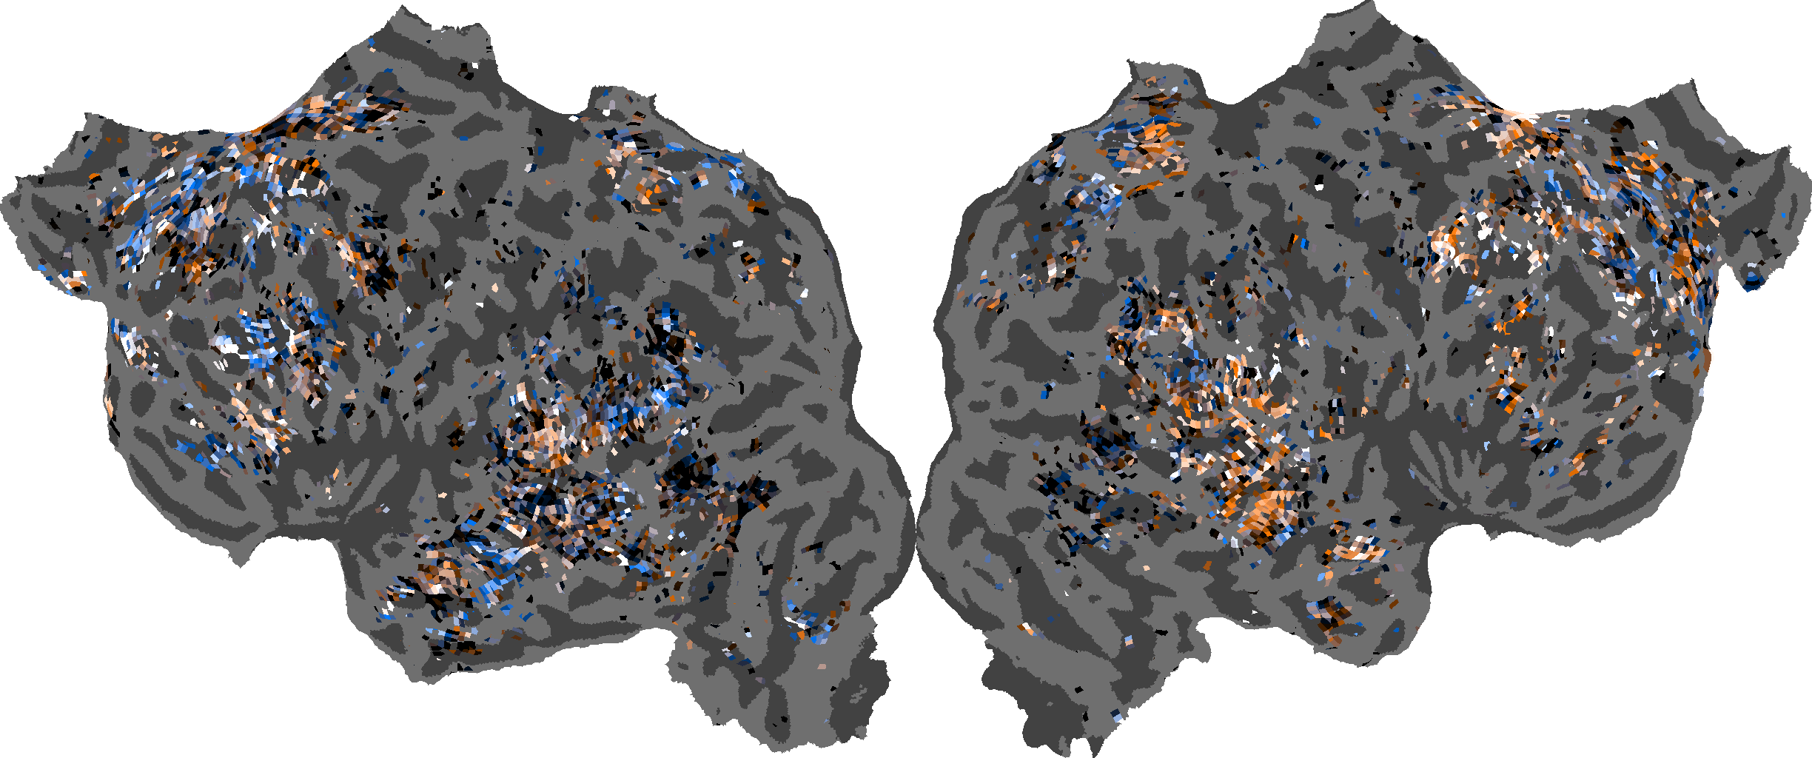
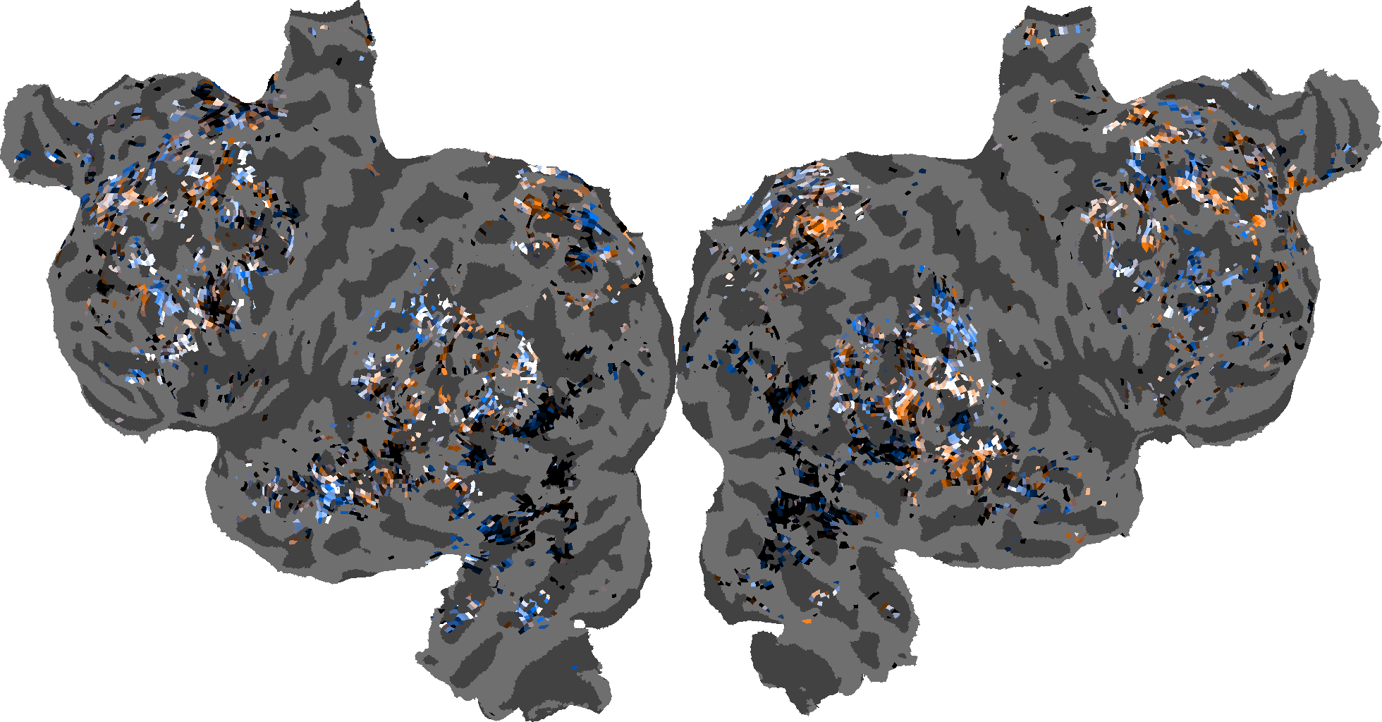
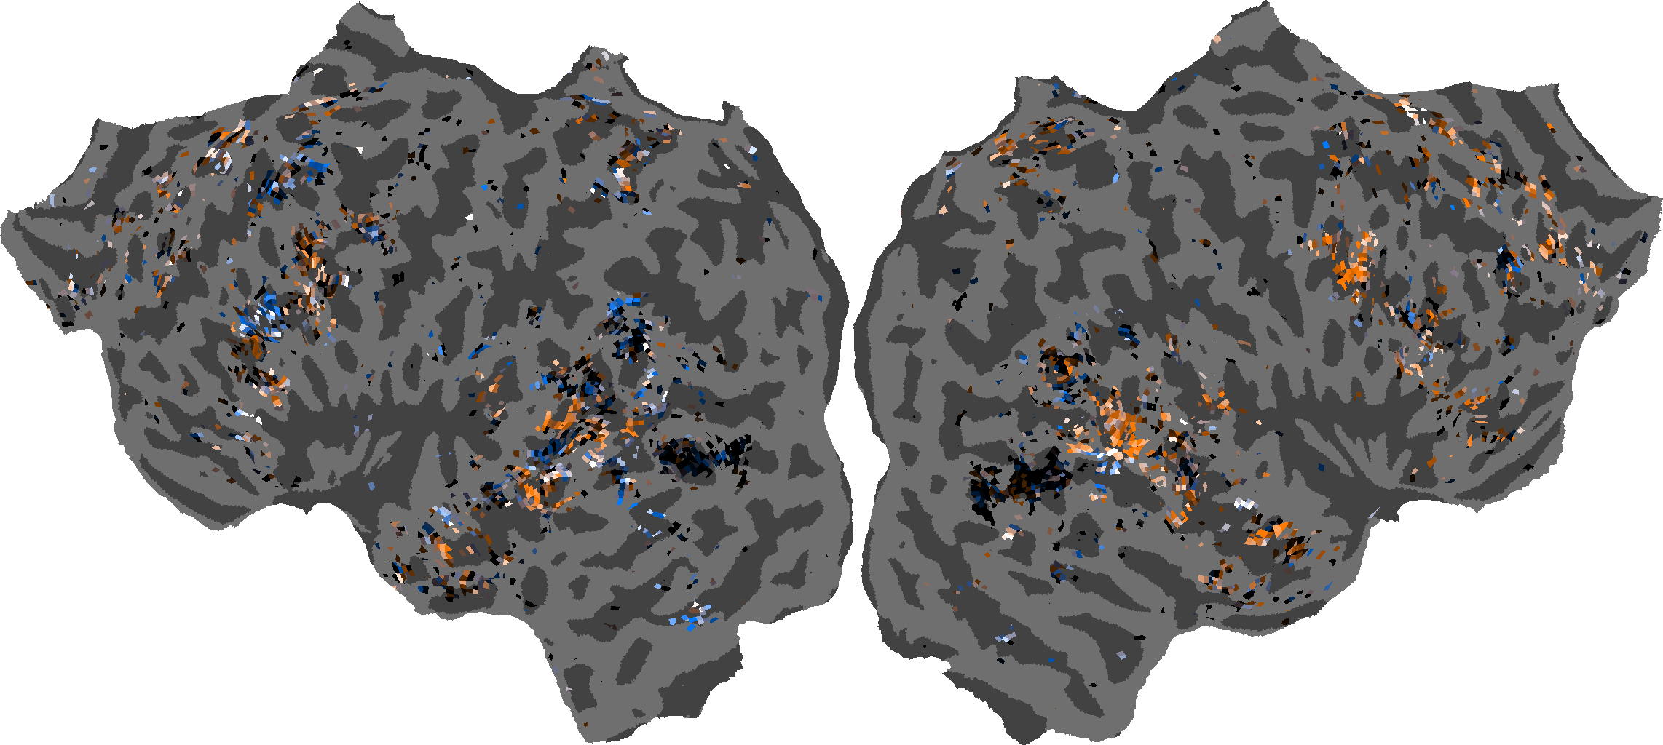
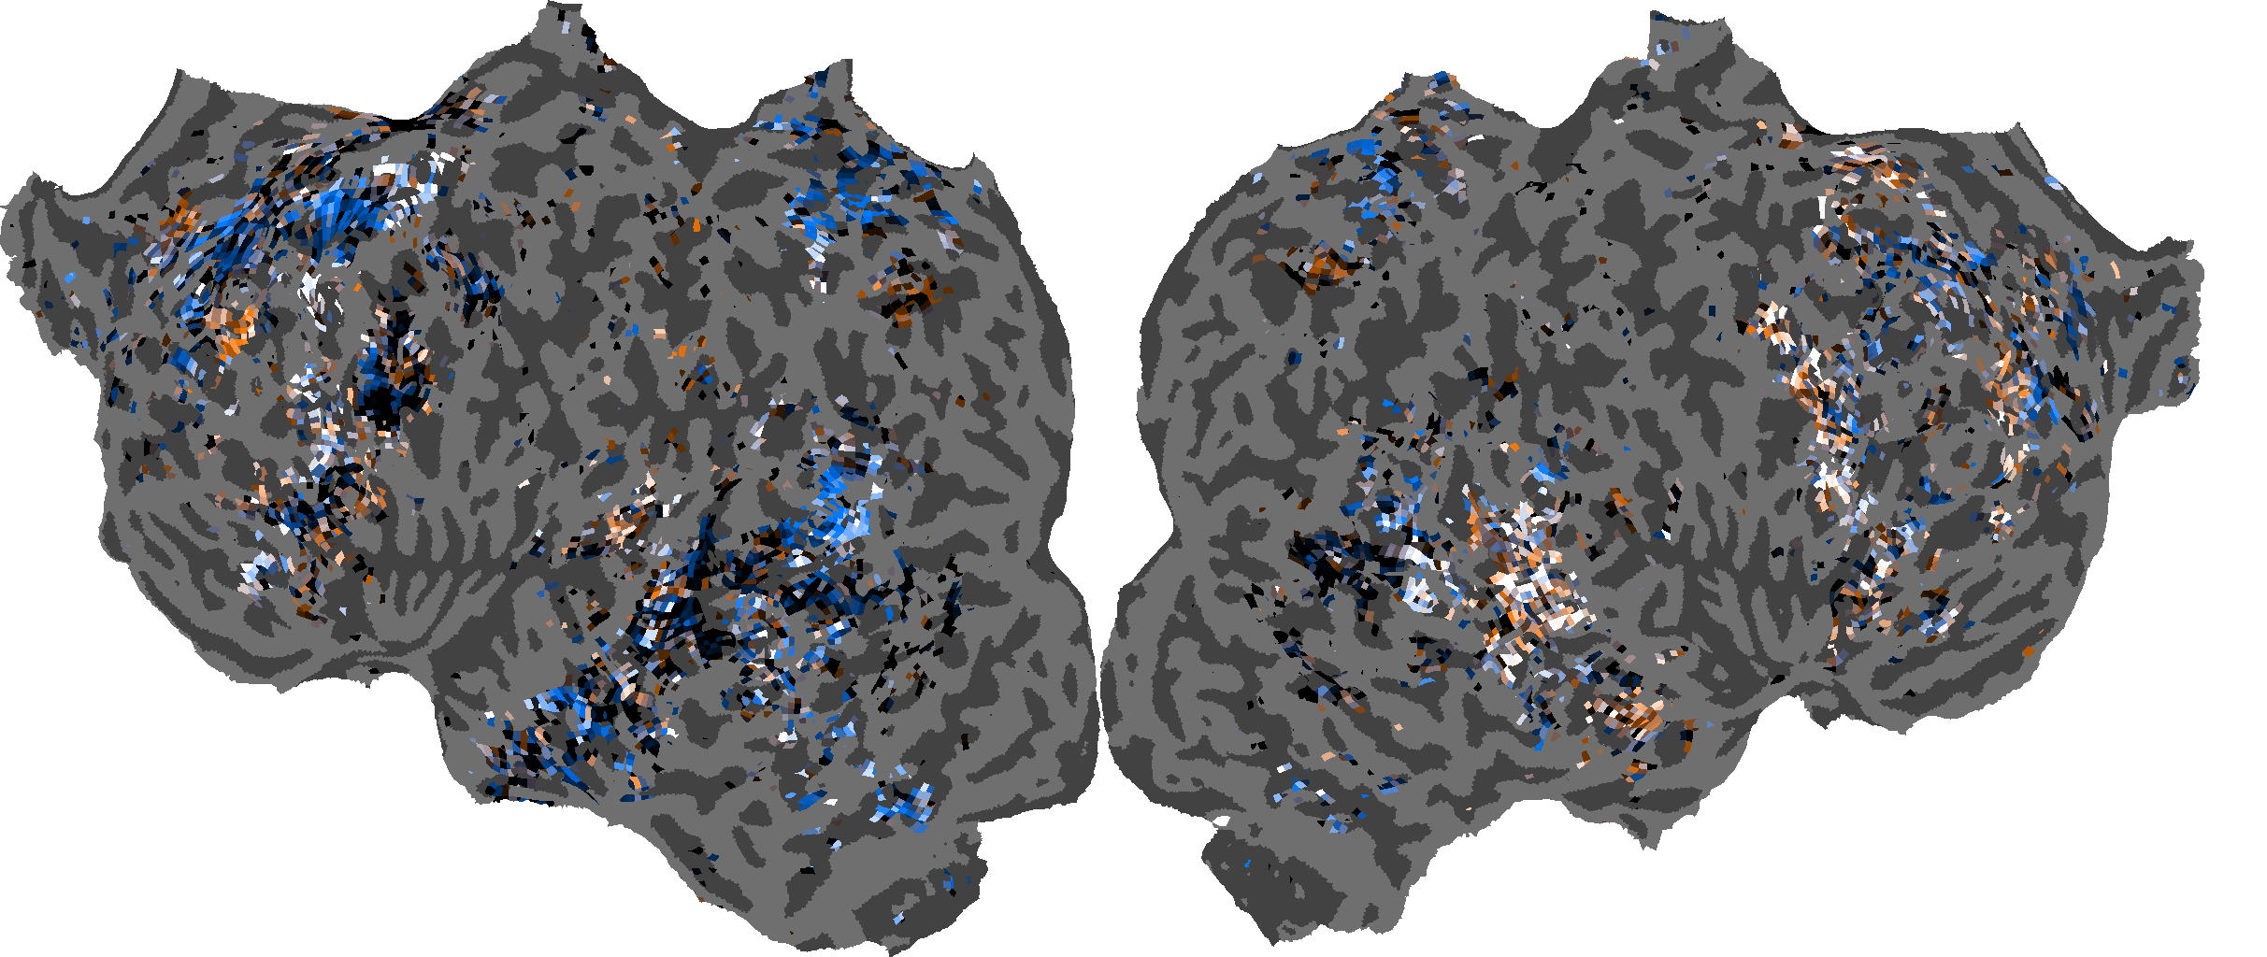
NOUN & VERB SENSITIVITY - READING

Slide 23
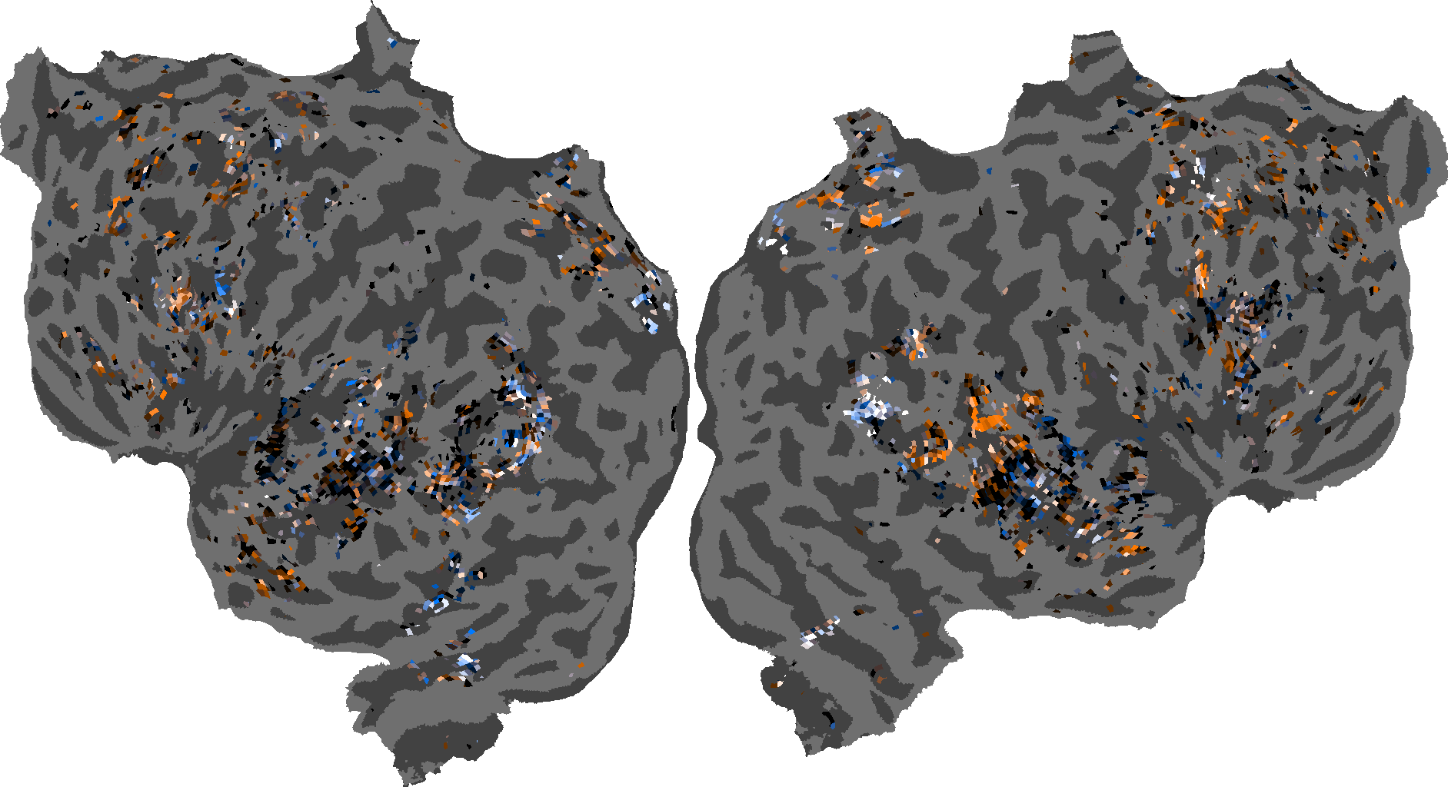
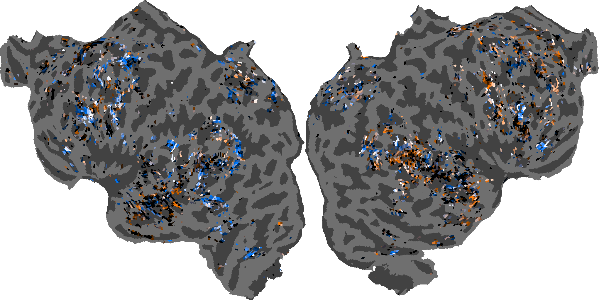
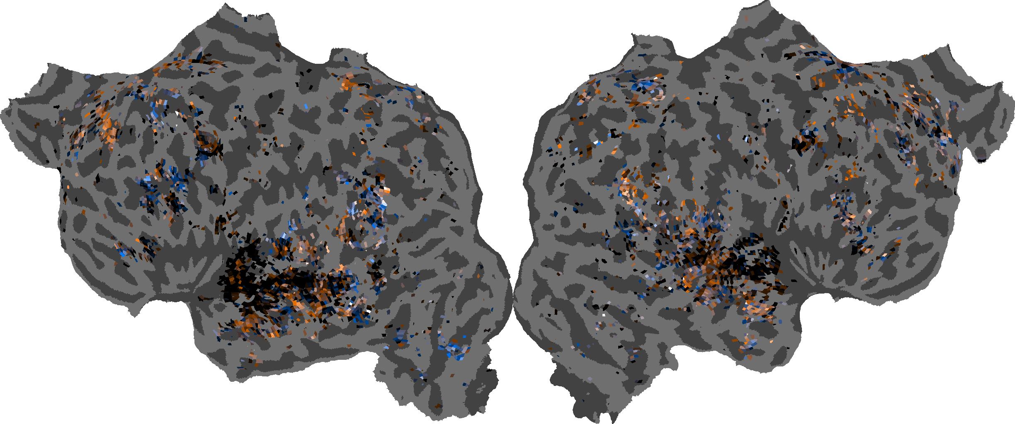
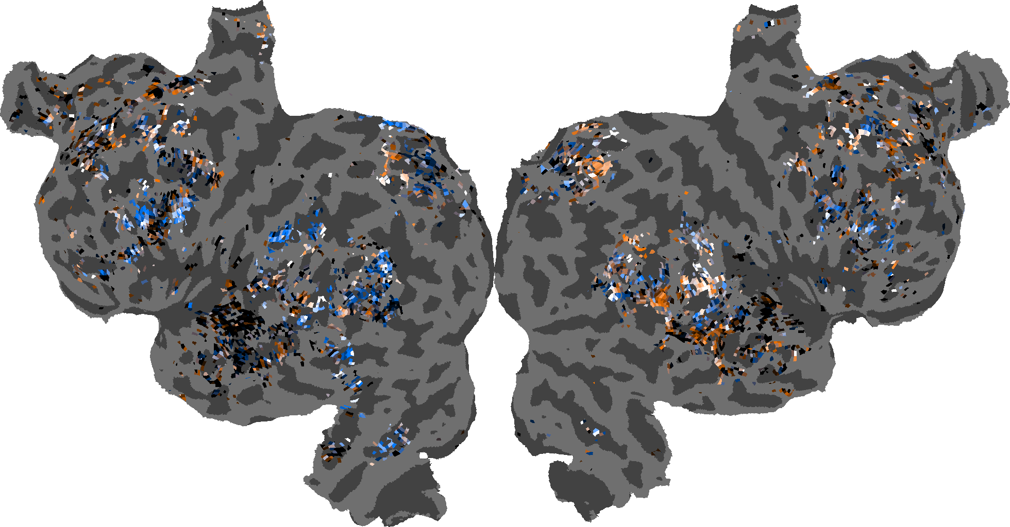
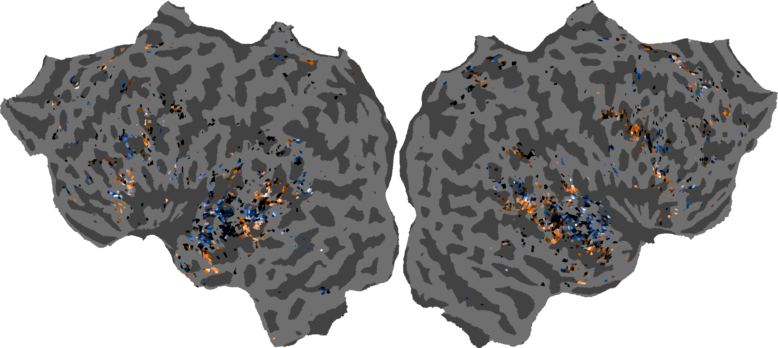
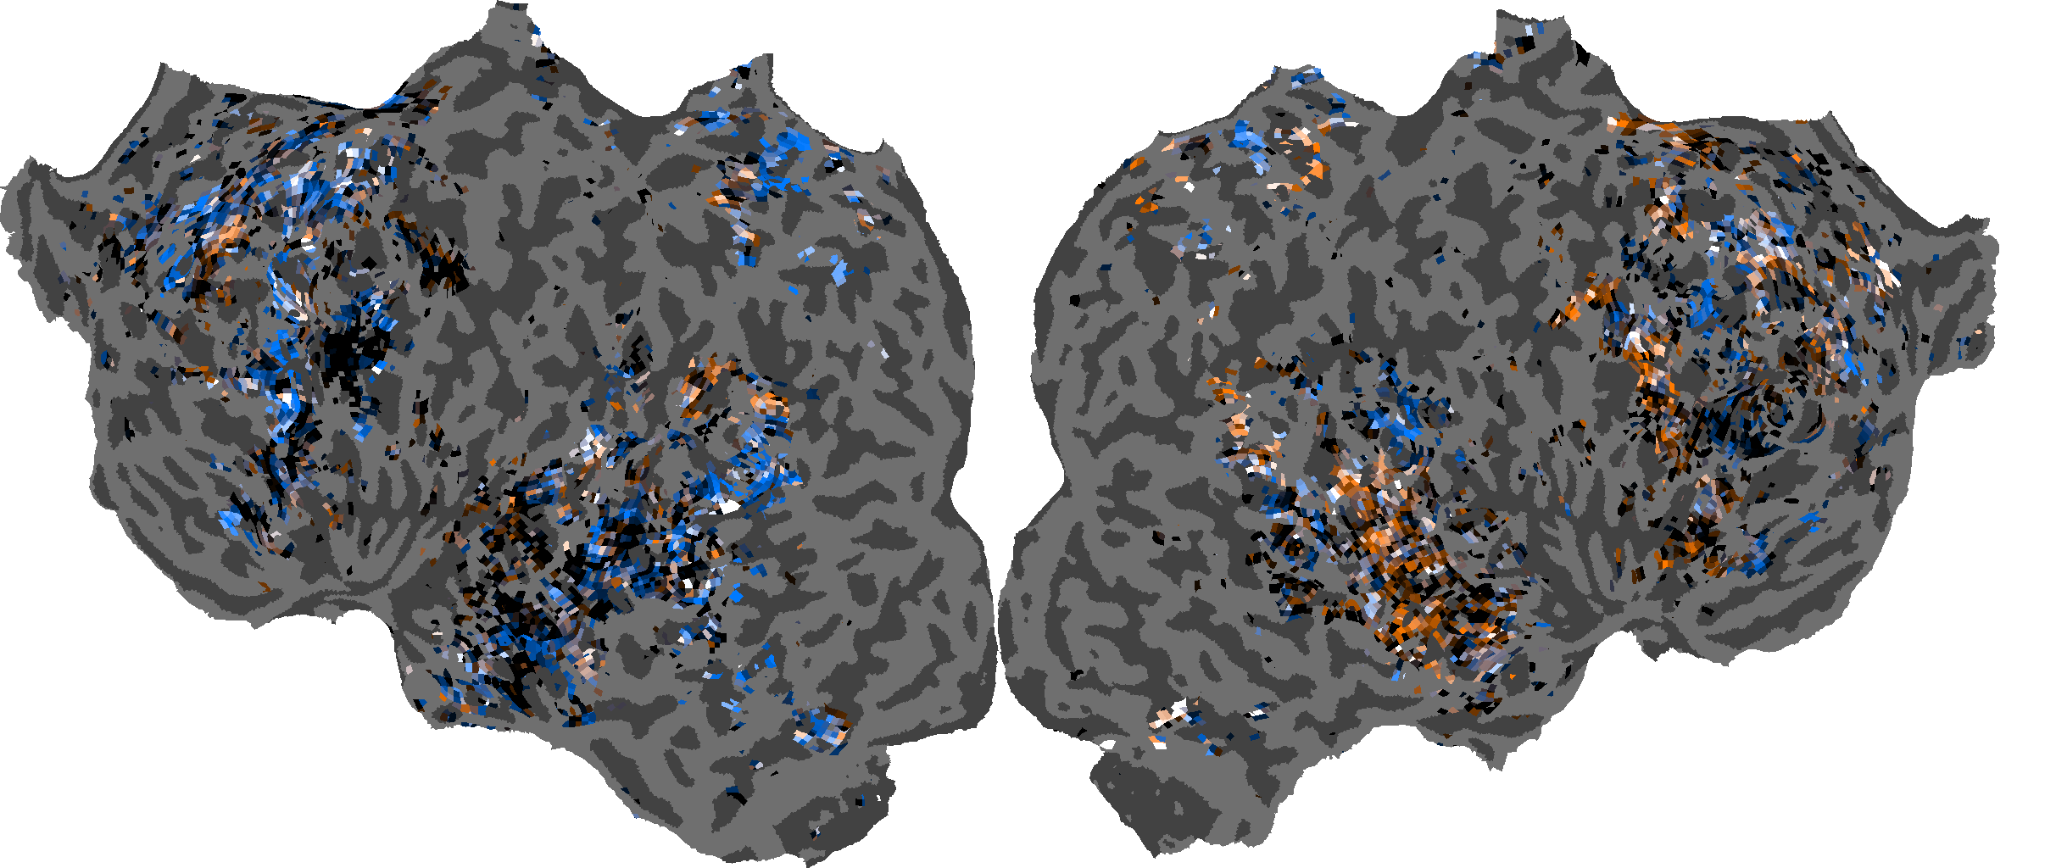
NOUN & VERB SENSITIVITY - LISTENING

Slide 24
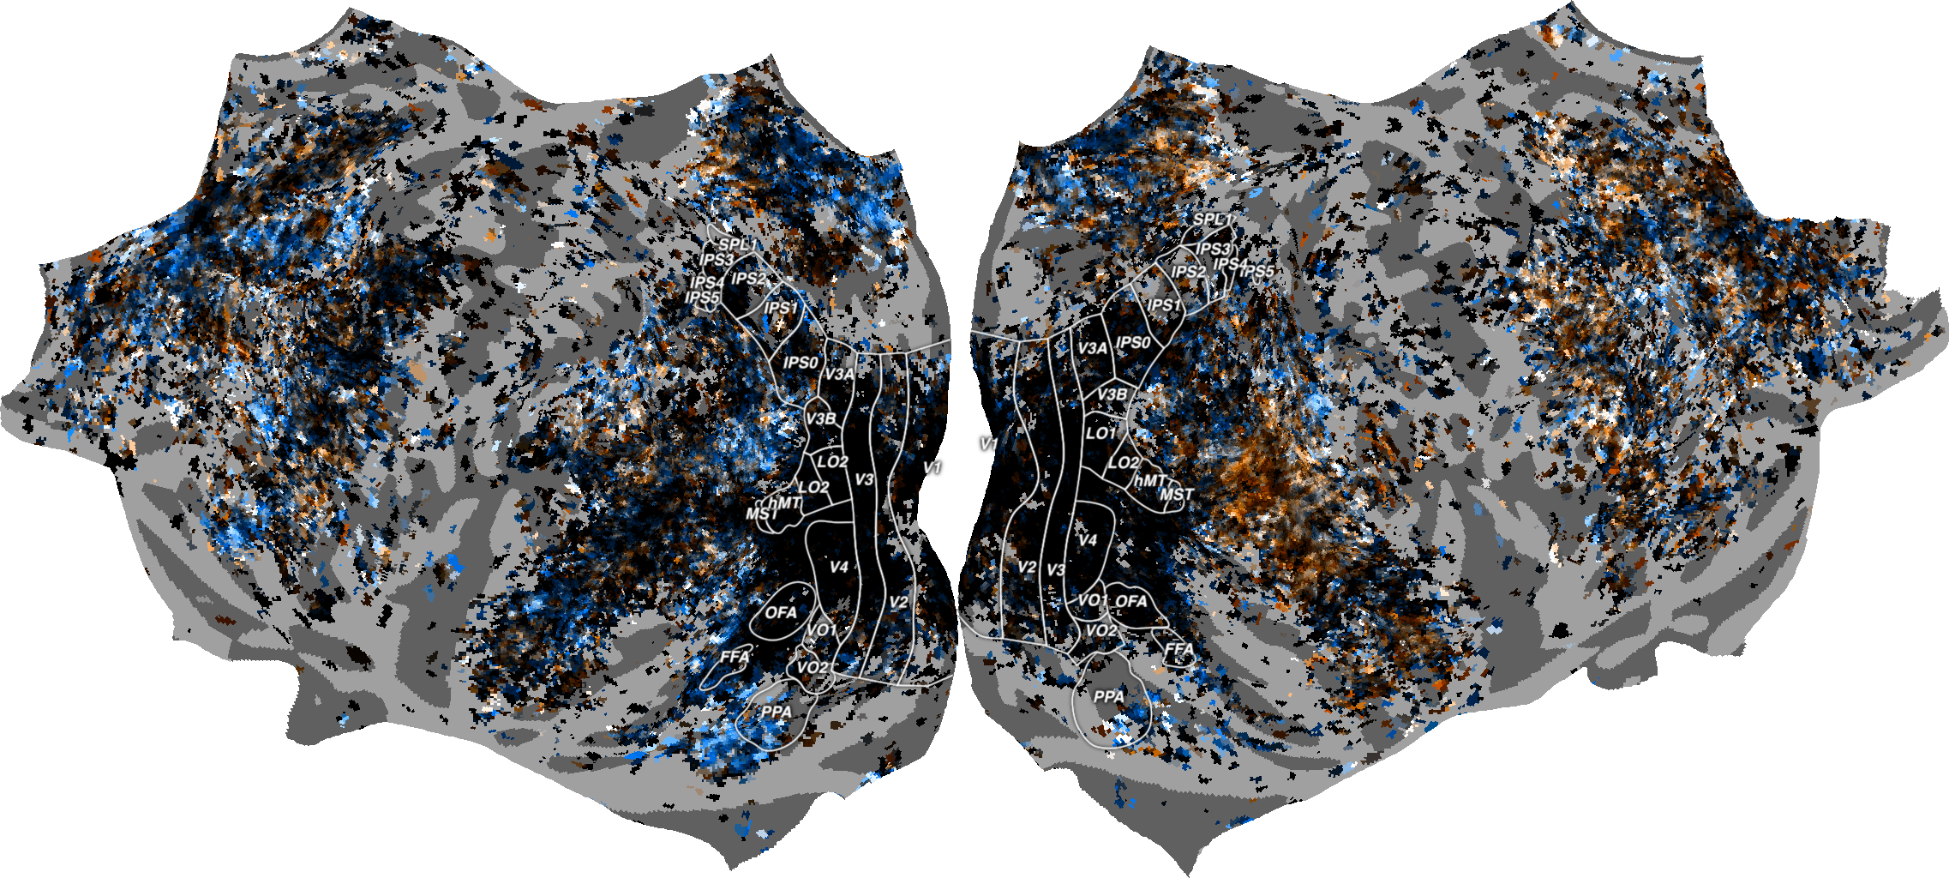
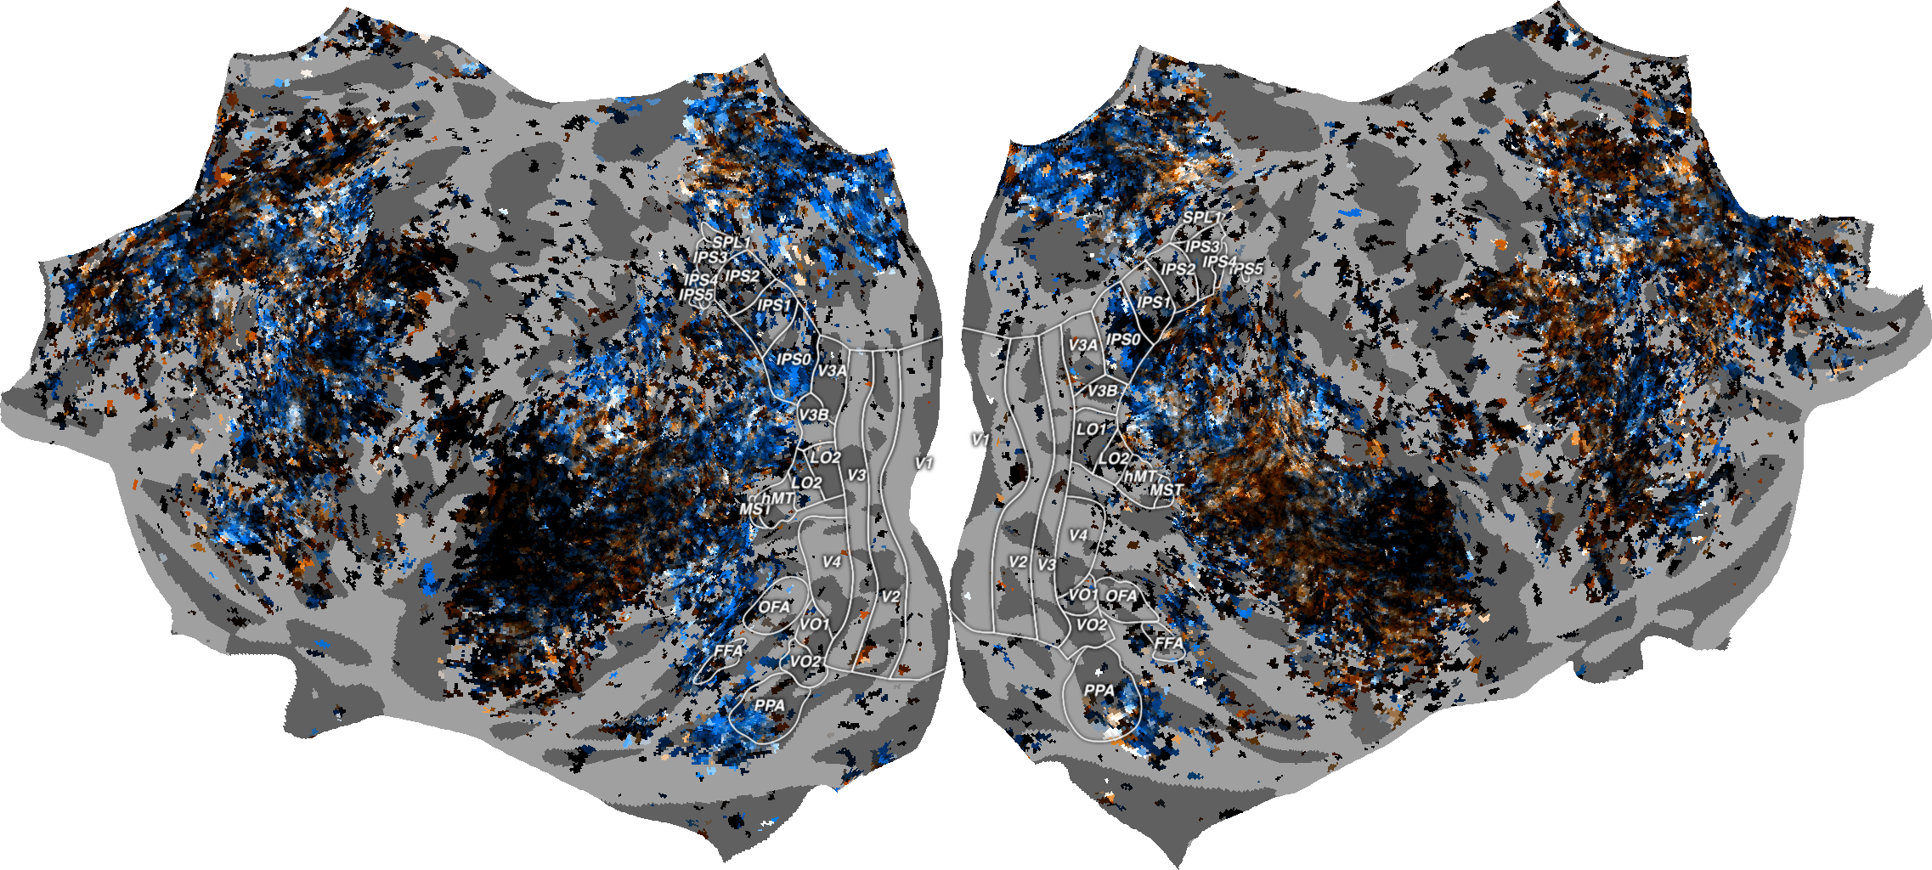

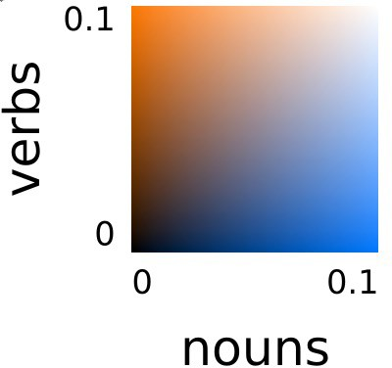
GROUP AVERAGE
Reading Modality
Listening Modality

Slide 25
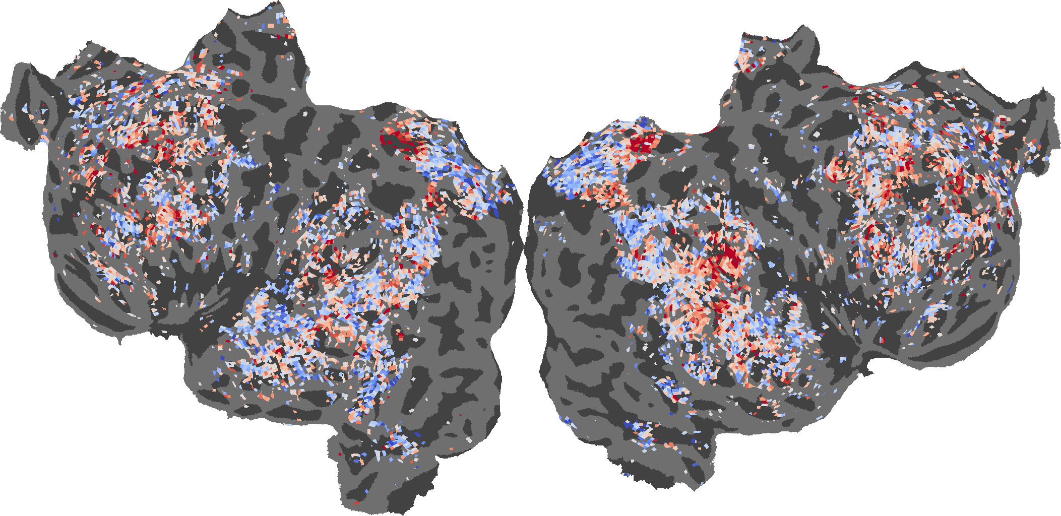
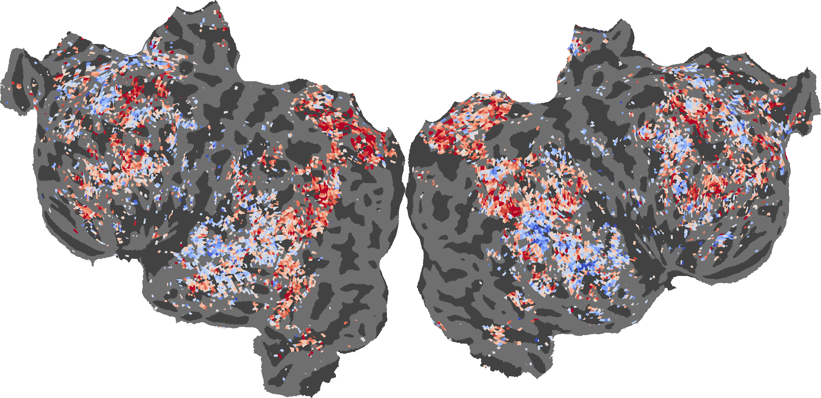


MASKING NOUNS AND VERBS IMPROVES PREDICTION ACCURACY IN SOME AREAS
Subject 7 Baseline - Verb
Subject 7
Baseline - Noun
baseline-masked
baseline worse
masked worse

Slide 26
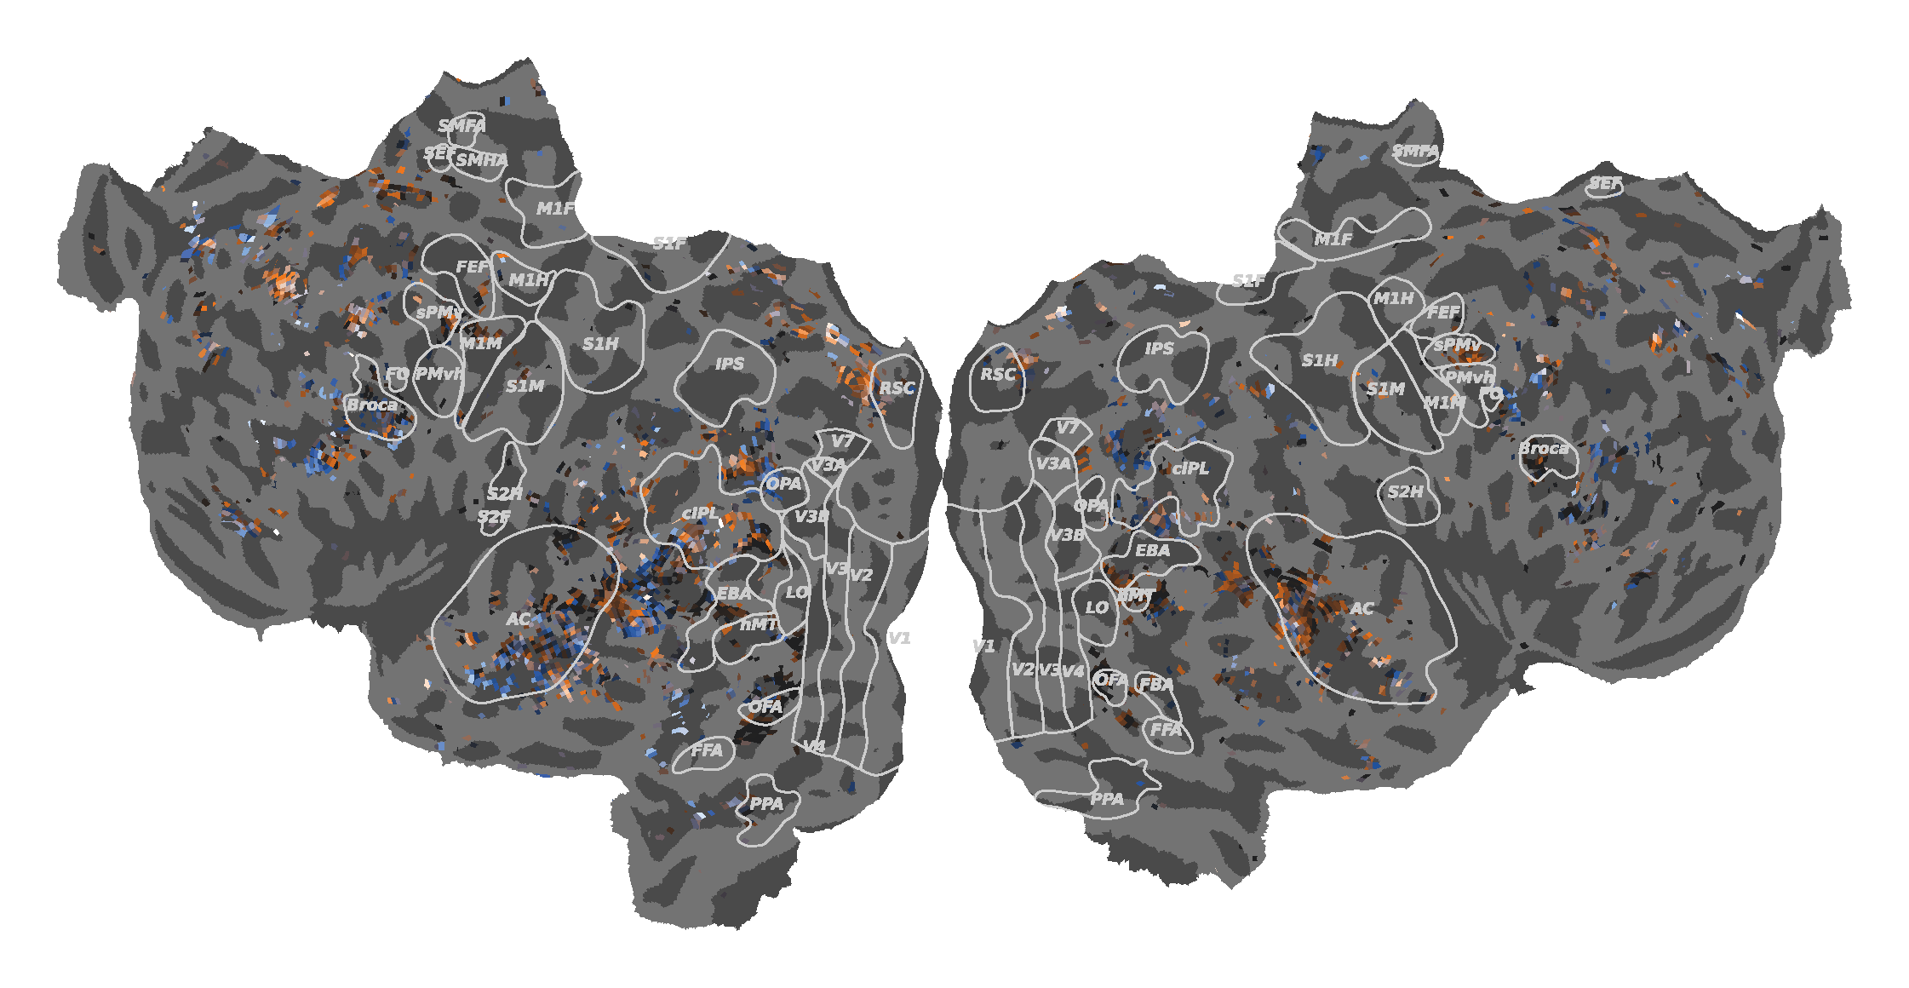
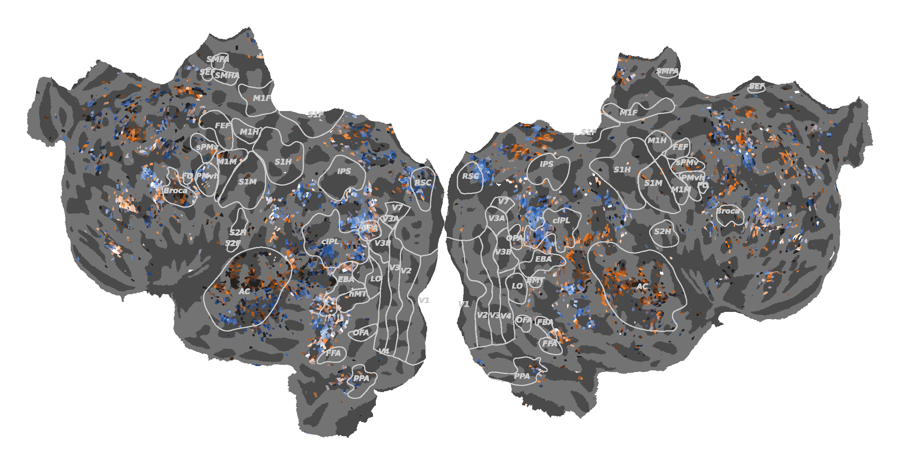
MASKING OF LEXICAL EMBEDDINGS PRODUCES SIMILAR SENSITIVITY MAPS
Subject 7 Baseline - Verb
Subject 7
Baseline - Noun

Slide 27






































VERB SENSITIVITY IS MORE PREVALENT ACROSS LANGUAGE ROIS
Language ROIs
Fedorenko et al. (2010)
Mean Drop
0.03 – 0.06
Verb > Noun
MFG, PTL, AG, ATL
Reading vs Listening
Similar across ROIs

Slide 28
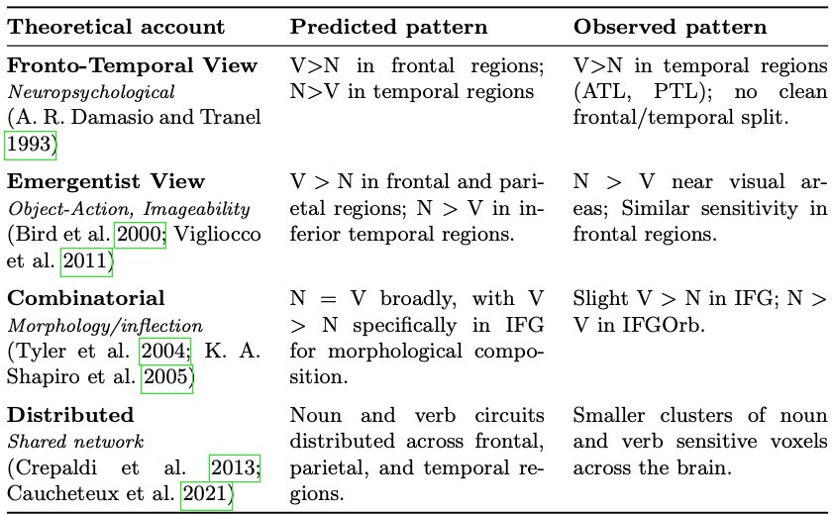
COMPARISON WITH LITERATURE

Slide 29
Conclusions
Noun and verb sensitivity forms distinct but distributed clusters across frontal, parietal and temporal cortex
Noun and verb processing is consistent across stimulus modality
Verb sensitivity dominates across most language ROIs
Results support a distributed account

Slide 30
LIMITATIONS
Only the absence of nouns / verbs is being investigated
ROIs used in quantification don’t cover all clusters / Clusters split across multiple ROIs
Cross-Modality not confirmed

Slide 31
FUTURE RESEARCH
Investigating presence of nouns and verbs
Using one-hot encodings
Using a different dataset
Other than Moth
Looking at a different Language
Other than English, e.g. Chinese
Cluster Categorization
Which kind of nouns / verbs in the clusters?

