Slide 1
FDS 21/22 Final project
Gradient descent with Runge-Kutta methods for faster and accurate learning
Andrei Caraman 1664744
Leonardo Skerl 1792917
Simone Piperno 1802968
Gianmarco Ursini 1635956

Slide 2
Task and motivation
Aim of the project is the implementation of an higher-than-first order Runge-Kutta method in order to obtain a smoother descent/ascent along the loss slopes in order to get a faster and/or more accurate way to converge to the loss minimum .
Indeed, in the simplest implementation of GD, the evaluation of the gradient of the loss is only on top of the actual learning parameters without any forecast of the future learning parameters, resulting in the typical GD zig-zag descent/ascent shape.
Furthermore, in GD the convergence happens at a rate just inversely proportional to the number of steps taken.
Leveraging theoretical proven results [1] we want to implement a high order Runge-Kutta integrator inside the GD algorithm so that the convergence rate will tend to the optimal rate 1/(N^2) with N denoting the number of taken steps. [1]:Direct Runge-Kutta Discretization Achieves Acceleration, arXiv:1805.00521v5

Slide 3
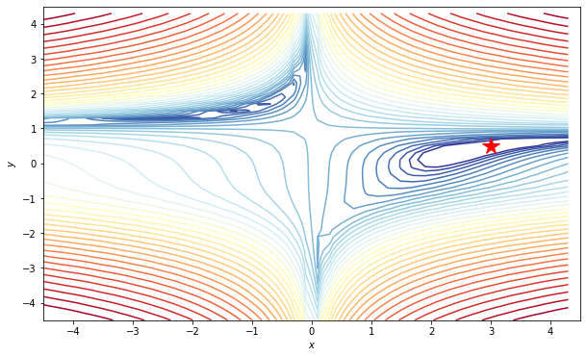
Models and tools
The behaviour of our RKGD will first be tested in a “controlled environment”: we will compare its performance with the simple GD and the well know optimal Nesterov Moment GD while optimizing a famous multimodal test function for optimization: the Beale function [2].
In a second moment, our RKGD will then be implemented into a classical ML optimization problem, i.e. PROBLEMA CHE HAI SCELTO LEO
[2]:Beale function, https://www.sfu.ca/~ssurjano/beale.html

Slide 4
Dataset and metric
Daje forte

