Slide 1
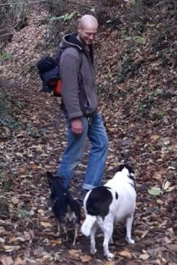
FDS 21/22 Final project
Gradient descent with Runge-Kutta methods for faster and accurate learning
Andrei Caraman 166474
Leonardo Piperno 1792917
Simone Skerl 1802968
Gianmarco Ursini 1635956

Slide 2
Task and motivation
The aim of the project is the implementation of a higher-than-first order Runge-Kutta method to obtain a smoother descent/ascent along the loss slopes, and get a faster and/or more accurate way to converge to the loss minimum.
Indeed, in the simplest implementation of GD, the loss function is computed fixing the parameters at each step, i.e. updating them at the end of the step! The typical consequence is a zig-zag descent/ascent shape.
Furthermore, in GD the convergence happens at a rate just inversely proportional to the number of steps taken.
The Runge-Kutta algorithm instead evaluates the gradient multiple times at each step and in different positions! This leads to a more accurate reconstruction of the loss slope.
Leveraging theoretical proven results [1] we want to implement a high order Runge-Kutta integrator inside the GD algorithm so that the convergence rate will tend to the optimal rate 1/(N^2) with N denoting the number of taken steps. [1]:Direct Runge-Kutta Discretization Achieves Acceleration, arXiv:1805.00521v5

Slide 3
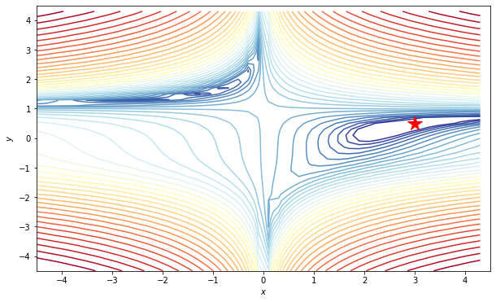
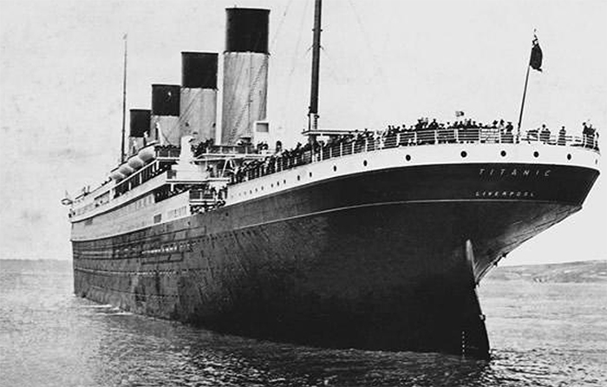
Models and tools
The behaviour of our RKGD will first be tested in a “controlled environment”: we will compare its performance with the simple GD and the well know optimal Nesterov Moment GD while optimizing a famous multimodal test function for optimization: the Beale function [2].
In a second moment, our RKGD will then be implemented into a classical ML optimization problem, i.e. we apply it over the "titanic" dataset to do a classification on the Survived Passengers
[2] Beale function, https://www.sfu.ca/~ssurjano/beale.html

Slide 4

Dataset and metric
The dataset we're using has 891 rows (that corresponds to all the passenger recorded in the dataset) and 12 features. Between these features we have qualitative and quantitative ones.
- Survived feature is a logistic feature with two levels "0" for not survived "1" for survived.
- Pclass, a discrete numeric feature with three levels meaning the class in which each passenger stayed.
- Sex, qualitative feature with two levels
- Age, discrete numeric feature that express the age for each passenger
- sibsp, discrete numeric feature that express N° of siblings/spouses aboard the titanic
- parch, discrete numeric feature that express N° of children/parents abroad the titanic
- ticket, qualitative feature with the number of ticket
- fare, discrete numeric feature that express the fare for each passenger's ticket
- cabin, qualitative feature with the cabin's number for each passenger
- embarked, qualitative feature with three levels that express the port of embarkation for each passenger.
The metrics we will adopt are the Accuracy and the number of steps executed to achieve convergence.
- / spouses aboard the Titanic

