Slide 1

SafeStreets: Mandatory SE2 Project
Authors:
Rosetti Nicola 940435,
Sartoni Simone 945542,
Torri Vittorio 945208
A.Y. 2019/2020

Slide 2
Scope and boundaries
World phenomena:
W1: A car is illegally parked;
W2: An accident occurs;
W3: An intervention is performed to make the roads safer.
Shared phenomena:
S1: A violation report is sent by a user;
S4: A traﬃc ticket is emitted by an agent, exploiting the municipality system, after a report analysis.
S6: A suggestion for a safety improvement on streets is made available.
Notes:
Simo S1 controlled by the world and observed by the machine S4 and S6 controlled by the machine and observed by the world

Slide 3
Domain assumptions
Domain assumptions to underline:
D3: Every municipality which exploits the SafeStreets services has deﬁned some areas in which the city is divided, eventually overlapped, and every street of the city is at least in one area (in the worst case the entire city is a single area).
D8: Every municipality that uses SafeStreets has at least one Agent and one Supervisor that are in charge for managing SafeStreets services.
Notes:
simo

Slide 4
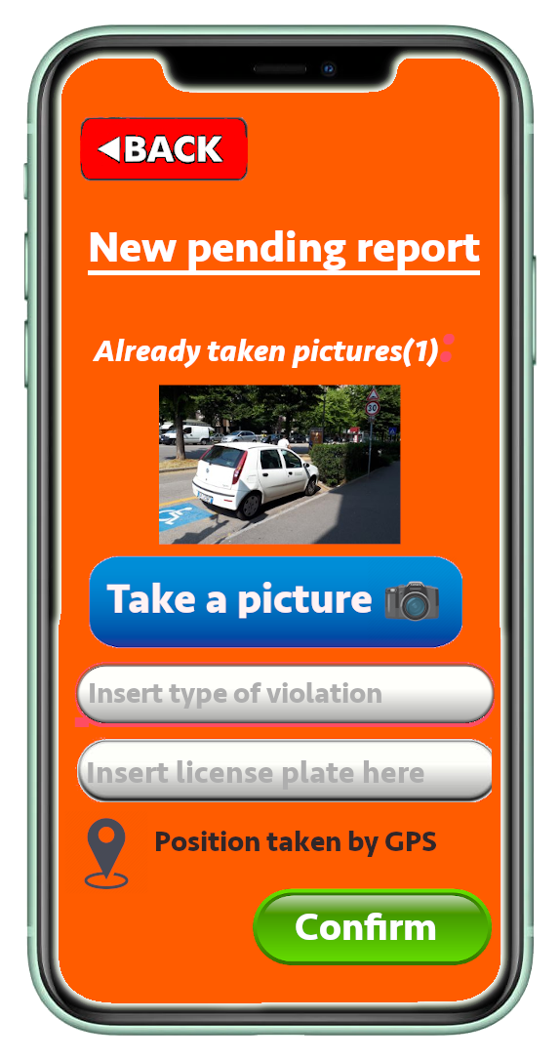
Meaningful Requirements(1/4)
G1: People must be allowed to report parking violations (missing parking disk, not paid parking meter, illegally parked vehicles).
R5: The system must let the user select the type of violation detected.
R7: While reporting the violation, the system must allow users to take one or more pictures of the potential violation.
Notes:
nico

Slide 5
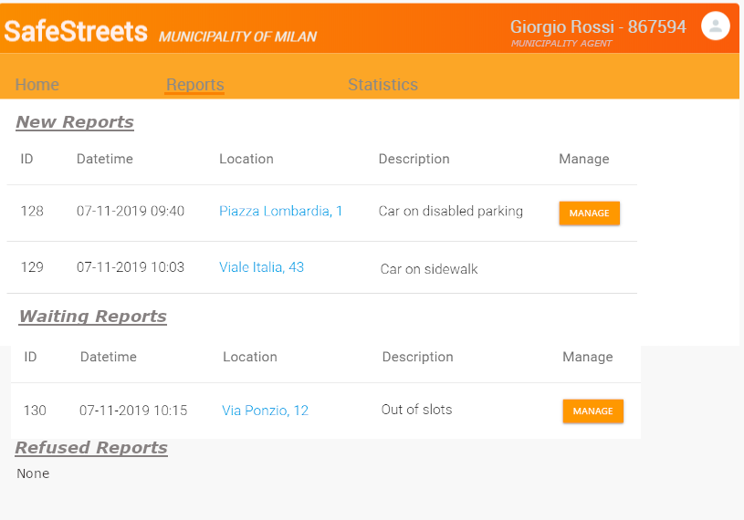
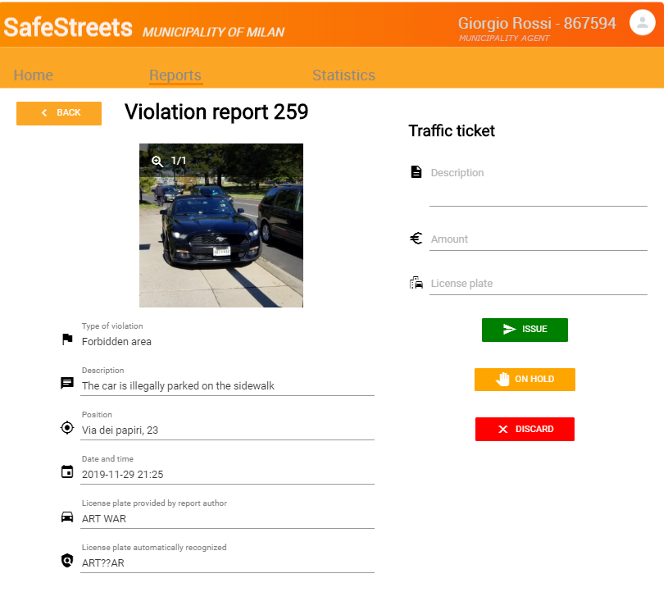
Meaningful requirements(2/4)
G2:Municipality agents must be notiﬁed about reports of potential violations in their area of interest, which can be possibly used to generate traﬃc tickets.
R13: The system must check reports to try to ﬁnd if the pictures of the violations have been modiﬁed.
R20: The system must allow an agent to see the reports for its municipality, checking them in order of arrival.
R21: The system must allow an agent to issue a traﬃc ticket to a certain person (i.e. license plate) through the correspondent municipality service.
Notes:
nico

Slide 6
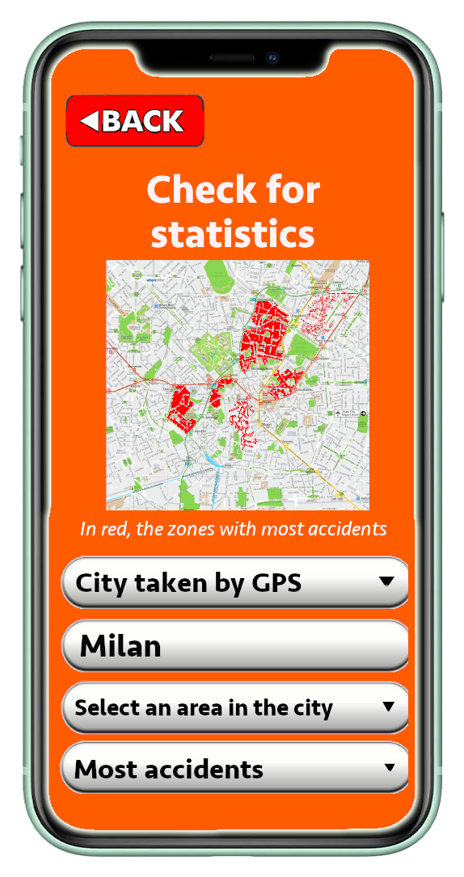
Meaningful Requirements(3/4)
G3: People must be allowed to retrieve information about streets or areas with the highest frequency of violations.
G4: People must be able to retrieve statistics and trends about the accidents correlated to the parking violations, the eﬀectiveness of SafeStreets initiatives and the issuing of traﬃc tickets.
R32:The system must use information about accidents and tickets to build statistics, crossing them with reported violations.
Notes:
nico

Slide 7
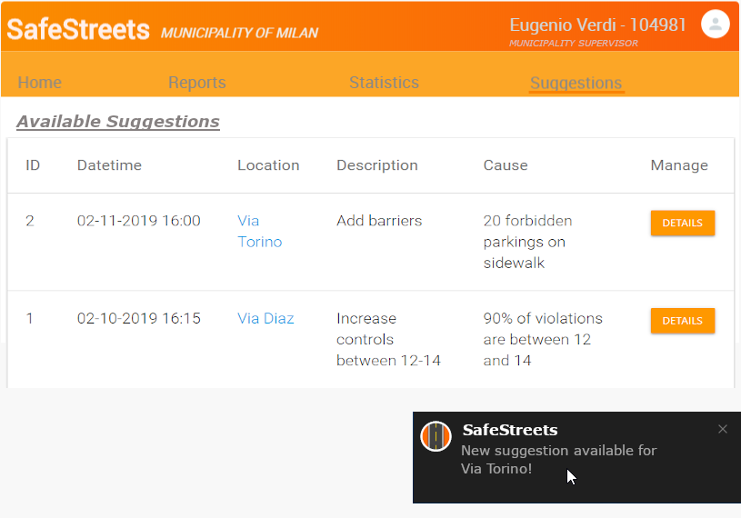
Meaningful requirements(4/4)
G6: Municipalities must be suggested for possible interventions about the mostly unsafe areas.
R41:The system must elaborate information about accidents, tickets and streets, combined with reports information, and try to ﬁnd possible solutions for problems.
R42:The system must notify the municipality supervisors about the solutions it has found.
Notes:
vitto

Slide 8
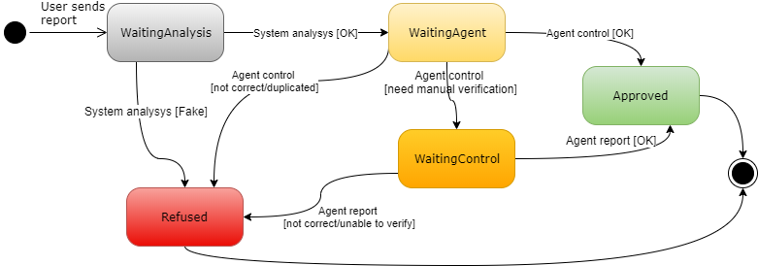
Alloy analysis
Formal definition of some internal and external constraints (requirements and domain assumptions) which allow the system to work properly, mainly through facts
Some examples:
The state evolution of a Report is consistent with its state diagram
The Statistics data are coherent with the data relative to the corresponding streets,areas and times
Every municipality has at least one agent and one supervisor, working only for that municipality
Certain parameters (#accidents, #tickets..) values should determine the presence of a suggestion for a street
Notes:
vitto

Slide 9
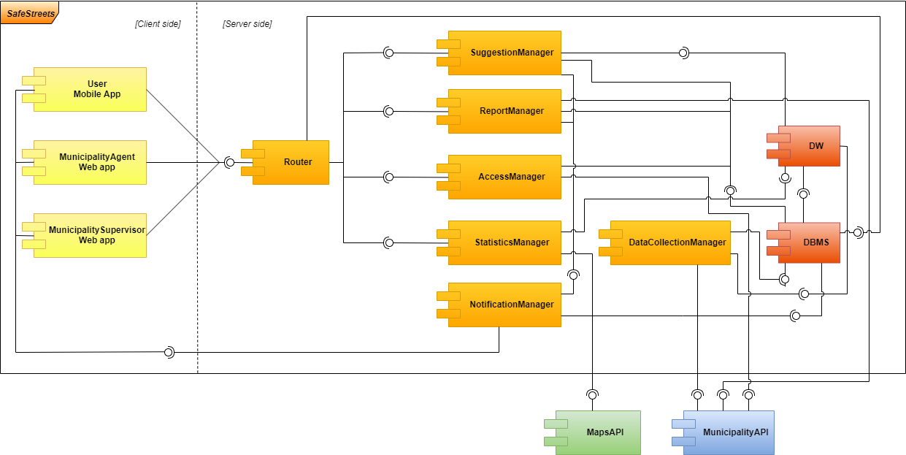
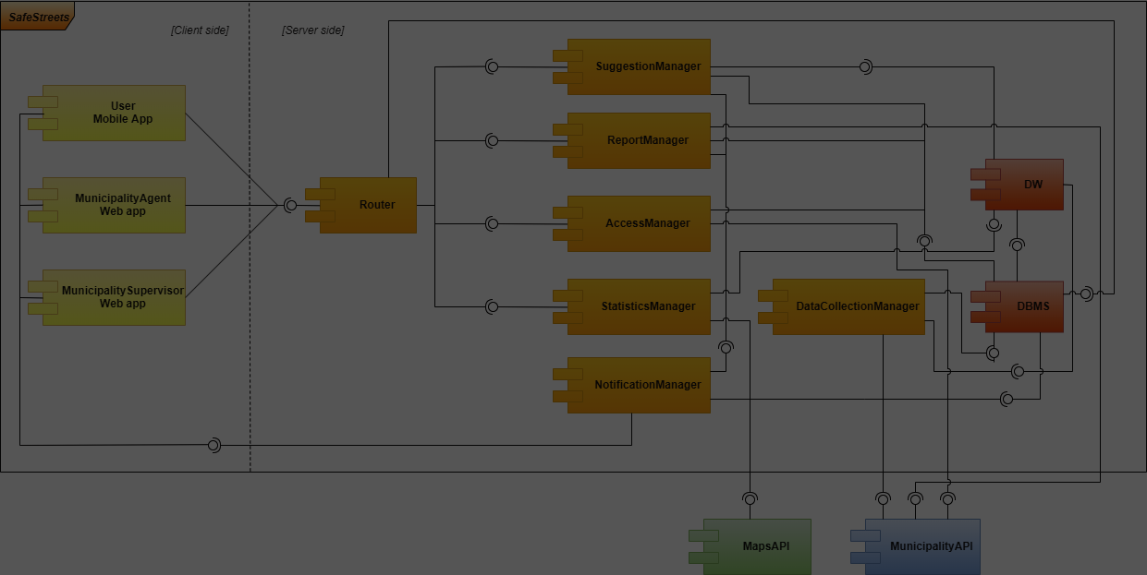
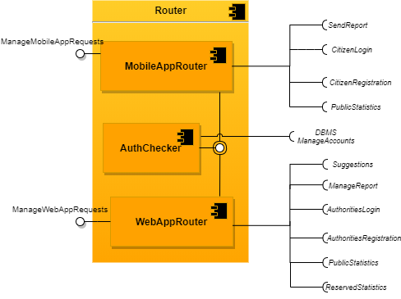
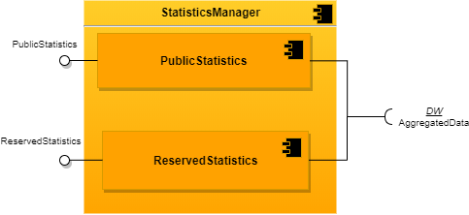
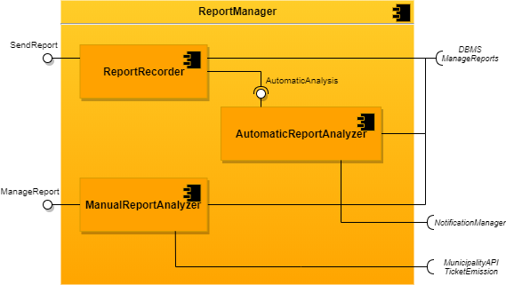
System components
Notes:
nico

Slide 10
Databases
Relational database
Operational database
Users, reports, municipalities, tickets emitted through SafeStreets
Datawarehouse
Support for Statistics and Suggestions
Aggregated data about tickets, accidents and reports coming from the operational db and from the municipalities
Notes:
simo

Slide 11
MunicipalityAPI
Standard API required for SafeStreets:
ticketEmission (licensePlate, description, amount, agent) : boolean
roadNetworkInformation() : List<Street>
statisticsForTickets() : List<Ticket>
statisticsForAccidents() : List<Accident>
identityCardCheck(identityCardNumber) : User
agentIdentityCheck(badge) : Agent
Notes:
simo

Slide 12
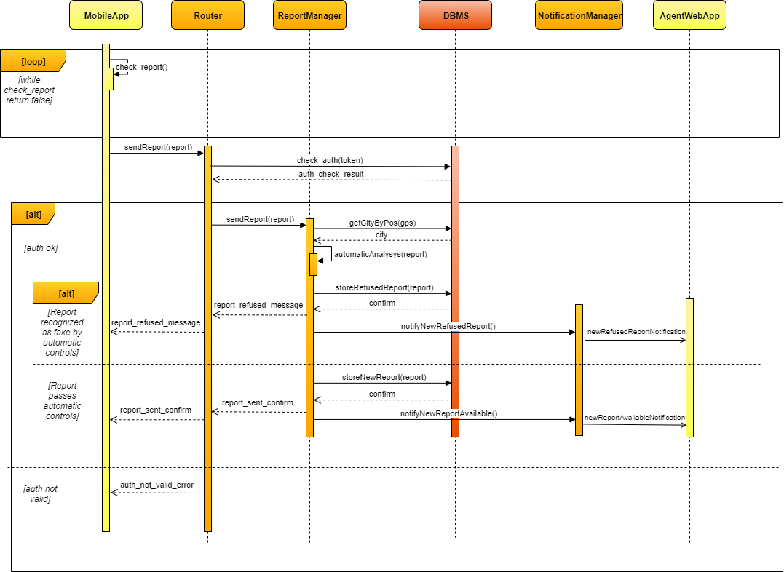
Use case: citizen send a report
Notes:
vitto

Slide 13
Implementation and testing
Implementation guided by the importance for the users of the different components, parallelized as much as possible
Unit tests with stubs and drivers: white box tests with good code coverage
Integration: thread-based, bottom up, black box
System test: alpha test and beta test with real users, performance tests
Notes:
vitto

