Slide 1
MHW1
Simone Squillaci
O46001862
31/03/2022

Slide 2
Descrizione Progetto
Primo progetto di pagina web. Consiste nella home di un sito di notize, prodotti e storia del mondo della lotta in generale (Boxe, MMA, Thay...)

Slide 3
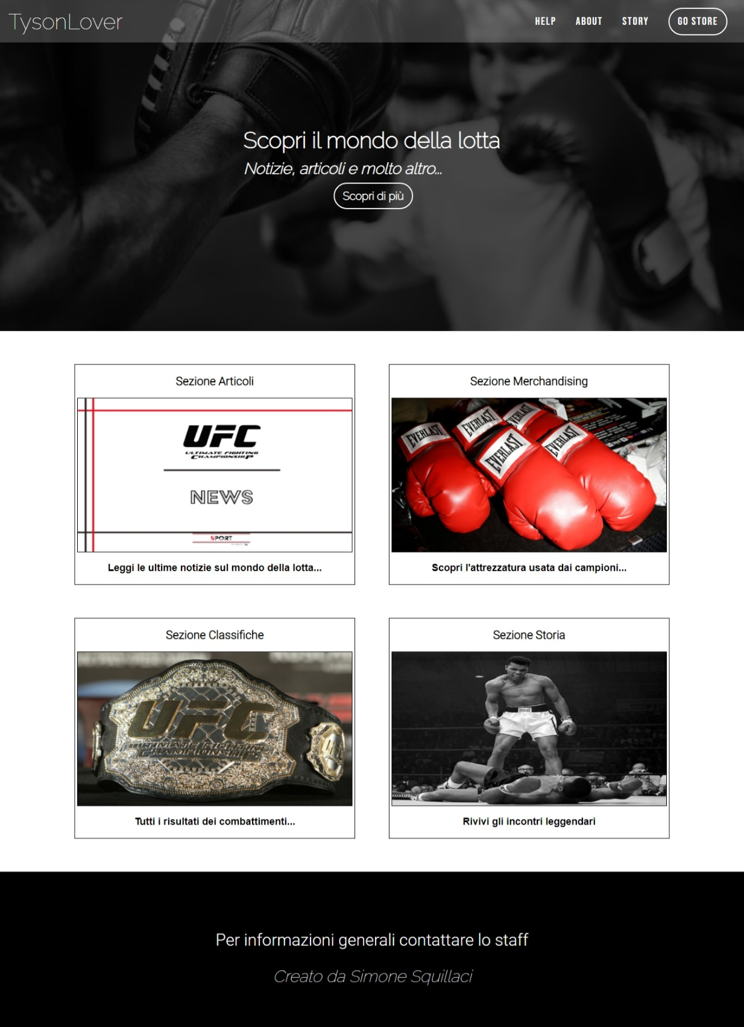
Layout complessivo HTML+CSS

Slide 4
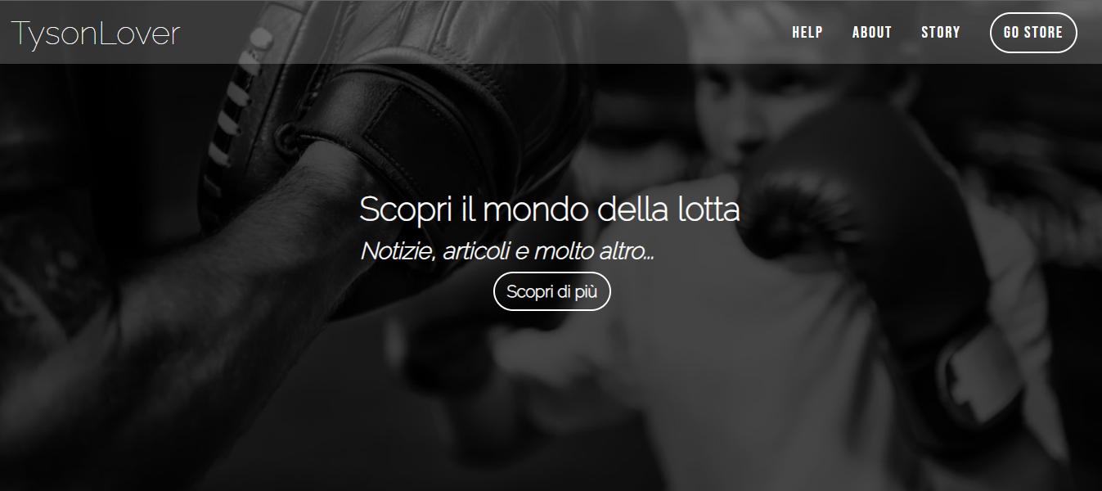
Header
Width: 100%
Height: 600 px;

Slide 5
Header
HTML
<header>
<nav>
<div id="logo">TysonLover</div>
<div id="links">
<a>Help</a>
<a>About</a>
<a>Story</a>
<a class="button">Go store</a>
</div>
<div id="menu">
<div></div>
<div></div>
<div></div>
</div>
</nav>
<h1>
<strong>Scopri il mondo della lotta</strong></br>
<em>Notizie, articoli e molto altro...</em></br>
<a class="button">Scopri di più</a>
</h1>
</header>

Slide 6
Header
CSS
header{
color: white;
width: 100%;
height: 600px;
background-image: url(https://www.palestraboxemilano.it/wp-content/uploads/2021/03/boy-boxing-training-punch-mitts-exercise-concept-PSYNPUU.jpg);
background-size: cover;
background-position: center;
position: relative;
display: flex;
flex-direction: column;
align-items: center;
justify-content: center;
}
header::before{
content: "";
background-color:
rgba(0,0,0,0.7);
position: absolute;
top: 0%;
right: 0%;
left: 0%;
bottom: 0%;
}
header h1{
font-size: 40px;
text-align: center;
position: absolute;
text-align: left;
color: white;
}

Slide 7
Header
CSS
header h1 em{
font-size: .7em;
}
header h1 a{
font-size: .5em;
margin-left: 35%;
}
/* PARTE HEADER MOBILE */
@media (max-width: 700px){
header{
height: 400px;
}
header h1{
font-size: 25px;
}
a.button{
padding: 5px 10px;
}
}

Slide 8
Menù navigazione
Width: 100%
Height: 60px; (Padding + Font-Size Logo)

Slide 9
Menù navigazione
HTML
<nav>
<div id="logo">TysonLover</div>
<div id="links">
<a>Help</a>
<a>About</a>
<a>Story</a>
<a class="button">Go store</a>
</div>
<div id="menu">
<div></div>
<div></div>
<div></div>
</div>
</nav>

Slide 10
Menù navigazione
CSS
header nav{
background-color: rgba(255,255,255,0.2);
position: absolute;
top: 0%;
left: 0%;
right: 0%;
font-size: 20px;
padding: 15px;
display: flex;
justify-content: space-between;
align-items: center;
}
#links a{
margin: 15px;
}
#logo{
font-size: 40px;
}
#menu {
display: none;
}
#menu div {
width: 25px;
height: 3px;
background-color: white;
margin: 5px 0;
}

Slide 11
Menù navigazione
CSS
/* PARTE NAV MOBILE */
@media (max-width: 700px) {
#links {
display: none;
}
#menu {
display: block;
}
#logo{
font-size: 30px;
}
}

Slide 12
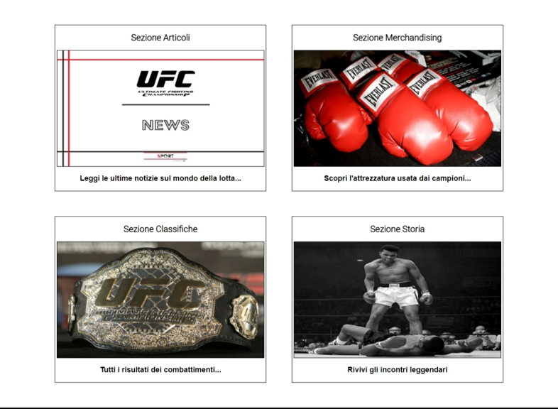
Sezione Contenuti
Width: 80%;
Height: 800px Totali; (400 a sezione)
Margini Sopra e Sotto: 60px;
Margini Laterali: 10% rimanenti;

Slide 13
Sezione Contenuti
HTML
<section>
<div id="section-item">
<h1>Sezione Articoli</h1>
<img src="https://sport.periodicodaily.com/wp-content/uploads/2021/11/ufc-news-768x512-1.png"/>
<a><p>Leggi le ultime notizie sul mondo della lotta...</p></a>
</div>
<div id="section-item">
<h1>Sezione Merchandising</h1>
<img src="https://library.sportingnews.com/styles/twitter_card_120x120/s3/2022-03/everlast%20boxing%20gloves.jpg?itok=keHm65Sb"/>
<a><p>Scopri l'attrezzatura usata dai campioni...</p></a>
</div>
</section>

Slide 14
Sezione Contenuti
HTML
<section>
<div id="section-item">
<h1>Sezione Classifiche</h1>
<img src="https://s3.eu-central-1.amazonaws.com/gitalia.cdn/wp-content/uploads/2016/05/16132840/taglio-del-peso-ufc.jpg"/>
<a><p>Tutti i risultati dei combattimenti...</p></a>
</div>
<div id="section-item">
<h1>Sezione Storia</h1>
<img class="flex" src="https://curiosando708090.altervista.org/wp-content/uploads/2011/09/muhammad_ali_versus_sonny_liston.jpg"/>
<a><p>Rivivi gli incontri leggendari</p></a>
</div>
</section>

Slide 15
Sezione Contenuti
CSS
section{
margin-top: 60px;
margin-left: auto;
margin-right: auto;
width: 80%;
height: 400px;
display: flex;
justify-content: space-between;
margin-bottom: 60px;
}
#section-item{
width: 47%;
border: 1px solid black;
background-color: white;
display: flex;
flex-direction: column;
justify-content: flex-start;
align-items: center;
}
section p{
font-size: 18px;
font-family: Arial, Helvetica, sans-serif;
font-weight: 700;
}
#section-item img{
width: 98%;
height: 70%;
border: 1px solid black;
}
section a{
color: black;
}

Slide 16
Sezione Contenuti
CSS
/* PARTE MOBILE SECTION */
@media(max-width: 850px){
section{
margin-top: 40px;
margin-bottom: 40px;
flex-direction: column;
justify-content: space-between;
align-items: center;
height: auto;
}
#section-item{
margin: 20px;
width: 80%;
}
}
@media(max-width: 500px){
#section-item h1{
font-size: 1em;
}
#section-item p{
font-size: .7em;
}
}

Slide 17

Footer
Width: 100%
Height: 105 px;

Slide 18
Footer
HTML
<footer>
<p>Per informazioni generali contattare lo staff</p>
<em>Creato da Simone Squillaci</em>
</footer>

Slide 19
Footer
CSS
footer{
background-color: black;
text-align: center;
padding: 75px;
color: white;
font-size: 30px;
}
/* PARTE MOBILE SECTION */
@media(max-width: 700px){
footer{
font-size: 15px;
}
}

Slide 20
Head
HTML
<head>
<title>Mini Homework 1</title>
<meta name="viewport" content="width=device-width, initial-scale=1">
<link href="https://fonts.googleapis.com/css2?family=Raleway:wght@100&display=swap" rel="stylesheet">
<link href="https://fonts.googleapis.com/css2?family=Bebas+Neue&display=swap" rel="stylesheet">
<link href="https://fonts.googleapis.com/css2?family=Roboto:wght@300&display=swap" rel="stylesheet">
<link rel="stylesheet" href="mhw1.css"/>
</head>

Slide 21
Codice Generico
CSS
body{
background-color: white;
font-family: 'Raleway', sans-serif;
margin: 0px;
font-size: 14px;
}
a{
cursor: pointer;
text-decoration: none;
color: white
}
section h1,p {
font-family: 'Roboto', sans-serif;
}
a.button{
padding: 10px 15px;
border: 2px solid white;
border-radius: 100px;
}
a.button:hover{
background-color: white;
color: black;
}
h1,p{
font-style: normal;
}

Slide 22
Codice Generico
CSS
#links{
font-style: normal;
font-family: 'Bebas Neue', cursive;
letter-spacing: 2px;
}

