Slide 1

MY SECRETS
An E-diary, text and to-do list application.

Slide 2
Programming Language and Resources
HTML
CSS
JavaScript (Node.js)
Bootstrap 4 – HTML template styling

Slide 3
Function of the Application
Text storage, write your thoughts and save them cause it uses an online database storage if used on any device.
To-do list set preferences and timelines for yourself. Going over what you have to do.
A diary where you can actually store your journals and other stuffs.

Slide 4
Application Architecture
Client Browser
HTTP Responses
(combine data and html)
HTTP Requests
(GET, POST, PUT, DELETE)
Controllers (and/or Routes)
Node.js Express Sever (app.js)
Get the requested page or document
Fetch Data
Models
[Data Store
(Sqlite 3)]
Views
(JavaScript, Html, and CSS files)

Slide 5
Application Architecture…
Node.js: A server-side JavaScript based language for developing real-time web applications.
Express.js: An Model(M) View(V) Controller(C), (i.e MVC) framework for developing web applications in Node.js
Controllers (Routes): Handle client requests.
Models: Store user and session data
Views: Static files (html, css, JavaScript, images)
HTTP Request Verbs:
  GET: get data from the server
  POST: send data to the server
  PUT: update existing data
  DELETE: remove existing data

Slide 6
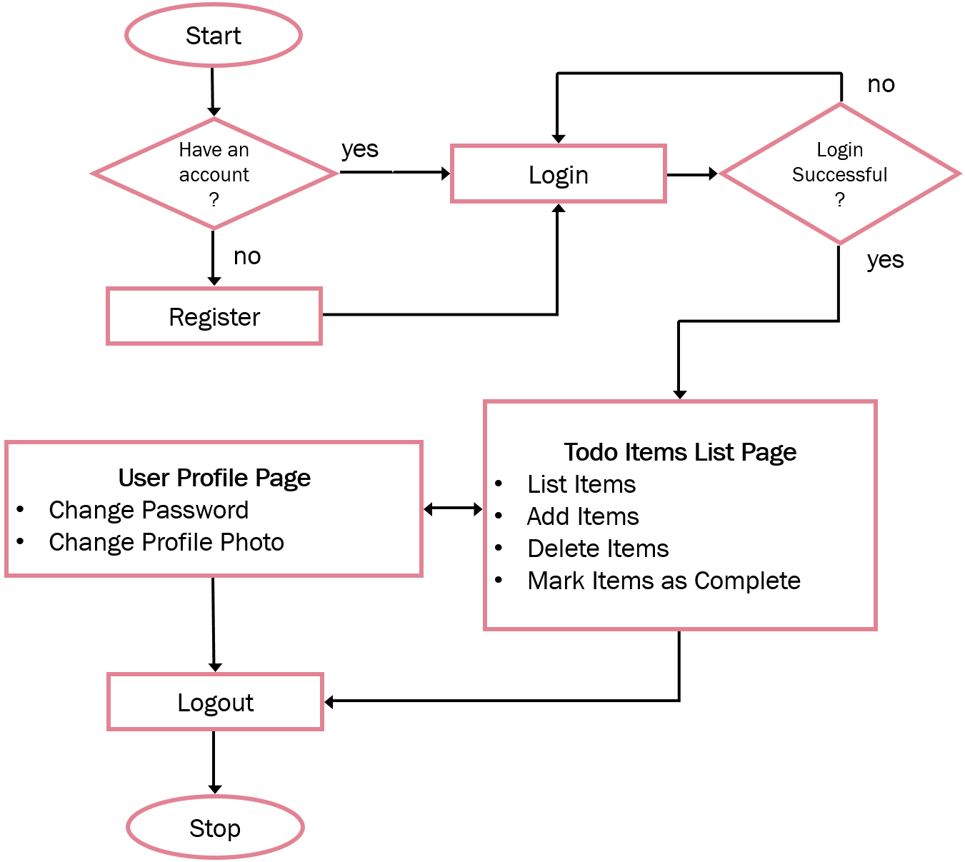
Application Flow Chart

Slide 7
Data Models
Session
session_id: varchar(32) => PK expires: datetime data: text createdAt: datetime updatedAt: datetime
Todo
id: int(11) => PK User_id: int(11) => FK description: varchar(255) isComplete: tinyint(1) createdAt: datetime updatedAt: datetime
1
N
User
id: int(11) => PK username: varchar(255) email: varchar(255) password: varchar(255) avatar: varchar(255) createdAt: datetime updatedAt: datetime
Note that the user_id
is not present in the
Session model as foreign key
Because its encrypted
in the column “data”
in the session model
1
1

Slide 8
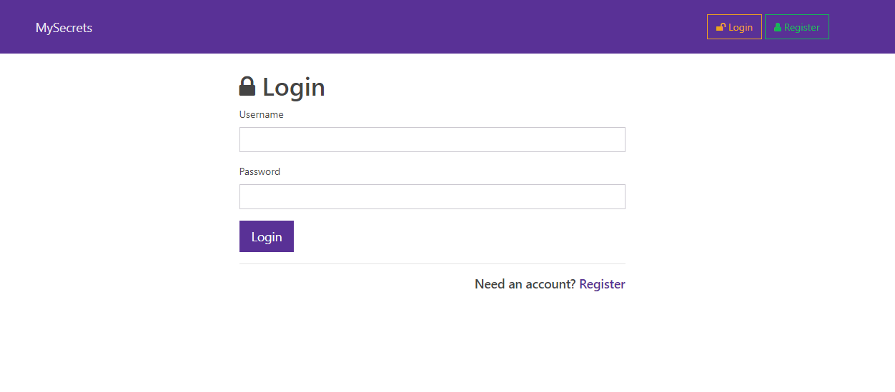
Login Page

Slide 9
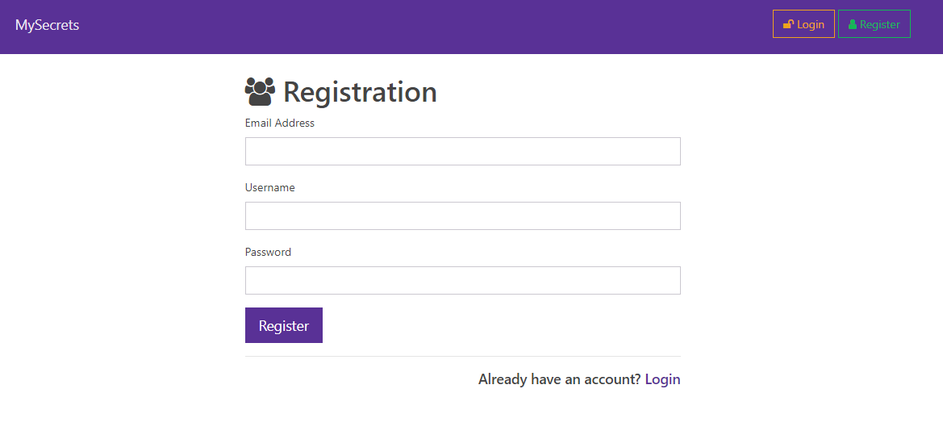
Registration Page

Slide 10
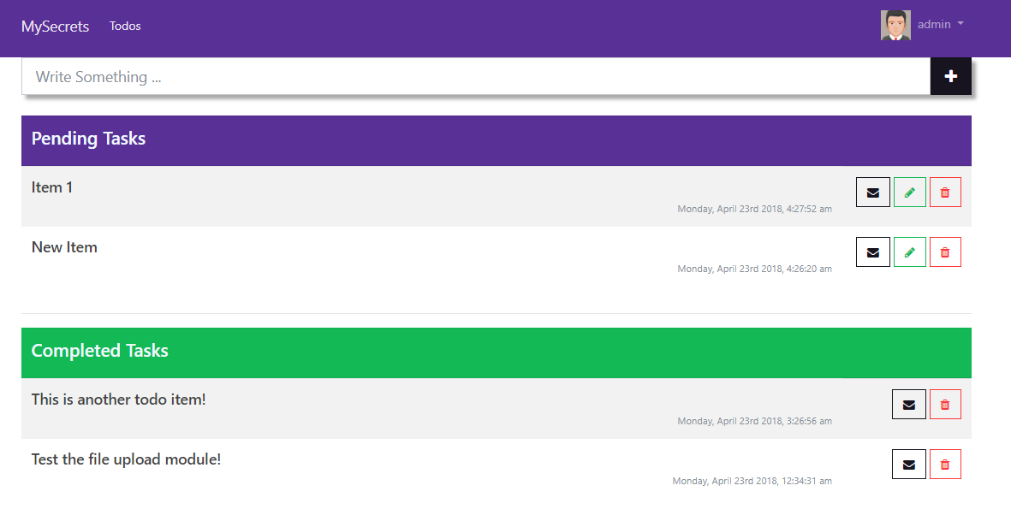
Todos List Page
Text Area
Save the item to database
Send the item by email
Mark task as complete
Delete the task

Slide 11
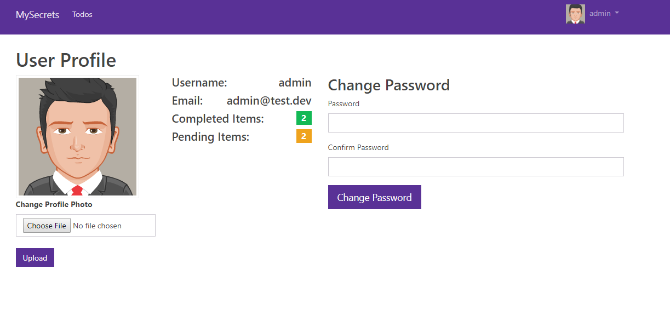
User Profile Page

Slide 12
Summary
This project has helped to understand better the in depth of different web programming languages, such as HTML, CSS, JavaScript, and server-side programming language (Node.js).
This project will be improved and updated.

