Slide 1

GrooveGalaxy
Grupo A42
José Cruz nº 99260
Miguel Pato nº 110833
Simão Silva nº 99329
Notes:
Miguel

Slide 2
Points of Discussion
Secure Document Format implementation
Built infrastructure
Secured channels
Key distribution
Security challenge implementation
Main results and conclusions
Notes:
Miguel

Slide 3
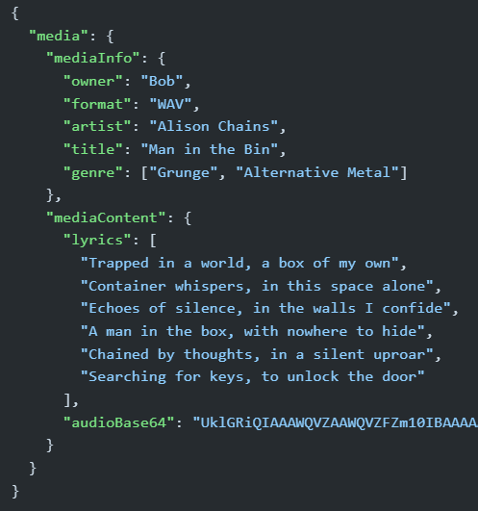
Secure Document Format Implementation
Only the audio (field “audioBase64”) is encrypted.
The encryption algorithm used was AES with CTR block encryption and zero padding.
The encryption is made using a temporary key sent encrypted by a permanent key to the client.
The document is sent as whole in “bytes” format.
The digital signature used to authenticate the server is made from the content plus the IV used to encrypt plus the encrypted temporary key, also the one used to encrypt.
The secure hash algorithm used was SHA-256.
For freshness we use a nonce, composed of a random number and a timestamp.
This ensures confidentiality of the audio and authenticity of the document.
Notes:
Miguel
AES - Advanced Encryption Standart
CTR - counter block encryption
(in the code) The nounce (number used only once) and the Counter for the CTR are passed just as IV

Slide 4
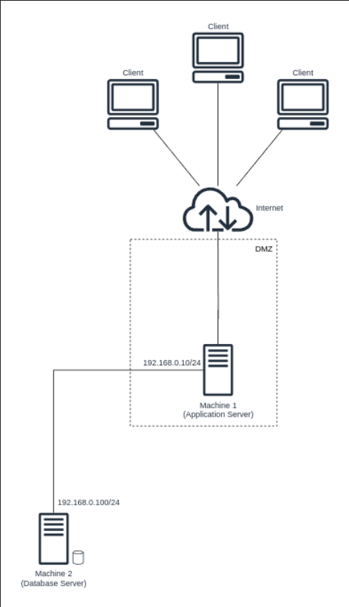
Built Infrastructure
Database server:
Authentication and TLS implemented by MySQL.
All the data in the database supposedly encrypted, also using MySQL already provided encryption.
Application server:
Deals with business logic and communicates with the clients and database server
Clients:
Connect to the application server through the internet.
Cannot be trusted
Notes:
Simão
falar do sfp

Slide 5
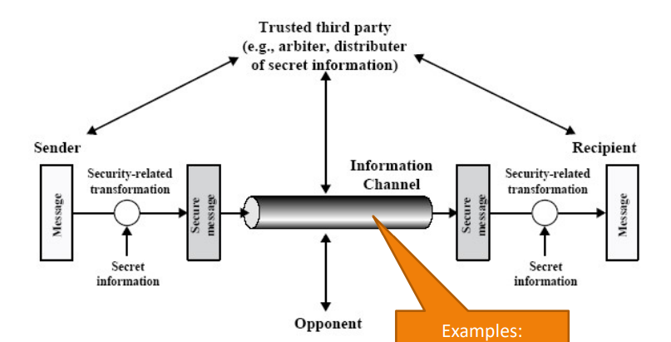
Secured Channels
Both the channels between the clients and the application server and this last and the database implement TLS/SSL.
This allows for encryption of the transmitted content.
Also provides authentication
The clients and the application server authenticate themselves to each other.
The database and the application server do this as well.
Notes:
Miguel

Slide 6
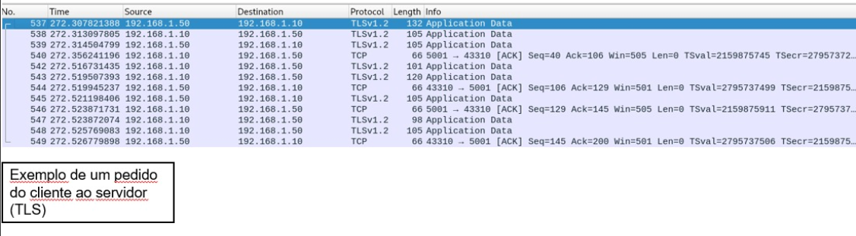
Secured Communication Between Client and Application Server
Notes:
Miguel

Slide 7
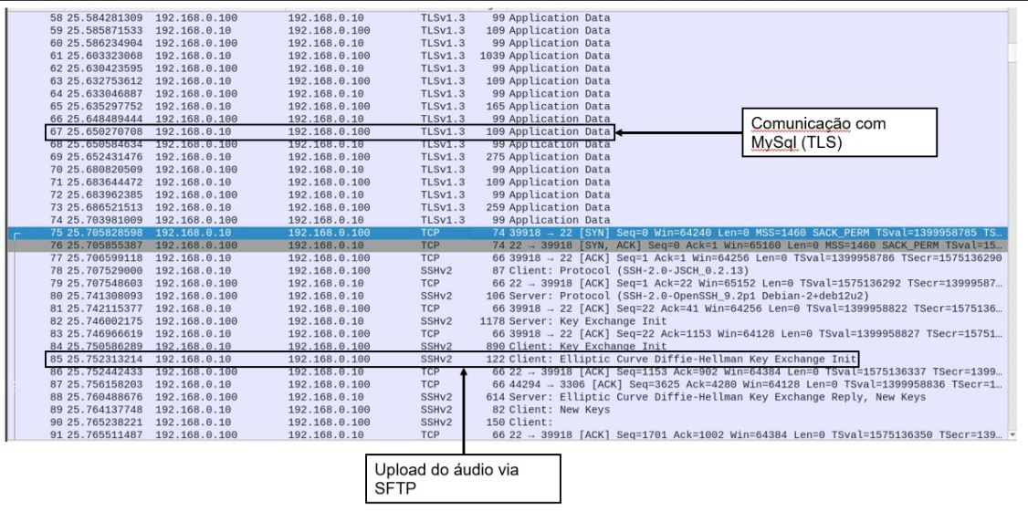
Secured Communication Between Application Server and Database
Notes:
Miguel

Slide 8
Key Distribution
The client and the application server share a secret (symmetric) key from the beginning.
This symmetric key is permanent (stored securely in java keystores).
It is used to encrypt a temporary key (stored in the database).
The document is encrypted using a symmetric temporary key
The temporary keys are renewed all at the same time by the database server.
The client also has the application server public key (not in a keystore) from the get go to verify the digital signature of received documents.
The server has its own private key (not in a keystore) to sign digital signatures.
Notes:
José

Slide 9
Certificate Distribution
The clients and application server posses two java keystores.
One containing the certificate of application server, allowing it to authenticate itself towards the clients.
Another containing client certificates (each client only has its own) so that the clients can authenticate themselves towards the application server.
This combination allows for the clients and application server to ensure that they are talking to each other and not a malicious attacker.
The database already has a certificate, made available by MySQL.
Notes:
José

Slide 10
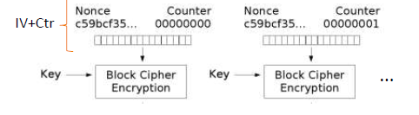

Security Challenge Implementation
In order to allow for playback of a music from the middle of it we used Counter mode for our symmetric block encryption keys.
To implement the concept of family sharing, we made it so that the temporary keys (used to encrypt the documents) would be a family key, also temporary, shared by all the users of a family.
This change is invisible to the clients.
Notes:
Simão

Slide 11
Main Results and Conclusions
We were able to secure the documents and the communication channels.
Unfortunately, our clients do not store the song documents in a confidential way.
We also did not setup the firewalls in the application server and the database, which would have improved security
Notes:
José

