Slide 1

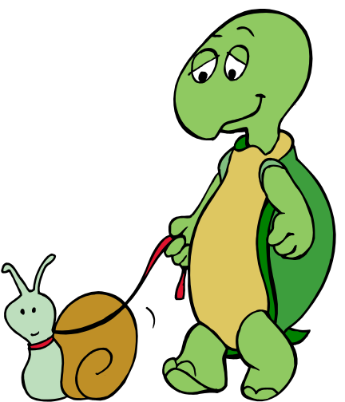
Good old lessons in teamwork
from an age-old fable
The Tortoise
And
The Hare

Slide 2
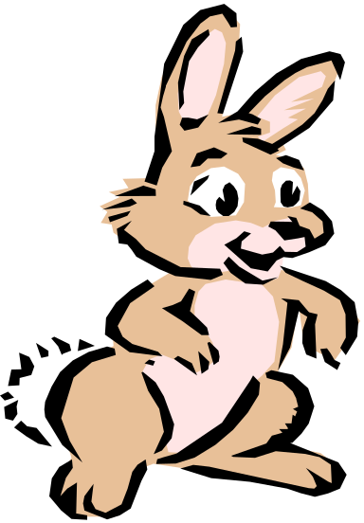
Once upon a time a tortoise and a hare had an argument about who was faster.
That’s not true.
The fastest runner is
me!
I’m the fastest
runner.

Slide 3
They decided to settle the argument with a race. They agreed on a route and started off the race.
Fine!
Ok, let’s have
a race.

Slide 4

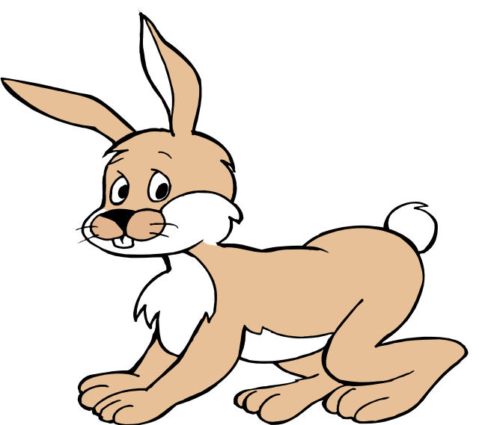
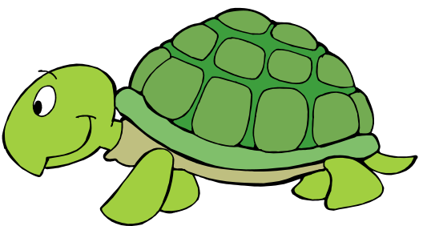
The hare shot ahead and ran briskly for some time. Then seeing that he was far ahead of the tortoise, he thought he'd sit under a tree for some time and relax before continuing the race.
Poor guy! Even if I take a nap, he could not catch up with me.

Slide 5
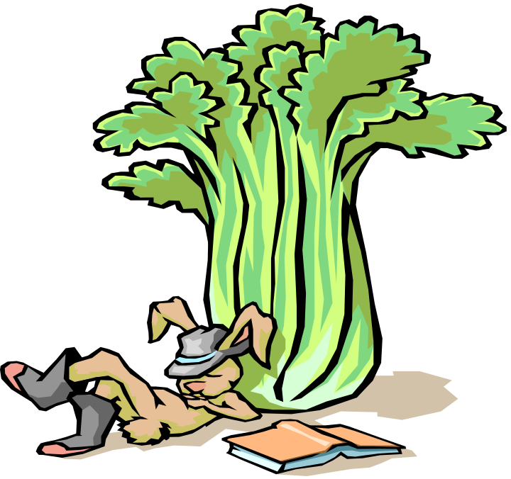
He sat under the tree and soon fell asleep.

Slide 6


The tortoise plodding on overtook him and soon finished the race, emerging as the undisputed champ.

Slide 7
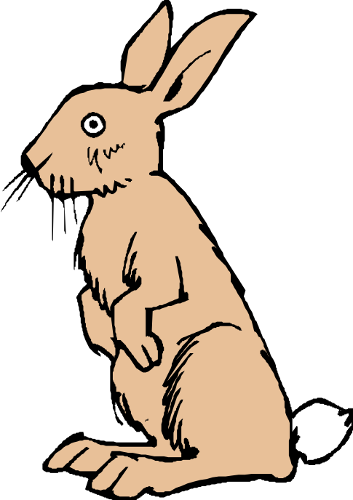

The hare woke up and realized that he'd lost the race.

Slide 8
The moral of the story is that slow and steady wins the race.
This is the version of the story that we've all grown up with.

Slide 9
The story continues …

Slide 10
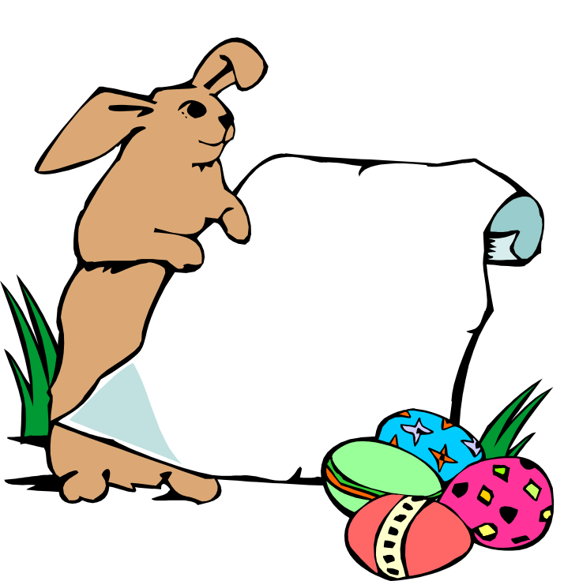
The hare was disappointed at losing the race and he did some soul-searching. He realized that he'd lost the race only because he had been overconfident, careless and lax. If he had not taken things for granted, there's no way the tortoise could have beaten him.
Why did I lose the race?

Slide 11
So he challenged the tortoise to another race. The tortoise agreed.
Ok.
Can we have
another race?

Slide 12
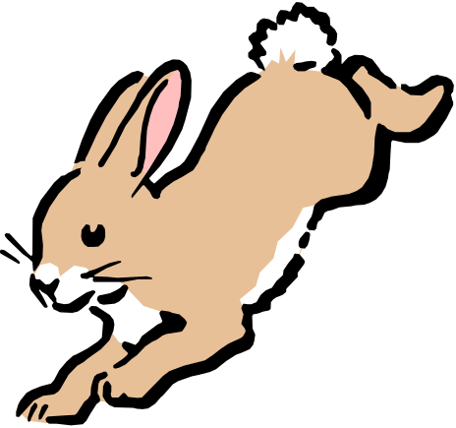

This time, the hare went all out and ran without stopping from start to finish. He won by several miles.

Slide 13
The moral of the story?
Fast and consistent will always beat the slow and steady. If you have two people in your organization, one slow, methodical and reliable, and the other fast and still reliable at what he does, the fast and reliable chap will consistently climb the organizational ladder faster than the slow, methodical chap.
It's good to be slow and steady; but it's better to be fast and reliable.

Slide 14
But the story doesn't end here …

Slide 15
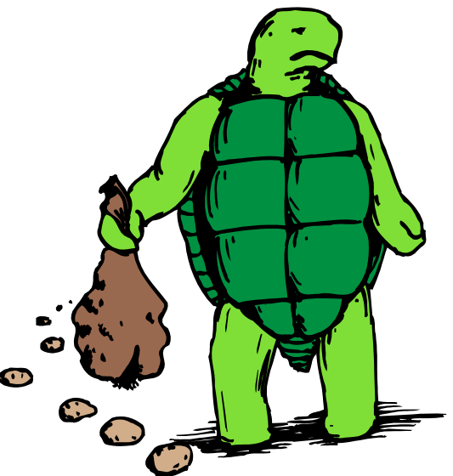
The tortoise did some thinking this time, and realized that there's no way he can beat the hare in a race the way it was currently formatted.
How can I can win the hare?

Slide 16
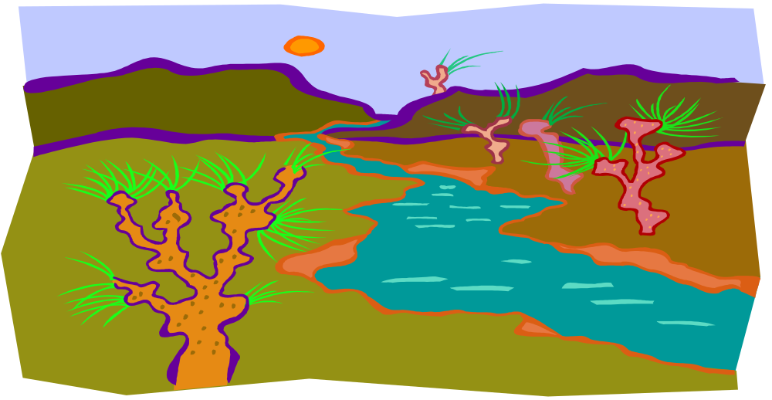
He thought for a while, and then challenged the hare to another race, but on a slightly different route.
The hare agreed.
Can we have another race? This time we’ll go through a different route.
Sure!

Slide 17
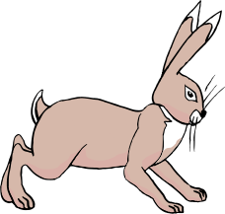

They started off. In keeping with his self-made commitment to be consistently fast, the hare took off and ran at top speed until he came to a broad river. The finishing line was a couple of kilometers on the other side of the river.
Goal

Slide 18
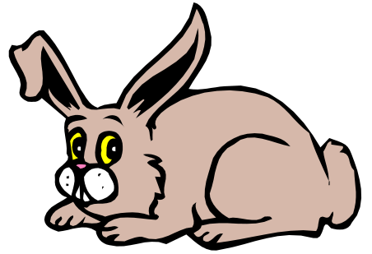


The hare sat there wondering what to do. In the meantime the tortoise trundled along, got into the river, swam to the opposite bank, continued walking and finished the race.
What should I do?

Slide 19
The moral of the story?
First identify your core competency and then change the playing field to suit your core competency.
In an organization, if you are a good speaker, make sure you create opportunities to give presentations that enable the senior management to notice you.
If your strength is analysis, make sure you do some sort of research, make a report and send it upstairs.
Working to your strengths will not only get you noticed, but will also create opportunities for growth and advancement.

Slide 20
The story still hasn't ended …

Slide 21
The hare and the tortoise, by this time, had become pretty good friends and they did some thinking together. Both realized that the last race could have been run much better.

Slide 22

So they decided to do the last race again, but to run as a team this time.
Great! I think we could do it much better, if we two help each other.
Hi, buddy. How
about doing our last
race again?
Hi, buddy. How
about doing our last
race again?

Slide 23

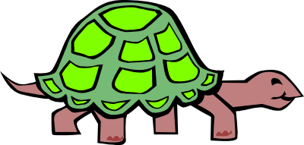

They started off, and this time the hare carried the tortoise till the riverbank.

Slide 24

There, the tortoise took over and swam across with the hare on his back.

Slide 25
On the opposite bank, the hare again carried the tortoise and they reached the finishing line together. They both felt a greater sense of satisfaction than they'd felt earlier.

Slide 26
The moral of the story?
It's good to be individually brilliant and to have strong core competencies; but unless you're able to work in a team and harness each other's core competencies, you'll always perform below par because there will always be situations at which you'll do poorly and someone else does well.
Teamwork is mainly about situational leadership, letting the person with the relevant core competency for a situation take leadership.

Slide 27
There are more lessons to be learnt from this story.
Note that neither the hare nor the tortoise gave up after failures. The hare decided to work harder and put in more effort after his failure. The tortoise changed his strategy because he was already working as hard as he could.
In life, when faced with failure, sometimes it is appropriate to work harder and put in more effort. Sometimes it is appropriate to change strategy and try something different. And sometimes it is appropriate to do both.
The hare and the tortoise also learnt another vital lesson. When we stop competing against a rival and instead start competing against the situation, we perform far better.

Slide 28
To sum up, the story of the hare and tortoise teaches us many things:
Never give up when faced with failure
Fast and consistent will always beat slow and steady
Work to your competencies
Compete against the situation, not against a rival.
Pooling resources and working as a team will always beat individual performers

Slide 29
Let’s go and build stronger teams!

