Slide 1


Simultaneous Localization and Mapping (SLAM)
By: Johan Lewenhaupt
Regi: José A. López Orozco
Faculty of Physical Sciences, Degree in Electronic Engineering
June 29, 2016, Madrid

Slide 2
Scheme
Objectives
Kalman Filter
Extended Kalman Filter
SLAM
MatLab Implementation
Results
Conclusion
Relevant algorithms

Slide 3
Objectives
SLAM
Extended Kalman Filter
Kalman Filter
MatLab Implementation
Results

Slide 4
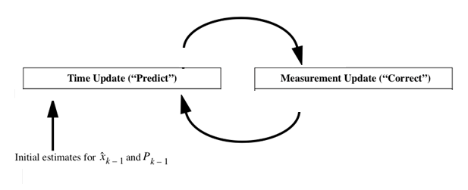
What is a Kalman Filter (KF)?
Developed by Rudolf E. Kalman in the 1950s.
Used for state Estimation
Uses a linear system

Slide 5
Kalman Filter Algorithm
Random error
Prediction Step
Random error
Correction Step

Slide 6
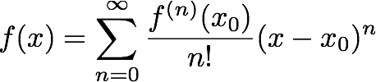
What is an Extended Kalman Filter (EKF)?
Extension of the Kalman Filter
Created by NASA Ames Research Center
Uses Non-linear systems
Linearizes the equations using Taylor expansion
Taylor Expansion

Slide 7
Extended Kalman Filter Algorithm
Random error
Prediction Step
Random error
Correction Step

Slide 8
Simultaneous Localization and Mapping (SLAM)
SLAM problems: Whenever we have no information of the environment nor of our position within it
Uses extended Kalman Filter
Major difference: Uses ”Landmarks”
What is a landmark?

Slide 9
SLAM Algorithm
Prediction Step
Random error
Correction Step
Random error

Slide 10
Landmarks
Sonar Measurement
Robot

Slide 11
Movement

Slide 12
New Measurements
Movement

Slide 13
Predicted Position
True Position

Slide 14
Predicted Position
Corrected Position
True Position

Slide 15

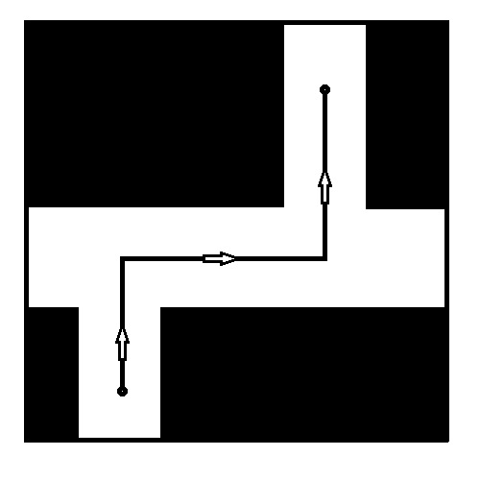
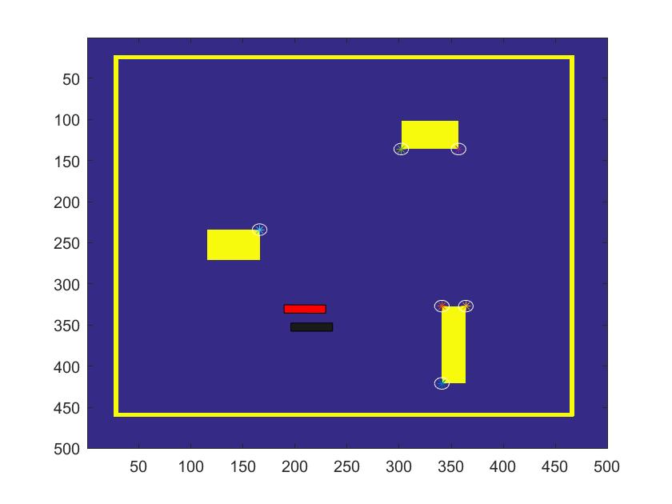
MatLab Implementation
Example Map with Landmarks
Example Map with Route
Example Map with Robots
Red: Estimated Position
Black: True Position

Slide 16
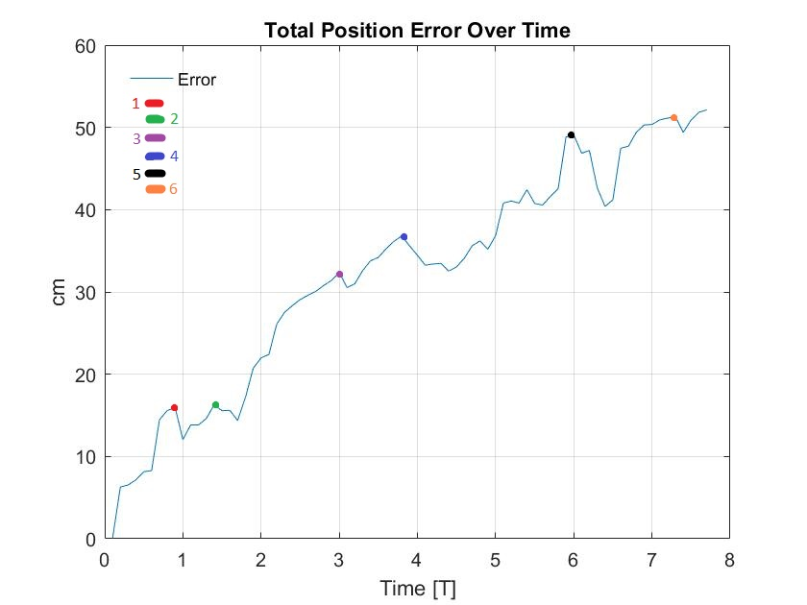
Results

Slide 17
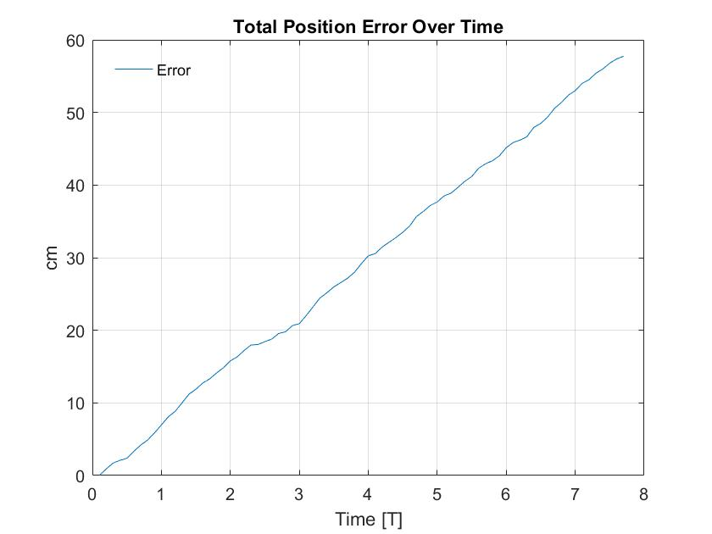
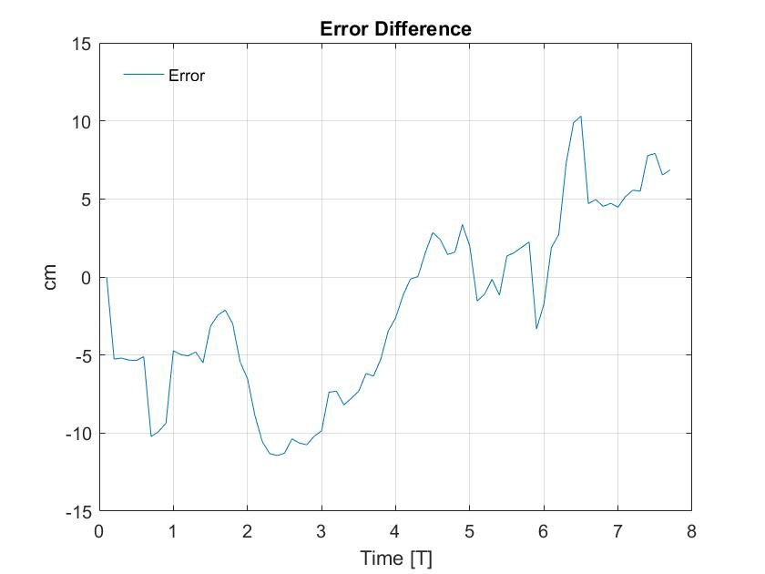
Results
No landmarks. Error only increases since the
correction step never happens
Error difference. Ends up larger than 0, which
means that the SLAM is working

Slide 18
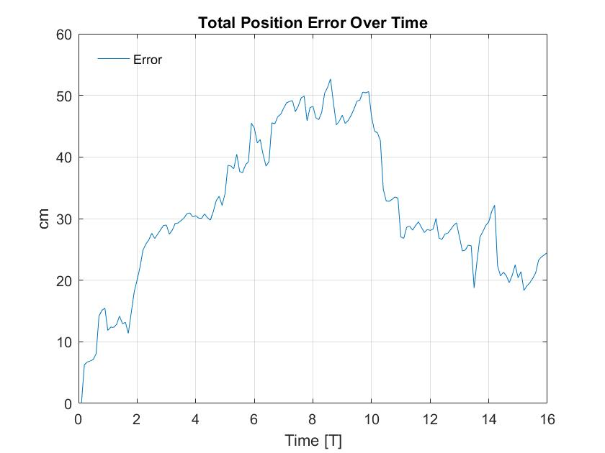
Results
Error reduced significantly
The robot returns

Slide 19
Conclusion
SLAM is a great algorithm, with a lot of future applications
Interested in 3-dimensional state estimation, instead of 2-dimensional, like in this project
Future work such as moving landmarks or more robots contributing to one map at once.

Slide 20
Thanks for listening. Any Questions?

