Slide 1


INDUSTRIAL SIZE SORTER AND
PRODUCTION COUNTER USING IOT
KAKINADA INSTITUTE OF ENGINEERING & TECHNOLOGY-2
(Affiliated to JNTU KAKINADA)
Mr. K.Manikanta Prasad
Assistant professor
Presented by :
G.Siman Babu (146Q1A0401)
B.Swathi Kiran (146Q1A0404)
P.J.S.Sagar (146Q1A0413)
L.Mahesh Kumar (146Q1A0422)
B.Vinay Teja (156Q5A0403)
Under the Guidence of :

Slide 2

CONTENTS:
ABSTRACT
INTRODUCTION
BLOCK DIAGRAM
COMPONENTS
WORKING
ADVANTAGES
CONCLUSION
FUTURE WORK

Slide 3
ABSTRACT
This project is intended for Industrial automation using internet of things. It will automatically sort the products according to their sizes by using IR sensors. Then it counts how many products are manufactured in the particular interval of time and automatically updates the value on blink server. The overall system is liberated from human interference. The system is comprehensive , cost efficient as well as time efficient.

Slide 4
INTRODUCTION
Industrial Automation plays an increasingly important part in the global economy and also in daily experience.
At present, for companies, the purpose of automation has shifted from growing productivity and reducing costs to broader issues.
This work takes the idea of automatic sorting and counting the products.
The control system uses microcontroller. Sorting is done on the conveyer belt via IR sensors and servo motor.
The second concern is while sensing it automatically update the count values in the server based on their sizes.

Slide 5
BLOCK DIAGRAM
BLYNK SERVER
IR SENSOR1
NODE MCU
ESP 8266 PROCESSOR
IR SENSOR2
INTERNET
CONVEYOR BELT
WITH PRODUCTS
POWER SUPPLY
SERVO MOTOR

Slide 6
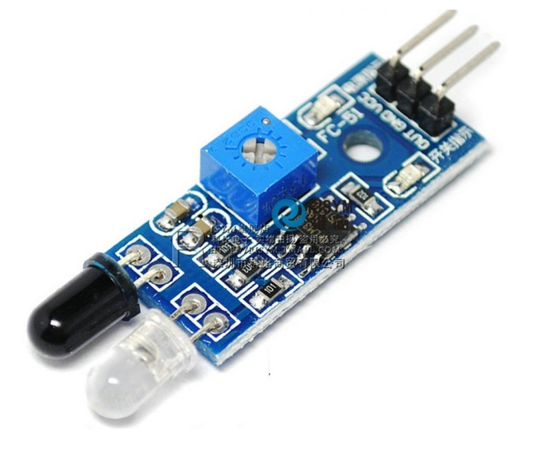
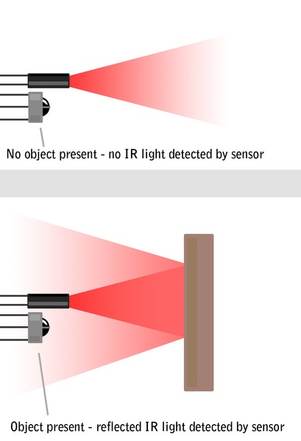
Infrared sensor
Product Code : LM393
Effective Range : 2 ~ 10cm
Working Voltage : 3.3V-5V
Direction Angle : 30degress

Slide 7
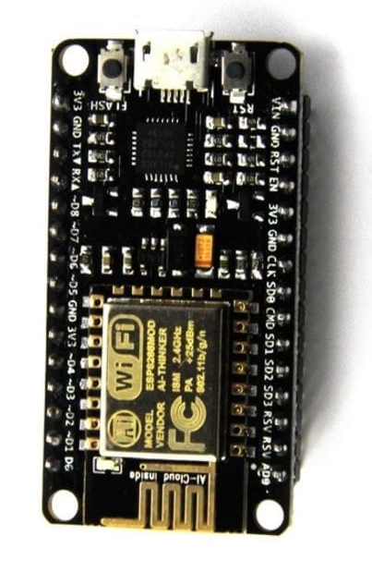
NODE MCU MICRO CONTROLLER
Developer : ESP8266
Open Source Community
Type : Single board microcontroller
OS : XTOS
CPU : ESP8266(LX106])
Memory : 128kBytes
Storage : 4MBytes
Power: USB

Slide 8
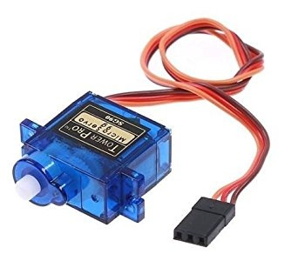
SERVO MOTOR
Servos are controlled by sending an electrical pulse of variable width, through the control wire. There is a minimum pulse, a maximum pulse, and a repetition rate. A servo motor can usually only turn 90° in either direction for a total of 180° movement. The motor's neutral position is defined as the position where the servo has the same amount of potential rotation in the both the clockwise or counter-clockwise direction
Torque : 1.8 kg-cm
Operating Voltage : 4.8v
Speed : 0.10 sec/60 degree.
Weight : 9 grams.
Gear Type : Plastic.
Rotational Range : 180 degree

Slide 9
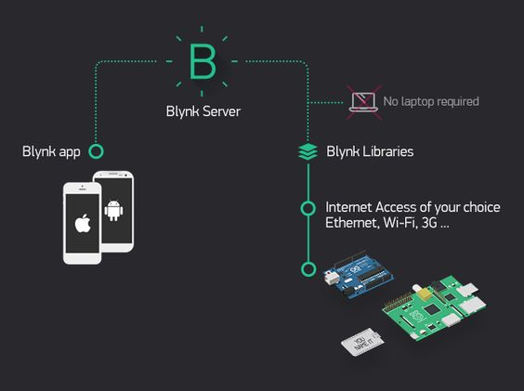
BLYNK APPLICATION

Slide 10
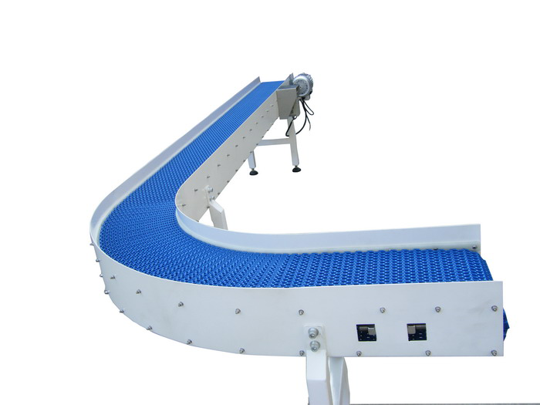
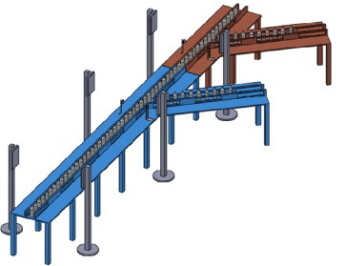
WORKING
CONVEYOR BELT WITH PRODUCTS
SORTING TECHNIQUE
USING SERVO MOTOR

Slide 11

APPLICATIONS

Slide 12
APPLICATIONS
Conveying product from machine to packaging
area and product delivery section
Soft Drop conveying systems for PET performs
to eliminate damage
Parts distribution for multiple box filling ,
Programmable to dispense precise number of
parts into each box
Pharmaceutical
Food beverage
Ceramic and tiles

Slide 13
ADVANTAGES
Cost efficient
Reduce labour by automation
Eliminates manual sorting
Reduces possibility of surface damage to product
Provides facility of using it from any where
Accurate results

Slide 14
CONCLUSION
Our objective of making this project is to provide a system that helps in industrial automation It not only decreases the manpower but also enables the user to check and operate from anywhere in the world with the help of latest technology which is know as Intenet of things(IOT).

Slide 15
FUTURE WORK
We did sorting on the basis of height of the products.
However, sorting can be improved through image processing.
In image processing products can be sorted on the basis of colors and shapes.

Slide 16
THANK
YOU

