Slide 1

Name | ID
Md. SImoon Magraby Olid | 1910481
Samiur Rahman Sami | 1931283
Abu Bakar M Abdullah | 1731127
Marshia Monsur | 2131044
Zahidur Rahman Milon | 1931407
Web application to store and analyze data on crop yields, soil condition and sand weather patterns
Section :03
Group : 05

Slide 2
Introduction
The project aims to address the critical need for a comprehensive solution in agriculture by developing a web application
Agriculture stands as a cornerstone of sustenance globally, and the challenges it faces such as maximizing yields, mitigating risks, and adapting to changing climatic condition are paramount.
To tackle these challenges, our solution involves the creation of an intuitive and robust web application that serves as a centralized platform. It will aggregate, store, and process diverse datasets related to crop yields, soil quality parameters, and historical weather patterns.
This platform aims to empower farmers, agronomists, researchers, and other stakeholders within the agricultural sector with actionable insights derived from comprehensive data analysis.

Slide 3
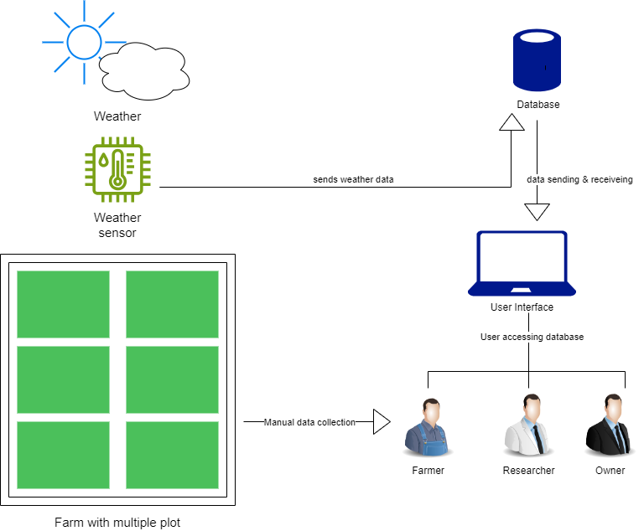
Existing
Rich Picture

Slide 4
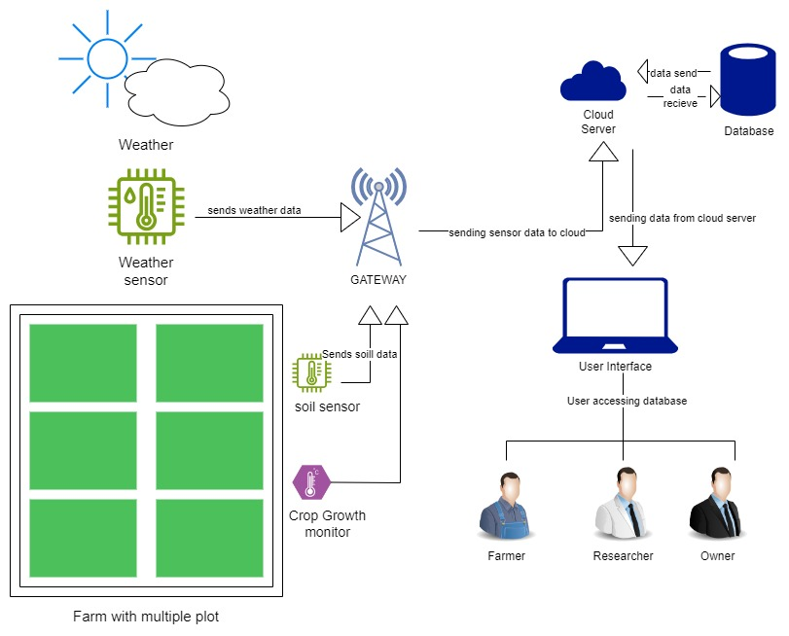
Proposed
Rich Picture

Slide 5
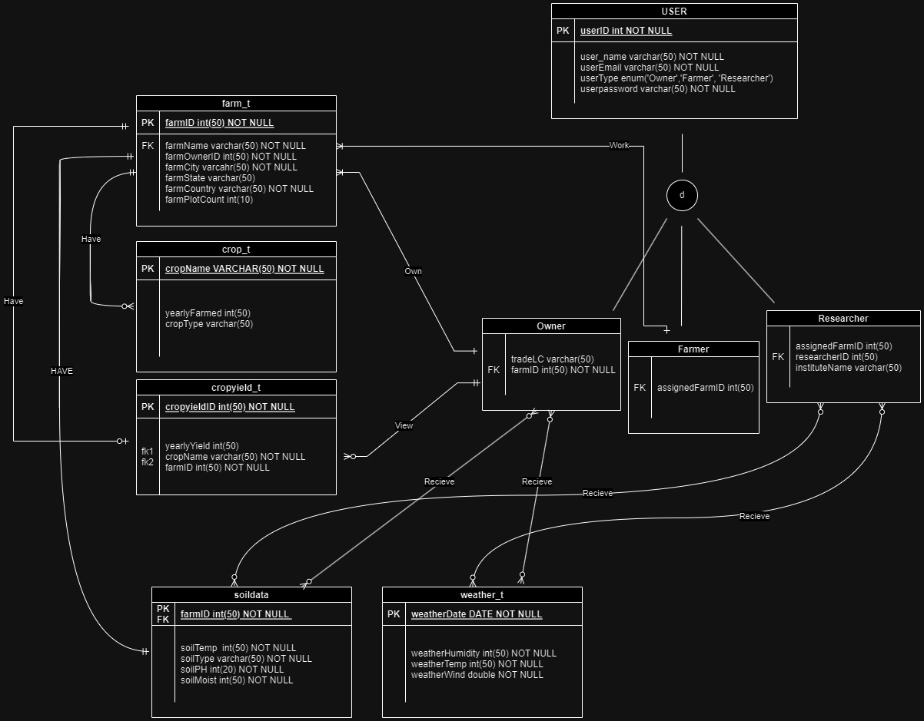
Entity Relationship Diagram
(ERD)

Slide 6
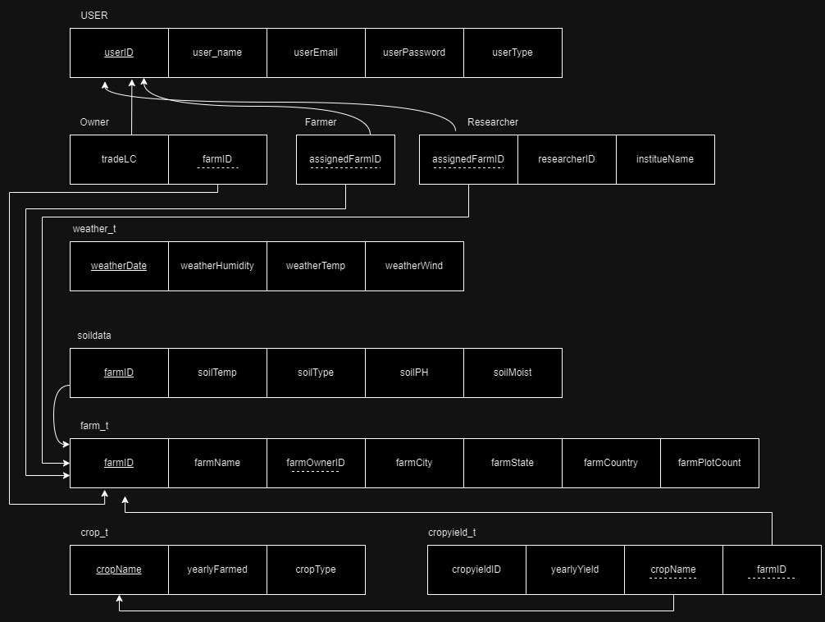
Relational Schema

Slide 7
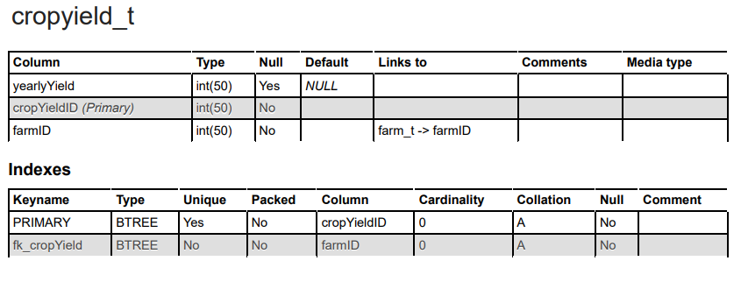
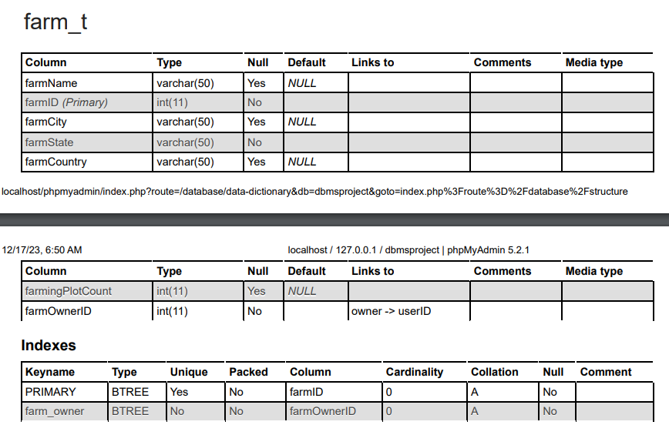
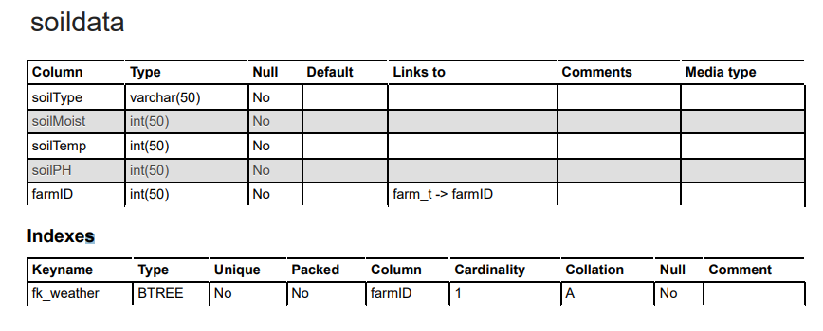
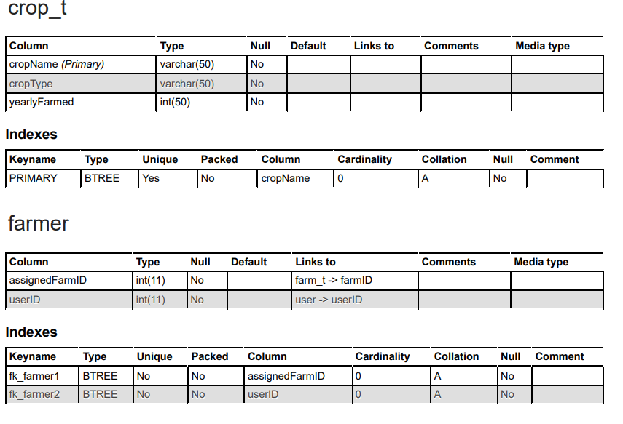
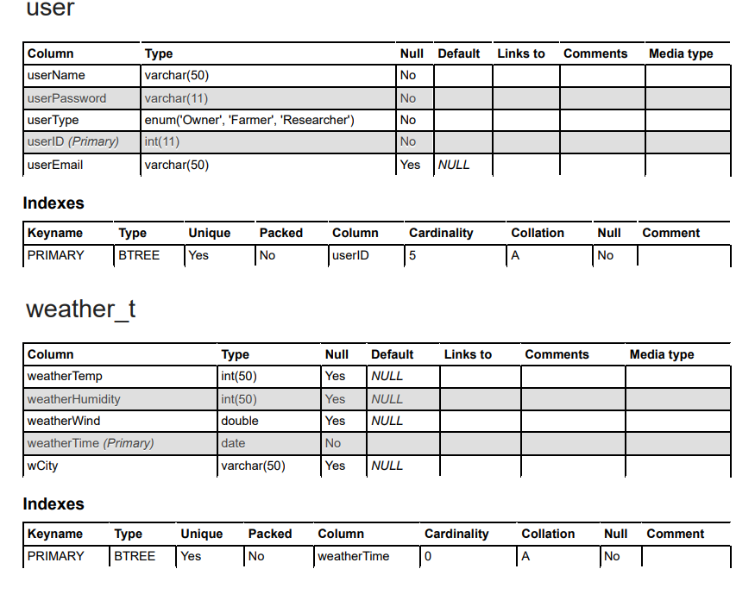
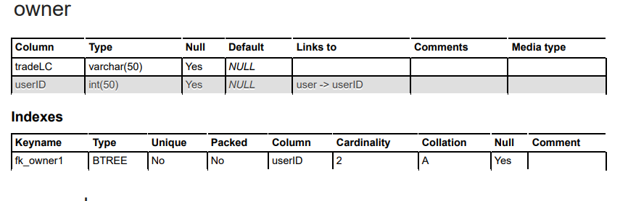
Data Dictionary

Slide 8
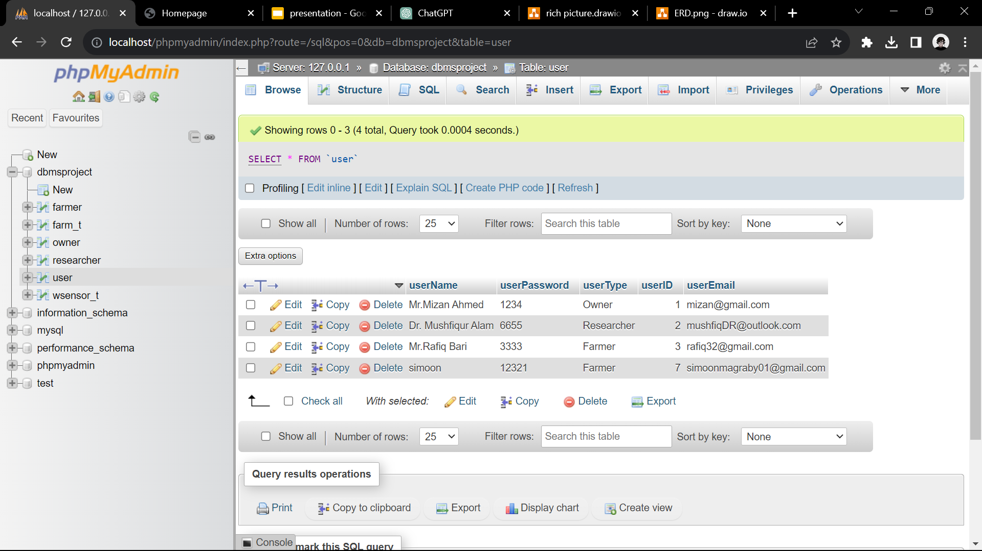
Database Tables

Slide 9
Conclusion
1.A very useful technological application for a country prone to natural disaster and depended crop yield.
2. Increased access information and resources for farmer.
3. Improved farm management tool through data-driven tools.

